Slide 1
Treatment Module
James Anderson and Alex Leffel

Slide 2
Treatment: A Two-part Approach
BACE1 is associated with beta-amyloid plaque formation
→ Our goal: down-regulate BACE1 to decrease rate of plaque formation
BACE2 is associated with beta-amyloid plaque degradation
→ Our goal: up-regulate BACE2 to increase rate of plaque degradation

Slide 3
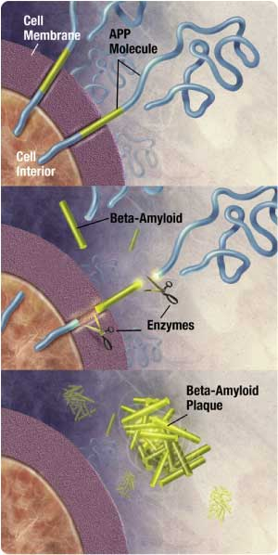
BACE1
BACE2 degrades the plaque

Slide 4
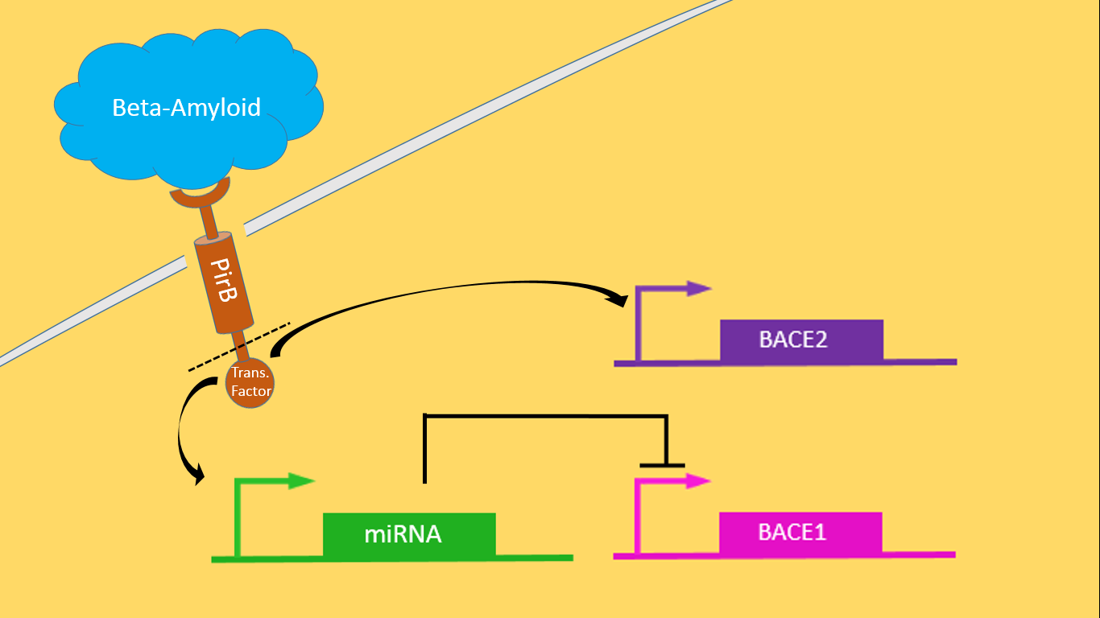
(extracellular)
(intracellular)
(endogenous)

Slide 5
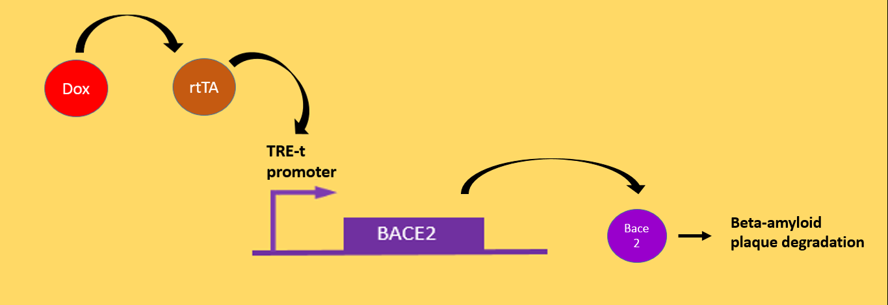
Up-regulating BACE2: TRE-t promoter
(an antibiotic)
(transcription factor)

Slide 6
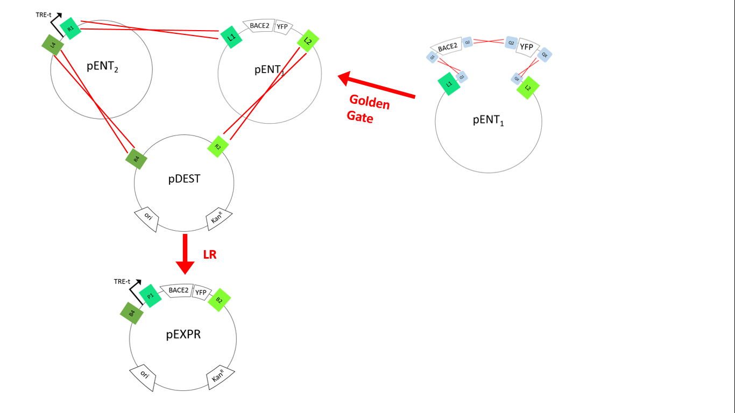

Slide 7
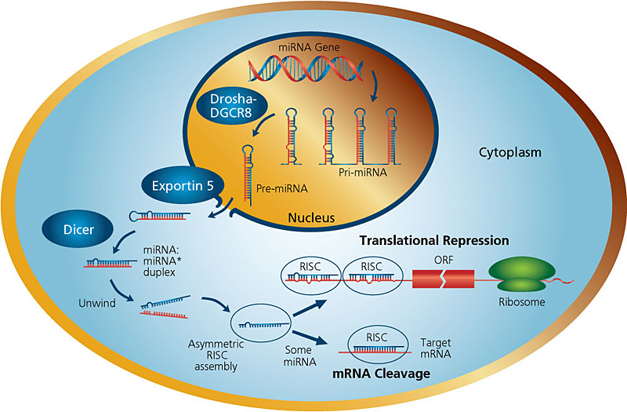
Down-regulating BACE1: miRNA silencing

