Slide 1
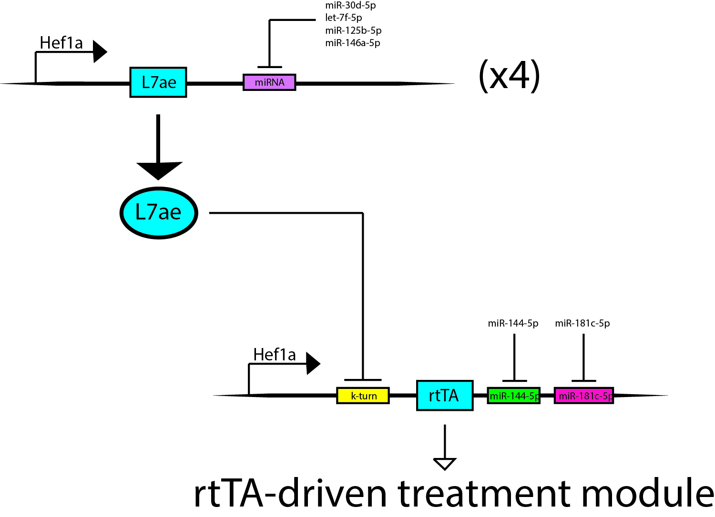

Slide 2
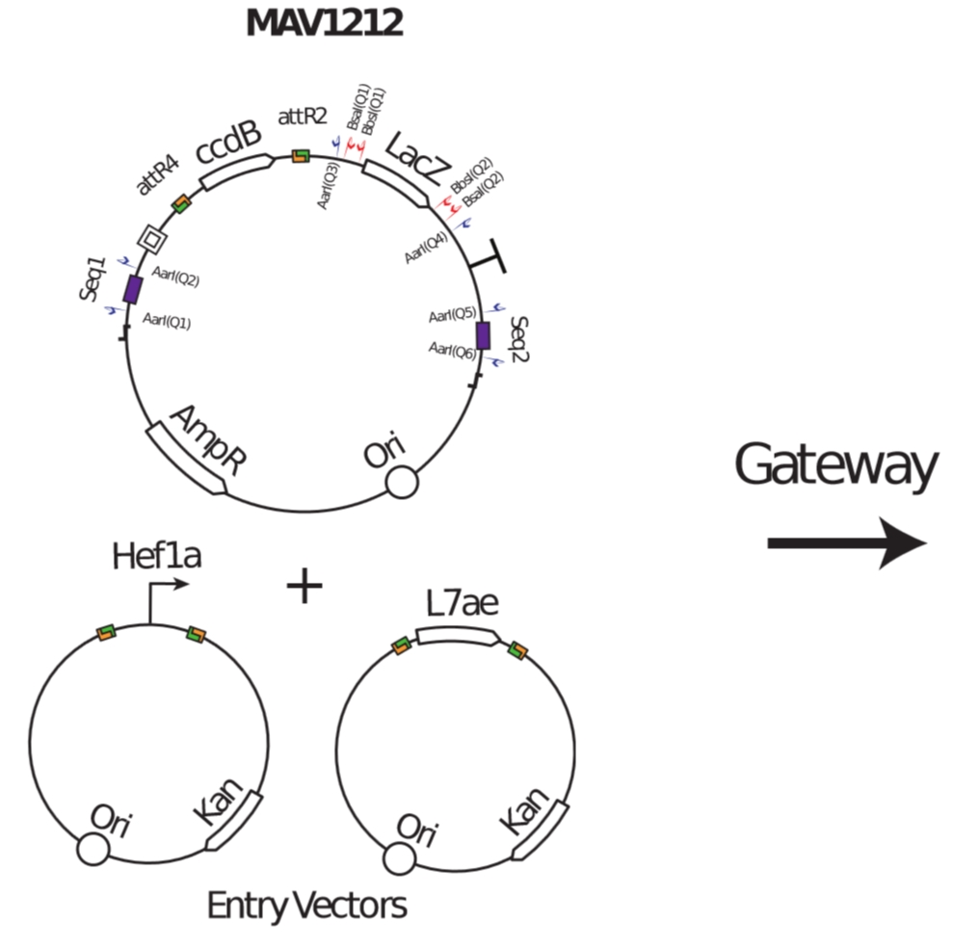
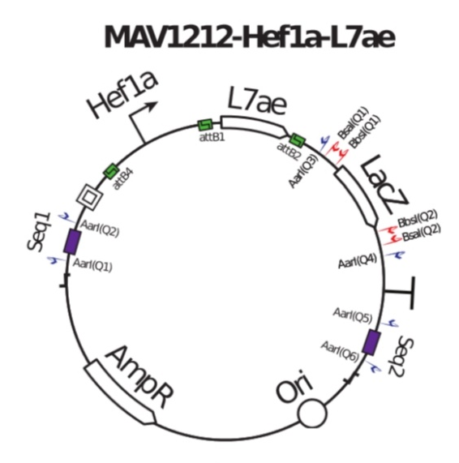
Notes:
Selection Markers: ccdB
Placeholder: LacZ (where miR-T sites go)

Slide 3
LacZ
Aar1
Bsa1
Bbs1
Bbs1
Bsa1
Aar1
Match miRNA Target Sites
Connect Multiple Sensors
Insert Into Plasmid

Slide 4
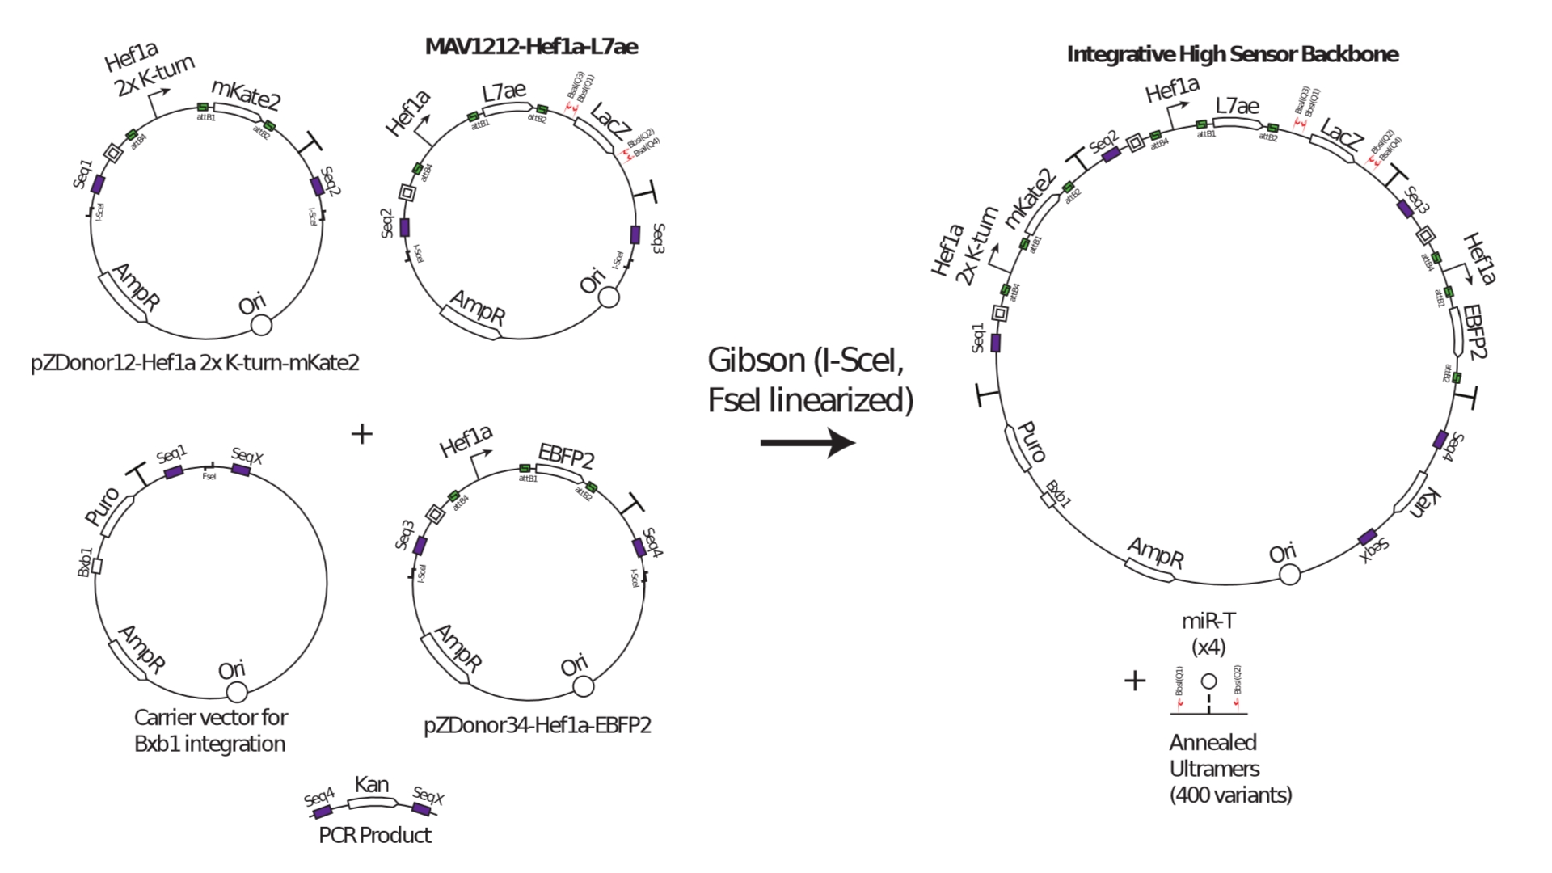

Slide 5
