Slide 1
miRNA Sensing
Facilitate silencing of genes
Measurable expression levels
Dysregulation reveal differing conditions within the cell.

Slide 2
High Sensor
miRNA
Actuator
Repressor
Output
Notes:
Implements double-inversion model
Actuator: Starts the circuit
Repressor: Represses output

Slide 3
High Sensor
miRNA
Actuator
Repressor
Output
Notes:
To check it doesn’t output when levels are low → we reset

Slide 4
Low Sensor
miRNA
Output

Slide 5
Low Sensor
miRNA
Output
Notes:
To check it doesn’t output when levels are high

Slide 6
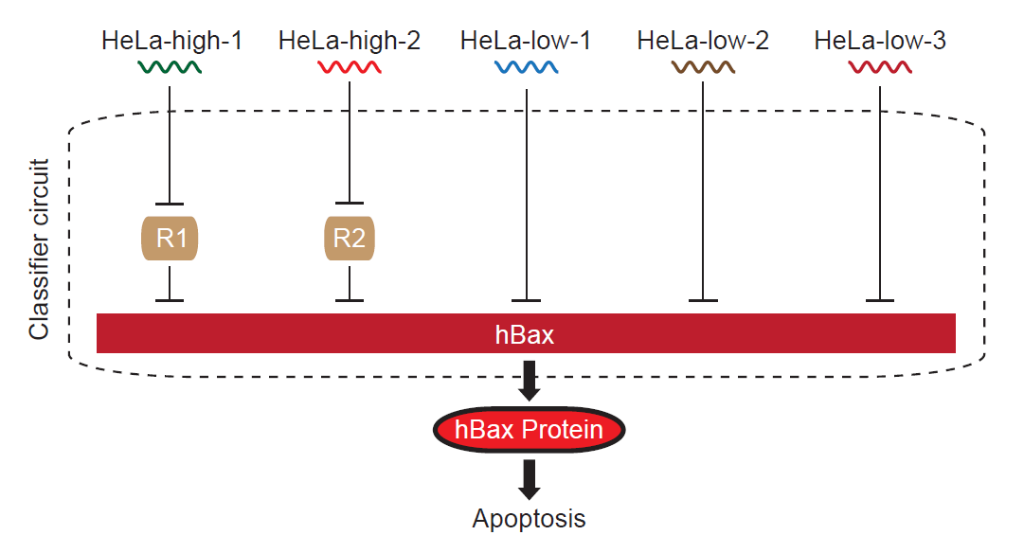
Combining Multiple Inputs to Create a Logic Circuit

