Slide 1

Notes:
Used by Purdue 2009 igem team. Did not actually transfect their circuit into the cells.
Other cell lines exist, but BV2 most characterized. N9 is other notable cell line.

Slide 2
Chip array of mRNA expression
Proteomic analysis
Inferon (cytokine) responsiveness
Stimulation of astrocytes

Slide 3
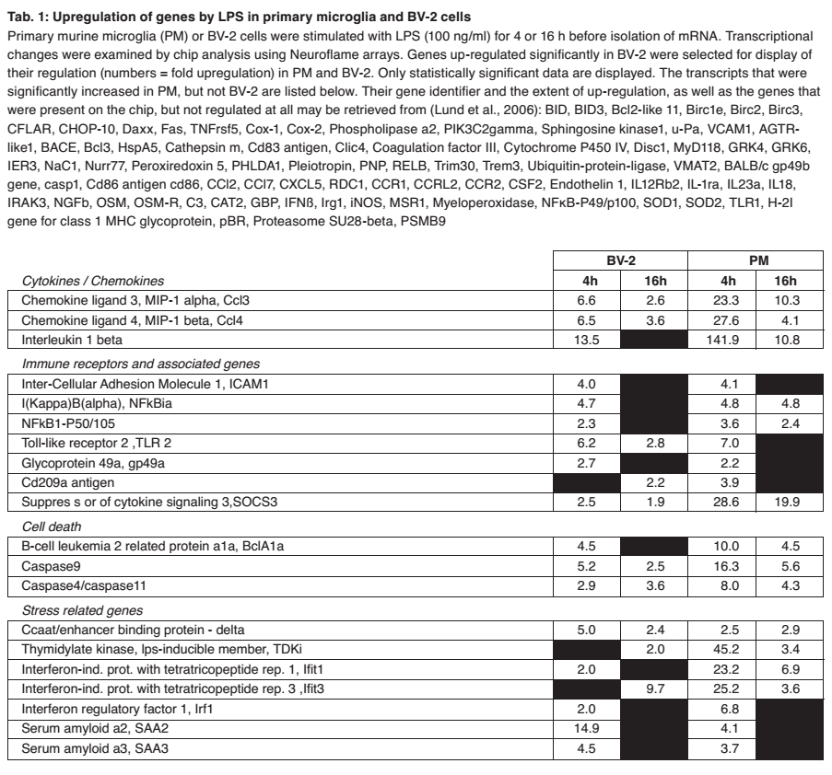
Notes:
LPS (lipopolysaccharid) is bacterial surface molecule
Table of chip analysis of mRNA. Neuroflame arrays.
Genes significantly upregulated in BV-2 are shown.
Primary Microglia (PM) data from previous studies. lund et al., 2006
BV-2 response was narrower and weaker.
Black blocks undetected (not significant).

Slide 4
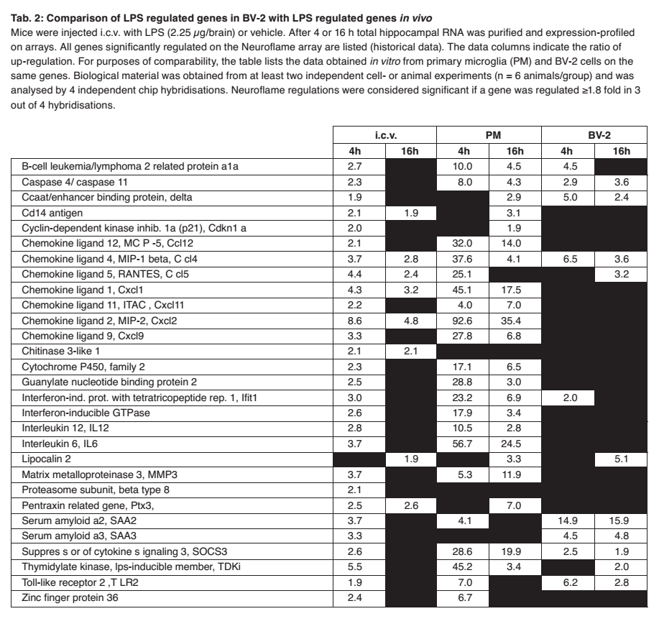
Notes:
Data shown is mRNA significantly upregulated in Neuroflame chips with in vivo microglia (old studies).

Slide 5
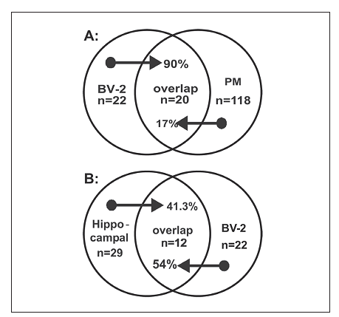
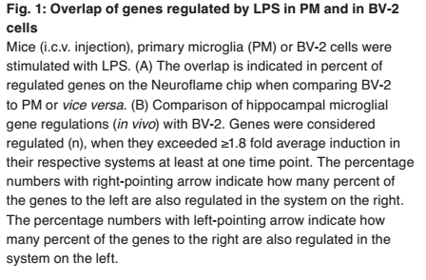

Slide 6
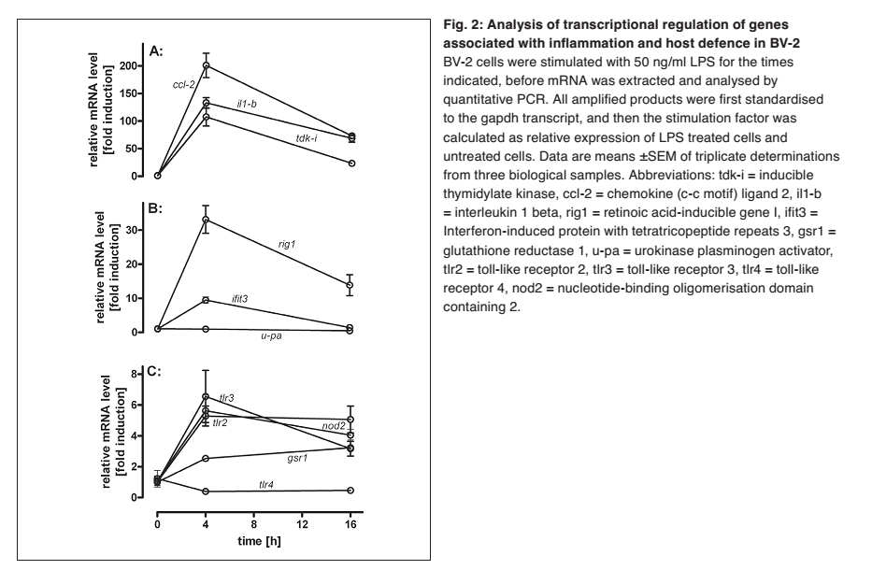
Notes:
Did quantitative PCR for genes involved in infection and inflammation response.
Showed that genes are actually upregulated.
So, BV-2 response may be wider than chip array shows.
uPA astrocyte marker
tlR-4 usually constantly expressed

Slide 7
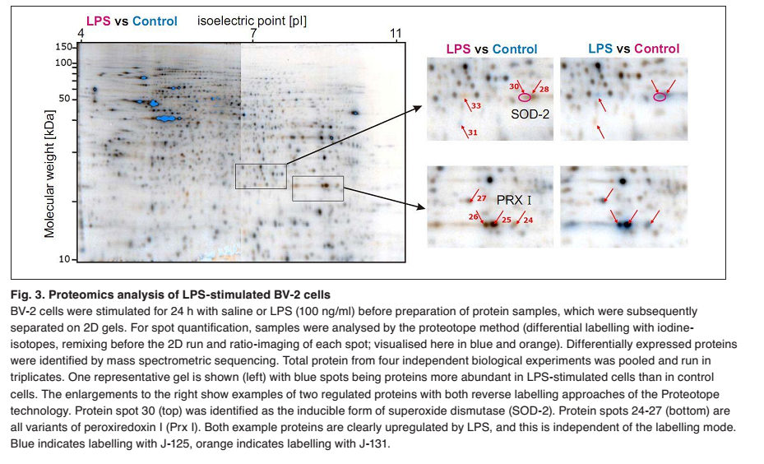
Notes:
32 specifically upregulated proteins, of which 10 sequenced.
Showed that proteins upregulated even though mRNA not detected.

Slide 8
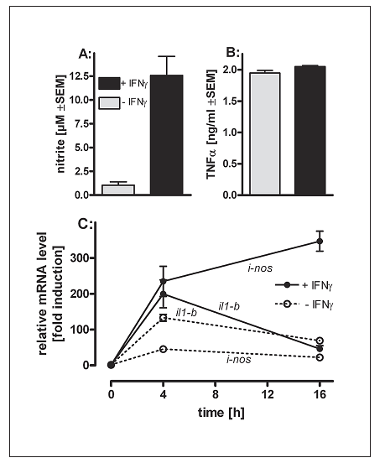
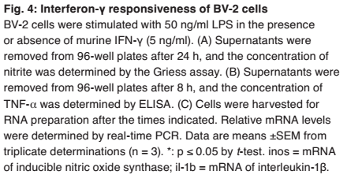
Notes:
Known: Production of nitrite produced only in presence of IFNg
Known: TNFa not affected by IFNg
C: mRNA expression of corresponding genes same

Slide 9
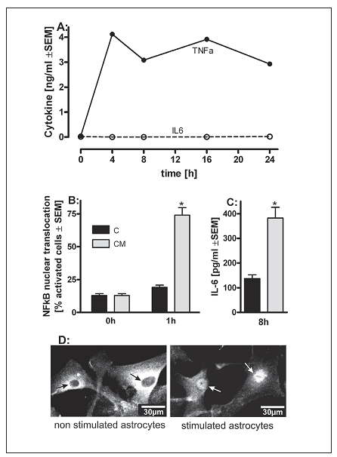
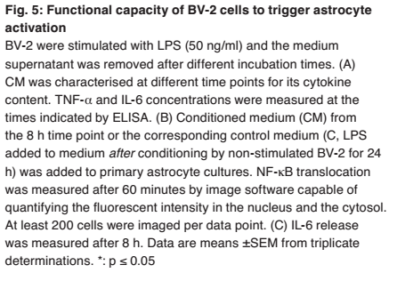
Notes:
Conditioned Media: high TNFa, but no IL-6
Control: LPS added after non-activated BV-2 cultured in media.
Astrocytes not activated by LPS
Resulted in high nuclear translocation of NFkB (responsible for triggering inflamation events)
Increased IL-6 production by astrocytes

Slide 10
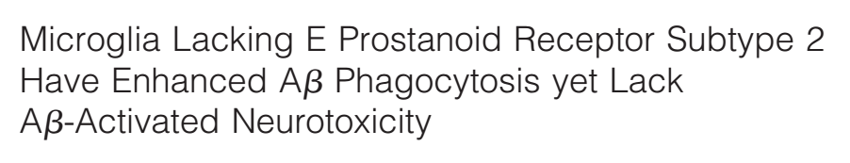
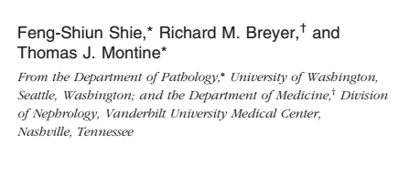
The paper thinks EP2 could be a potential target for AD treatment.
Knocking out EP2 increases phagocytosis of AB-immunoreactive material (hence, AB) by a LOT, and microglia lacking EP2 do not cause neurodegeneration.
We could downregulate EP2 in microglia in response to AB (same as we are planning for BACE1 currently). Since they will only be in microglia, the shouldn't cause problems with other cells. The system should shut down without AB signalling.

