Slide 1
Micro RNA

Slide 2
miRNA 9
GenBank NR_029691.1; chr 1q22
NF-kB-regulated, retinoic acid-inducible sncRNA enriched in primary human neural cells
associated with neurogenesis, morphogenesis, developmental patterning, brain cell proliferation, and glioblastoma
regulating the expression of multiple transcription factors including Foxg1, Nr2e1, and Pax6
significantly down-regulated in the tissues of fetuses with severe congenital abnormalities, including anencephaly

Slide 3
125b
125 was first shown to be up-regulated in differentiating mouse and human neurons
implicated in mammalian neuronal development and function in the brain
induced by neurotoxic metal sulfates that generate robust levels of oxidative stress
up-regulated in brain cancers where it apparently targets and down-regulates CDKN2A, a negative regulator of cell growth
Up-regulation of miRNA-125b is further associated with down-regulation of both the 15-lipoxygenase (15-LOX) and the synaptic vesicle-associated phosphoprotein synapsin-2 (SYN-2)
  The 15-LOX enzyme is essential in the conversion of the essential omega-3 fatty acid docosahexaenoic acid (DHA) into the potent neuroprotectin D1 (NPD1), and deficits in 15-LOX correlate with NPD1 deficits in AD brain and other human tissues

Slide 4
146a
NF-κB-regulated pro-inflammatory miRNA
target signaling proteins of innate immune responses, and more specifically the 232 nt 3′-UTR of CFH mRNA in human monocytes
Elevated miRNA-146a in AD brain has been shown to also specifically target CFH and the interleukin-1 associated kinase-1 (IRAK-1) mRNAs.
believed to contribute to altered innate immune responses and neuroinflammation in degenerating human brain cells and tissues in inflammatory neurodegenerative diseases
least basally abundant miRNA when compared to miRNA-9, miRNA-125b, and miRNA-155, it is the most inducible and up-regulated miRNA in human neuronal and astroglial cells compared to all other NF-κB-regulated miRNA species so far indentified
three tandem, canonical NF-κB binding sites within the human pre-miRNA-146a promoter

Slide 5
155
cytokine, NF-κB, and cell cycle-regulated
partially overlapping binding (recognition) sites in the CFH mRNA 3′-UTR
inflammatory cytokines increase miRNA-155 expression
orchestrate innate immune responses and chronic inflammatory processes

Slide 6
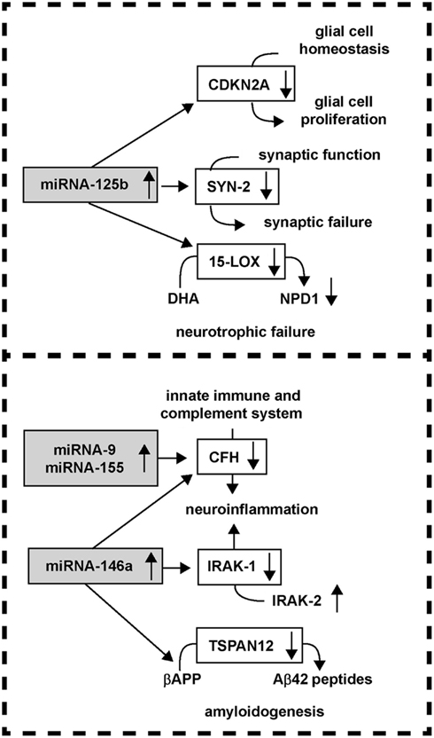
Overview

Slide 7
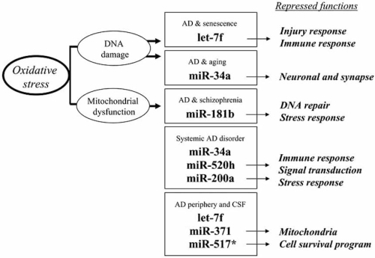
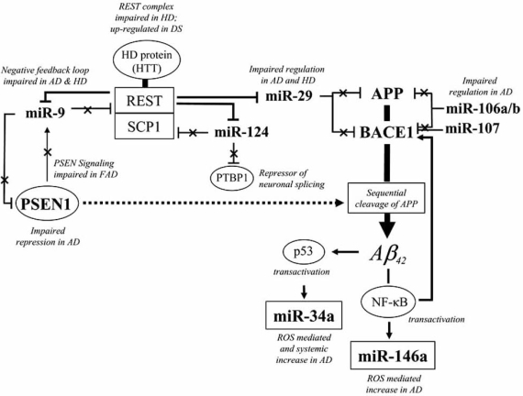
Overview

Slide 8
34a
Important to cancer repression and apoptosis via p53
Up regulated in Alzheimer’s

Slide 9
27a

Slide 10
212

