Slide 1
miRNA Profiles

Slide 2
Method 1: Experimentally

Slide 3
Methods
NGS to screen all miRNAs in blood and identify 140 dys-regulated mature miRNA
Searched for clusters of miRNA coding regions on chromosomes
Window Size | Cluster Found | Up-Regulated | Down-Regulated
1,000 | Chromosome 19 | hsa-miR-99b-5p hsa-miR-125a-5p | hsa-let-7e-5p
1,000 | Chromosome 22 | hsa-let-7b-3p | hsa-let-7a-5p hsa-let-7b-5p
5,000 | Chromosome 9 | hsa-let-7f-1-3p hsa-let-7d-3p | hsa-let-7a-5p hsa-let-7f-5p hsa-let-7d-5p
30,000 | Chromosome 6 | hsa-miR-30c-5p hsa-miR-30a-3p hsa-miR-30a-5p
Notes:
Extensively classified AD patients and age matched health patients
In hopes of the presence of a common regulatory mechanism

Slide 4
Profile
Machine learning algorithm reduced profile to 12 miRNA
Eliminates cross correlation
Ensures these aren’t dys-regulated in many other diseases
Up-Regulated | Down-Regulated
brain-miR-112 | hsa-miR-107
brain-miR-161 | hsa-miR-103a-3p
hsa-miR-26a-5p | hsa-miR-532-5p
hsa-miR-5010-3p | hsa-miR-26b-5p
hsa-miR-1285-5p | hsa-let-7f-5p
hsa-miR-151a-3p
hsa-let-7d-3p

Slide 5
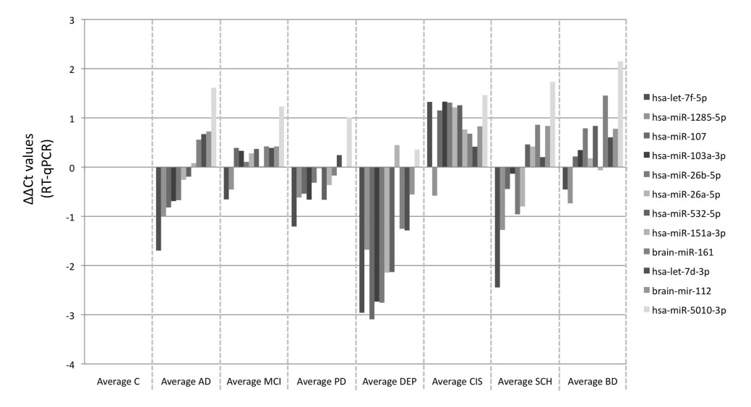
Results
Successfully able to distinguish AD
No difference in expression between different stages of AD
Notes:
2. Screened patients with MMSE (cognitive test) to distinguish moderate/severe

Slide 6
Method 2: Computer Modeling

Slide 7
Methods
Partition cells into k classes to be distinguished
Compute candidate marker information gain and optimal thresholds with respect to these classes
Discard all except for the C candidates with the highest information
Determine which candidate can be discarded with minimal rise in the predicted misclassification rate, and discard that candidate
Repeat until there are only n candidate markers remaining or until misclassification rate would rise beyond acceptable limits

Slide 8
Implementation
Programming Language: Proto
High accuracy detector circuits
Template for Threshold Sensor Tests
Full Detector Circuit
(def miRNA< (mir|symbol threshold|scalar) boolean :grn-motif ((RXN mir|scalar represses value)
(P|threshold value T)))
(def miRNA> (mir|symbol threshold|scalar) Boolean :grn-motif ((RXN mir|scalar represses value)
(RXN mir|scalar represses ?X)
(P|threshold ?X T)
(P R- ?X value T)))
(and (miRNA< ’hsa-let-7c 5.0)
(miRNA> ’hsa-miR-130a 0.3)
(miRNA< ’hsa-miR-29b 27.0)
(miRNA< ’hsa-miR-154 0.3)
(miRNA< ’hsa-miR-197 0.3))
Notes:
1. Ron Weiss and Jacob Beal have experience with this

Slide 9
Citations
Toward Automated Design of Cell Detectors (Jacob Beal, Fusun Yaman)
Automatic Compilation from High-Level Biologically-Oriented Programming Language to Genetic Regulatory Networks (Jacob Beal, Ting Lu, Ron Weiss)
A blood based 12-miRNA signature of Alzheimer disease patients (Petra Leidinger, Christina Backes, Stephanie Deutscher, et. al.)

