Slide 1
miRNA Profiles

Slide 2
Method 1: Experimentally

Slide 3
Methods
NGS to screen all miRNAs in blood and identify 140 dys-regulated mature miRNA
Searched for clusters of miRNA coding regions on chromosomes
Window Size | Cluster Found | Up-Regulated | Down-Regulated
1,000 | Chromosome 19 | hsa-miR-99b-5p hsa-miR-125a-5p | hsa-let-7e-5p
1,000 | Chromosome 22 | hsa-let-7b-3p | hsa-let-7a-5p hsa-let-7b-5p
5,000 | Chromosome 9 | hsa-let-7f-1-3p hsa-let-7d-3p | hsa-let-7a-5p hsa-let-7f-5p hsa-let-7d-5p
30,000 | Chromosome 6 | hsa-miR-30c-5p hsa-miR-30a-3p hsa-miR-30a-5p
Notes:
Extensively classified AD patients and age matched health patients
In hopes of the presence of a common regulatory mechanism

Slide 4
Profile
Machine learning algorithm reduced profile to 12 miRNA
Eliminates cross correlation
Ensures these aren’t dys-regulated in many other diseases
Up-Regulated | Down-Regulated
brain-miR-112 | hsa-miR-107
brain-miR-161 | hsa-miR-103a-3p
hsa-miR-26a-5p | hsa-miR-532-5p
hsa-miR-5010-3p | hsa-miR-26b-5p
hsa-miR-1285-5p | hsa-let-7f-5p
hsa-miR-151a-3p
hsa-let-7d-3p

Slide 5
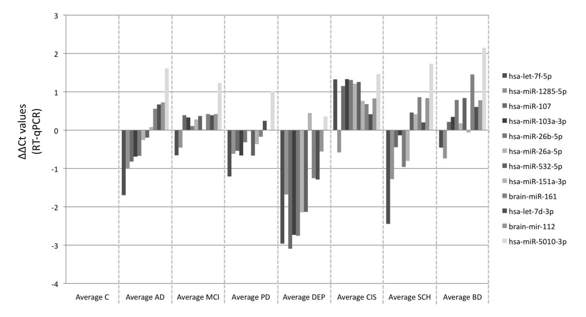
Results
Successfully able to distinguish AD
No difference in expression between different stages of AD
Notes:
2. Screened patients with MMSE (cognitive test) to distinguish moderate/severe

Slide 6
Method 2: Computer Modeling

Slide 7
Methods
Partition cells into k classes to be distinguished
Compute candidate marker information gain and optimal thresholds with respect to these classes
Discard all except for the C candidates with the highest information
Determine which candidate can be discarded with minimal rise in the predicted misclassification rate, and discard that candidate
Repeat until there are only n candidate markers remaining or until misclassification rate would rise beyond acceptable limits

Slide 8
Implementation
Programming Language: Proto
High accuracy detector circuits
Template for Threshold Sensor Tests
Full Detector Circuit
(def miRNA< (mir|symbol threshold|scalar) boolean :grn-motif ((RXN mir|scalar represses value)
(P|threshold value T)))
(def miRNA> (mir|symbol threshold|scalar) Boolean :grn-motif ((RXN mir|scalar represses value)
(RXN mir|scalar represses ?X)
(P|threshold ?X T)
(P R- ?X value T)))
(and (miRNA< ’hsa-let-7c 5.0)
(miRNA> ’hsa-miR-130a 0.3)
(miRNA< ’hsa-miR-29b 27.0)
(miRNA< ’hsa-miR-154 0.3)
(miRNA< ’hsa-miR-197 0.3))
Notes:
1. Ron Weiss and Jacob Beal have experience with this

Slide 9
Building the Circuit

Slide 10
What They Did
Senses expression of a set of microRNAs
Triggers a cell response
Customizable
Based on concentration
Transcriptional/Post-transcriptional
Predictable with computational model
Proof of Concept: Induced apoptosis of HeLa cancer cells

Slide 11
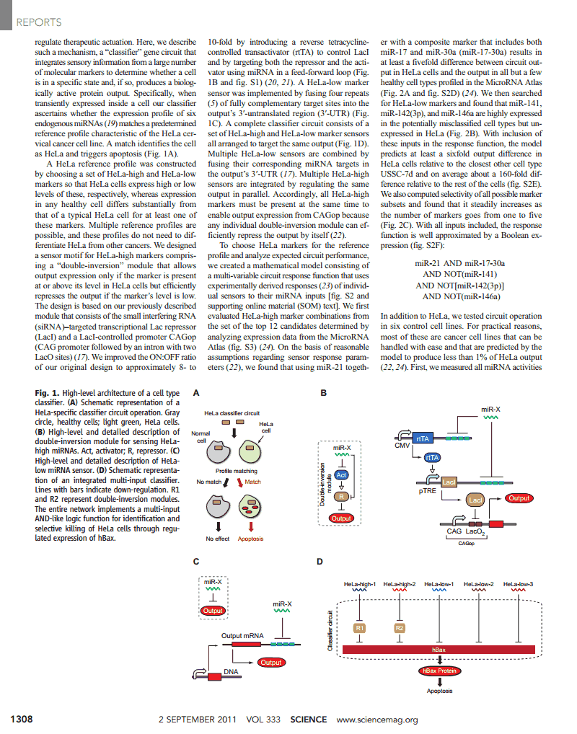
Sensing
Double-Inversion Model
HeLa High
HeLa Low
Promotes output if level is ≥ what it is in HeLa cells
Represses output if level is low

Slide 12
Sensing
Boolean Expression
Circuit Diagram
miR‐21 AND miR‐17‐30a AND NOT(miR‐141) AND NOT[miR‐142(3p)] AND NOT(miR‐146a)
Sensitivity of the design
6x output difference between HeLa cells and closest related cell (USSC-7d)
Selectivity increases as number of markers increases

Slide 13
Response
Maximum output: Constitutive expression (unrepressed CAGop promoter)
Minimum output: Completely repressed (double-inversion with all low marker)
Initial Tests
Output: DsRed, red fluorescent protein
Final Test
Output: hBax, leads to apoptosis only in HeLa and HEK293 cells

Slide 14
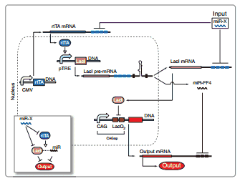
Caveats
System fails when one marker is high and the rest are low
Solution: Introduce engineered intronic miRNA to coexpress LacI

Slide 15
How It Relates to AD
Up-Regulated | Down-Regulated
brain-miR-112 | hsa-miR-107
brain-miR-161 | hsa-miR-103a-3p
hsa-miR-26a-5p | hsa-miR-532-5p
hsa-miR-5010-3p | hsa-miR-26b-5p
hsa-miR-1285-5p | hsa-let-7f-5p
hsa-miR-151a-3p
hsa-let-7d-3p
miRNA Profile: 12 (max) dys-regulated miRNA associated with AD
Output: Transcription Factor

Slide 16
Citations
Toward Automated Design of Cell Detectors (Jacob Beal, Fusun Yaman)
Automatic Compilation from High-Level Biologically-Oriented Programming Language to Genetic Regulatory Networks (Jacob Beal, Ting Lu, Ron Weiss)
A blood based 12-miRNA signature of Alzheimer disease patients (Petra Leidinger, Christina Backes, Stephanie Deutscher, et. al.)
Multi-Input RNAi-Based Logic Circuit for Identification of Specific Cancer Cells (Zhen Xie, Liliana Wroblewska, Laura Prochazka, et. al.)

