Slide 1
Cell Models

Slide 2
Method 1: Reverse Transfection of siRNA

Slide 3
Compared to Traditional
Traditional Transfection
Reverse Transfection
Plate the cells for 24 hours beforehand
Simultaneously transfect and plate
Key parameters for siRNA transfection
Health of Cultured Cells
Transfection Method
Transfection Conditions
Quality and Quantity of siRNA
Notes:
2. Similar to transfecting suspension cells
3. a. cell density
c. amount of transfection agent
d. concentration and amount of left over junk inside siRNA

Slide 4
Benefits
Time efficient
Equivalent/Improved transfection efficiency
Amount of exposed cell surface is usually the limiting factor
Kits are available to purchase
Notes:
You’re not waiting 24 hours after you plate before you can transfect
Over traditional pre plating
NOT number of cells you have

Slide 5
Benefits
Time efficient
Equivalent/Improved transfection efficiency
Amount of exposed cell surface is usually the limiting factor
Kits are available to purchase
Notes:
You’re not waiting 24 hours after you plate before you can transfect
Over traditional pre plating
NOT number of cells you have

Slide 6
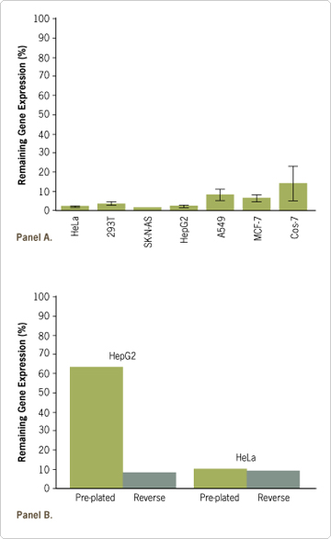
Caveats
High efficiency transfection of siRNA is difficult
Increased transfection efficiency depends on the cell type
Notes:
Graph. Note: All mammalian cell lines

Slide 7
Citations
Low transfection efficiency and low cell viability are the most frequent causes of unsuccessful gene silencing experiments
Notes:
You’re not waiting 24 hours after you plate before you can transfect
Over traditional pre plating
NOT number of cells you have

