Slide 1
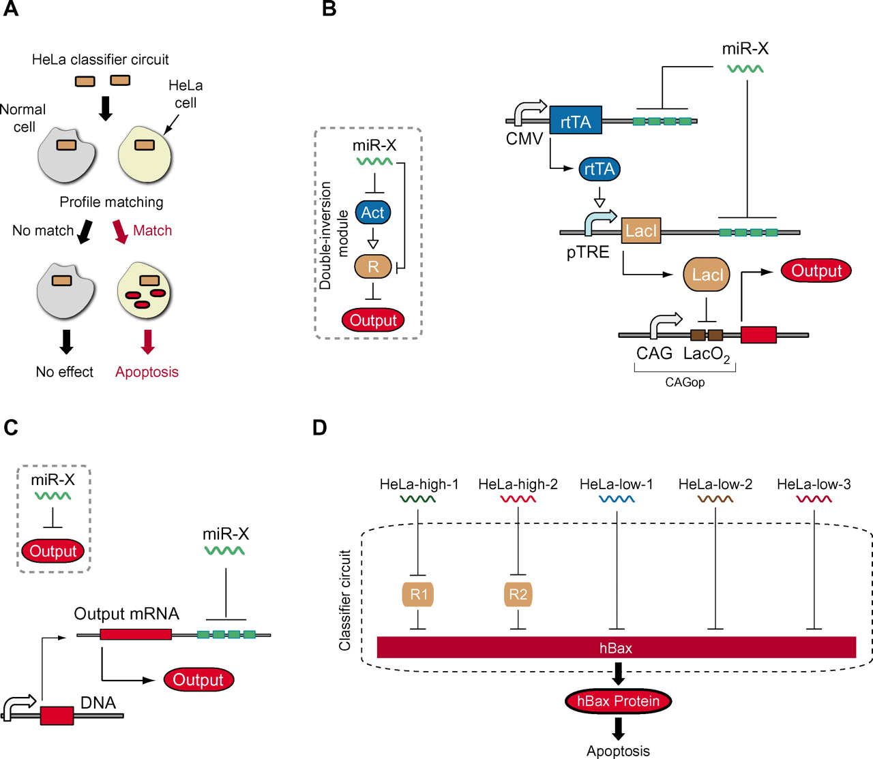

Slide 2
Cell Classifier Circuit

Slide 3
What They Did
Senses expression of a set of microRNAs
Triggers a cell response
Customizable
Based on concentration
Transcriptional/Post-transcriptional
Predictable with computational model
Proof of Concept: Induced apoptosis of HeLa cancer cells

Slide 4
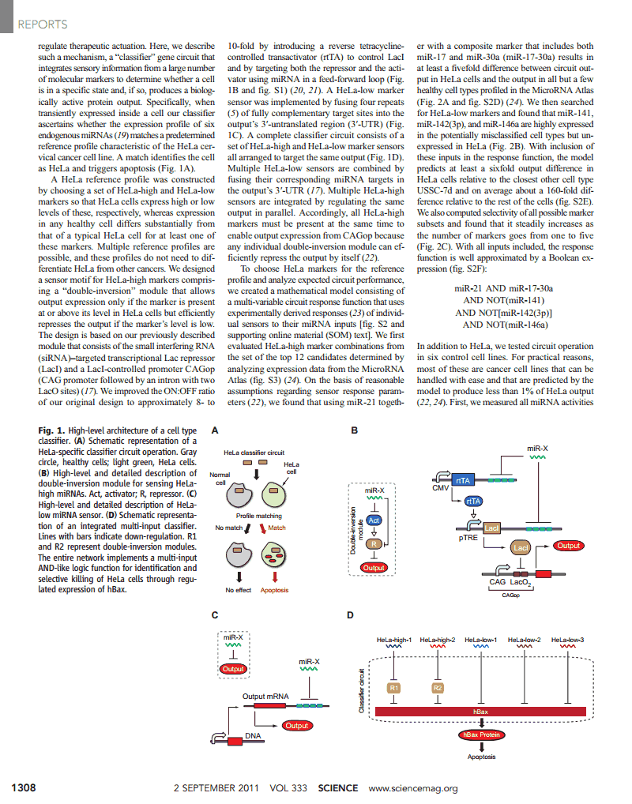
Sensing
Double-Inversion Model
HeLa High
HeLa Low
Promotes output if level is ≥ what it is in HeLa cells
Represses output if level is low

Slide 5
Sensing
Boolean Expression
Circuit Diagram
miR‐21 AND miR‐17‐30a AND NOT(miR‐141) AND NOT[miR‐142(3p)] AND NOT(miR‐146a)
Sensitivity of the design
6x output difference between HeLa cells and closest related cell (USSC-7d)
Selectivity increases as number of markers increases

Slide 6
Response
Maximum output: Constitutive expression (unrepressed CAGop promoter)
Minimum output: Completely repressed (double-inversion with all low marker)
Initial Tests
Output: DsRed, red fluorescent protein
Final Test
Output: hBax, leads to apoptosis only in HeLa and HEK293 cells

Slide 7
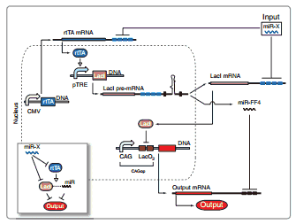
Caveats
System fails when one marker is high and the rest are low
Solution: Introduce engineered intronic miRNA to coexpress LacI

Slide 8
How It Relates to AD
Up-Regulated | Down-Regulated
brain-miR-112 | hsa-miR-107
brain-miR-161 | hsa-miR-103a-3p
hsa-miR-26a-5p | hsa-miR-532-5p
hsa-miR-5010-3p | hsa-miR-26b-5p
hsa-miR-1285-5p | hsa-let-7f-5p
hsa-miR-151a-3p
hsa-let-7d-3p
miRNA Profile: 12 (max) dys-regulated miRNA associated with AD
Output: Transcription Factor

Slide 9
Citations
Multi-Input RNAi-Based Logic Circuit for Identification of Specific Cancer Cells (Zhen Xie, Liliana Wroblewska, Laura Prochazka, et. al.)

