Slide 1
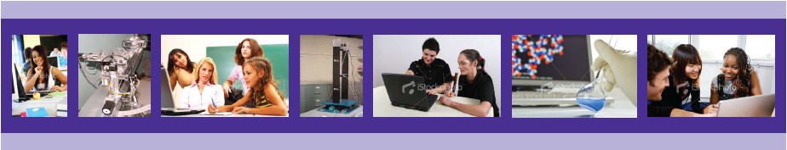
The iLab Network: Broadening Access to Hands-on STEM Learning via Remote Online Laboratories
Julia Skolnik, MSEd
Kemi Jona, PhD
Office of STEM Education Partnerships
Northwestern University, School of Education and Social Policy

Slide 2
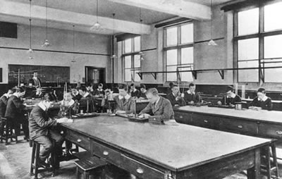
High School Science Lab in 1900
Notes:
Look at what a science lab looked like 100 yrs ago

Slide 3
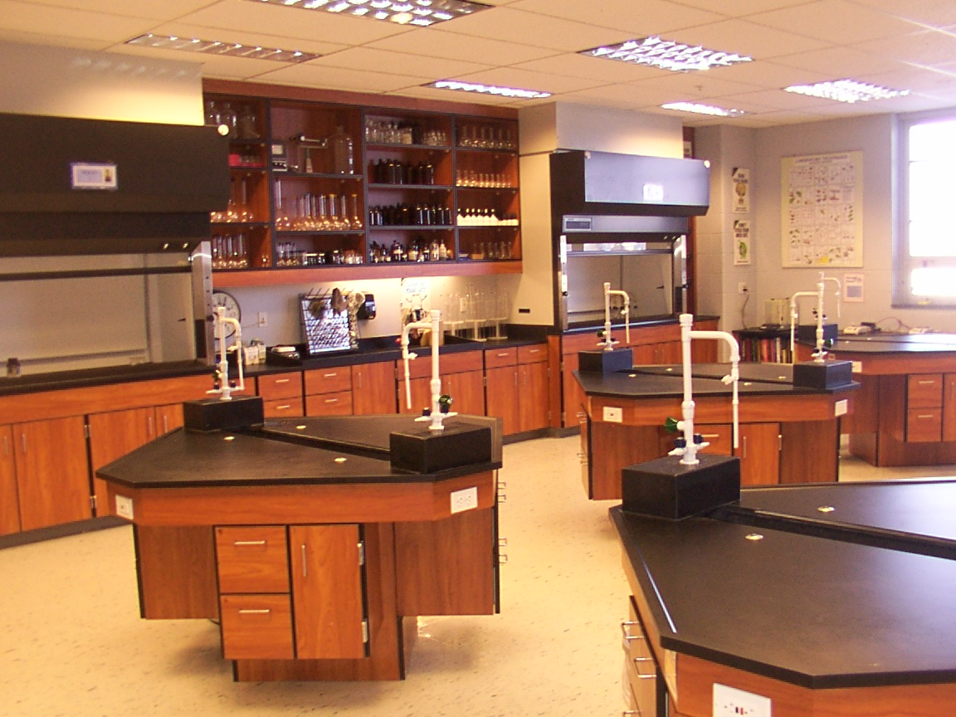
High School Science Lab Today
Notes:
What it looks like today – they don’t look that different. Teacher from 100 yrs ago might be pretty comfortable in a high school lab today.

Slide 4
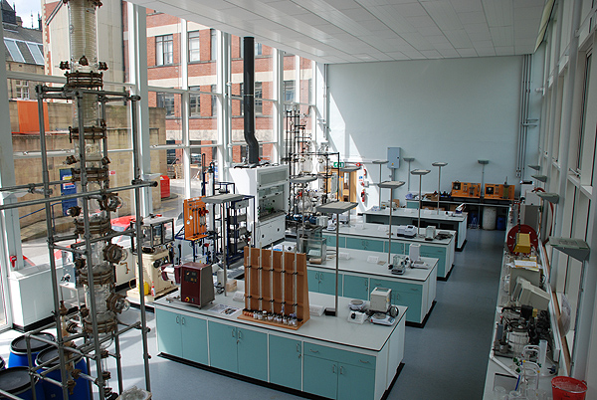
Science Lab: The Real World
Notes:
Professional lab looks completely different than high school science labs. Lots of equipment, computers. Growing gap between school science and real science

Slide 5
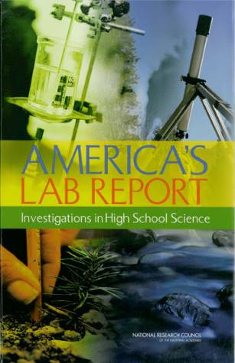
Science Education is in Trouble
“Most high school students participate in a limited range of laboratory activities that do not help them to fully understand science process.”
“The quality of current laboratory experiences is poor for most students.”
(NRC, 2005, p. 6)
Notes:
5

Slide 6
Issues of Access & Equity
“Students in schools with higher concentrations of non-Asian minorities spend less time in laboratory instruction than students in other schools, and students in lower level science classes spend less time in laboratory instruction than more advanced science classes. And some students have no access to any type of laboratory experience.”
(NRC, 2005, p. 6)
Notes:
Concern especially for whether College board will continue to allow online AP science courses. This is not democratization of education

Slide 7
~140,000 elementary/secondary schools in US
How do we close the gap?
Notes:
How can we close the gap between school science and real science? Should we try to make HS labs on the left look like the real world lab on the right across 140,000 schools in the US?

Slide 8


The iLab Network
Share science lab facilities through remote access
Direct control of real experimental equipment accessed through the Internet
Anywhere / any time
Not “virtual laboratories” (simulations)
Not “canned experiments” (“one-click” labs)
The iLab Network is supported in part by the National Science Foundation under grant OCI-0753324. However, any opinions, findings, conclusions, and/or recommendations are those of the investigators and do not necessarily reflect the views of the Foundation.

Slide 9
Conceptual Structure
iLabCentral.org
UQ Radioactivity Device
Undergraduate Version
High School Physics
MIT Neutron Beam Device
Undergraduate Version
Devices
Labs & Curricula
High School Chemistry
Repository
New labs authored by teachers

Slide 10
Transformative at Multiple Levels
State/District
Broadens access
Sharing collaboratives
Classroom
Curriculum restructuring
Use of teacher time
Student
Individualization
Flexible access
Authentic science
Scaffolding
New funding models

Slide 11
www.iLabCentral.org

Slide 12
Benefits of using iLabs
More time on task / less setup, cleanup
More repetitions
Safer
Less expensive (currently free)
Can do labs before and after class
Share & compare results locally or globally
Notes:
A different approach. Model details:

Slide 13
Pilot Test of Radioactivity iLab
Currently conducting a pilot test of curriculum
  20 teachers
  1000 students
  Schools in Illinois, Wisconsin, Kentucky, Massachusetts, and New York
  Both face-to-face and online classrooms
    Virtual Schools: VHS, IVS, GLL @ NU
  Grades 8-12 and community college
  Subject areas include: Physics, AP Physics B & C, Nuclear Physics, Chemistry, AP Chemistry, AP Biology, Environmental Science, Physical Science

Slide 14
Preliminary Pilot Results
Completed curriculum and analyzed data: 5 teachers, 373 students
Preliminary Pre/Post Test Results:
Learning gain (% score increase, 10 items) | 19%
Statistical significance | P ≤ 0.0001
Effect size | 0.94

Slide 15
Experiment Design Parameters
Average Number of Experiment Runs = 1.8
(n = 342)
Experiment Design Parameter | First Run of iLab (n = 238) | Subsequent Runs of iLab (n=238) | % Students Increasing (n=238) | % Students Decreasing (n=238)
Average number of distances | 4.95 | 7.10 | 61% | 10%
Average measurement time | 4.95 | 5.27 | 34% | 24%
Average number of trials | 4.39 | 4.99 | 38% | 18%

Slide 16
Nature of Science Investigations
n = 231 students
 | Pre-Test |  | Post-Test
 | Disagree | Agree | Disagree | Agree
Science labs involve creativity. | 23% | 77% | 16% | 84%
Science labs involve following directions. | 0% | 100% | 2% | 98%
Science labs involve making decisions. | 11% | 89% | 7% | 93%

Slide 17
What classroom teachers are saying about iLabs:
“A great way for students to use real equipment and get real data”
“Created a sense of purpose among students who are traditionally unsuccessful in science”
“Gave flexibility to the lab process”
“Reinforces the importance of good experimental design”

Slide 18
What online teachers are saying about iLabs:
“Students are remotely manipulating lab equipment rather than running simulations - that’s a big plus in our area”
“Constantly looking for opportunities like this that allow students to participate in ‘hands on’ science”
“The only opportunity [the students] have to experiment with radioactivity that isn’t in the form of a simulation.”
“The wave of the future in online labs”

Slide 19
What online students are saying about iLabs:
“Gives you the chance to be creative in a science setting”
“Provide a chance to do different labs that you wouldn’t normally get to do during your high school career”

Slide 20
So what does the high school science lab of the future look like?
?
Notes:
It’s the laptop!

Slide 21
Transforming Science:
The Tough Questions

Slide 22
Are the science labs that students are doing really the most relevant and educationally valuable…
…or just the cheapest, easiest, & safest?

Slide 23
Given the flexibility and access provided by iLabs, should we fundamentally re-examine the labs that are taught in schools?

Slide 24
What we have available for high schools now
www.iLabCentral.org/radioactivity
Radioactivity Lab
  Curriculum written by Northwestern University and being pilot tested by over 1000 students is available for general use NOW
  Contact us for teacher materials and professional development
  Four new curriculum adaptations of the original Radioactivity iLab Curriculum for biology, chemistry, AP Physics, and math written by Chicago-area high school teachers
Notes:
*Combine with slide 29

Slide 25
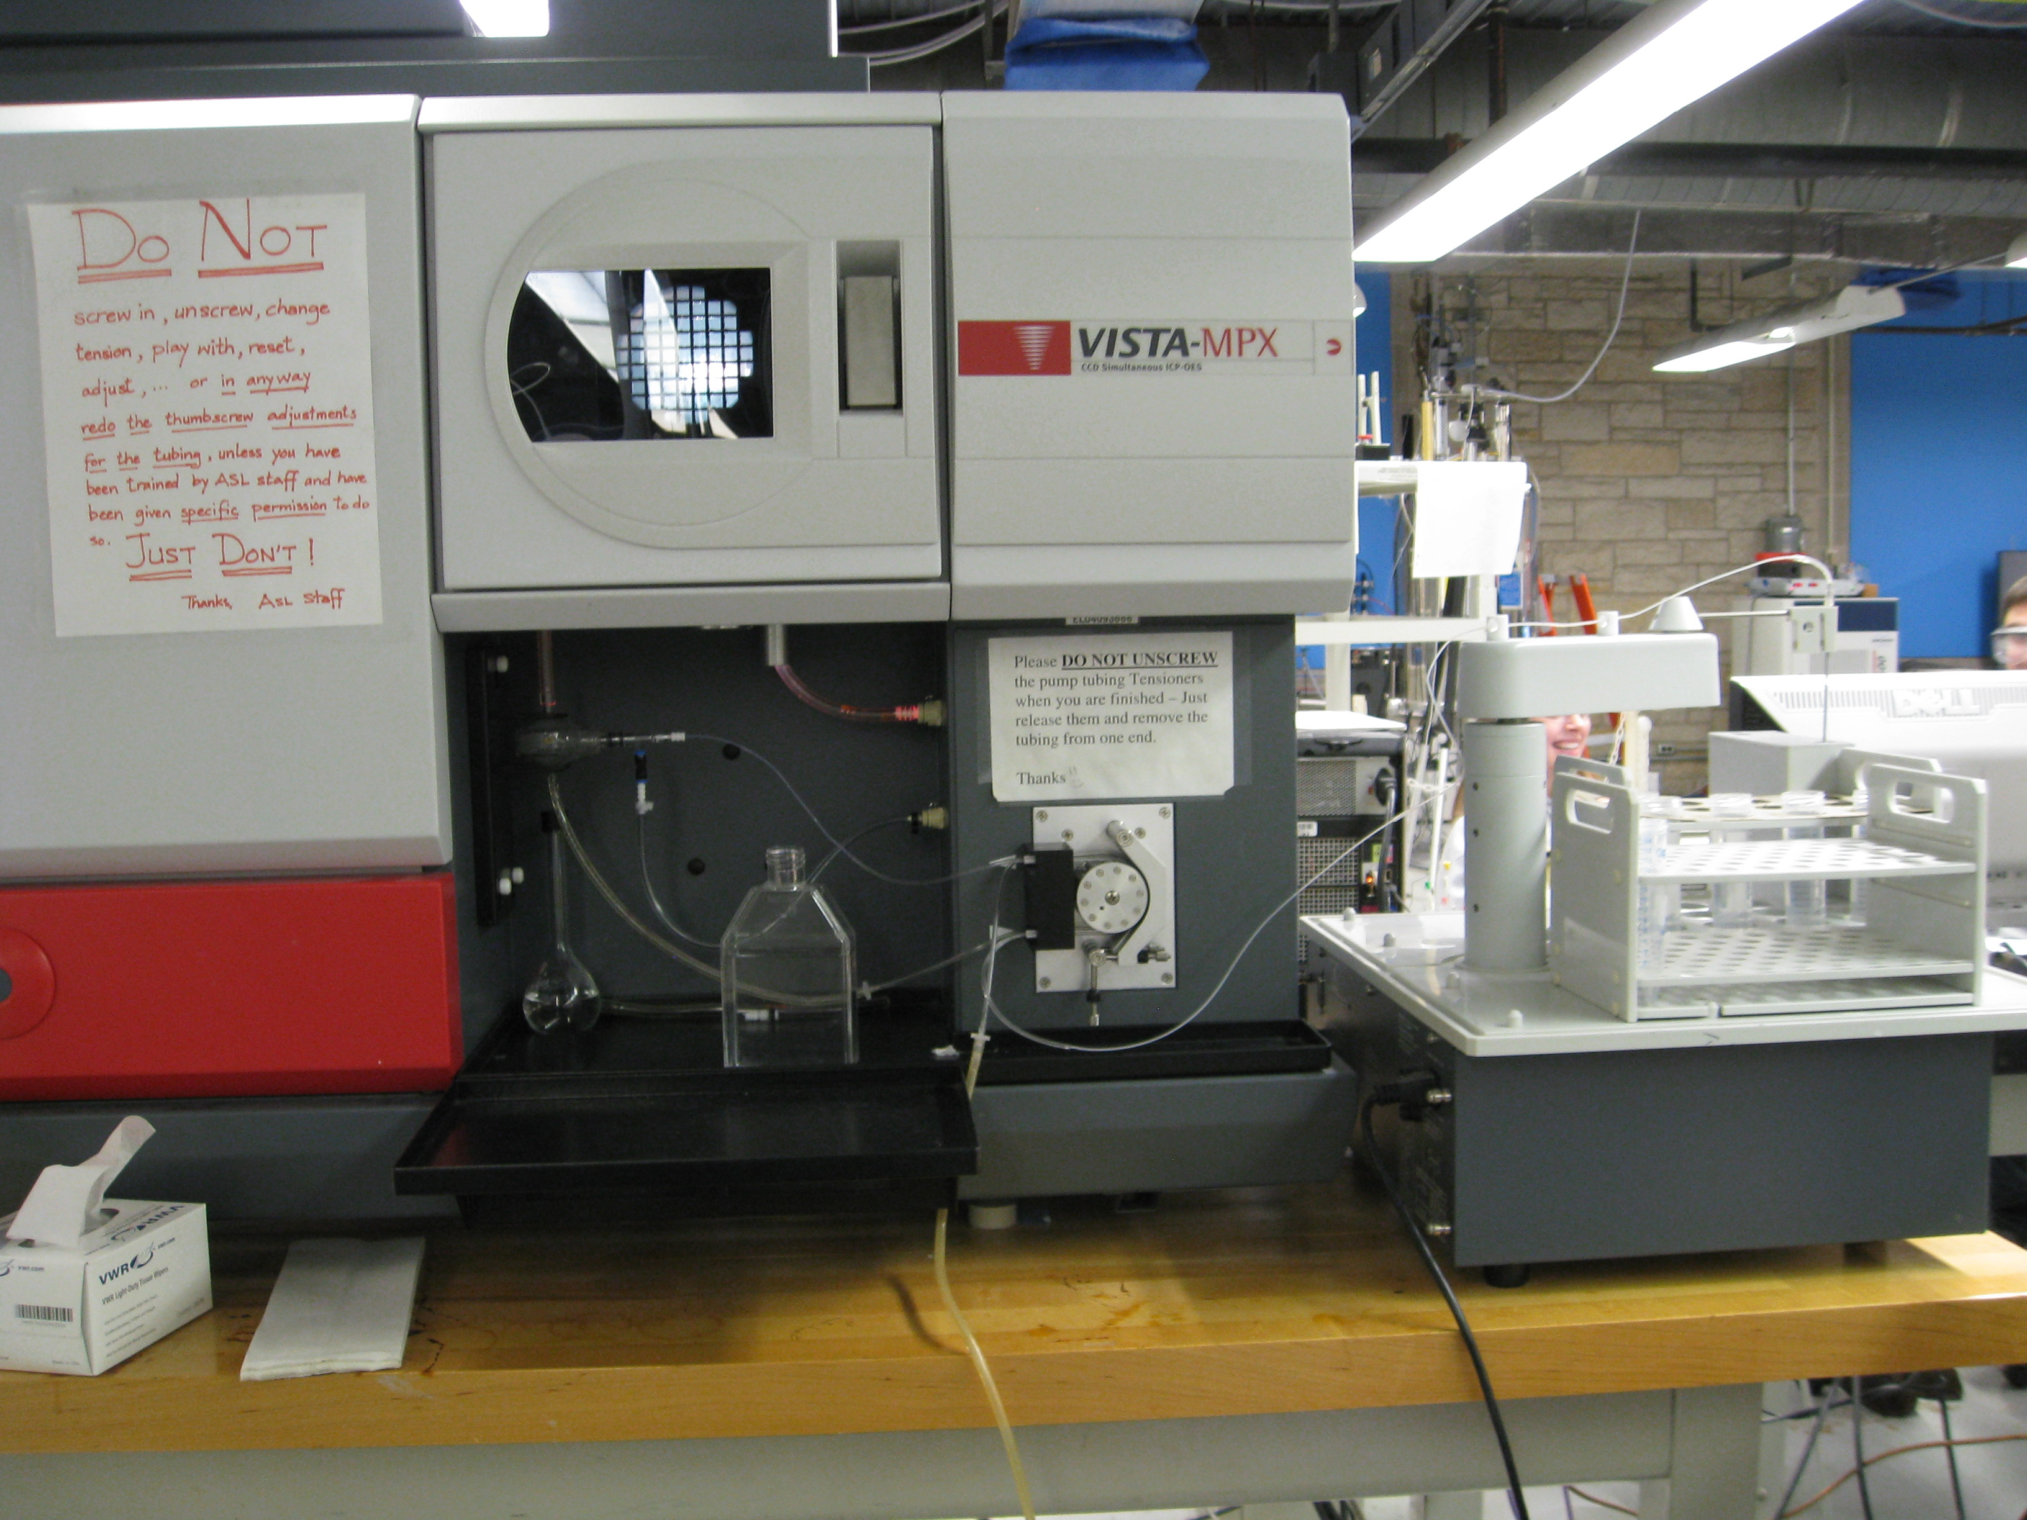
New iLab: ICP-OES
Inductively Coupled Plasma-Optical Emission Spectrometer (ICP-OES)
Detects trace metals in solutions using the emission of light from excited atoms
Located in shared chemistry lab facility at Northwestern University
Applications in chemistry, biology, environmental sciences
Will be available in fall 2010

Slide 26
The Future of iLabCentral.org
Community Authoring
  Interface will allow teachers to modify iLab curricula to fit their own classes and share with others (Wikipedia-style)
Lab Assignment & Management Tools
  Teachers will be able to assign iLabs to students and manage their completion of the lab, as well as assess student lab reports

Slide 27
Join our effort to transform science education!
Visit www.iLabCentral.org and sign up to be part of the iLab Central Community
Use existing iLabs and curriculum materials
Adapt Radioactivity lab to other courses
Be a part of a teacher design team or pilot test of the ICP-OES iLab Curriculum in 2010
Share new lab devices of your own
Help foster partnerships with vendors and research labs for device sharing
Feedback for using iLabs in online classrooms (e.g. integration into LMS & grade books)
Notes:
let me leave you with a couple of closing thoughts….

Slide 28
Thank YOU!
Contact:
Julia Skolnik, j-barnathan@northwestern.edu
Kemi Jona, kjona@northwestern.edu
Website: www.iLabCentral.org
Radioactivity iLab: www.ilabcentral.org/radioactivity

