Slide 1
Alzheimer’s Group
Lyla Atta, Kathryn Brink, Christian Richardson,
James Anderson, Raymond Liu.

Slide 2
Overview
3 Approaches
3 Approaches
Sensing
β-amyloid
τ-protein
miRNA
Processing
Actuation

Slide 3
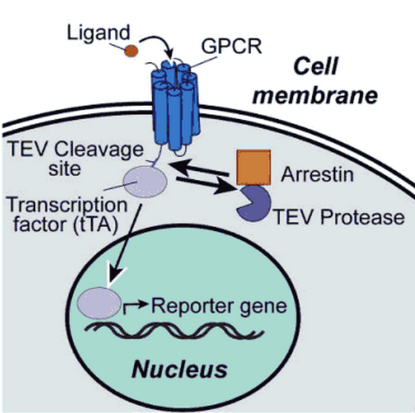
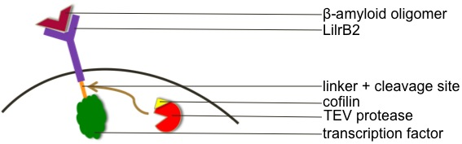
β-amyloid
Established “tango” system
Sensing extracellular β-amyloid with modified tango system
LilrB2: Receptor specific to β-amyloid oligomers
Cofilin (fused to a protease) is recruited by the activated LilrB2
Dephosphorylated cofilin is active
Binding of β-amyloid to LilBR2 activates cofilin by dephosphorylating it
Interaction of LilBR2 and cofilin is not well-characterized

Slide 4
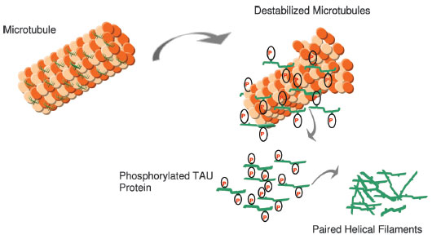

τ-protein
Involved in the stabilization of axonal microtubules
Abnormal τ-protein is a characteristic of Alzheimer’s (similar to β-amyloid)
  Abnormal τ-protein is hyper-phosphorylated
  Hyper-phosphorylation causes aggregates in paired helical filaments which leads to neurofibrillary tangles
  Affects long-term potentiation, brain plasticity and results in loss of brain function

Slide 5
τ-protein
Advantage: intracellular; easier to sense and initiate response
Sensing development of Alzheimer’s as in relation to τ-protein:
  Sensing mechanical stress associated with the destabilized microtubules
  Sensing the hyper-phosphorylated τ-protein
  Mechanism of hyper-phosphorylated τ-protein production → sensing some earlier step in the mechanism

Slide 6
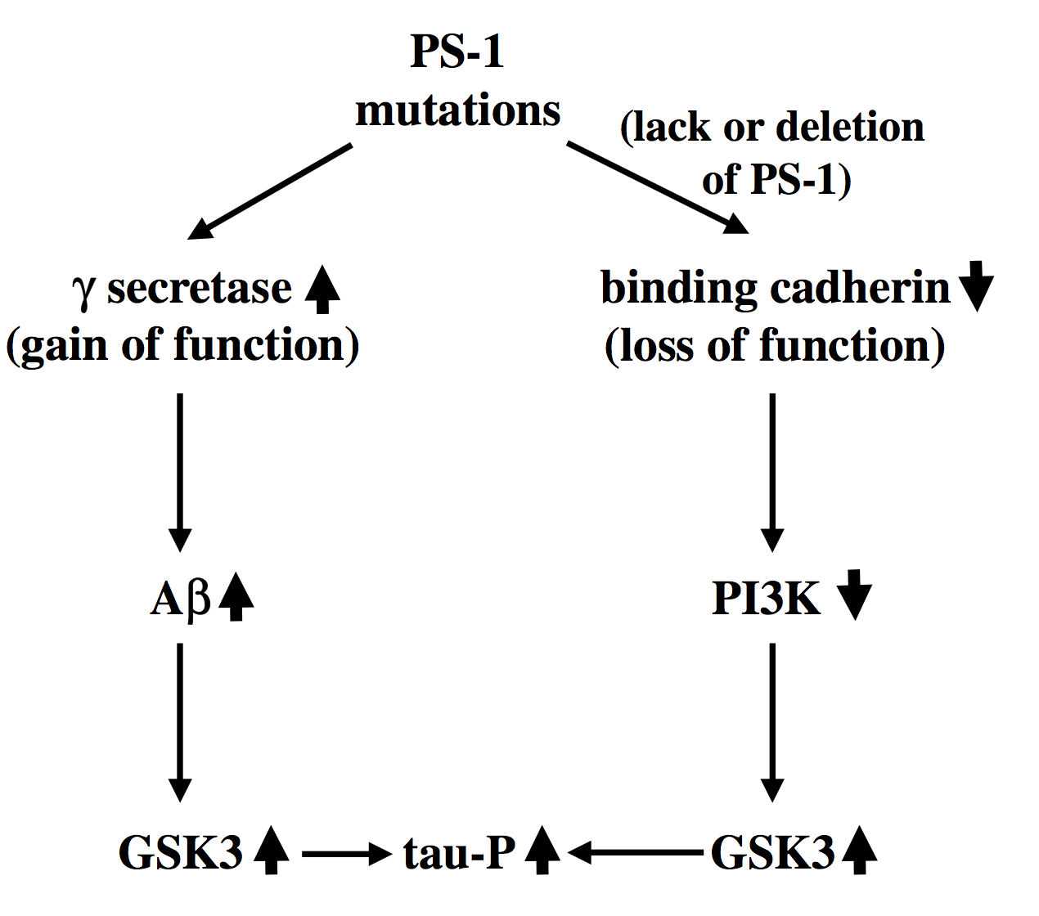
Hyper-phosphorylation
Hyper-phosphorylation of τ-protein is involved in many neurodegenerative diseases (“taupathies”)
79 possible phosphorylation sites (at serine/threonine residues)– at least 30 of these sites are phosphorylated in Alzheimer’s
Phosphorylation occurs by two different types of kinases:
  Proline directed (GSK3, cdk5, p38)
  Non-proline directed (PKA, PKC, CKII)
Paired helical filament formation induced in vitro using inducers:
  Heparin
  Fatty acids
  Quinones
Aggregation of β-amyloid is thought to induce the hyper-phosphorylation of τ-protein

Slide 7
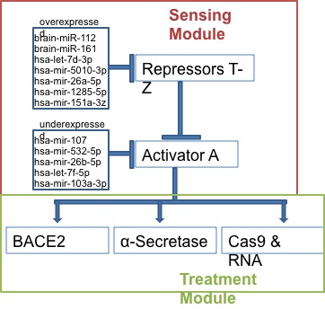
miRNA
miRNAs inhibit the creation of proteins
Their expression varies in Alheimer’s patients
The Cas9 would be targeted to inhibit BACE1 production

Slide 8
Processing: the Circuit
A
BACE2
X
BACE1

Slide 9
Actuation: Treatment
APP cleavage by α-secretase prevents further cleavage by β-secretase → preventing production of β-amyloid
Two types of β-secretase:
  BACE2 shown to degrade β-amyloid → up-regulation to reduce amount of β-amyloid
  BACE1 cleaves APP to produce β-amyloid → down regulation to reduce β-amyloid

Slide 10
Components of Our Circuit to Assay
Fusing cofilin with TEV protease
Recruiting cofilin/TEV protease to LilrB2 upon beta-amyloid binding
Cleaving LilrB2’s intracellular domain with TEV protease
Fusing our repressor mechanism (maybe a transcription factor for miRNA that silences beta-secretase expression) to LilrB2
Targeting whatever transcription factor we decide on to the nucleus
Binding beta-amyloid plaques

Slide 11
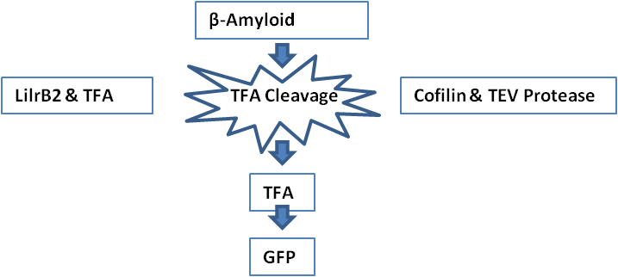
Initial Testing: β-amyloid
Test each of the 12 miRNA individually
Then assemble them into a miRNA sensing module
Problems converting RNA levels into digital signals

Slide 12
Initial Testing: miRNA
Test each of the 12 miRNA individually
Then assemble them into a miRNA sensing module
Problems converting RNA levels into digital signals
Underexpressed
Overexpressed
miRNA
miRNA
Repressor
TFA
GFP
TFA
GFP

Slide 13
Treatment Module Testing
Test every possible combination of these three treatments 7 possible
Thioflavin S stain for beta amyloid and tau protein tangles
Use fluorescent microscopy
Vary promoter sequence
TFA
BACE2
α-Secretase
miRNA

