Slide 1
Alzheimer’s Group
Lyla Atta, Kathryn Brink, Christian Richardson,
James Anderson, Raymond Liu.

Slide 2
Overview
3 Approaches
3 Approaches
Sensing
β-amyloid
τ-protein
miRNA
Processing
Actuation

Slide 3
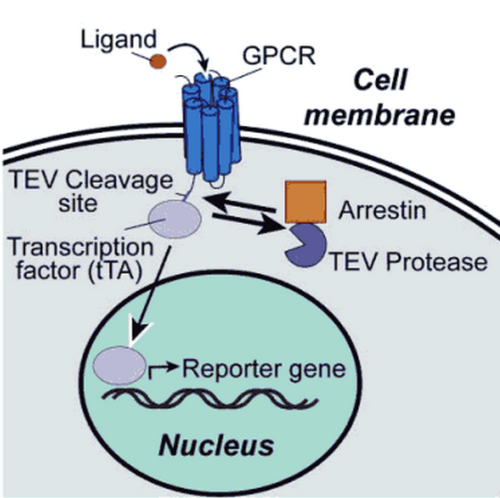
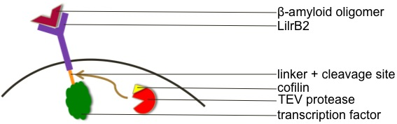
β-amyloid
Established “tango” system
Sensing extracellular β-amyloid with modified tango system
LilrB2: Receptor specific to β-amyloid oligomers
Cofilin (fused to a protease) is recruited by the activated LilrB2

Slide 4
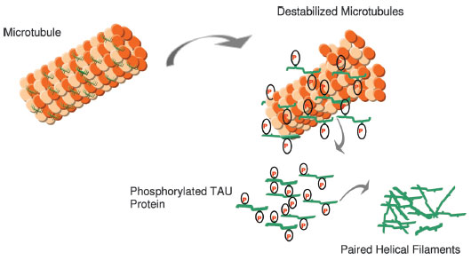

τ-protein
Involved in the stabilization of axonal microtubules
Abnormal τ-protein is a characteristic of Alzheimer’s (similar to β-amyloid)
  Abnormal τ-protein is hyper-phosphorylated
  Hyper-phosphorylation causes aggregates in paired helical filaments which leads to neurofibrillary tangles
  Affects long-term potentiation, brain plasticity and results in loss of brain function

Slide 5
τ-protein
Advantage: intracellular; easier to sense and initiate response
Sensing development of Alzheimer’s as in relation to τ-protein:
  Sensing mechanical stress associated with the destabilized microtubules
  Sensing the hyper-phosphorylated τ-protein
  Mechanism of hyper-phosphorylated τ-protein production → sensing some earlier step in the mechanism

Slide 6
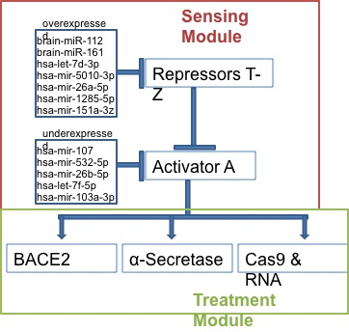
miRNA
miRNAs inhibit the creation of proteins
Their expression varies in Alheimer’s patients
The Cas9 would be targeted to inhibit BACE1 production

Slide 7
Processing: the Circuit
A
BACE2
X
BACE1

Slide 8
Actuation: Treatment
APP cleavage by α-secretase prevents further cleavage by β-secretase → preventing production of β-amyloid
Two types of β-secretase:
  BACE2 shown to degrade β-amyloid → up-regulation to reduce amount of β-amyloid
  BACE1 cleaves APP to produce β-amyloid → down regulation to reduce β-amyloid

