Slide 1
Alzheimer’s Group
Lyla Atta, Kathryn Brink, Christian Richardson,
James Anderson, Raymond Liu.
… AND
Alexa Garcia, Gary Burnett, Alex Smith,
Katie Bodner, Andrew Yang, Kyle Lathem.

Slide 2
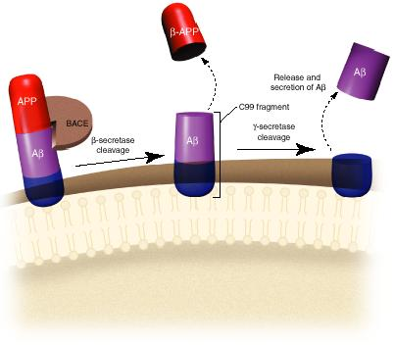
Production of β-Amyloid

Slide 3
Overview
3 Approaches
3 Approaches
Sensing
β-amyloid
τ-protein
miRNA
Processing
Actuation

Slide 4
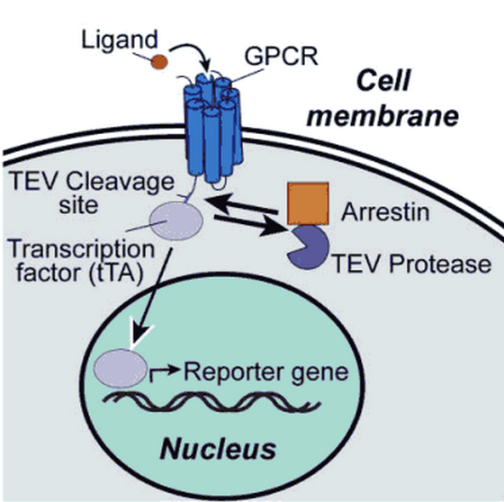
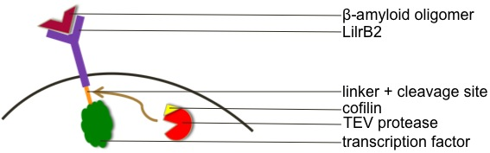
β-amyloid
Established “tango” system
Sensing extracellular β-amyloid with modified tango system
LilrB2: Receptor specific to β-amyloid oligomers
Cofilin (fused to a protease) is recruited by the activated LilrB2
Dephosphorylated cofilin is active
Binding of β-amyloid to LilBR2 activates cofilin by dephosphorylating it
Interaction of LilBR2 and cofilin is not well-characterized

Slide 5
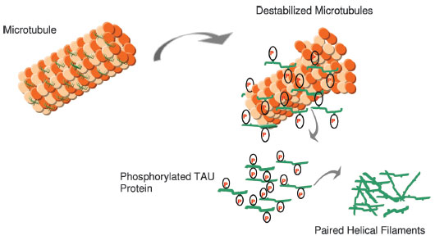

τ-protein
Involved in the stabilization of axonal microtubules
Abnormal τ-protein is a characteristic of Alzheimer’s (similar to β-amyloid)
  Abnormal τ-protein is hyper-phosphorylated
  Hyper-phosphorylation causes aggregates in paired helical filaments which leads to neurofibrillary tangles
  Affects long-term potentiation, brain plasticity and results in loss of brain function

Slide 6
τ-protein
Advantage: intracellular; easier to sense and initiate response
Sensing development of Alzheimer’s as in relation to τ-protein:
  Sensing mechanical stress associated with the destabilized microtubules
  Sensing the hyper-phosphorylated τ-protein
  Mechanism of hyper-phosphorylated τ-protein production → sensing some earlier step in the mechanism
  Recruit dephosphorylators
  Replicon rna

Slide 7
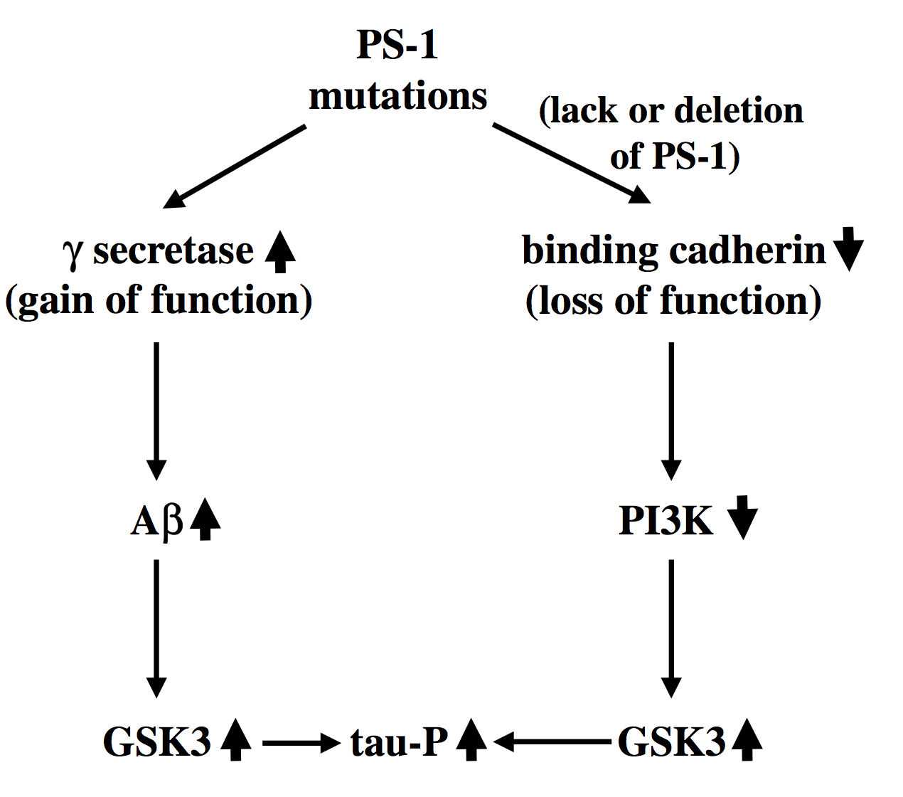
Hyper-phosphorylation
Hyper-phosphorylation of τ-protein is involved in many neurodegenerative diseases (“taupathies”)
79 possible phosphorylation sites (at serine/threonine residues)– at least 30 of these sites are phosphorylated in Alzheimer’s
Phosphorylation occurs by two different types of kinases:
  Proline directed (GSK3, cdk5, p38)
  Non-proline directed (PKA, PKC, CKII)
Paired helical filament formation induced in vitro using inducers:
  Heparin
  Fatty acids
  Quinones
Aggregation of β-amyloid is thought to induce the hyper-phosphorylation of τ-protein

Slide 8
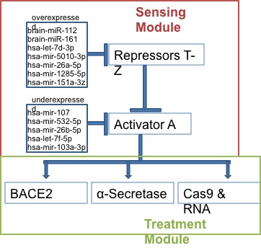
miRNA
miRNAs inhibit the creation of proteins
Their expression varies in Alheimer’s patients
The Cas9 would be targeted to inhibit BACE1 production

Slide 9
Processing: the Circuit
A
BACE2
X
BACE1

Slide 10
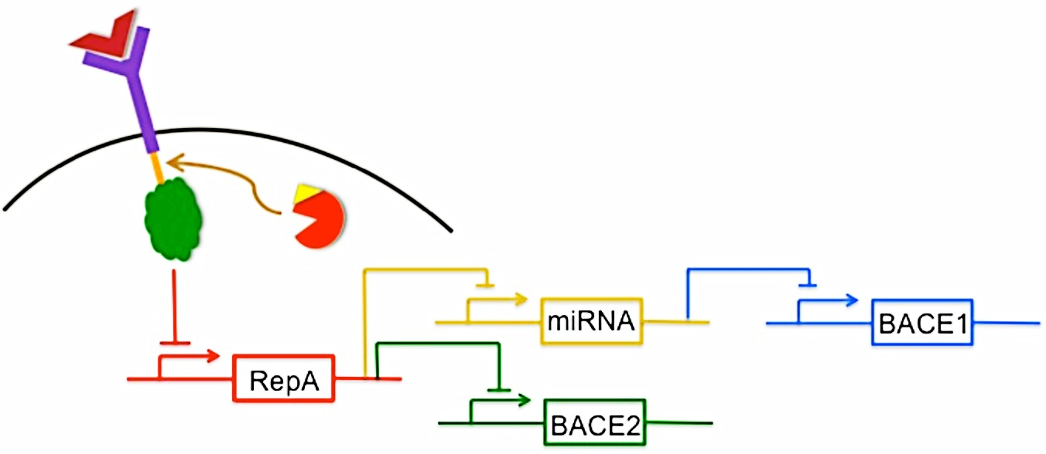
Processing: the Circuit

Slide 11
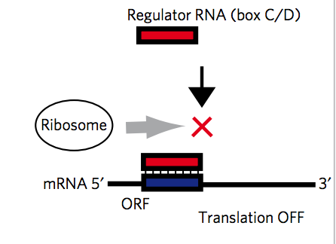
miRNA Inhibition
L7Ae is an RNA binding protein that represses translation of targeted transcript
2013 iGEM

Slide 12
Actuation: Treatment
APP cleavage by α-secretase prevents further cleavage by β-secretase → preventing production of β-amyloid
Two types of β-secretase:
  BACE2 shown to degrade β-amyloid → up-regulation to reduce amount of β-amyloid
  BACE1 cleaves APP to produce β-amyloid → down regulation to reduce β-amyloid

Slide 13
Components of Our Circuit to Assay
Fusing cofilin with TEV protease
Recruiting cofilin/TEV protease to LilrB2 upon beta-amyloid binding
Cleaving LilrB2’s intracellular domain with TEV protease
Fusing our repressor mechanism (maybe a transcription factor for miRNA that silences beta-secretase expression) to LilrB2
Targeting whatever transcription factor we decide on to the nucleus
Binding beta-amyloid plaques

Slide 14
Preliminary Experimentation
In vitro models of Alzheimer’s Disease
Assaying for the presence of β-amyloid plaques

Slide 15
In Vitro Systems
Possible in vitro models of Alzheimer’s Disease:
  N2a-APPSwe mutated cell lines
  Engineered HEK cells
  ReproNeuro
Lab at McGovern contacted for possible new ideas

Slide 16
Engineered HEK Cells
HEK293-APPSwe
  Different mechanism of producing β-amyloid plaques
  Two missense mutations in APP in the BACE cleavage site increase the rate of β-amyloid production
Engineering HEK Cells to overexpress BACE1 would provide a more accurate model for Alzheimer’s Disease

Slide 17
N2a-APPSwe Cell Lines
Difficult to transfect
Swe mutation produces β-amyloid using a different mechanism – not suitable for testing circuit

Slide 18
ReproNeuro
Little information characteristics of system
No information on previous use in research
Protocols on how to use available on website

Slide 19
Assaying for β-Amyloid
Molecular Imaging
  Radiotracers include Pittsburgh compound B (PIB) and 18F flutemetanol (flute); detected via PET scan
ELISA Assay
  Pre-made kit; detected visually (via color change)
Staining
  Congo red and thioflavin T commonly used; detected visually (via fluorescence)
Electron Microscopy
  Immunogold electron microscopy also binds to membrane bound glycogen.

Slide 20
Further Research
Testing the success of the circuit:
  Is the presence of β-amyloid the only index we would use to test the success of our circuit?
  How does the presence of β-amyloid affect cellular pathways leading to neuron deficiencies?
  Would we need to test for improvements in other neuron functions?

