Slide 1
Japanese I
Orientation

Slide 2
Sections and Instructors
Sections:
  Section 1: MTRF 9-10: 4-249
  Section 2: MTRF 10-11: 4-249
  Section 3: MTRF 12-1: 4-249
  Section 4: MTRF 1-2: 4-249
Instructors:
  Aikawa-sensee (Takako Aikawa: taikawa@mit.edu) 14N-314
  Ikeda-sensee (Masami Ikeda: mikeda@mit.edu) 14N-232
  Nagaya-sensee (Yoshimi Nagaya: yoshimi@mit.edu) 14N-224

Slide 3
Course Objectives
Lessons 1 through 6 of Genki I (Second Edition): An Integrated Course in Elementary Japanese
    Textbooks
    1. “Genki, An Integrated Course in Elementary Japanese I” (Second Edition), The Japan
    Times (available at Kendall Coop)
    2. “Genki I Workbook” (Second Edition), The Japan Times (available at Kendall Coop)
Reading, Writing, Listening, and Speaking
Kana (Hiragana and Katakana) + Basic Kanji characters
Two types of classes: Grammar Session & Drill Session

Slide 4
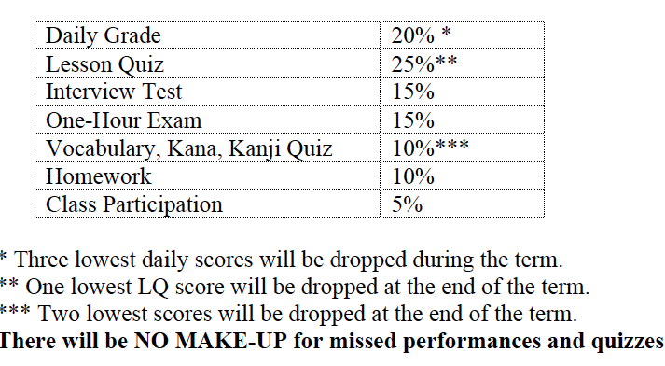
Evaluation

Slide 5
Policies
Attendance Policy
1. Attend all sessions and keep up with the course work on a daily basis! If you feel you are falling behind, contact instructors immediately. Take advantage of our office hours!
2. Be punctual. Coming in late not only results in missed performances and quizzes that may
not be made up for, but also distracts other students. Showing up late may affect your daily
grade negatively.
3. No eating or text messaging will be allowed during class.
Homework Policy
Submit all assignments at the beginning of the class. Late submission will be accepted
with 5% deduction each day. Assignments turned in after three days will not receive any credit,
however, all writing assignments must be completed and submitted to receive a final course
grade.

Slide 6
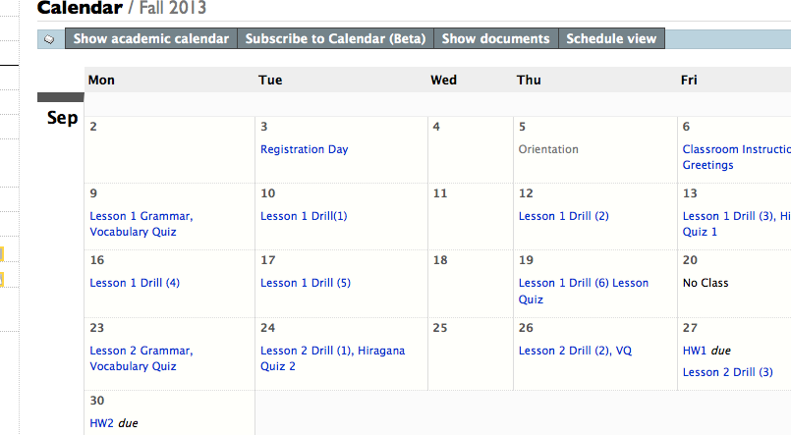
Stellar – Calendar-

Slide 7
Classroom Instructions
Itte kudasai ("Please say (it).") いってください。
Moo ichido Itte kudasai ("Please say (it) again.")
もういちどいってください。
Kiite kudasai ("Please listen.") きいてください。
~san ni kiite kudasai ("Please ask ~ .")
~さんにきいてください。
Minna de itte kudasai ("Say (it) together .")
みんなでいってください。
Kotaete kudasai ("Please answer (it).")
こたえてください。

Slide 8
Greetings (from p.35)
Ohayoo. ("Good morning") おはよう。
Ohayoo gozaimasu. ("Good morning" (polite)) おはようございます。
Konnichiwa. ("Good afternoon.") こんにちは。
Konbanwa. ("Good evening.") こんばんは。
Sayoonara. ("Good-bye.") さようなら。
Oyasuminasai. ("Good night.") おやすみなさい。
Arigatoo. ("Thank you.") ありがとう。
Arigatoo gozaimasu. ("Thank you." (Polite)) ありがとうございます。
Iie. ("No.; Not at all.") いいえ。
~ sensee ("Prof. ~") ~せんせい
~ san (“Mr./Ms. ~”) ~さん
(Additional Expressions)
Onegaishimasu ("Please.") (おねがいします。)
Hai ("Yes.") (はい。)

Slide 9
For 9/6
Let’s check Stellar Calendar…

