Slide 1
Japanese I
Orientation

Slide 2
Sections and Instructors
Sections:
  Section 1: 9-10: 4-249 (T. Aikawa)
  Section 2: 10-11: 4-249 (T. Aikawa)
  Section 3: 12-1: 4-249 (M. Ikeda-Lamm)
  Section 4: 1-2: 4-249 (Y. Nagaya)
Instructors:
  Aikawa-sensee
  Ikeda-sensee
  Nagaya-sensee

Slide 3
Course Objectives
Lessons 1 through 6 of Genki I: An Integrated Course in Elementary Japanese
Reading, Writing, Listening, and Speaking
Basic Kanji characters + Kana (Hiragana and Katakana)
Two types of classes: Grammar Session & Drill Session

Slide 4
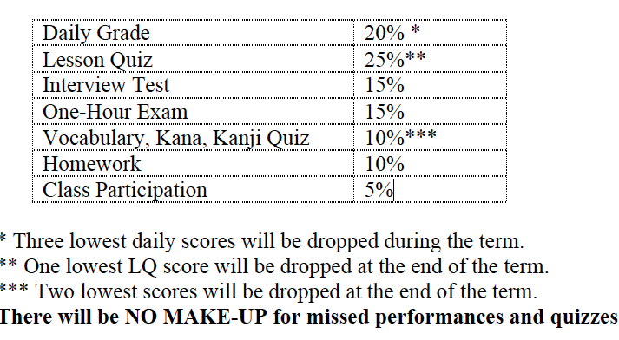
Evaluation

Slide 5
Policies
Attendance Policy
1. Attend all sessions and keep up with the course work on a daily basis! If you feel you are falling behind, contact instructors immediately.
2. Be punctual. Coming in late not only results in missed performances and quizzes that may
not be made up for, but also distracts other students. Showing up late may affect your daily
grade negatively.
3. No eating or text messaging will be allowed during class.
Homework Policy
Submit all assignments at the beginning of the class. Late submission will be accepted
with 5% deduction each day. Assignments turned in after three days will not receive any credit,
however, all writing assignments must be completed and submitted to receive a final course
grade.

Slide 6
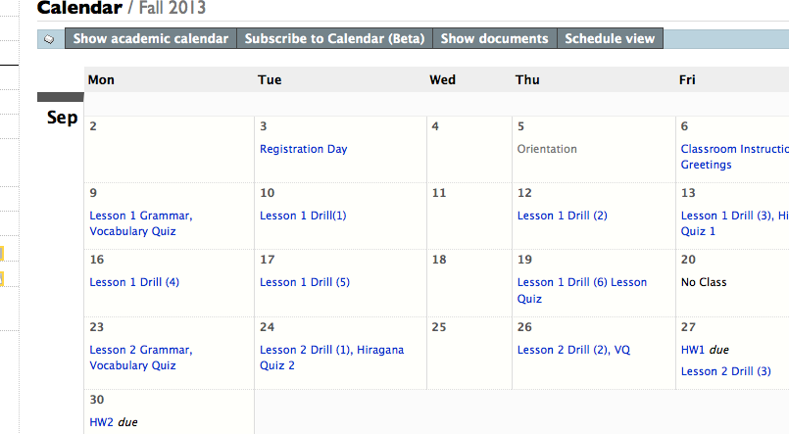
Stellar – Calendar-

Slide 7
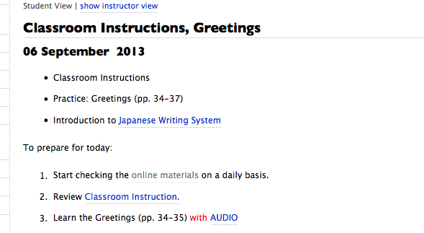
Audio/Learning Materials

Slide 8
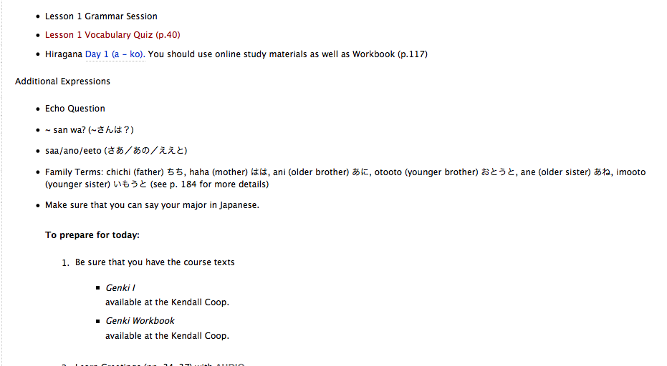
For 9/9

Slide 9
Classroom Instructions
Kiite kudasai ("Please listen.") きいてください。
Itte kudasai ("Please say (it).") いってください。
Moo ichido Itte kudasai ("Please say (it) again.")
もういちどいってください。
~san ni kiite kudasai ("Please ask ~ .")
~さんにきいてください。
Minna de itte kudasai ("Say (it) together .")
みんなでいってください。
Kotaete kudasai ("Please answer (it).")
こたえてください。

Slide 10
Additional Expressions
Onegaishimasu ("Please.") (おねがいします。)
Hai ("Yes.") (はい。)
Sumimasen ("Thank you.") (すみません。)
Doomo ("Thank you.") (どうも。)

