Slide 1

Rethink online education
AAKRITI SHROFF, BRAD CORDOVA, KYLE FISHER

Slide 2
IMPLEMENTATION
EVALUATION
REFLECTIONS
DESIGN

Slide 3
KEY
PPM = PAPER PROTOTYPING MODIFICATION
HEM = Heuristic Evaluation MODIFICATION
UTM = USER TESTING MODIFICATION

Slide 4
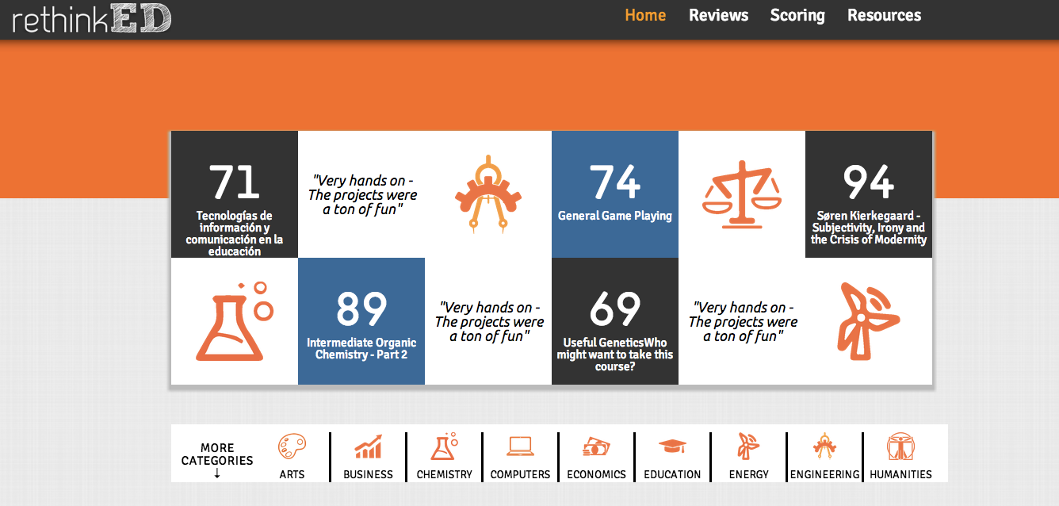
PPM
DESIGN

Slide 5
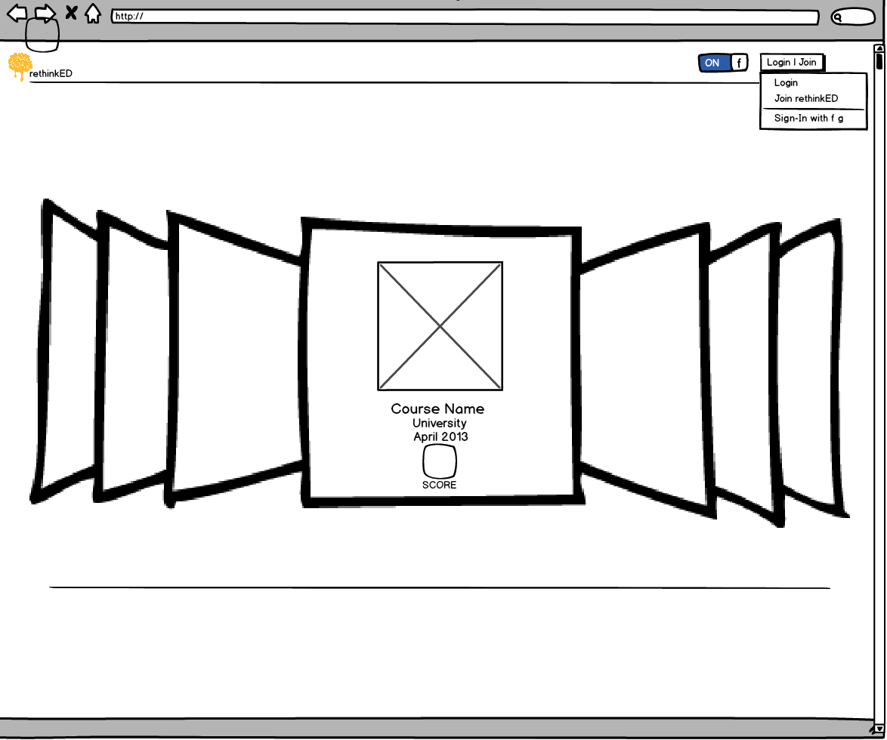
DESIGN
ALTERNATIVE DESIGNS FOR TOP LAYOUT
EFFICIENCY ISSUES: USERS DON’T WANT TO SCROLL THROUGH A GALLERY OR SCROLL DOWN TO GET TO THE MAIN CONTENT

Slide 6
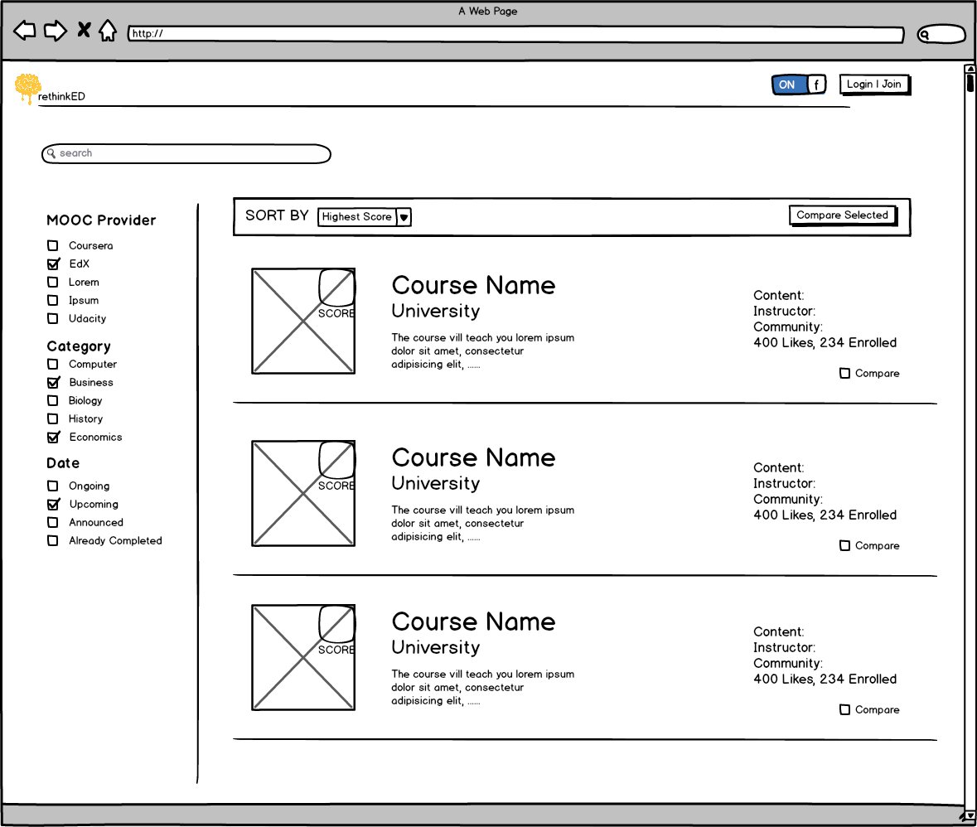
DESIGN
ALTERNATIVE DESIGNS FOR TOP LAYOUT
LEARNABILITY ISSUES:
IT IS NOT IMMEDIATELY CLEAR WHAT THE WEBSITE DOES.

Slide 7
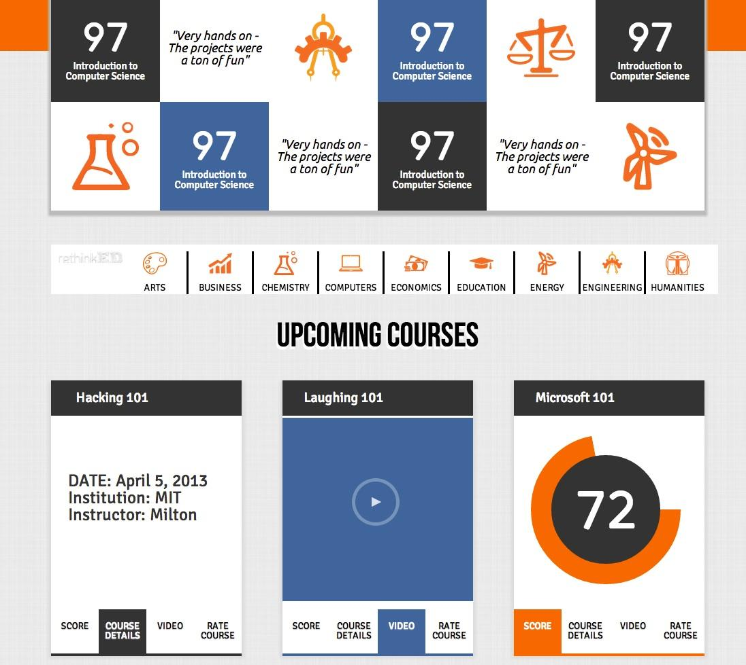
DESIGN
A GRID TO HELP USERS LEARN DIFFERENT ELEMENTS FOUND ALL OVER THO PAGE: ICONS, SCORES, REVIEWS

Slide 8
UTM
DESIGN
CATEGORIES MENU
WE CREATED A CATEGORIES MENU THAT BECOMES A STICKY NAVIGATION MENU, ONCE THE USER SCROLLS PAST IT – MAKES FILTERING BY CATEGORIES MORE EFFICIENT.
Notes:
Speak: Course Numbers

Slide 9


















DESIGN
DESIGNED CONSISTENT ICONS – SIMPLICITY, REGULARITY
CATEGORIES MENU
Computers
Mathematics
Information
Humanities
Engineering
Biology
Physics
Economics
Arts
Education
Chemistry
Earth Sciences
Energy
Business
Medicine
Music
Data
Law
Notes:
Speak: Course Numbers

Slide 10
DESIGN
PROVIDES ALTERNATE VIEW OF COURSES – EFFICIENCY
UPCOMING COURSES
UTM
Notes:
Speak: Course Numbers

Slide 11
DESIGN
PROVIDES ALTERNATE VIEW OF COURSES – EFFICIENCY
UPCOMING COURSES
UTM
Notes:
Speak: Course Numbers

Slide 12
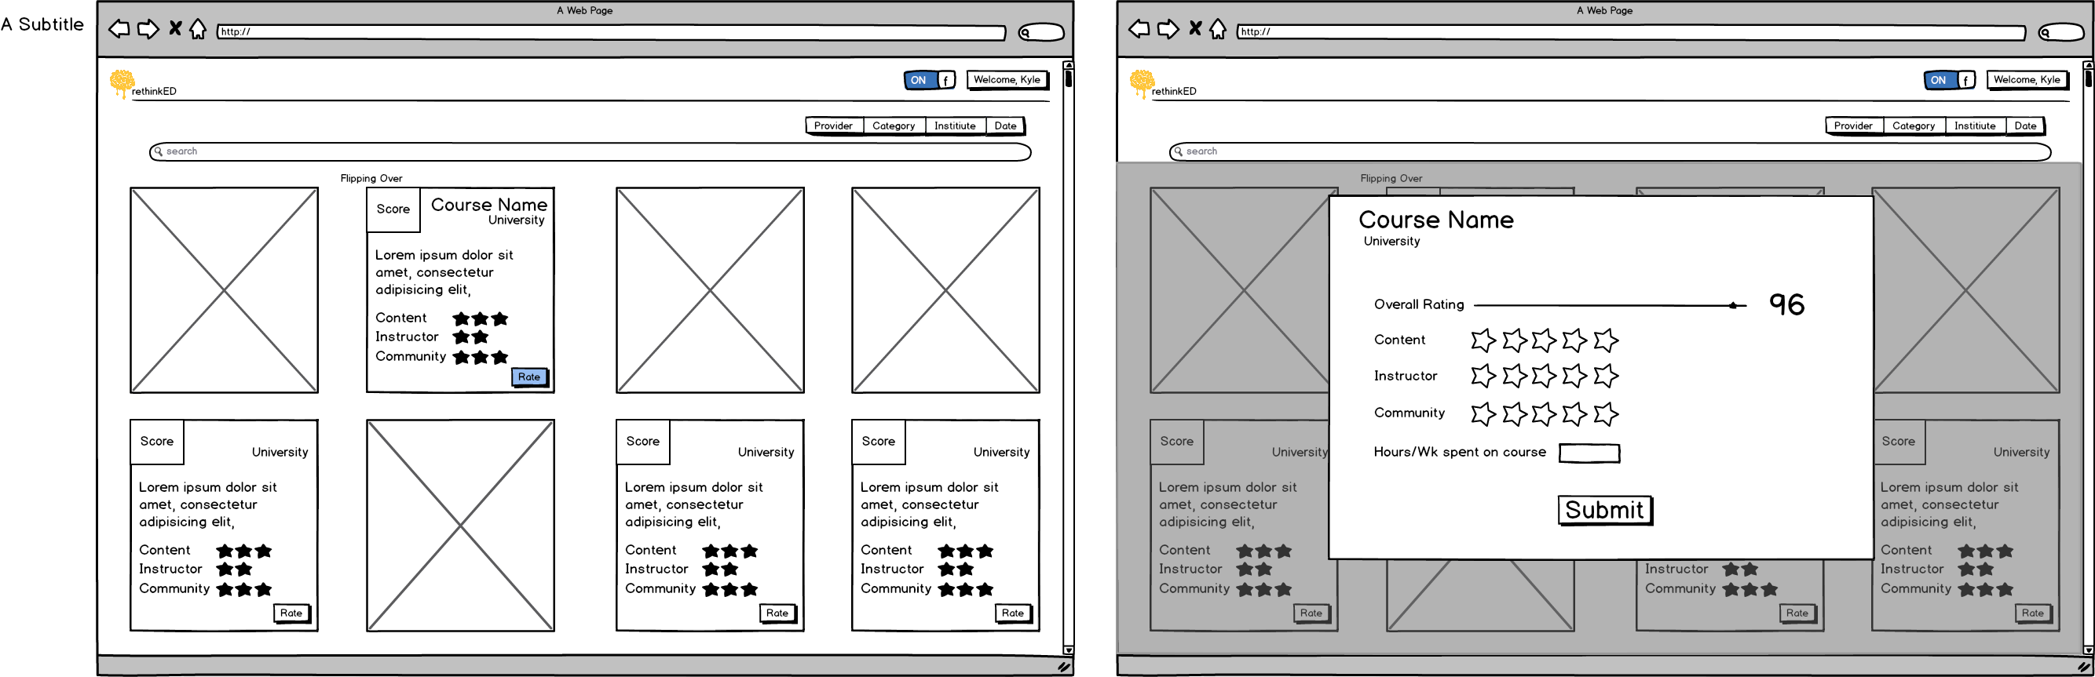
DESIGN
ALTERNATIVE DESIGNS UPCOMING COURSES
Notes:
Speak: Course Numbers

Slide 13
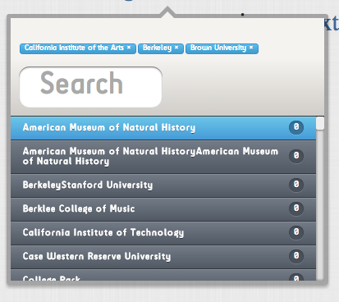
SAFETY ISSUE ADDRESSED AFTER TESTING. USERS CAN CANCEL SELECTED FILTERS EASILY
DESIGN
FILTERING
Notes:
Speak: Course Numbers

Slide 14
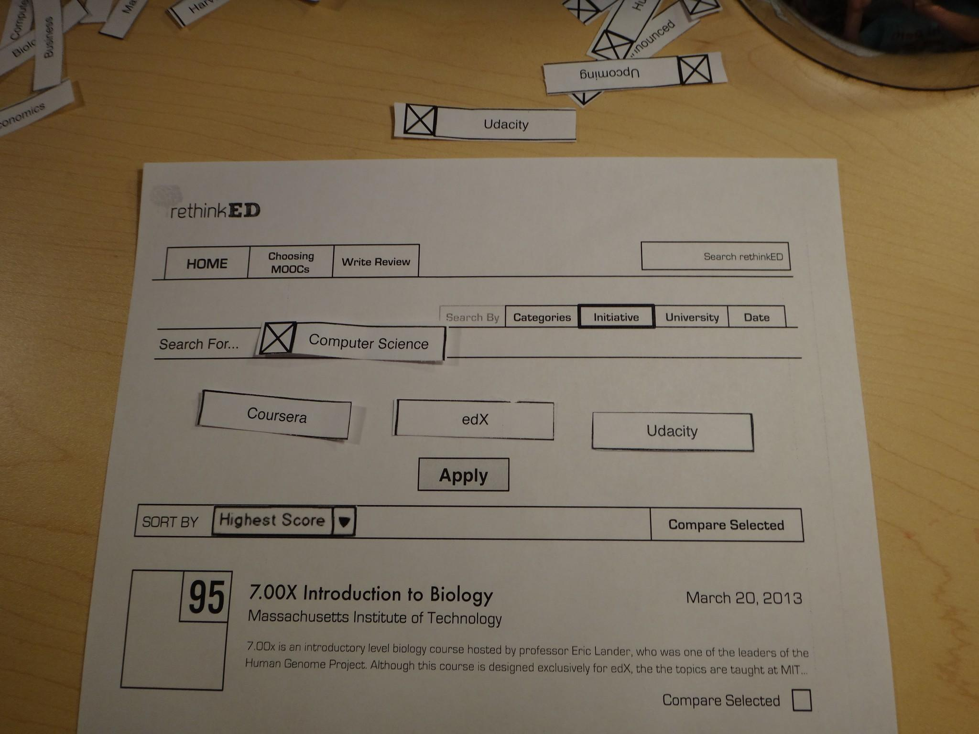
DESIGN
PPM: ADDRESSED EFFICIENCY ISSUE
ALTERNATIVE FILTERING VIEW
Notes:
Speak: Course Numbers

Slide 15
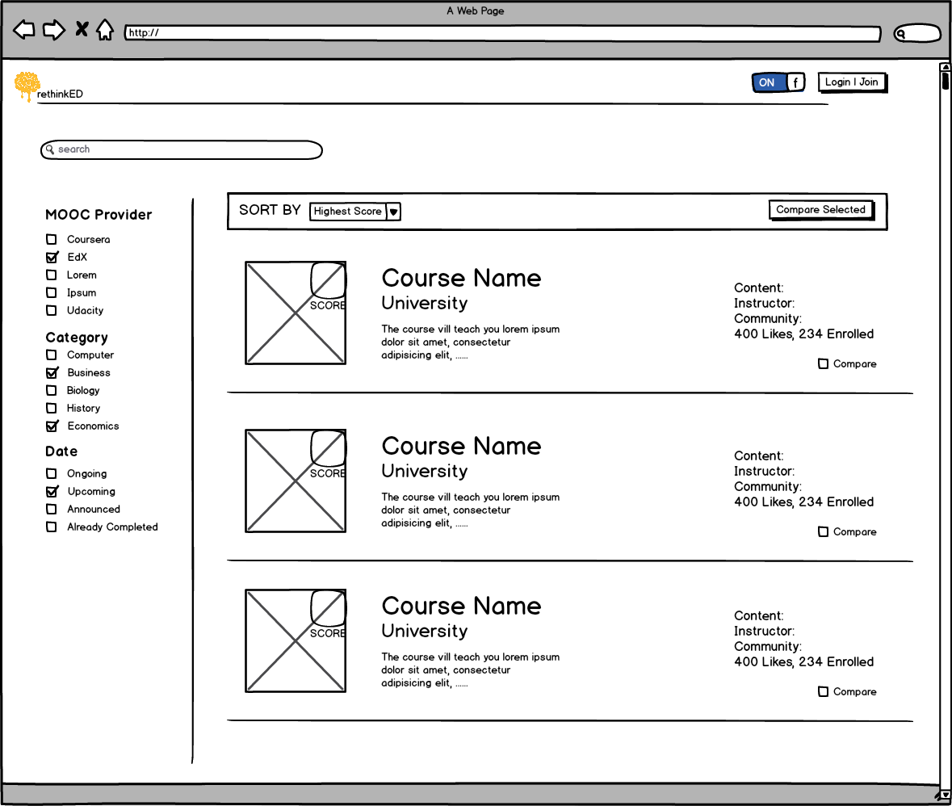
DESIGN
DESIGN ITERATION
ALTERNATIVE FILTERING VIEW
Notes:
Speak: Course Numbers

Slide 16
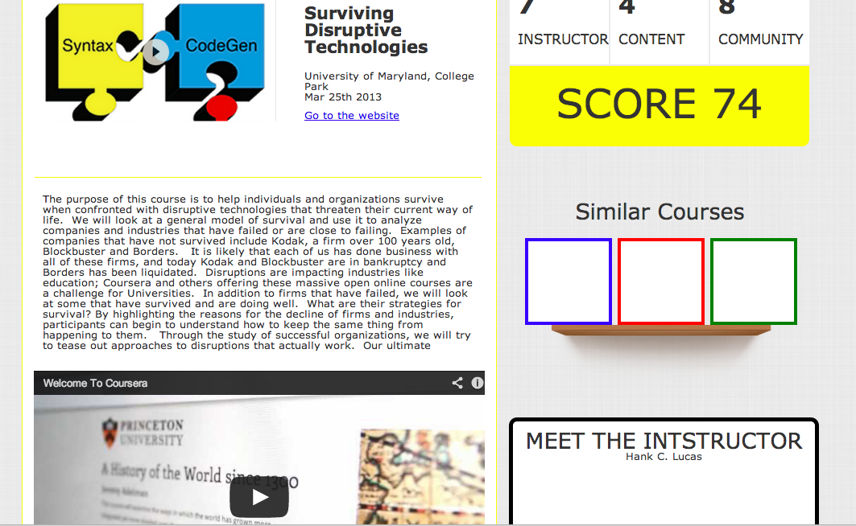
DESIGN
INDIVIDUAL COURSE PAGE
Notes:
Speak: Course Numbers

Slide 17
DESIGN
IMPLEMENTATION
EVALUATION
REFLECTIONS
IMPLEMENTATION

Slide 18
SPECIFICATIONS
HOSTED ON: AMAZON ELASTIC COMPUTING LOUD
SERVED USING: APACHE 2
PLATFORM: DJANGO, HMTL5, CSS3, JS/JQ, phantomJS
WIREFRAMING TOOLS: BALSMIQ
UI ELEMENTS: ADOBE ILLUSTRATOR

Slide 19
DECISIONS + CHALLENGES
USING DJANGO
EXCELLENT OBJECT-RELATIONAL MAPPER: OUR WEBSITE IMPLEMENTS SIGNIFICANT AMOUNT OF DATABASE QUERYING

Slide 20
DECISIONS + CHALLENGES
FETCHING DATA FROM JAVASCRIPT-LOADED WEBPAGES
Coursera is very concerned about third party developers fetching data from their site. Using. We decided to use phantomjs to retrieve the data. This took us a really long time.

Slide 21
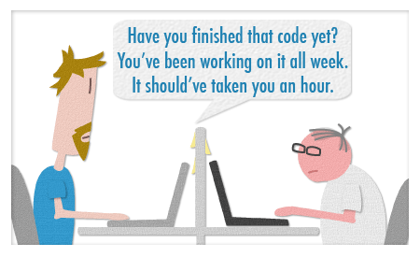
DECISIONS + CHALLENGES
ONE OF THE FIRST THINGS WE DID WAS MODULARIZE THE CODE AS WELL AS DESIGN TO ALLOCATE TASKS EFFECTIVELY. WE LEARNED QUITE A BIT ABOUT COORDINATING BETWEEN DESIGN AND DEVELOPMENT- TOOLS USED, WORKFLOWS

Slide 22
DESIGN
IMPLEMENTATION
EVALUATION
REFLECTIONS
EVALUATION

Slide 23

USER TESTING
GIVEN LARGE USER POPULATION, IT WAS EASY FOR IS TO FIND USERS TO TEST OUR PROTOTYPE OUT. WE HAD PREVIOUSLY COMPLETED QUITE A FEW ONLINE COURSES, AND CONTACTED 5 USERS FROM 4 COURSES EACH. 11 OF THEM AGREED TO TEST THE PROTOTYPE AND PROVIDE FEEDBACK. AMONG THE USERS, THERE WERE 4 COLLEGE STUDENTS, 2 HIGH SCHOOL STUDENT, 4 JOB PROFESSIONALS, 1 “DAD ” – A DECENT REPRESENTATION OF OUR USER GROUP.

Slide 24
BRIEFING
You are junior marketing analyst (or any other non-software job you’ve dreamed of having) who has recently been asked by his boss to learn how to code. “Your next assignment will involve considerable coding,” your boss adds. You have never coded a day in your life and don’t quite know where to start from. Also, you have no other information about what you might be asked to code in the assignment. Having taken a MOOC before, you head over to rethinkED to see if there’s a relevant computer science course that suits your needs.

Slide 25
ISSUES
IMPORTANCE OF COURSE VIDEO: ONE USER ASKED US WHY WE GAVE COURSE VIDEOS SO MUCH IMPORTANCE. HE INFORMED US THAT AS A STUDENT, HE RARELY VISITS THE COURSE VIDEO AND PERHAPS SOME OTHER RELEVANT INFORMATION COULD BE PUT THERE INSTEAD.

Slide 26
ISSUES
UPCOMING COURSES SELECTION: ONE USER ASKED US IF WE COULD ADD A CALENDAR LIKE FEATURE SO THEY CAN SELECT UPCOMING COURSES BY DATE EASILY. WE STILL HAVE SOME MINOR FIXES TO DO TO COMPLETE THIS FEATURE.

Slide 27
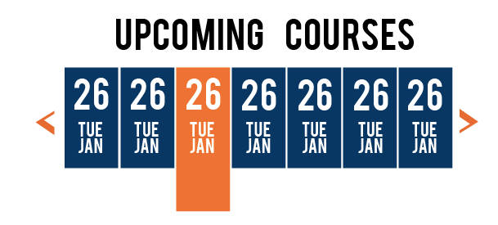
ISSUES

Slide 28
DESIGN
IMPLEMENTATION
EVALUATION
REFLECTIONS
REFLECTION

Slide 29
PAPER PROTOTYPING WAS EXTREMELY USEFUL!

Slide 30
WE IMPLEMENTED OUR INDIVIDUAL PIECES FIRST, AND THEN THE LAYOUT. OUR GR4 AS SUCH APPEARD INCOMPLETE. WE WONDER IF IT’S THE RIGHT ORDER OF DOING THINGS, OR SHOULD THE LAYOUT BE IMPLEMENTED FIRST .

Slide 31
WE IMPROVED COORDINATING WORK AS WE MOVED ALONG, BUT COULD HAVE USED IT EARLIER ON.

Slide 32
MORE ITERATIONS SO THAT WE CAN INCORPORATE FEEDBACK. THERE ISN’T MUCH TIME TO BUILD A COMPUTER PROTOTYPE AND ITERATE WITH FEEDBACK.

Slide 33
STUDIOS WERE REALLY HELPFUL IN PROVIDING FEEDBACK

