Slide 1
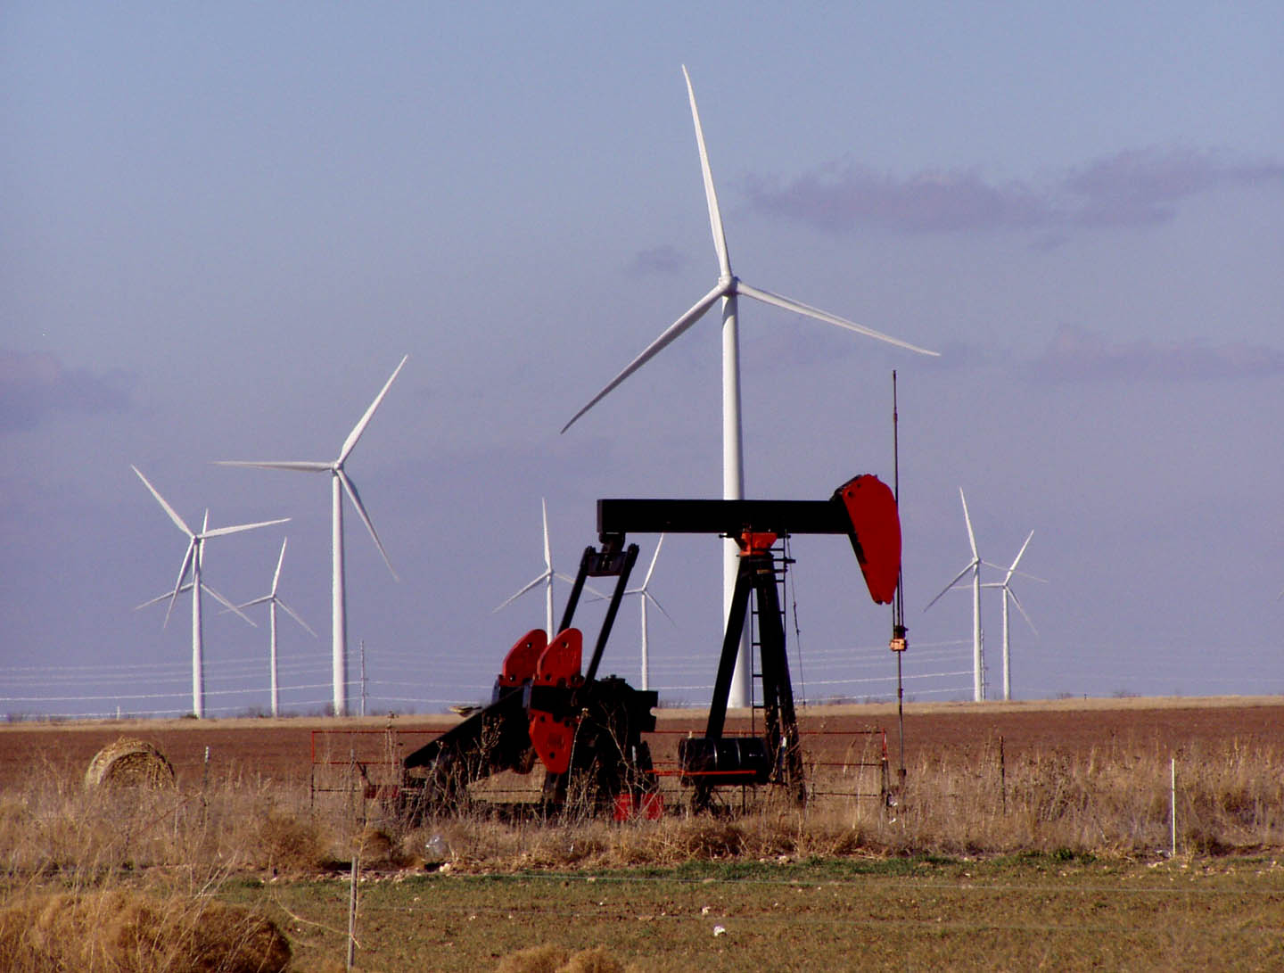

Introduction to Geologic Sequestration of CO₂
Susan D. Hovorka
Gulf Coast Carbon Center, Bureau of Economic Geology
Jackson School of Geosciences, The University of Texas at Austin
Notes:
Introduce myself: BEG is geologic survey of Texas. I usually work with water quality protection, past 8 years working with CCS.
This photo from near Big Spring Texas frames question about the role of fossil fuel in a carbon constrained world.

Slide 2
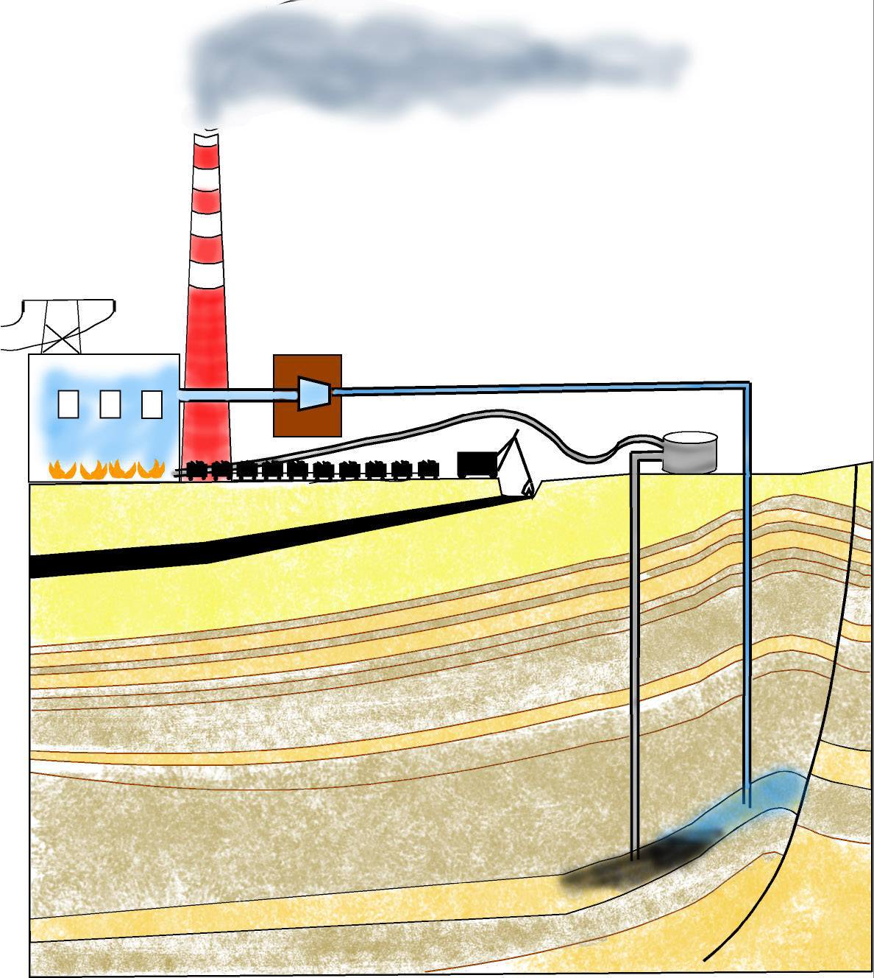

What is Geologic Sequestration?
To reduce CO₂ emissions
to air from point sources..
CO₂ is captured as concentrated
high pressure fluid by one of several
methods..
is currently burned and
emitted to air
CO₂ is shipped as supercritical
fluid via pipeline to a selected,
permitted injection site
CO₂ injected at pressure into
pore space at depths
below and isolated (sequestered)
from potable water.
Carbon extracted
from a coal or other
fossil fuel…
CO₂ stored in pore space
over geologically
significant time frames.

Slide 3
Is geologic sequestration ready to be used as part of a greenhouse gas emissions reduction program?
Are subsurface volumes are adequate to sequester the volumes needed to impact atmospheric concentrations?
Is storage security adequate to avoid inducing hazards and to benefit atmospheric concentrations?
Is the whole system (pipeline, well construction, permitting) mature enough to proceed forward?
Notes:
These questions will be discussed during this talk.

Slide 4
Assessing Adequacy of Subsurface Volumes: the Value of Compression
At depths >800 m CO₂ is stored as a dense phase (1metric ton = about 1.6 cubic m)
Seven Gigatons (7 x 10⁹T) CO₂/year US emissions from stationary sources:
if spread evenly over US:
30 cm/year
at @STP
(surface
temperature
and pressure)
0.4 mm/year at
reservoir conditions
Notes:
Compression is of great value in creating enough space for storage. However, we really cannot spread CO2 evenly as a 0.4 mm sheet underground across the US.

Slide 5
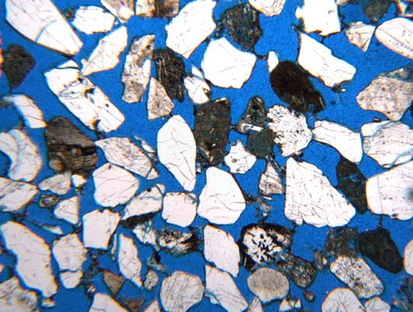
What is Known about Storage Capacity?
Assessing Adequacy of Subsurface Volumes: Microscope View
Storage volume is in abundant microscopic spaces (pores) between grains in sedimentary rocks that are now filled with brine (or locally oil or gas)
2mm
Sandstone thin section photomicrograph, Frio Fm.
Blue areas were filled with brine
now are 10-30% filled with CO₂
Notes:
Many people imagine storage of CO2 in a big underground tank or cavern which could suddenly blow out. Actually the Co2 is stored in microscopic pore systems. A lot is known about flow though these pores from oil and gas production. At high concentrations, e.g. in a trap, the CO2 is mobile, it can flow to the surface (demonstration with marble bottle). In a trap, the quality of the seal is critical (example from jar). However, if the CO2 spreads in an open system, the distance that it will flow is self limiting. The limiting principle is non-wetting immiscible phase trapping, or “phase trapping” example from jar. Evidence from Frio. CO2 is also dissolved in brine. Work underway at Frio to determine rate and timing of dissolution.

Slide 6
What is Known about Storage Capacity?
Assessing Adequacy of Subsurface Volumes: Distribution
Pores to store and seals to prevent leakage upward are typical of sedimentary rocks found widely in the US and globally
  Economically acceptable estimation of pore space commonly done for oil and gas reservoirs using available tools is adapted to brine-filled volumes
  Not all sedimentary rocks are equally well known – confidence of estimates of storage volume is variable.
Notes:
Hovorka 2000 study

Slide 7
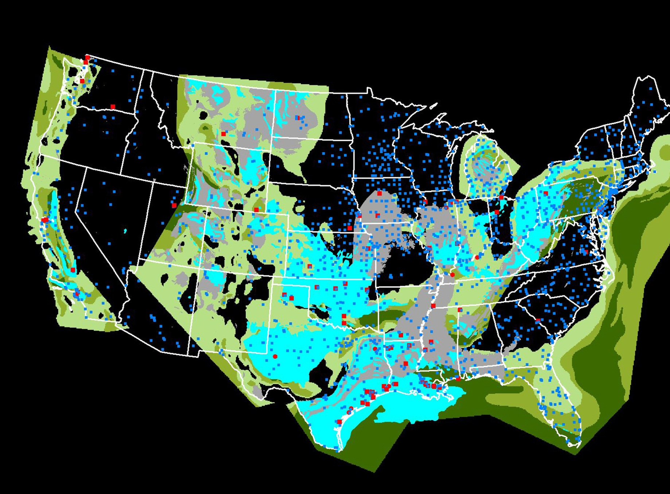
Assessing Adequacy of Subsurface Volumes – map view
[This 2000 data soon to be superseded by DOE Regional Partnerships summary]
Power Plants
Pure CO₂ sources
Oil and Gas (USGS)
Coal (USGS)
Brine Aquifer> 1000m
Source: Gulf Coast Carbon Center
Notes:
This slide shows distribution of power plants (blue dots), refineries ethanol and fertilizer plants superimposed on the distribution of geologic equestrian targets. Here we are especially interested in brine aquifer ( in green), with dark green showing greatest thickness.

Slide 8
Assessing Adequacy of Subsurface Volumes
New study of capacity by DOE - NETL Regional Carbon Sequestration Partnerships to be released soon
Major result: making conservative assumptions*: Space for 1000 Gigatons CO₂ at reservoir conditions - adequate space for >120 years of all CO₂ at current point source emission rates
  * only fairly well known rock volumes assessed
  * Assume that CO₂ fills 1% of the volume
Uncertainty is risks incurred when very large volumes are injected

Slide 9

Is storage security adequate?
What are
the risks?
Substitute
underground
injection for air
release
Escape of brine
or CO₂ to
groundwater,
surface water,
or air via long
flowpath
Earthquake
Escape of CO₂
or brine to
groundwater,
surface water
or air through
flaws in the seal
Failure of well cement or
casing resulting in leakage
Notes:
Let's review what are the main negative events that we predict during injection.

Slide 10
Risk
Is Security of Sequestered CO₂ Adequate? Types of Risks:
Catastrophic or rapid escape of CO₂ or brine – death or damages
  Well–known volcanogenic CO₂ outgassing: examples at Lake Nyos, Cameron; Mammoth Lakes, CA,; industrial confined space risks
Slow escape of CO₂ – storage becomes ineffective for atmospheric benefit, cost without benefit
  Slow leakage of either CO₂ or brine within ranges of normal variability is probably acceptable in environmental and resource conservation context
  However leakage rates < 0.1% of stored volume/year are required to benefit atmosphere
Notes:
Catastrophic volcanogenic leakage is a poor analogy for proposed storage in sedimentary rocks – highly fractured, no shale seals, large stresses.
Large volumes of volcanogenic Co2 are emitted without hazard.
many natural environments have high and variable Co2. Soil gas for example is commonly several percent CO2. Additional information is needed on natural variability in the context of understanding where leakage might cause damage.
Slow leakage year by year adds up to a large amount of the stored CO2 lost. Model of storage and leakage. Note that when leakage occurs it is mostly during injection and shortly after – even under the worst conditions most of the Co2 will be stored.

Slide 11
What is Known about Storage Capacity?
Is Security of Sequestered CO2 Adequate?
Pores to store and seals to prevent leakage upward are typical of sedimentary rocks found widely in the US and globally
  Economically acceptable estimation of pore space commonly done for oil and gas reservoirs using available tools is adapted to brine-filled volumes
  Not all sedimentary rocks are equally well known – confidence of estimates of storage volume is variable.
Notes:
Storage volumes for sequestration are typical of sedimentary rocks.

Slide 12
Techniques to Assure Safe Injection of CO₂ Used Currently
Health and safety procedures for CO₂ pipelines, shipping, handling, and storing
Pre-injection characterization and modeling
Isolation of injectate from Underground Sources of Drinking Water (USDW)
Maximum allowable surface injection pressure (MASIP) to prevent earthquakes.
Mechanical integrity testing (MIT) of engineered system
Standards for well completion and plug and abandonment in cone of influence and area of review around injection wells.
Reservoir management; extensive experience in modeling and measuring location of fluids
Notes:
Current injection practices under the Safe Drinking Water Act of 1974 (Underground Injection Control Program) provide safeguards that are used to assure safe injection of many types of fluids.
Pre –injection characterization and modeling is an essential step, where the permittee provides detailed evidence of the integrity of the seal, and the presence of barriers to prevent damage to USDW. MASIP is calculated to keep injection pressure below the fracture pressure of the rock and seal. Fracture pressure of rocks are fairly well known because of the common practice of “fracing” a reservoir, deliberately injecting fluid at high pressure to break the rock, and increase oil or gas production.
Well engineering is known to be a weak point in the history of injection. Well failure can provide a very direct conduit from the injection zone to the surface. Current work underway to investigate the integrity of wells under CO2 flood – so far so good.

Slide 13
How can Security of Sequestration be Better Assured?
Rigorous site selection requirements
Comprehensive monitoring requirements and mitigation plans
Additional research
Need for a balanced and phased approach
Not too restrictive: encourage early entry into CCS – gain experience
Adequate rigor to assure that early programs do not fail
Mature = standardized, parsimonious but
adequate approach
Notes:
Examples of more rigorous site selection would be 3-D seismic images.
Next slide I will talk more of monitoring the CO2 and brine to see that it is responding as predicted and that the predictions of benign behavior are verified. Mitigation refers to actions that will be taken to mitigate failure. Additional research - testing to understand for example what a parsimonious approach.

Slide 14
Assuring Security:
Monitoring Options
Atmosphere
  Ultimate integrator but dynamic
Biosphere
  Assurance of no damage but dynamic
Soil and Vadose Zone
  Integrator but dynamic
Aquifer and USDW
  Integrator, slightly isolated from ecological effects
Above injection monitoring zone
  First indicator, monitor small signals, more stable.
In injection zone - plume
  Oil-field type technologies. Will not find small leaks
In injection zone - outside plume
  Assure lateral migration of CO₂ and brine is acceptable
Atmosphere
Biosphere
Vadose zone & soil
Aquifer and USDW
Seal
Monitoring Zone
Seal
CO2 plume
Notes:
It is possible to collect geochemical and geophysical data to (1) confirm expected events in the injection zone and (2) demonstrate that leakage does not occur in other zones.

Slide 15
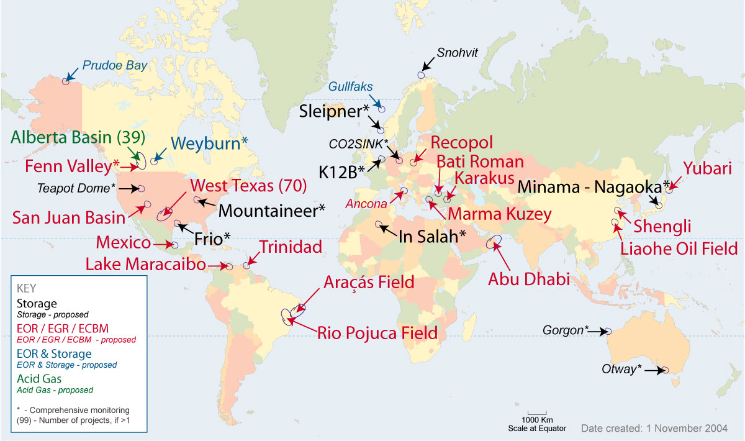
System mature enough to proceed: Global experience in CO₂ injection
From Peter Cook, CO2CRC
Notes:
Numerous and growing experience with CO2 injection is available worldwide. Most experience Steve will be discussing in the Permian Basin, and much of it is injection of Co2 to enhance oil production. .

Slide 16
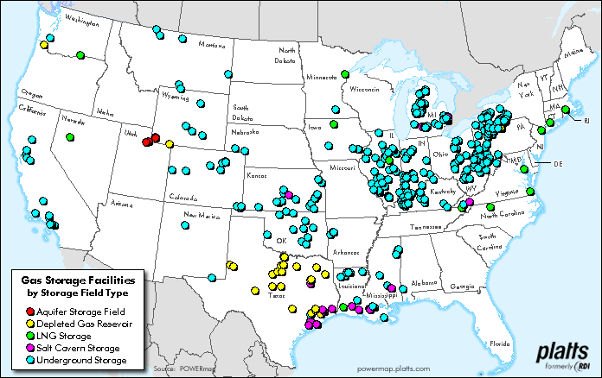
System mature enough to proceed: US experience in gas storage
Slide from Sally Benson, LBNL
Notes:
Natural gas is more dangerous than CO2 because it is explosive – provides an analogy for CCS

Slide 17
Geologic storage is ready to be used as part of a greenhouse gas emissions reduction program
Subsurface volumes are adequate to sequester the volumes needed to impact atmospheric concentrations
Using available technology, adequate storage security can be assured to avoid inducing hazards and to benefit atmospheric concentrations
The whole system (pipeline, well construction, permitting) is mature enough to proceed forward-some work remaining
Notes:
Summary

Slide 18
What needs to be done next?
Prior to injection, CO₂ has to be captured at high concentration and compressed to about 2200 psi
  Capture is major limit on utilization of geologic storage
Assurance provided to industry on property rights and permitting
  Legal precedents for large volume injection into brine in most states are inadequate
Consensus on Best Practices for monitoring injection and post injection clarified
  This should be a result of research in coming year – how much monitoring is adequate?

Slide 19
Geologic Sequestration of Carbon – Put it back
Carbon extracted
from coal or other
fossil fuel…
Returned into the earth
where it came from

