Slide 1

Metabolism – Carbon cycle
Anthony J. Sinskey, Sc.D.
September 28, 2011
Lecture 7-1

Slide 2
Outline
Global carbon cycle
Anoxic decomposition
Microbial communities
  Cattle rumen
  The life aquatic
Methanogens

Slide 3
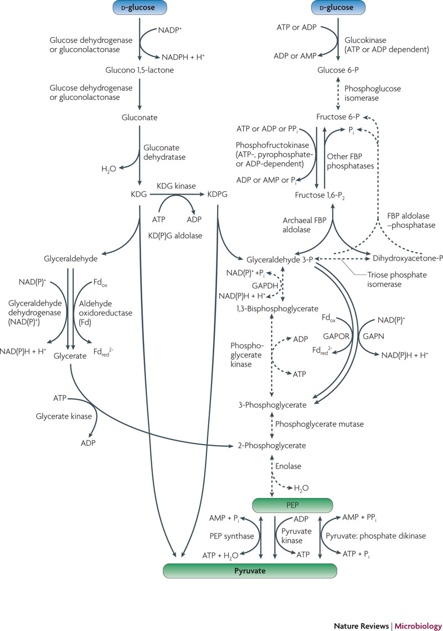
Central Carbohydrate Metabolism
Pyruvate and phosphoenolpyruvate (PEP) formation differ in autotrophic organisms
Gluconeogenesis from pyruvate seems to be uniform
Bifunctional enzyme catalyzes both steps in archaea
Berg et. al. 2010 Nature Reviews Microbiology, 8: 447

Slide 4
Choose Among the Various Pathways
Considerations | Outcome Options
Oxygen, metals | low ATP yields – reductive acetyl-CoA pathway more available essential metals – reductive acetyl-CoA pathway O₂-insensitive enzymes – hydroxypropionate-hydroxybutyrate cycle
Energy demands | energy required: to synthesize CO₂ fixation-related enzymes in catalysis organisms favor energy-saving mechanisms and mechanisms related with less energy involved autotrophy-related enzymes
Metabolic fluxes | fluxes from: acetyl-CoA, pyruvate, oxaloacetate, and 2-oxoglutarate use Calvin cycle because its regulation is almost detached from the central carbon metabolism
CO₂ species | bicarbonate is more concentrated in slightly alkaline water than dissolved CO₂ usage of bicarbonate might be more favorable at certain environment
Co-assimilation of organic compounds | growth in aquatic habitats results in mixotrophs co-assimilation increases efficiency

Slide 5
Global Carbon Cycle
Carbon is cycled through the atmosphere, the land, the oceans, other aquatic environments, sediments, rocks, and biomass
Most rapid global carbon transfer is via CO₂
Carbon cycle and oxygen cycle are linked
  Oxygenic photosynthesis removes CO₂ and produces O₂,
  Respiratory processes utilizes CO₂ removes O₂

Slide 6
Carbon Cycle
(CH₂O)_{n}
(organic matter)
Oxygenic photosynthesis
CO₂ + H₂O → (CH₂O)_{n} + O₂
Aerobic Respiration
(CH₂O)_{n} + O₂ → CO₂ + H₂O
Chemolithotrophy
Oxic
CH₄
CO₂
Anoxic
Methanogenesis
CH₄ + 2H₂O → CO₂ + 2H₂
Acetogenesis
Acetate + H₂O → CH₄ + HCO₃⁻
Anaerobic respiration and fermentation
(CH₂O)_{n} + SO₄²⁻ → CO₂ + SH₂
Anoxygenic photosynthesis
CO₂ + SH₂ → (CH₂O)_{n} + SO₄²⁻
(CH₂O)_{n}
(organic matter)
Adapted from Madigan and Martinko 2006 Biology of Microorganisms, ed. Brock

Slide 7
Anoxic Decomposition
Phototrophic organisms are the foundation of the carbon cycle
Photosynthetically fixed carbons are degraded into methane (CH₄) and carbon dioxide (CO₂)
Methanogenesis by Archaea is a strictly anaerobic process

Slide 8
Anoxic Decomposition
Complex polymers (polysaccharides, proteins)
Hydrolysis
Monomers (sugars, amino acids)
Fermentation
H₂ + CO₂
acetate
propionate, butyrate, succinate, alcohols
Acetogenesis
Fermentation
acetate
H₂ + CO₂
acetate
Methanogenesis
CH₄ + CO₂

Slide 9
Rumen as a Fermenter
Cellulose (CH₂O)_{n} + microorganism + NH₃ microorganism + VFAs (volatile fatty acids) + CO₂ + CH₄
Cellulose
Hemicellulose
Starch
Mono/disaccharides
Pectins
Glucose
Pyruvate
Lactate
Formate
Acetate
H₂
Propionate
Butyrate
CO₂
CH₄

Slide 10
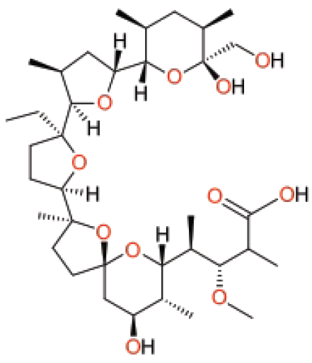
Role of Monensin
Naturally produced polyether ionophore antibiotics
Complexes with monovalent cations such as Li⁺, Na⁺, K⁺ et.
Important Na⁺/H⁺ antiporter
Used in beef and dairy industries to prevent coccidiosis

Slide 11
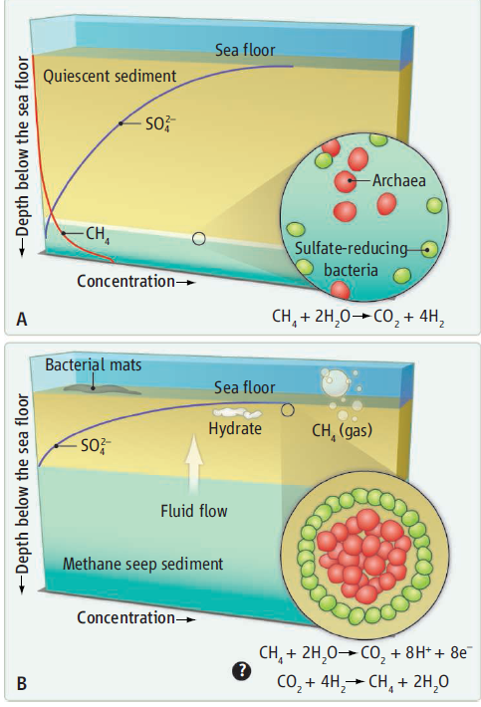
Microbial Communities in Nature
Sea Floor Methane Oxidation
Zones of quiescent ocean sediments
(Methane oxidation most active deep down)
B) Zones of dynamic methane seeps
(Methane oxidation most active near surface)
In (A) and (B), archaea oxidize methane to CO₂ and H₂, and sulfate-reducing bacteria consume the H₂.
Image from: Alperin and Hoehler (2010), Science, 329, 288-289

Slide 12
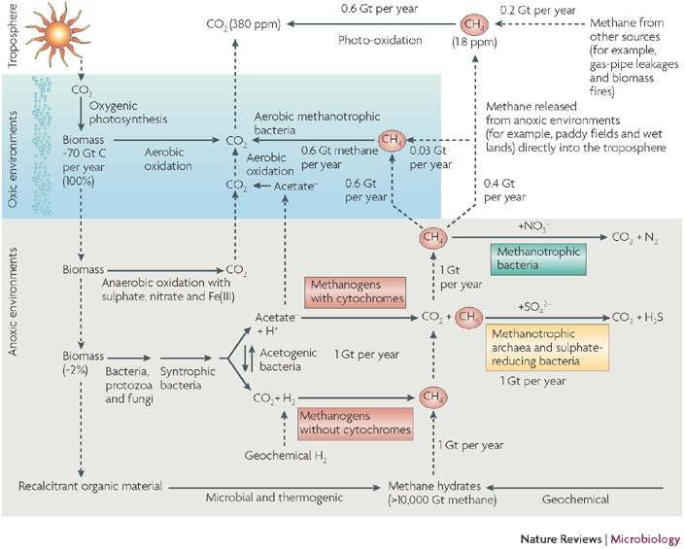
Methane in the Global Carbon Cycle
2 Gt of methane produced per year
  ~0.6 Gt is oxidized to CO₂ by aerobic bacteria
  ~1 Gt is oxidized by anaerobic archaea
  ~0.4 Gt escapes into the atmosphere
0.2 Gt per year methane released into atmosphere from gas-pipe leakages, etc.
  0.03 Gt removed by aerobic bacteria
Overall troposphere methane concentration increase ~0.9 to 1.8 ppm (parts per million) for every 100 years
Thauer et.al 2008. 6: 579

Slide 13
Cytochromes and Methanogenic Archaea
Methanogens with cytochromes (Methanosarcinales)
Contain methanophenazine
Grow on H₂ and CO₂ yields 7 g/mole of methane
Grow on acetate, methanol, and methylamines
Cannot grow on formate
Threshold H₂ partial pressure >10 Pa
Doubling time >10 hrs
No hyperthermophilic species
Methanogens without cytochromes (Methanobacteriales, Methanococcales, Methanomicrobiles, Methanopyrales)
Do not contain methanophenazine
Grow on H₂ and CO₂ yields 3 g/mole of methane
Cannot grow on acetate, methanol, and methylamines
Can grow on formate
Threshold H₂ partial pressure >10 Pa
Doubling time ~1 hr
Many hyperthermophilic species
Thauer et.al 2008. 6: 579
Notes:
Chapter 13 – C1 Metabolism
Section 13.1.5 – Methanogenesis from CO2 and H2 (pp. 368 – 371)

Slide 14
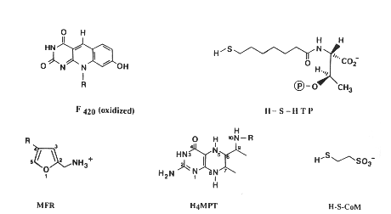
Coenzymes in Methanogens

Slide 15
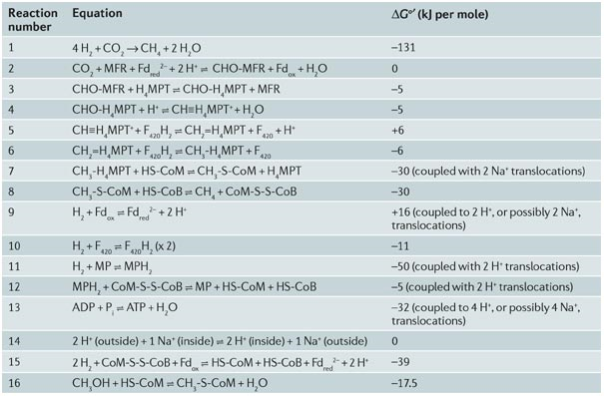
Reactions involved in CO₂ or
methanol reduction with H₂ to methane
Thauer, et al. 2008, Nature Reviews Microbiology Vol. 6, p. 579-591.

Slide 16
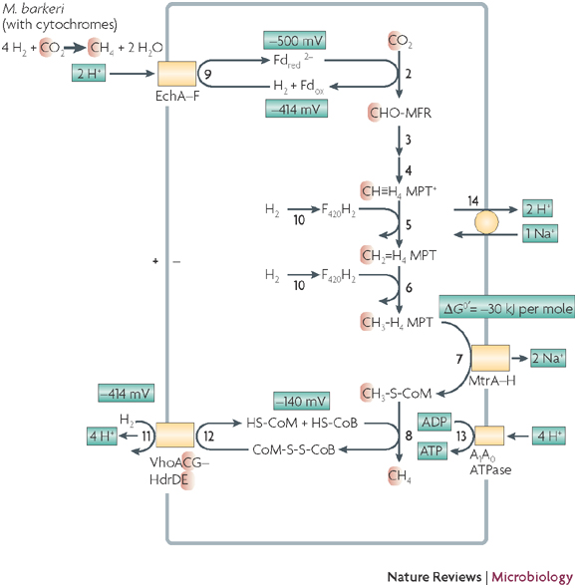
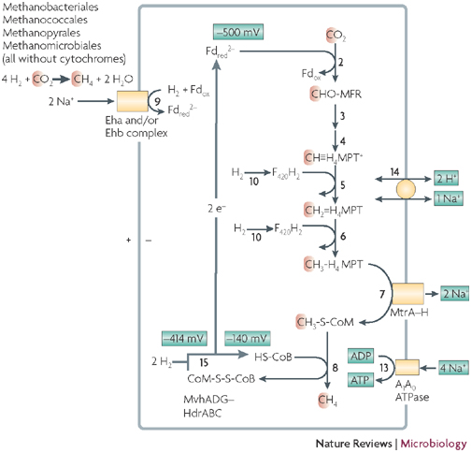
4H₂ + CO₂ → CH₄ + 2H₂O ΔG^{0’} = -131 kJ per mole
With Cytochromes
Without Cytochromes
1.5 moles of ATP per 1 mole of methane
E^{0’} = -500 mV (ferredoxin) and (CO₂/CHO-MFR couple)
0.5 moles of ATP per 1 mole of methane
E^{0’} = -500 mV (ferredoxin) and (CO₂/CHO-MFR couple)
Thauer et.al 2008. 6: 579
Notes:
Chapter 13 – C1 Metabolism
Section 13.1.5 – Methanogenesis from CO2 and H2 (pp. 368 – 371)

Slide 17
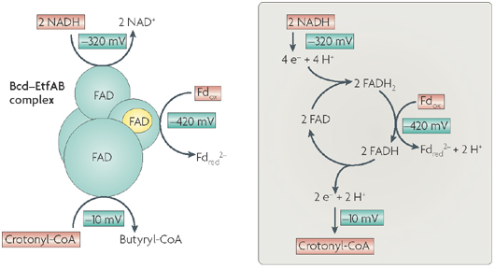
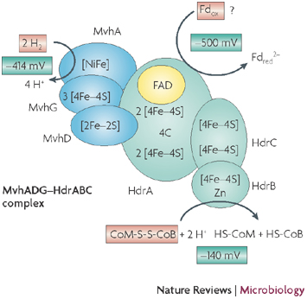
Butyryl-CoA Dehydrogenase
Hydrogenase-heterodisulphide Reductase Complex
2NADH + crontonyl-CoA + Fd_{ox} → 2NAD⁺ + butyryl-CoA + Fd_{red}²⁻
ΔG^{0’} = -40 kJ per mole
Butyryl-CoA Dehydrogenase
enzyme complex couples with endergonic reduction of ferredoxin (Fd) with NADH to the exergonic reduction of crotonyl-CoA with NADH by flavin-based electron bifurcation
FADH and FAD reduced by one electron
FADH₂ and FAD reduced by two electrons
Hydrogenase-heterodisulphide Reductase Complex
endergonic reduction of ferredoxin with H₂
exergonic reduction of CoM-S-S-CoB with H₂

Slide 18
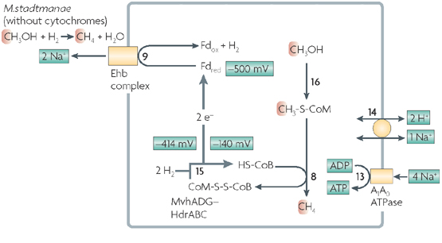
Growth on Methanol and Hydrogen
CH₃OH + H₂ → CH₄ + H₂O ΔG^{0’} = -112.5 kJ/mole
Thauer et.al 2008. 6: 579

Slide 19
Carbon Cycle Overview
Most rapidly transferred form of carbon = CO₂
Phototrophy – the foundation of the carbon cycle
Methane is an important player in many facets of the global carbon cycle
Methanogens – presence or absence of cytochromes suggests lifestyle
  Role of cytochromes – determines usable growth substrates

Slide 20
Metabolism of microorganisms
Research of bacterial metabolism provided significant insight into many fundamental functions
1935: Heterotrophic CO₂ fixation discovered by Harland Wood (1907-1991) while working on propionic acid fermentation
Autotrophic CO₂ fixation was being studied within 15 yrs of radioactive carbon discovery in 1940; study began after M. Calvin, A.A. Benson and J.A. Bassham elucidated biochemical pathway of carbon in Chlorella and Scenedesmus in 1954

Slide 21
Physiological Diversity – Energy Source
Chemicals
Chemotrophy
Phototrophy
Organic Chemicals
Glucose, acetate, etc
Inorganic Chemicals
H₂, H₂S, Fe²⁺, NH₄⁺, etc
Chemoorganotrophs
Chemolithotrophs
Phototrophs
Glucose + O₂ CO₂ + H₂O
H₂ + O₂ H₂O
Light
ATP
ATP
ATP
Brock biology of microorganisms / Michael T. Madigan, John M. Martinko. –11th ed.

Slide 22
Physiological Diversity – Carbon Source
Autotrophic – CO₂ as carbon source
Heterotrophic – one or more organic compounds as carbon source
Nutritional Type | Energy Source | Carbon Source
Photoautotrophs | Light | CO₂
Photoheterotrophs | Light | Organic compounds
Chemoautotrophs or Lithotrophs (Lithoautotrophs) | Inorganic compounds (H₂, H₂S, Fe²⁺, NH₄⁺, etc) | CO₂
Chemoheterotrophs or Heterotrophs | Organic compounds | Organic compounds

Slide 23
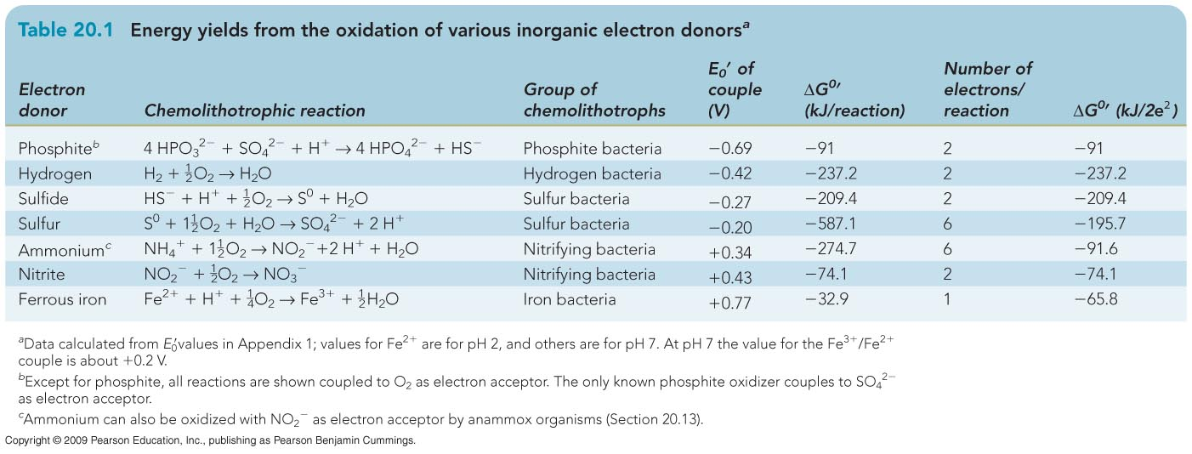
Physiological Diversity – electron acceptor
Reactions | Terminal Electron Acceptor
Aerobic respiration | O₂
Anaerobic respiration | NO_{x}, SO_{x,} Fe, etc
Fermentation | Organic compounds
P_{i} + P_{i} PP_{i} ΔG^{0’} = 33.5kJ/mol ; PP_{i} + AMP ATP ΔG^{0’} = 32.2kJ/mol
ATP synthesis ~ 66kJ/mol
#ATP
1.4
3.6
3.2
8.9
4.2
1.1
0.5
Brock biology of microorganisms / Michael T. Madigan, John M. Martinko. –11th ed.

Slide 24
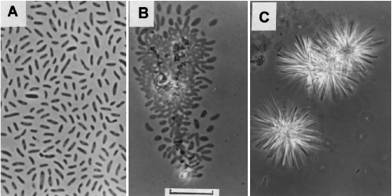
Phosphite Bacteria
Desulfotignum phosphitoxidans
Lithoautotrophic Growth
sole electron donor-phosphite
electron acceptor-sulfate
4HPO₃²⁻ + SO₄²⁺ + H⁺ → 4HPO₄²⁻ + HS⁻
ΔG⁰’ = -364 kJ/mol sulfate, or -91 kJ/mol phosphite
Autotrophic Growth
sole electron donor-phosphite
electron acceptor-carbon dioxide
4HPO₃²⁻ + 2CO₂ + H₂O + 4HPO₄²⁻ → 4HPO₄²⁻ + CH3COO⁻ + H⁺
ΔG⁰’ = -308 kJ/mol acetate, or -77 kJ/mol phosphite
Presence of carbon monoxide dehydrogenase and absence of 2-oxoglutarate dehydrogenase
  Indicate acetyl-CoA pathway (“Wood pathway”)
Can grow on sugars (glucose, arabinose, and xylose)
  Unusual among sulfate-reducing bacteria
1 mol ATP ≈10 g cell material, much higher than normal (2-3 g cell matter per mol ATP)
Schink et al. Arch Microbiol (2002) 177:381-391

Slide 25
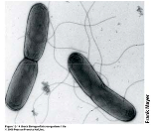
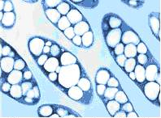
Hydrogen Bacteria
Ralstonia eutropha
‘Knall-gas’ reaction using H₂ as sole electron donor and O₂ as electron acceptor
H₂+1/2O₂ H₂O ΔG^{0’}=-237kJ
Catalyzed by hydrogenases
Can grow autotrophically using CO₂ via Calvin cycle
Can also use organic compounds as energy source (facultative chemolithotrophs)
Can switch between chemolithotrophic and chemoorganotrophic modes of metabolism depending on habitat
Brock biology of microorganisms / Michael T. Madigan, John M. Martinko. –11th ed.

Slide 26
Metabolism – Carbon fixation 1
Anthony J. Sinskey, Sc.D.
September 26, 2011
Lecture 6-1

Slide 27
Carbon fixation outline
Autotrophy overview
Calvin Cycle
  Pathway
  Energetics
  Cellular location
Carboxysomes
  α carboxysomes
  β carboxysomes
Carbonic anhydrase
  Active site
  Mechanism

Slide 28
Autotrophic CO₂ Fixation
Majority of carbon on earth is in the form of CO₂
Autotrophs have enzymes that reduce CO₂ to complex organic compounds
  Energy from light (phototrophs) or inorganic molecules (lithotrophs)
There are 6 mechanisms that assimilate CO₂ into cellular material
  The Calvin Cycle
  Reverse Citric Acid Cycle
  Reductive Acetyl-CoA Pathway
  3-Hydroxypropionate Cycle
  3-Hydroxypropionate-4-hydroxybutyrate Cycle
  Dicarboxylate-4-Hydroxybutyrate Cycle
Notes:
Chapter 13 – C1 Metabolism

Slide 29
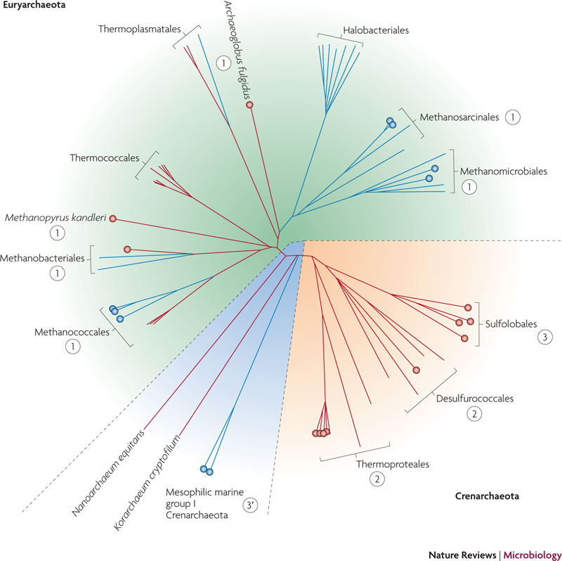
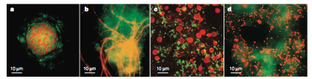
Berg et. al. 2010 Nature Reviews Microbiology, 8: 447
Schleper et. al. 2005 Nature Reviews Microbiology, 3: 479
ANME-2C
Euryarchaeota
Cenarchaeum symbiosum
Euryarchaeon SM1
Crenarchaeota
1-reductive acetyl-CoA pathway 2-dicarboxylate-hydroxybutyrate cycle
3-hydroxypropionate-hydroxybutyrate cycle 3’-modified hydroxypropionate- hydroxybutyrate cycle
Notes:
Chapter 13 – C1 Metabolism

Slide 30
Calvin Cycle
Most common CO₂ fixation pathway
Operates in plants, algae, cyanobacteria, Proteobacteria, mycobacteria etc
Often refer to as ‘Dark Cycle’
  Light-independent (misleading; enzymes are activated by light)
Other names
  Reductive Pentose Phosphate Cycle
Requires NADPH and ATP as energy source from photosynthesis
Key enzymes - ribulose bisphosphate carboxylase (RuBisCO) and phosphoribulokinase
Notes:
Chapter 13 – C1 Metabolism
Section 13.1.1 – The Calvin Cycle (pp. 359-364)

Slide 31
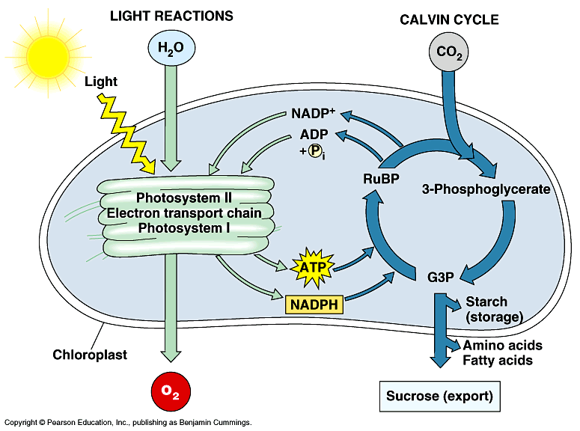
Calvin Cycle
Light-dependent Light-independent
From: tutorvista.com

Slide 32
Calvin Cycle Energetics
CO₂ (oxidation state = +4) reduced to cellular carbon with oxidation state = 0 (average)
Very energetically unfavorable reaction
Must be coupled with ATP hydrolysis
Reduction driven by low-potential reduced coenzymes (NADPH)
In | Out
3 CO₂ | 1 Glyceraldehyde 3-phosphate
9 ATP | 9 ADP
7 NADPH | 6 NADP⁺
Notes:
Chapter 13 – C1 Metabolism
Section 13.1.1 – The Calvin Cycle (pp. 359-364)

Slide 33









Calvin cycle diagram
12 3-phospho-glycerate (36 carbons)
12 1,3-bisphospho-glycerate (36 carbons)
6 ribulose 1,5-phosphate (30 carbons)
6CO₂+12NAD(P)H+18ATP C₆H₁₂O₆(PO₃H₂)+12NADP⁺+18ADP+17P_{i}
12 glyceraldehyde 3-phosphate (36 carbons)
6 ribulose 5-phosphate (30 carbons)
10 glyceraldehyde 3-phosphate (30 carbons)
+
1 fructose 1,6-bisphosphate (6 carbons)
Biosynthesis
1 fructose 6-bisphosphate (6 carbons)
Notes:
Chapter 13 – C1 Metabolism
Section 13.1.1 – The Calvin Cycle (pp. 359-364)

Slide 34
Unique steps
1. Carboxylation
Ribulose Bisphosphate Carboxylase
(RubisCO)
+ CO₂
ribulose 1,5-phosphate (5 carbons)
2 3-phospho-glycerate (6 carbons)
2. Reduction
Glyceraldehyde-3-pohosphate Dehydrogenase
2 1,3-bisphospho-glycerate (6 carbons)
NAD(P)H NAD(P)⁺
2 glyceraldehyde 3-phosphate (6 carbons)
3. Regeneration
Phosphoribulokinase
ribulose 5-phosphate (5 carbons)
ATP ADP
ribulose 1,5-phosphate (5 carbons)
Notes:
Chapter 13 – C1 Metabolism
Section 13.1.1 – The Calvin Cycle (pp. 359-364)

Slide 35
Calvin Cycle Location (Carboxysomes)
In Eukaryotes – membrane-bound organelles increase level of organization within a cell
Proteinaceous microcompartment has similar function as organelle
  Sequesters specific enzymes from a metabolic pathway
Advantages: increase pathway efficiency, control, and specificity
Carboxysomes - microcompartments in cyanobacteria and some chemoautotrophs

Slide 36

Carboxysomes
Polyhedral in shape
Surrounded by proteinaceous envelope
Contains Calvin Cycle enzymes such as RuBisCO
Two types of RuBisCO:
    α – in α-cyanobacteria with type 1A RuBisCO, genes in a single operon
    β – in β-cyanobacteria with type 1B RuBisCO, genes arranged in multiple gene cluster
Transmission Electron Micrograph
100 nm
Halothiobacillus neapolianus
Purified carboxysomes (α type)
Purified carboxysomes (β type)
Other microcompartment (pdu)
Yeates et. al. Nature Reviews. Microbiology 2008. 6: 681

Slide 37
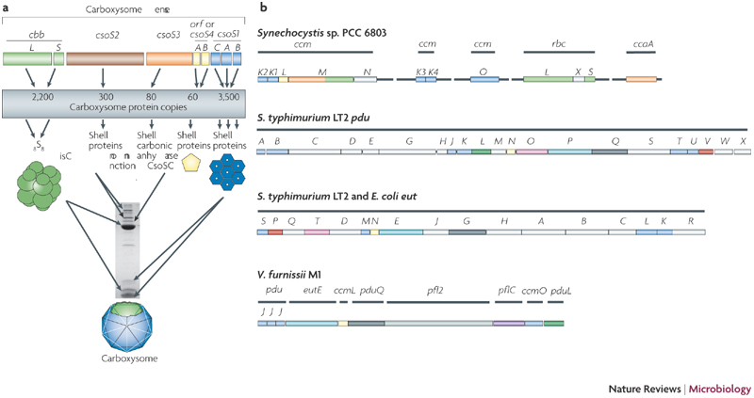
α Carboxysomes
Example from Halothiobacillus neapolitanus
ccb L & S – RuBisCO
csoS3 – carboxysome shell carbonic anhydrase CsoSCA
csoS2, scoS4, csoS1 – shell proteins
Colocalization of RuBisCO and carbonic anhydrase:
  Increasing CO₂-fixing efficiencies
  Mitigate CO₂ loss from the carboxysome
Yeates et. al. Nature Reviews. Microbiology 2008. 6: 681

Slide 38
β Carboxysome
RubisCO
Carbonic Anhydrase
Yeates et. al. Nature Reviews. Microbiology 2008. 6: 681

Slide 39
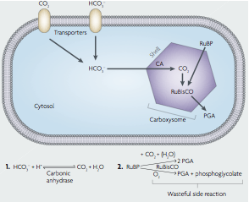
Carbon Concentration Mechanism (CCM)
CCM is a 2-step process
  Transporters concentrate bicarbonates inside the cell
  Carboxysome enhances CO₂ fixation by co-localizing RuBisCO and carbonic anhydrase (CA) inside the shell
Yeates et. al. Nature Reviews. Microbiology 2008. 6: 681

Slide 40
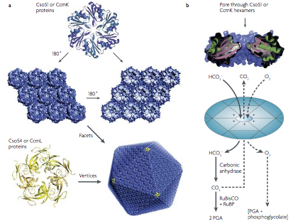
Crystal Structures of Carboxysome Shell Proteins
Both sides have different geometric and chemical properties
RuBP & PGA
* Also negatively changed
Positive electrostatic potential surrounds the narrow pore created by charged amino acid residues
Yeates et. al. Nature Reviews. Microbiology 2008. 6: 681

Slide 41
Carbonic Anhydrase
Ubiquitous in nature
Catalyzes
CO_{2(aq)} + H₂O HCO₃⁻ + H⁺
Functions to hydrate CO₂
CO₂ - important in living systems
  Product of aerobic respiration and reactant for photosynthesis
CO₂ solubility in water = extremely low
Carbonic anhydrase converts CO₂ into more soluble ion HCO₃⁻

Slide 42
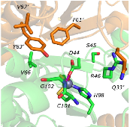
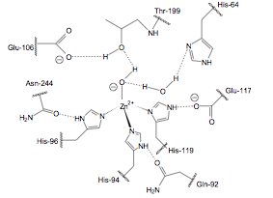
Carbonic Anhydrase Active Site
Enzyme active site is half hydrophobic and half hydrophilic (accommodates both CO₂-hydrophobic and HCO₃—hydrophilic)
Zinc cofactor is coordinated by group of 3 histidines
Rowlett 2010 Biochimica et Biophysica 1804: 362

Slide 43
Carbonic Anhydrase Active Site - Continued
Cofactor Zn(II) coordinated with water has pKa of 7
Hydrophilic side of active site
  Water molecule enters and facilitates the proton transfer
Hydrophobic side pre-orients the CO₂ substrate
A hydrogen bond network will reach substrate CO₂
Rowlett 2010 Biochimica et Biophysica 1804: 362

Slide 44
Carbon fixation 1 - overview
Calvin Cycle – most common CO₂ fixation pathway
Calvin Cycle – energetically unfavorable
  Must be coupled with ATP hydrolysis
Location = carboxysomes
Carboxysomes – colocalization of RuBisCO and other important Calvin Cycle enzymes
Carbonic anhydrase – ubiquitous
  Converts CO₂ to bicarbonate
Carbonic anhydrase active site coordinates CO₂ molecule (Zn cofactor)

Slide 45
Metabolism – Carbon fixation 2
Anthony J. Sinskey, Sc.D.
September 28, 2011
Lecture 6-2

Slide 46
Outline
Carbon fixation pathways other than the “Calvin Cycle”
  Reductive citric acid cycle
    Key steps
  Reductive acetyl-CoA pathway
    Key steps
    CO dehydrogenase (CODH)
  3-hydroxypropionate cycle
    Key steps
  Hydroxypropionate-hydroxybutyrate cycle
    Key steps
  Dicarboxylate-hydroxybutyrate cycle
    Key steps

Slide 47
Reductive Citric Acid Cycle
The TCA cycle - acetyl-CoA broken down
  With release of 2CO₂ and energy
Reductive TCA cycle - acetyl CoA is synthesized
  Incorporation of 2 CO₂ and energy
Share the same enzymes as in the TCA cycle
  With exception of three steps
Found in green sulphur bacteria, Proteobacteria, and microaerophilic bacteria
Enzymes are O₂ sensitive
Only active in anaerobes or aerobes in low oxygen tension environment
Less energy-consuming than the Calvin cycle
Notes:
Chapter 13 – C1 Metabolism
Section 13.1.9 – The reductive tricarboxylic acid cycle (pp. 372-375)

Slide 48












Reverse Citric Acid Cycle
2H
Ferredoxin_{red}
pyruvate
oxalacetate
acetyl-CoA
malate
2H
fumarate
phosphoenolpyruvate
citrate
3CO₂+12H+5ATP triose-phosphate
succinate
triose-phosphate
aconitate
succinyl CoA
2H
Biosynthesis
Ferredoxin_{red}
α-ketoglutarate
isocitrate
Notes:
Chapter 13 – C1 Metabolism
Section 13.1.9 – The reductive tricarboxylic acid cycle (pp. 372-375)

Slide 49
Reductive TCA Cycle Key Steps
Fumarate Reductase
fumarate
succinate
2-oxoglutarate:ferredoxin Oxidoreductase
Ferredoxin_{red}
Ferredoxin_{ox}
succinyl CoA
α-ketoglutarate
ATP Citrate Lyase
ATP
ADP
citrate
acetyl-CoA
oxalacetate
Notes:
Chapter 13 – C1 Metabolism
Section 13.1.9 – The reductive tricarboxylic acid cycle (pp. 372-375)

Slide 50
Reductive Acetyl-CoA Pathway
Non-cyclic pathway
Found in Gram-positive bacteria, methane-forming archaea, Proteobacteria, Planctomycetes, spirochaetes and Euryarchaeota
Most energetically favorable CO₂ fixation
Restricted to strictly anaerobic organisms
Notes:
Chapter 13 – C1 Metabolism
Section 13.1.2 – The acetyl-CoA pathway (pp. 364-365)

Slide 51

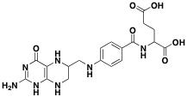
Reductive Acetyl-CoA Pathway (simplified view)
formic acid
T-tetrahydrofolate
Biosynthesis
acetyl-CoA
1 CO₂ – reduced to CO (bound to nickel atom via CO dehydrogenase)
1 CO₂ – reduced to methyl group (bound to tetrahydropterin carrier)
Methyl-transferring corrinoid protein acts as methyl transferase - combines methyl group with CoA and CO to yield acetyl-CoA
Notes:
Chapter 13 – C1 Metabolism
Section 13.1.2 – The acetyl-CoA pathway (pp. 364-365)

Slide 52
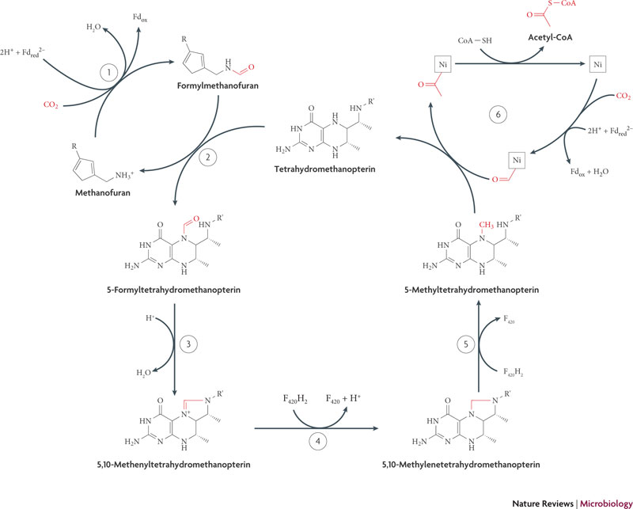
Reductive Acetyl-CoA Pathway
Enzyme list:
1-formalmethanolfuran
dehydrogenase
2-formylmethanofuran:
Tetrahydromethanopterin
formyltransferase
3-methenyl-
tetrahydromethanopterin
cyclohydrolase
4-methylene-tetrahydrom
ethanopterin dehydrogenase
5-methylene-tetrahydromethanopterin
reductase
6-CO dehydrogenase-
acetyl-CoA-synthase
Berg et al 2010 (8) Nature Reviews Microbiology 447-460
Notes:
Chapter 13 – C1 Metabolism
Section 13.1.2 – The acetyl-CoA pathway (pp. 364-365)
Two CO2 molecules are reduced. One is reduced to CO bound to a Ni atom in the active center of CO dehydrogenase. The other to a methyl group bound to the carrier tetrahydropterin.
Then a methyl-transferring corrinoid protein functions in methyl transfer, and acetyl-enzyme A is synthesized from CO and the methyl group.

Slide 53
Reductive Acetyl-CoA Key Step
acetyl-CoA
CO Dehydrogenase-acetyl-CoA Synthase
Notes:
Chapter 13 – C1 Metabolism
Section 13.1.2 – The acetyl-CoA pathway (pp. 364-365)
Carbon monoxide dehydrogenase (pp. 366-367)

Slide 54
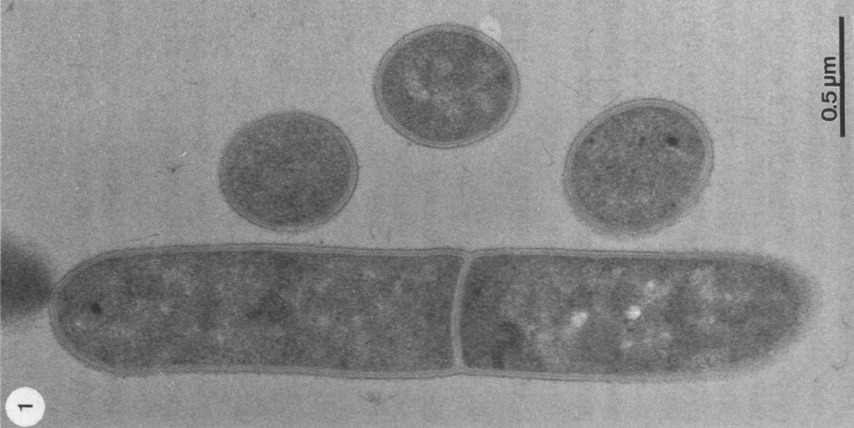
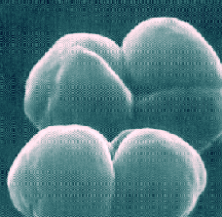
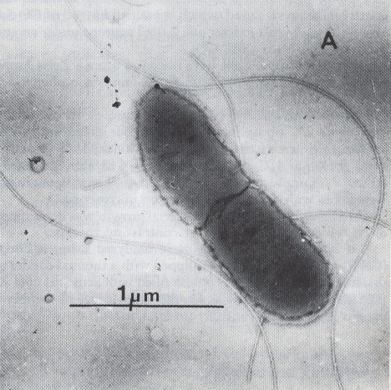
CODH and utilization of H₂/CO₂ and CO
Carboxydothermus hydrogenoformans
Moorella thermoacetica
CO + H₂O CO₂ + H₂
4 H₂ + 2 CO₂ CH₃COOH + 2 H₂O
Strict anaerobe, volcanic hot springs in Russia
Highly active CO metabolism, k_{cat} = 40,000 s⁻¹
Doubling time, exclusively on CO: 2 hrs.
Temperature range 40-80 ºC, optimum 70 ºC
Model acetogenic bacterium
Strict anaerobe
soils, oceans, lakes, GI tract of animals
Temperature optimum 55 ºC
Methanosarcina barkeri
CO₂ + 4 H₂ CH₄ + 2 H₂O
CH₃COOH CH₄ + CO₂
Model methanogenic archaea
Uses two main CH₄-evolving routes
Strict anaerobe
Lives in mud, bogs, sewage, cattle rumen
Yan Kung, Drennan Laboratory, MIT, HHMI
Notes:
Chapter 13 – C1 Metabolism
Section 13.1.2 – The acetyl-CoA pathway (pp. 364-365)
Carbon monoxide dehydrogenase (pp. 366-367)

Slide 55
CODH and carbon cycling
Energy (ATP)
+
acetate
biomass
~10¹¹ tons acetate produced per year
ΔG°′ = -95 kJ/mol
H₂
CO₂
acetyl-CoA
2H⁺,
2e⁻
CODH
CODH/ACS
ACDS Complex
CoA
CH₃
H₂O
~10⁹ tons of methane produced per year
ΔG°′ = -36 kJ/mol
methane
~10⁸ tons CO
removed per year
ΔG°′ = -20 kJ/mol
CO
Yan Kung, Drennan Laboratory, MIT, HHMI
Notes:
Chapter 13 – C1 Metabolism
Section 13.1.2 – The acetyl-CoA pathway (pp. 364-365)
Carbon monoxide dehydrogenase (pp. 366-367)

Slide 56
Reductive Acetyl-CoA Pathway
Lowest energetic cost CO₂ fixation pathway
  Less than 1 ATP per Acetyl-CoA made
High demand on metals, cofactors, anaerobiosis, and substrates with low reducing potential
Notes:
Chapter 13 – C1 Metabolism
Section 13.1.2 – The acetyl-CoA pathway (pp. 364-365)

Slide 57
3-Hydroxypropionate Cycle
Also referred to as 3-hydroxypropionate bicycle
  Assimilation of glyoxylate requires second cycle
Found in green non-sulphur bacteria (Chloroflexus) and archaea
Chloroflexus is the earliest branching anoxygenic phototroph on the tree of Bacteria
  Suggest the 3-hydroxypropionate cycle might be the first attempt at autotrophy in anoxygenic phototrophs

Slide 58








3-Hydroxypropionate Cycle
6H
CO₂
malonyl-CoA
glyoxylate
malonate semialdehyde
acetyl-CoA
3-hydroxypropionate
Biosynthesis
acrylyl-CoA
2CO₂+6H+3ATP glyoxylate
malyl-CoA
propionyl-CoA
malate
methylmalonyl-CoA
succinate
succinyl-CoA

Slide 59
3-Hydroxypropionate Cycle Key Steps
CO₂
Acetyl-CoA Carboxylase
acetyl-CoA
ATP
ADP
malonyl-CoA
CO₂
Propionyl-CoA Carboxylase
propionyl-CoA
ATP
ADP
methylmalonyl-CoA
Malyl-CoA Lyase
acetyl-CoA
glyoxylate
malyl-CoA

Slide 60
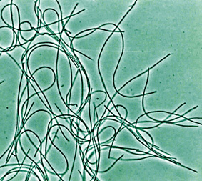
Chloroflexus aurantiacus
Thermophilic
Anoxygenic
Photoheterotrophic
Has properties of both purple bacteria (Pheo-quinone RC) and green sulfur bacteria (bacteriochlorophyll c)
Image taken from: genome.jgi-psf.org

Slide 61
Overview
2CO₂ + 6H⁺ + 3ATP → Glyoxylate
Glyoxylate then converted to pyruvate via a different cycle
Pyruvate = precursor to gluconeogenesis

Slide 62
Hydroxypropionate-Hydroxybutyrate Cycle
Shares common intermediates and carboxylation reactions as 3-hydroxypropionate cycle
  Enzymes are not homologs
  Evolved independently
Found in aerobic Crenarchaeota
  grow at harsh environments (pH 2, 60-90°C)
  facultative anaerobic and strictly anaerobic Sulfolobales
Enzymes are oxygen tolerant

Slide 63
Hydroxypropionate-Hydroxybutyrate Cycle
Acetyl-CoA formed from 2 molecules of bicarbonate
Key enzyme = acetyl-CoA-propionyl-CoA carboxylase
Acetyl-CoA carboxylase in Bacteria and Eukaryotes catalyses 1st step in fatty acid biosynthesis
  Archaea contain no fatty acids
Two parts to the Cycle:
  transformation of acetyl-CoA + 2 bicarbonate molecules to succinyl-CoA
  conversion of succinyl-CoA to 2 acetyl-CoA molecules
    1 used for biosynthesis
    1 as bicarbonate receptor
Berg et. al. 2010 Nature Reviews Microbiology, 8: 447

Slide 64











Hydroxypropionate-Hydroxybutyrate Cycle
HCO₃⁻
Methylmalonyl-CoA
Propionyl-CoA
Succinyl-CoA
Acryloyl-CoA
Succinic semialdehyde
3-hydroxypropionyl-CoA
4-hydroxybutyrate
Biosynthesis
3-hydroxypropionate
4-hydroxybutyryl-CoA
Acetyl-CoA
Malonate semialdehyde
Crotonyl-CoA
Malonyl-CoA
3-hydroxybutyryl-CoA
HCO₃⁻
Acetoacetyl-CoA
Acetyl-CoA

Slide 65

Hydroxypropionate-Hydroxybutyrate Cycle
Key Steps
HCO₃⁻
Acetyl-CoA-propionyl-CoA
Carboxylase
acetyl-CoA
ATP
ADP
malonyl-CoA
HCO₃⁻
Acetyl-CoA-propionyl-CoA
Carboxylase
propionyl-CoA
ATP
ADP
methylmalonyl-CoA

Slide 66
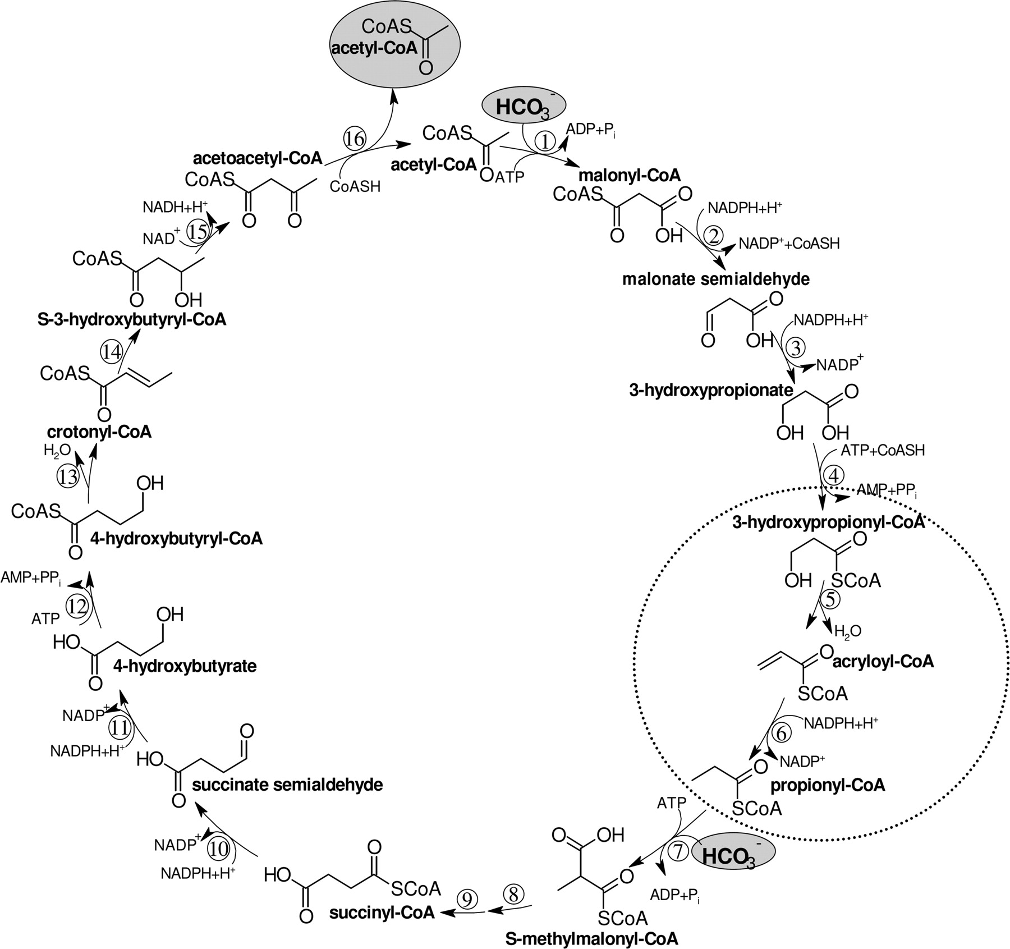
Hydroxypropionate-hydroxybutyrate Cycle vs. Hydroxypropionate Cycle
Hydroxypropionate-hydroxybutyrate cycle uses 3 enzymes to convert from 3-hydroxypropionate to propionyl-CoA:
  3-hydroxypropionyl-CoA synthetase
  3-hydroxypropionl-CoA dehydratase
  Acryloyl-CoA reductase
Hydroxypropionate cycle uses only 1 enzyme, propinyl-CoA synthetase, which can catalyze all of these reactions
Teufel, R. et al. 2009. J. Bacteriol. 191(14):4572-4581

Slide 67
Dicarboxylate-hydroxybutyrate Cycle
Found in anaerobic or microaerobic autotrophic members of the Crenarchaeal orders
  Thermoproteales and Desulfurococcales
Key enzyme 4-hydroxybutyryl-CoA dehydratase
  Contains 4Fe-4S centre
Enzymes such as pyruvate synthase and electron carriers (ex: ferredoxin) are oxygen sensitive
  Thus, this cycle is anaerobic

Slide 68
Dicarboxylate-hydroxybutyrate Cycle
Two Parts:
  acetyl-CoA, CO₂, and bicarbonate are made into succinyl-CoA
  succinyl-CoA is converted into 2 molecules of acetyl-CoA
    1 used in biosynthesis
    1 used to regenerate the succinyl-CoA
Pyruvate synthase (pyruvate:ferredoxin oxidoreductase) is oxygen-sensitive
4-hydroxybutyryl-CoA dehydratase contains a 4Fe-4S centre and FAD
  Reaction catalyzed by a ketyl radical mechanism

Slide 69

Dicarboxylate-hydroxybutyrate Cycle
Succinyl-CoA
Succinate
Fumarate
Succinic semialdehyde
Malate
4-hydroxybutyrate
Biosynthesis
Oxaloacetate
4-hydroxybutyryl-CoA
HCO₃⁻
Acetyl-CoA
PEP
Crotonyl-CoA
3-hydroxybutyryl-CoA
Pyruvate
CO₂
Acetoacetyl-CoA
Acetyl-CoA

Slide 70

Dicarboxylate-hydroxybutyrate Cycle Key Steps
CO₂
Pyruvate Synthase
acetyl-CoA
Fd_{red}²⁻
Fd_{ox}
pyruvate
PEP Carboxylase
phosphoenolpyruvate (PEP)
HCO₃⁻
Pi
oxalacetate
4-Hydroxybutyryl-CoA Dehydratase
4-hydroxybutyryl-CoA
H₂O
crotonyl-CoA

Slide 71
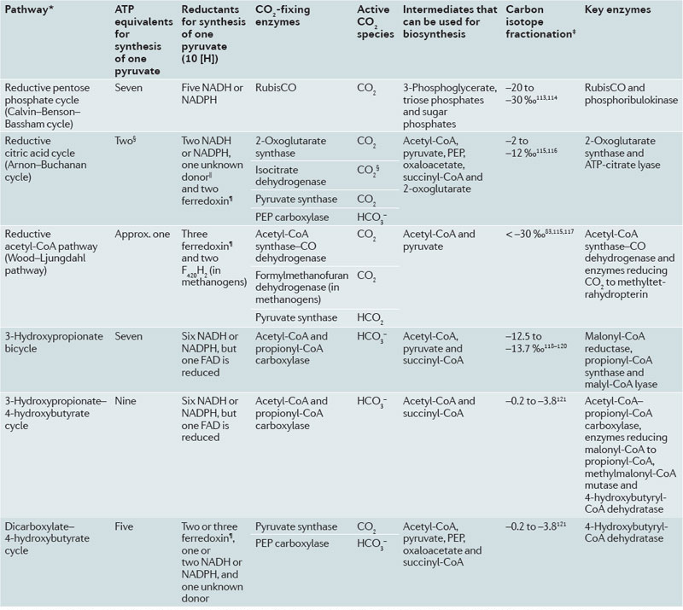
Autotrophic CO₂ Fixation Summary
Berg et. al. 2010 Nature Reviews Microbiology, 8: 447

Slide 72
Gluconeogenesis from Acetyl-CoA
Biosynthesis from (C2) acetyl-CoA to any C6 compound goes through formation of pyruvate and PEP
Gluconeogenesis starts with PEP
Bifunctional fructose 1,6-bisphosphate (FBP) aldolase-phosphatase replaces reactions of the FBP aldolases and FBP phosphatase

Slide 73
Carbon fixation summary
Six CO₂ fixation pathways
  Calvin cycle
  Reductive TCA cycle
  Reductive acetyl-CoA pathway
  3-hydroxypropionate cycle
  3-Hydroxypropionate-4-hydroxybutyrate cycle
  Dicarboxylate-4-hydroxybutyrate cycle
Acetyl-CoA is one of the most important molecules in the cell
  Produced from all autotrophic pathways
  For each CO₂ fixation cycle there are 1-3 key steps
    All involve acetyl-CoA

