Slide 1
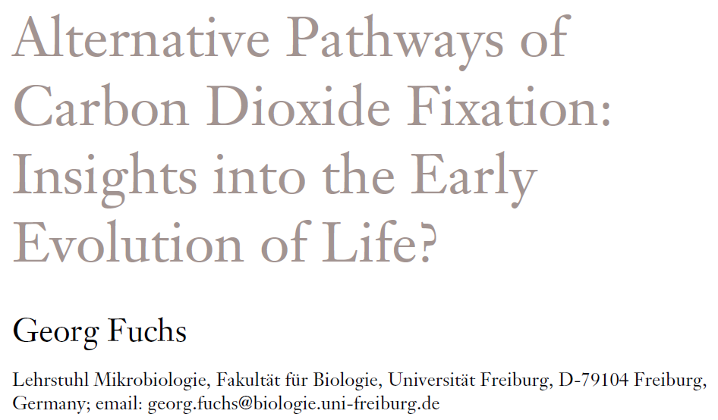

October 28th, 2011
Journal Club
Jingnan Lu

Slide 2
Autotrophic Pathways
Calvin-Benson-Bassham Cycle
Reductive Acetyl-CoA Pathway
Reductive Citric Acid Cycle
4-Hydroxybutyrate Cycle
3-Hydroxypropionate/4-hydroxybutyrate Cycle
3-Hydroxypropionate Bi-Cycle

Slide 3
Autotrophic Pathways
Calvin-Benson-Bassham Cycle
Reductive Acetyl-CoA Pathway
Reductive Citric Acid Cycle
4-Hydroxybutyrate Cycle
3-Hydroxypropionate/4-hydroxybutyrate Cycle
3-Hydroxypropionate Bi-Cycle

Slide 4
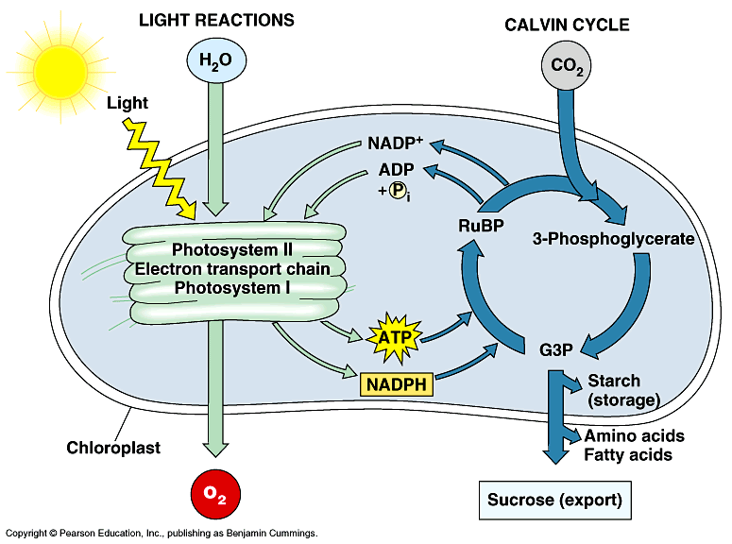
Calvin-Benson-Bassham Cycle
Also referred to as Reductive Pentose Phosphate Cycle
Most common CO₂ fixation pathway
Operates in plants, algae, cyanobacteria, Proteobacteria, mycobacteria etc.
Requires NADPH and ATP as energy source from photosynthesis or other source
Light-dependent Light-independent

Slide 5
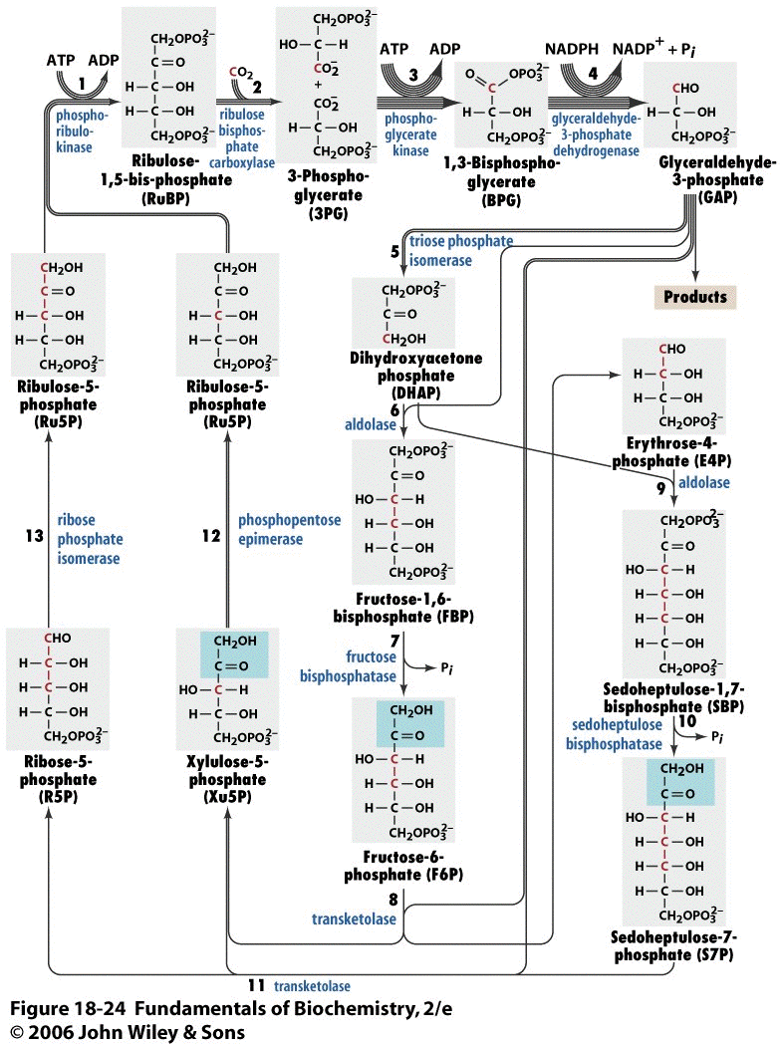
Calvin-Benson-Bassham Cycle
6CO₂+12NADPH+18ATP C₆H₁₂O₆(PO₃H₂)+12NADP⁺+18ADP+17P_{i}
Key enzyme:
Ribulose bisphosphate carboxylase oxygenase (RuBisCO)
Considered to be the most abundant protein on Earth
Also very inefficient, substrates CO₂ to O₂ ratio is 4:1
Mg(II) involved to activate the CO₂
Rate-controlling step in Calvin-Benson Cycle
Biotechnological interest:
  increase catalytic activity
  decrease oxygenation activity

Slide 6








CBB Cycle in Archaebacteria?
12 3-phospho-glycerate (36 C)
12 1,3-bisphospho-glycerate (36 C)
12 NADPH
6 ribulose 1,5-bisphosphate (30 C)
RuBisCo Type III gene found in Archaebacteria
Active RuBisCo
no operative Calvin-Benson Cycle
no ribulose 1,5 bisphosphate regeneration gene
role in O₂ detoxification
role in consumption of excess reducing equivalents
12 glyceraldehyde 3-phosphate (36 C)
6 ribulose 5-phosphate (30 carbons)
+
10 glyceraldehyde 3-phosphate (30 C)
1 fructose 1,6-bisphosphate (6 C)
Biosynthesis
1 fructose 6-bisphosphate (6 C)

Slide 7
Autotrophic Pathways
Calvin-Benson-Bassham Cycle
Reductive Acetyl-CoA Pathway
Reductive Citric Acid Cycle
4-Hydroxybutyrate Cycle
3-Hydroxypropionate/4-hydroxybutyrate Cycle
3-Hydroxypropionate Bi-Cycle

Slide 8
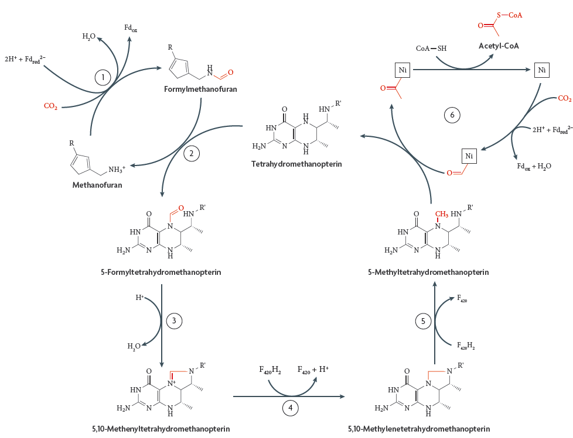
Reductive Acetyl-CoA Pathway
2CO₂ + 4H₂ + CoASH CH₃CO-SCoA + 3H₂O
Wood-Lungdahl Pathway used by acetogenic, Eubacteria and methanogenic Euryarchaeota
Simultaneously fix CO₂ and generate ATP by converting acetyl-CoA to acetate
1 CO₂ reduced to CO (bound to nickel atom via CO dehydrogenase)
1 CO₂ reduced to methyl group (bound to tetrahydropterin carrier)
CO dehydrogenase/acetyl-CoA synthase bifunctional enzyme combines methyl group with CoA and CO to yield acetyl-CoA

Slide 9
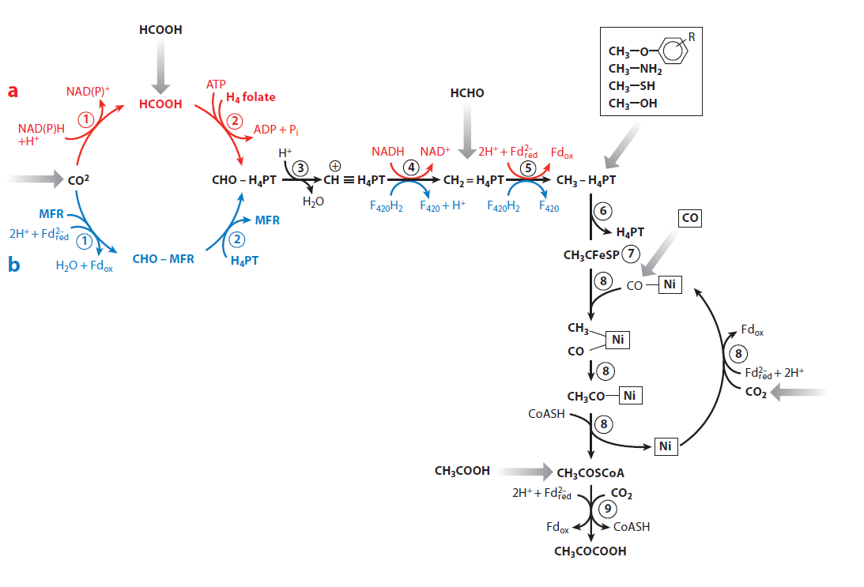
Reductive Acetyl-CoA Pathway
Moorella thermoacetica (red)
Methanothermobacter marburgensis (blue)
Formate dehydrogenase/formyl-methanofuran dehydrogenase
10-formyl-H₄ folate synthetase/formyl transferase
Cyclohydrolase
Dehydrogenase
Reductase
Methyl-H₄ folate:corrinoid iron-sulfur protein methyltransferase
Corrinoid iron-sulfur protein
CO dehydrogenase/acetyl-CoA synthase
Pyruvate synthase
Lowest energetic cost CO₂ fixation pathway:
  1 ATP per Acetyl-CoA made
High demand on metals, cofactors, anaerobiosis, and substrates with low reducing potential

Slide 10
Autotrophic Pathways
Calvin-Benson-Bassham Cycle
Reductive Acetyl-CoA Pathway
Reductive Citric Acid Cycle
4-Hydroxybutyrate Cycle
3-Hydroxypropionate/4-hydroxybutyrate Cycle
3-Hydroxypropionate Bi-Cycle

Slide 11

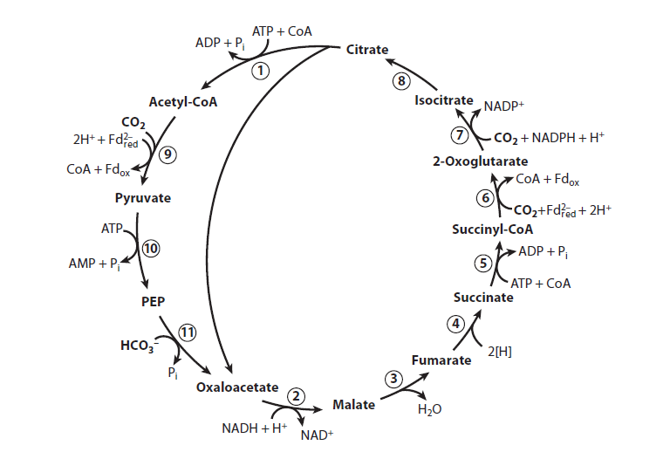










Reductive Citric Acid Cycle
Malate dehydrogenase
Fumarate hydrtase
Fumarate reductase (succinate dehydrogenase)
Succinyl-CoA synthetase
Oxoglutarate synthase (oxogluatarate dehydrogenase)
Isocitrate dehydrogenase
Aconitase
Citryl-CoA synthetase
Citryl-CoA lyase (citrate synthase)
Pyruvate synthase
PEP synthetase

Slide 12
Reductive Citric Acid Cycle
Two-component isocitrate dehydrogenase system (7) that favors isocitrate formation
Isocitrate dehydrogenase: ATP/biotin-dependent oxoglutarate carboxylase
Keeping the ferredoxins in the reduced form is fairly challenging
ΔG⁰’= +27 kJ
ΔG⁰’= +19 kJ
ΔG⁰’= +8 kJ

Slide 13
Autotrophic Pathways
Calvin-Benson-Bassham Cycle
Reductive Acetyl-CoA Pathway
Reductive Citric Acid Cycle
4-Hydroxybutyrate Cycle
3-Hydroxypropionate/4-hydroxybutyrate Cycle
3-Hydroxypropionate Bi-Cycle

Slide 14
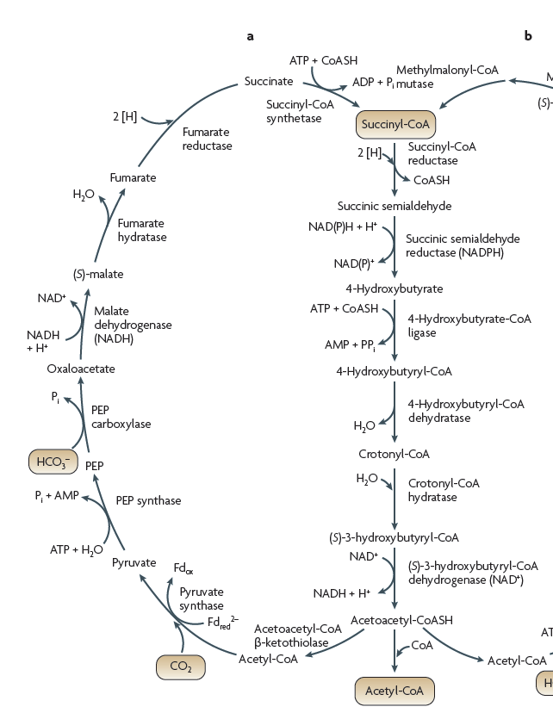







4-Hydroxybutyrate (Dicarboxylate) Cycle
of Thermoproteales and Desulfurococcales
Shared Intermediates and Enzymes with the Reductive TCA Cycle
Shared Intermediates and Enzymes with the 3-hydroxypropionate/4-hydroxybutyrate Cycle
4-hydroxybutyryl-CoA dehydratase
[4Fe-4S] cluster, FAD-containing dehydratase
ketyl radical mechanism
β-oxidation

Slide 15
Autotrophic Pathways
Calvin-Benson-Bassham Cycle
Reductive Acetyl-CoA Pathway
Reductive Citric Acid Cycle
4-Hydroxybutyrate Cycle
3-Hydroxypropionate/4-hydroxybutyrate Cycle
3-Hydroxypropionate Bi-Cycle

Slide 16
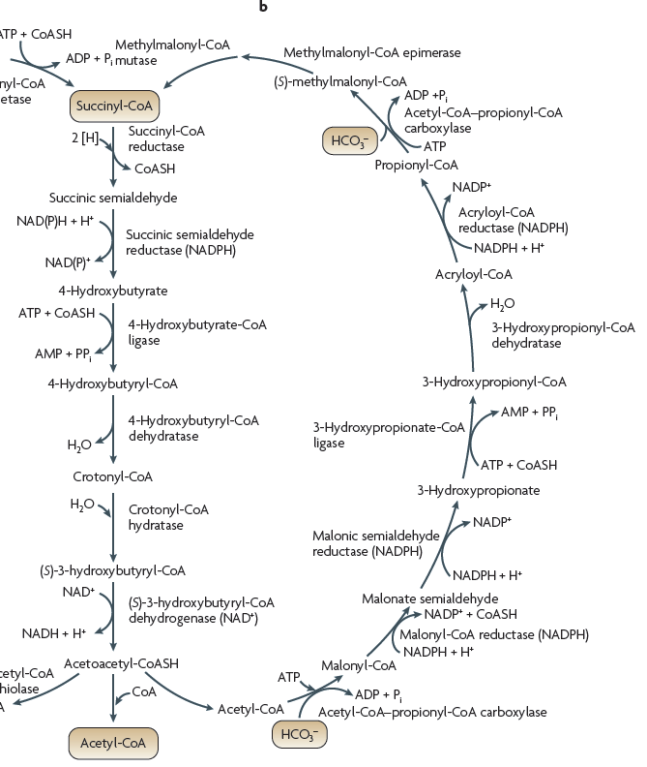







3-Hydroxypropionate/4-hydroxybutyrate Cycle
of Sulfolobales and Stygiolobus
Shared Intermediates and Enzymes with the 3-hydroxypropionate/4-hydroxybutyrate Cycle

Slide 17
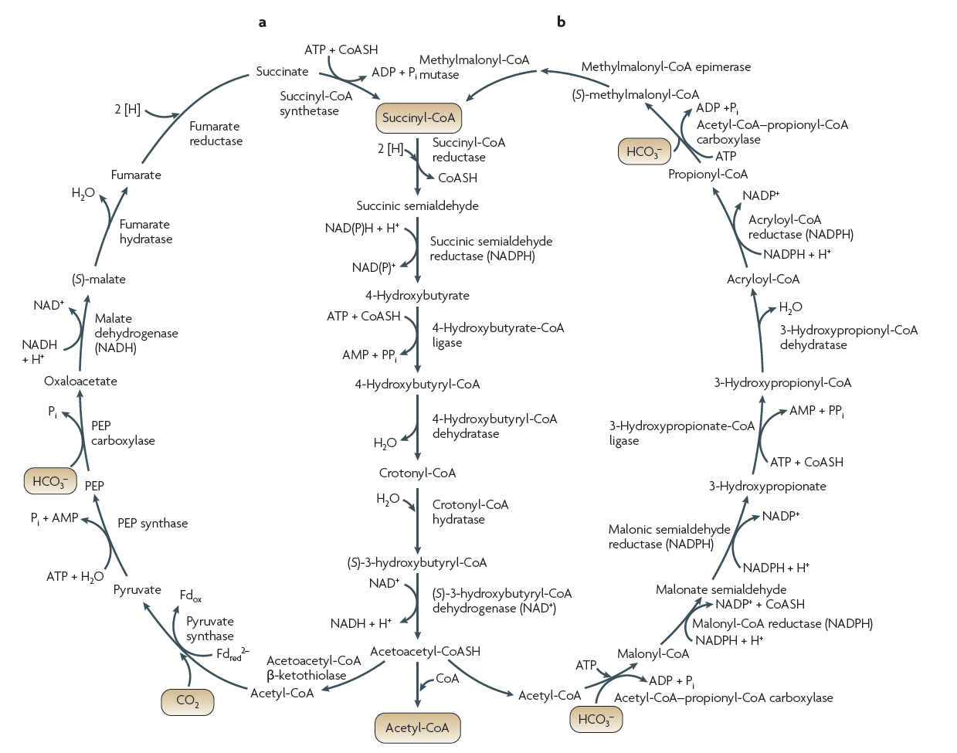
a: 4-Hydroxybutyrate Cycle
b: 3-Hydroxypropionate/4-Hydroxybutyrate Cycle

Slide 18
Autotrophic Pathways
Calvin-Benson-Bassham Cycle
Reductive Acetyl-CoA Pathway
Reductive Citric Acid Cycle
4-Hydroxybutyrate Cycle
3-Hydroxypropionate/4-hydroxybutyrate Cycle
3-Hydroxypropionate Bi-Cycle

Slide 19
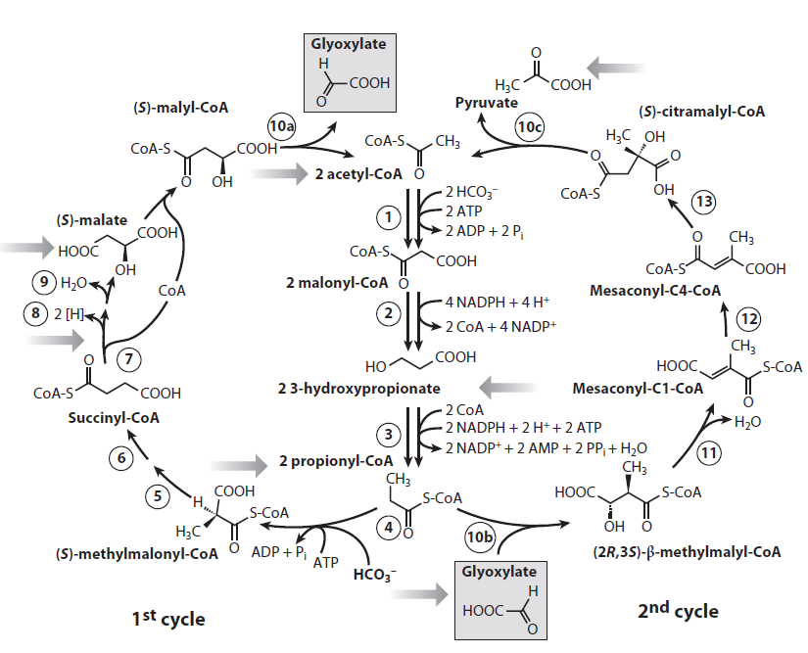
3-Hydroxypropionate Bi-Cycle
of Chloroflexus and Chloroflexi
Acetyl-CoA carboxylase
Malonyl-CoA reductase
Propionyl-CoA synthase
Propionyl-CoA carboxylase
Methylmalonyl-CoA epimerase
Methylmalonyl-CoA mutase
Succinyl-CoA transferase
Succinate dehydrogenase
Fumarate hydratase
10a.Malyl-CoA lyase
10b.Methylmalyl-CoA lyase
11. Mesaconyl-CoA hydratase
12. Mesaconyl-CoA transferase
13. Mesaconyl hydratase
10c.Citramalyl-CoA lyase

Slide 20
3-Hydroxypropionate Bi-Cycle
Identical to the steps in 3-hydroxypropionate/4-hydroxybutyrate cycle
Common in many organisms for the synthesis of succinyl-CoA

Slide 21
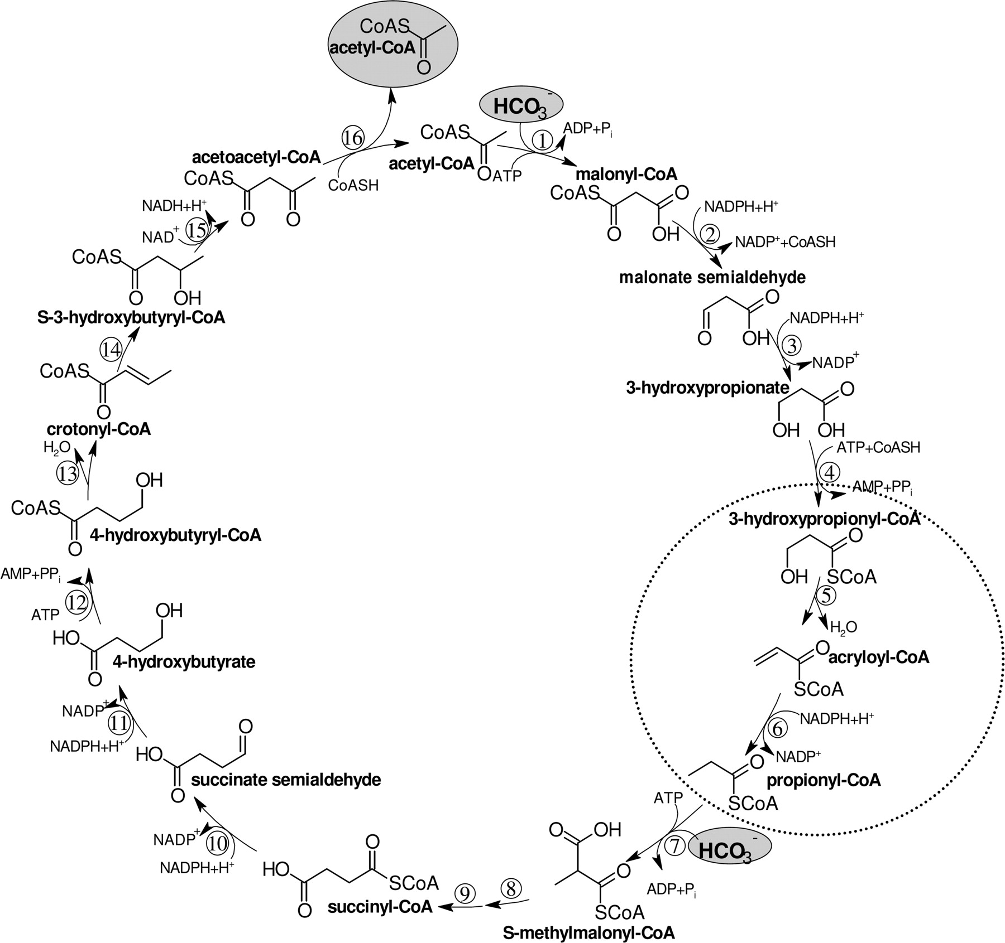
3-Hydroxypropionate/4-hydroxybutyrate Cycle (HPHB) vs. 3-Hydroxypropionate Bi-Cycle (HP)
HPHB cycle uses 3 enzymes to convert from 3-hydroxypropionate to S-methylmalonyl-CoA:
  3-hydroxypropionyl-CoA synthetase
  3-hydroxypropionl-CoA dehydratase
  Acryloyl-CoA reductase
HP cycle uses only 1 enzyme, propinyl-CoA synthetase, which can catalyze all of these reactions for the generation of S-methylmalonyl-CoA
Teufel, R. et al. 2009. J. Bacteriol. 191(14):4572-4581

Slide 22
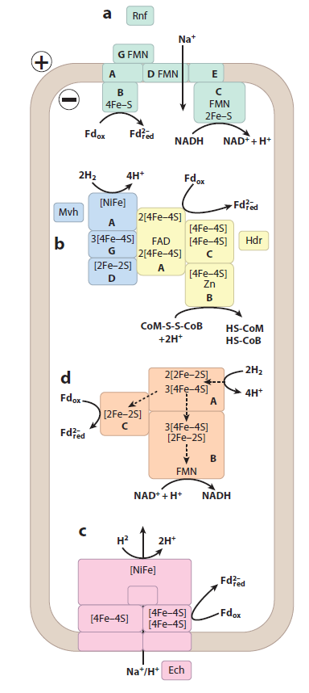
Reduction of Ferredoxin
a: Ferredoxin reduction by NADH via Rnf (Rhodobacter nitrogen fixation) complex:
ferredoxin: NAD+ oxidoreductase
coupled with the electrogenic transduction of Na+ ions across the membrane
b: Ferredoxin reduction by H₂ in methanogens via soluble [NiFe] hydrogenase
coupled with crotonyl-CoA reduction to butyryl-CoA (electron bifurcation)
H₂ can be substituted with formate
d: Ferredoxin reduction by H₂ via soluble [Fe-Fe] hydrogenase
c: Ferredoxin reduction by H₂ via membrane-bound [NiFe] hydrogenase
coupled to translocation of proton or sodium ion to the outside

Slide 23
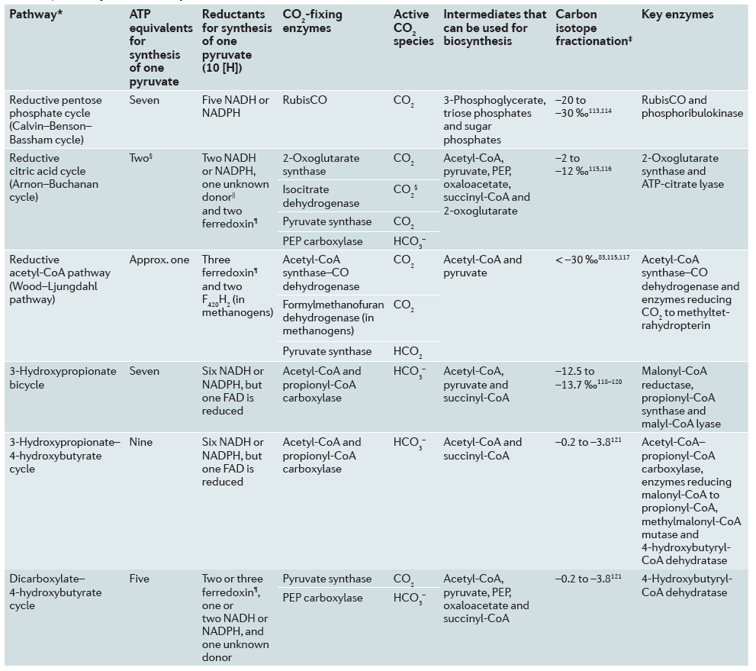
Summary

Slide 24
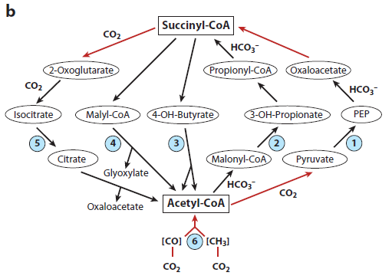
Final Remarks
Prokaryotes do not contain lignocellulose cell walls like plants, therefore no need to biosynthesize large amounts of sugar
Carbon fixation molecules direct fluxes to acetyl-CoA (29%), pyruvate (21%), oxaloacetate (13.5%), and 2-oxoglutarate (8.2%)
Apparent pKa [HCO₃⁻/CO₂] = 6.3
[CO₂] = 0.012 mM, [HCO₃⁻] = 0.26 mM in water
Autotrops may benefit from using bicarbonate instead of CO2

Slide 25
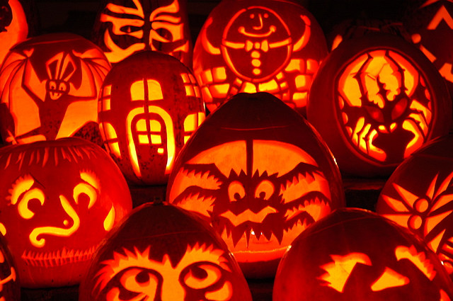
Thank You
&
Happy Early Halloween

