Slide 1
Service Portfolio:
Lessons Learned
Mary L. Pretz-Lawson
Planning & Project Management Office
Carnegie Mellon University
ACUTA April 30, 2012

Slide 2
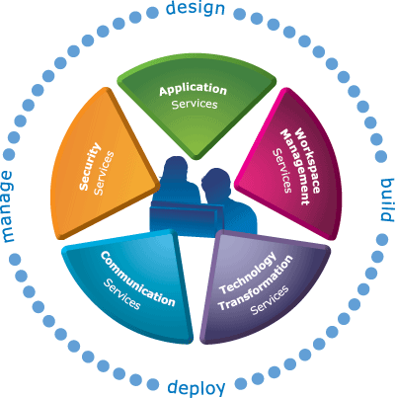
Goal is a Common Service Framework

Slide 3

Outline
Definitions
Service Portfolio “v1”
  History and Lessons Learned
Service Portfolio “v2”
  What’s different?
  Measuring Value
  Lessons Learned

Slide 4

Carnegie Mellon University
R1 Carnegie Class (>40% of budget from research)
Founded 1900 as a technical school; became Carnegie Mellon University in 1967
11,000 students; 5,000 staff
Computing Services = central IT
  200+ staff
  PMO with 3 project managers, 2 service management staff and 1 director

Slide 5
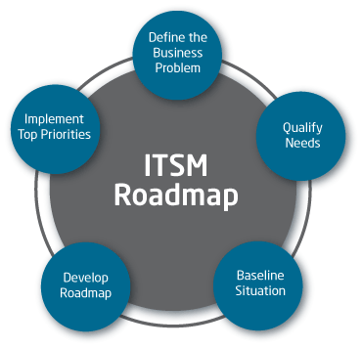

Definitions
ITSM (IT Service Management) is a way to manage IT systems centered on the customer rather than the technology.
ITIL (IT Infrastructure Library) is a set of good practices for ITSM that aligns IT services with business needs.

Slide 6
Definitions
Service Portfolio encompasses strategic lifecycle of all services managed by IT service provider.
  Example on Slide 2
Service Catalog provides single source of all operational services available to customers today.

Slide 7
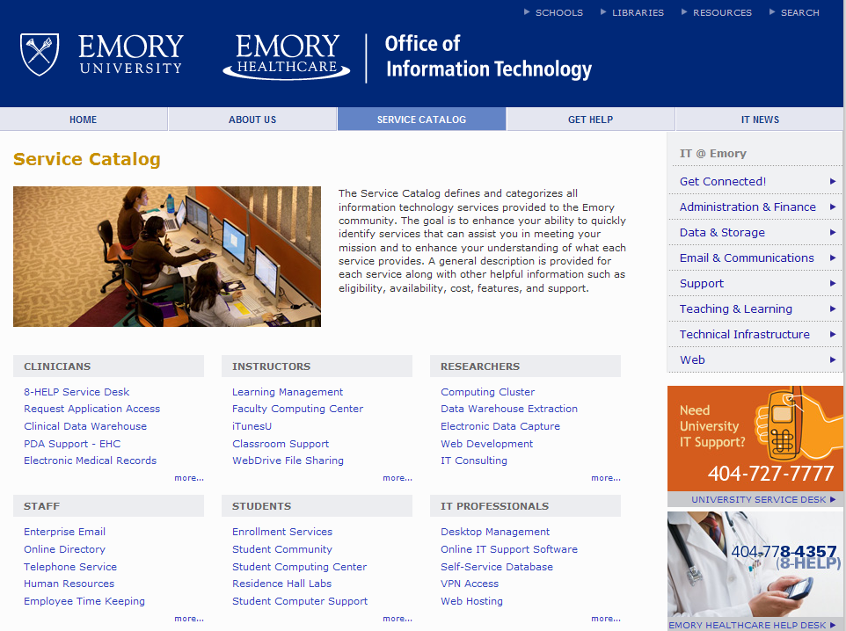

Slide 8
Service Portfolio “v1” Description
Built in 2007-2010
100 services, not aggregated into buckets
Tool was Excel, then Oracle with web front-end
Implemented by 2.5-3 FTEs from PMO
Zillions of interviews with service owners

Slide 9
Service Portfolio “v1” Lessons Learned
What Worked
What Didn’t Work
Comprehensive list of services
Informed Service/Help Center escalations
Defined service ownership
OLAs and role definition got the most traction
Insufficient value proposition
Tool was difficult to update
Not tied to division processes
Organizational ITSM immaturity
Overall low adoption rate

Slide 10
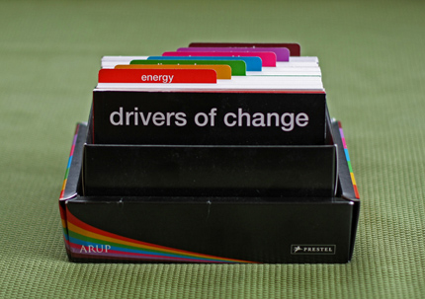
Drivers for Service Portfolio “v2”
Consistent service framework
Customer communications
challenges
IT budget negotiation tool
Pending CIO leadership transition
Parallel FootPrints service tracking project
Integrating services into central repository

Slide 11
What’s Different about “v2”?
Use cases documented, prioritized,
and selected
Governance with steering committee
More ITSM organizational maturity
Start with external customer value
Engaging consultant
Maintenance and data
renewal plan

Slide 12
Service Portfolio “v2” Use Cases
External Executive view of IT service value
Provide framework for FootPrints service tracking
Central IT process integration
IT Disaster Recovery
Operating Level Agreements/Service Level Agreements

Slide 13

How will we measure value?
Defined success criteria
Fewer one-off service lists
Anecdotal feedback from CIO and
project steering committee
Insert/grow additional use cases
Traffic and “organic maintenance” beyond pilot

Slide 14
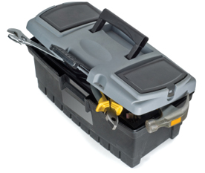
Service Portfolio Lessons Learned
Stakeholders and governance structure
Drivers and definitions clear
Scope control
User friendly tool
Don’t underestimate the
amount of work
Tie to existing work so it isn’t siloed

Slide 15



In Summary…
Solve a defined problem
Start somewhere
Consult with
peer institutions

Slide 16
Types of Services
External Customers
Business Services
Business Services
Business Services
Administrative Department
Academic Department
Academic Department
Customer Facing
IT Services
External Customer Facing
IT Service
Academic Department IT Team
Customer Facing
IT Services
Customer Facing
IT Services
Customer Facing
IT Services
Customer Facing
IT Services
IT Department
IT Team, e.g. Applications Team
Supporting Services
IT Team, e.g. Infrastructure Team

Slide 17
Service Portfolio vs Service Catalog
Business Executives
Business Management
Business Users
IT Executives
IT Management
Service Desk & Fulfillment Teams
Service Portfolio
Decide level of investment in each service
Service Catalog
Communication & expectation setting
What services are available?
What service level to expect?
How do I request it?
What does it cost?
Request Catalog
Channel for transactional requests

