Slide 1

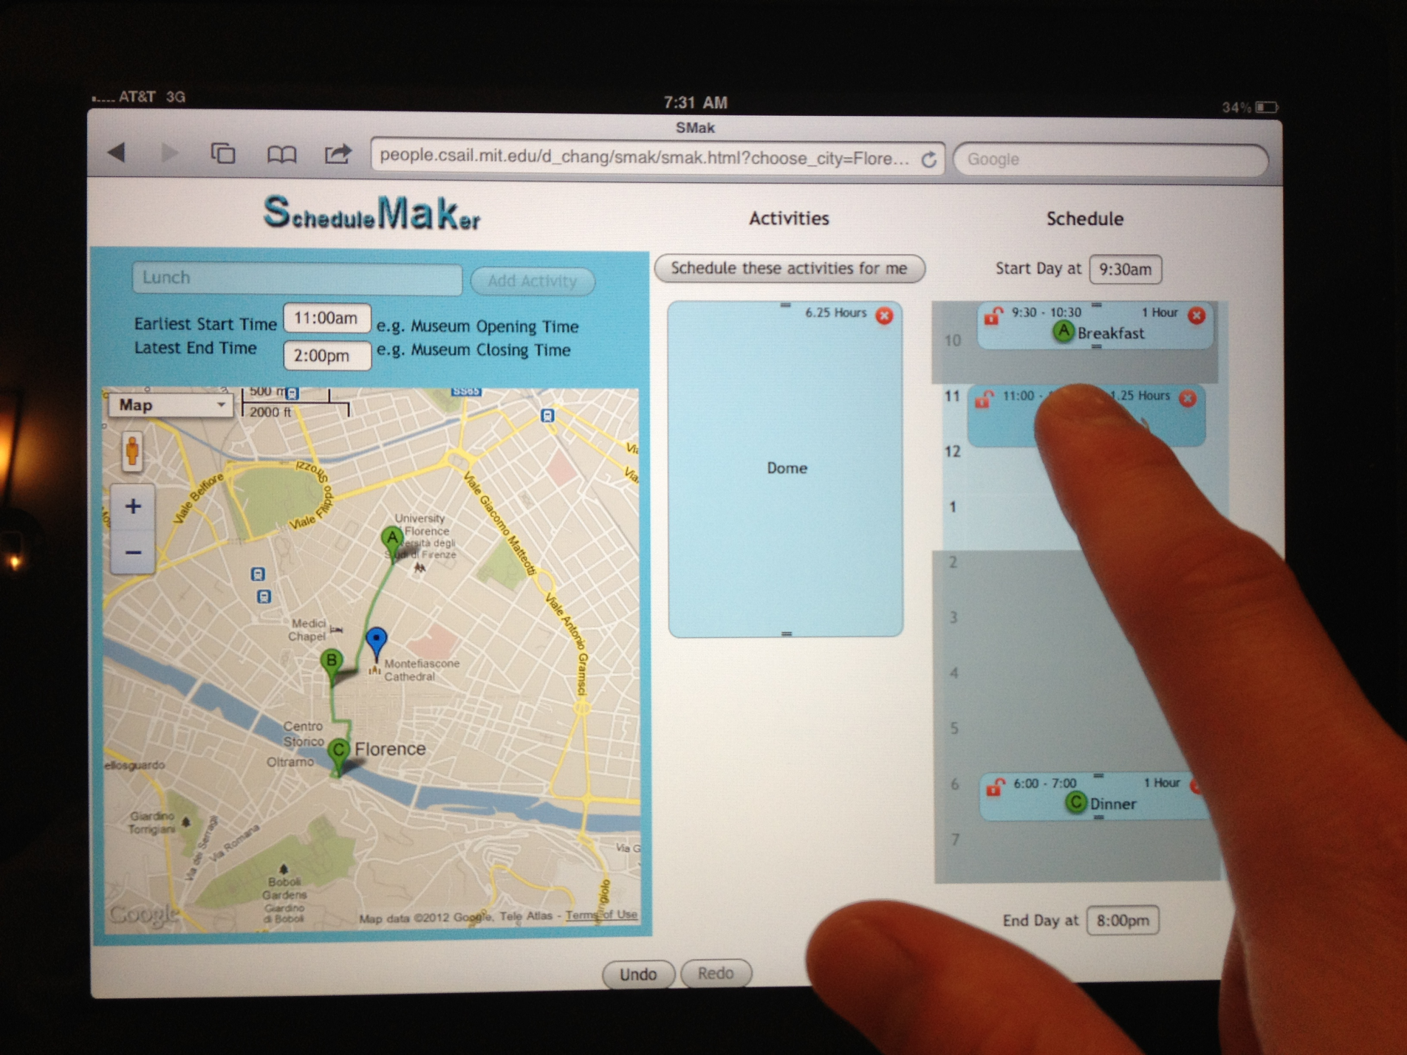
Danica Chang Andrew Farrell Chris Fletcher

