Slide 1
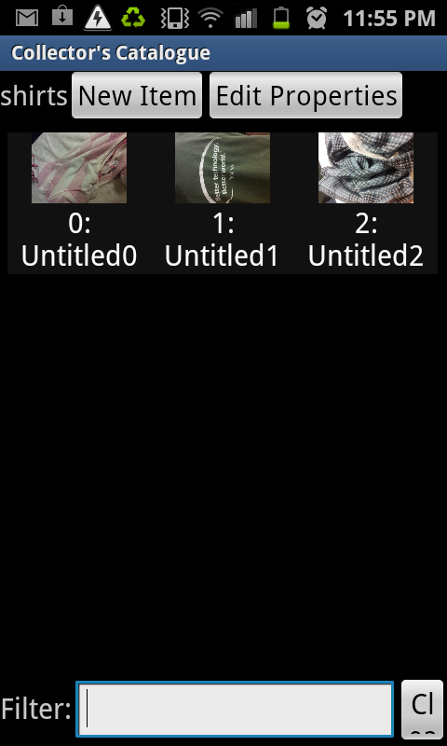
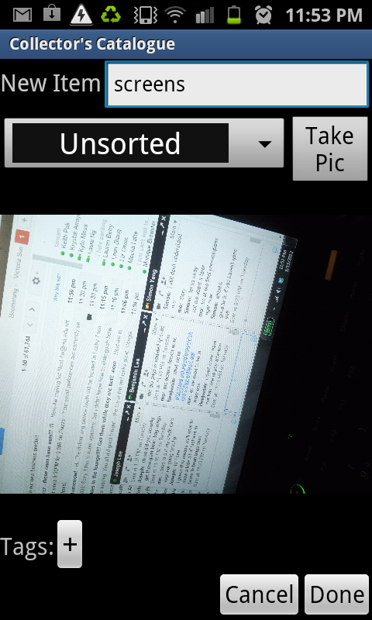
collector’s catalogue
An easy way to store and organize collections.
Benjamin Lee
Thomas Schultz
Victoria Sun

