Slide 1

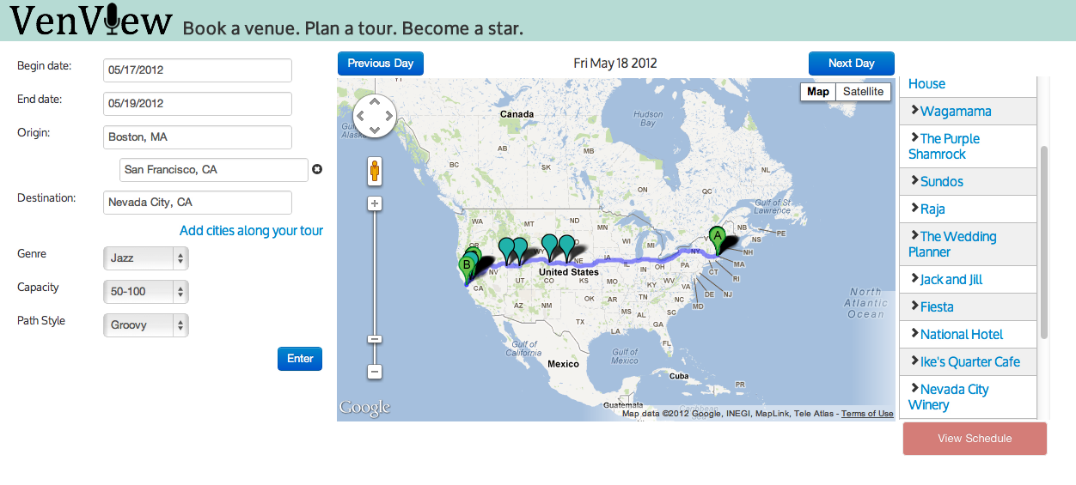
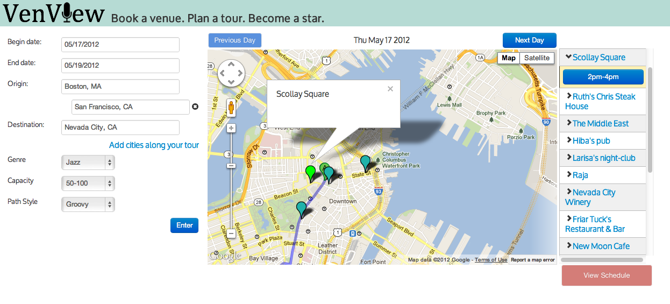
VenView
Noor AlSharif, Hiba Awad, Larisa Berger

