Slide 1
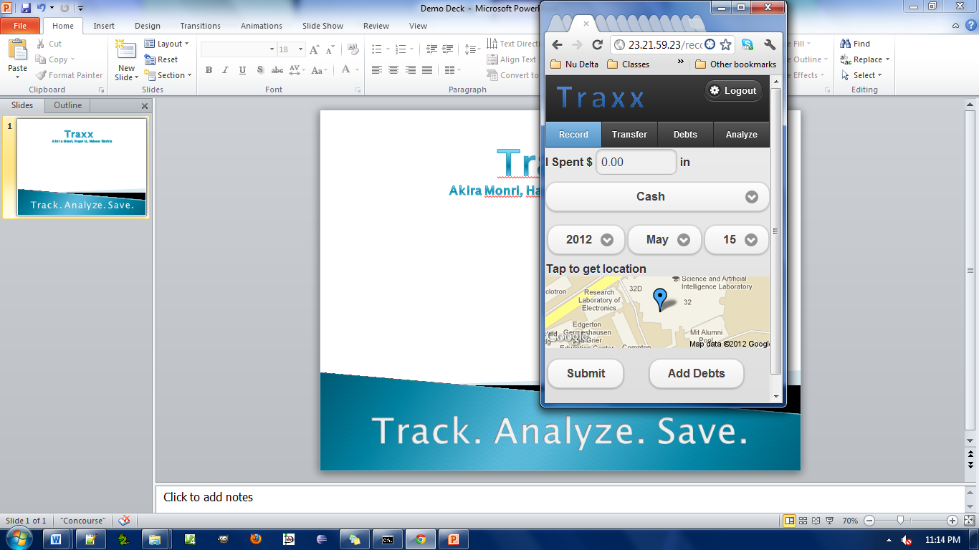
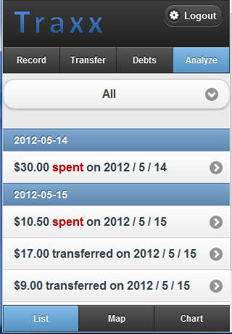
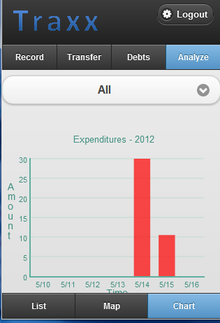
Traxx
Akira Monri, Hayoi Li, Nahom Workie
Track. Analyze. Save.

