Slide 1
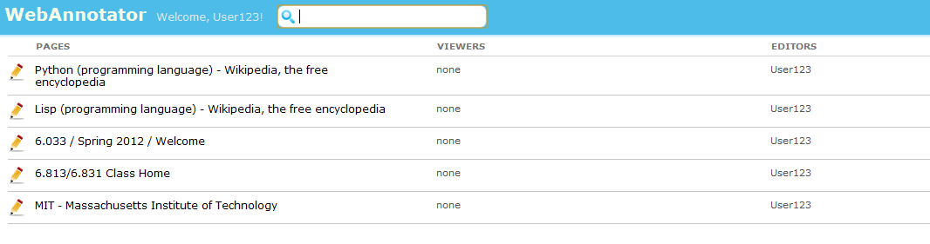
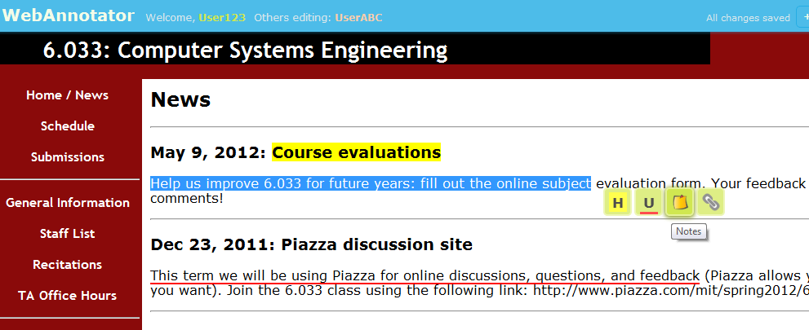
WebAnnotator
Jin Wan, Sam Wong, Yunlu Yang
Annotate webpages just like your pdf annotator
Share your annotations with friends
It’s simple, and fun to use!

