Slide 1
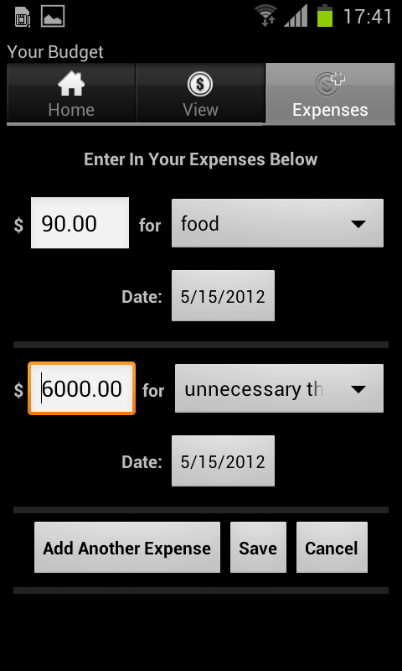

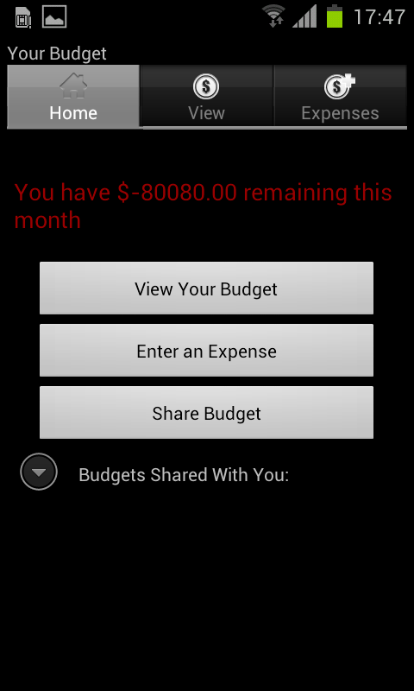
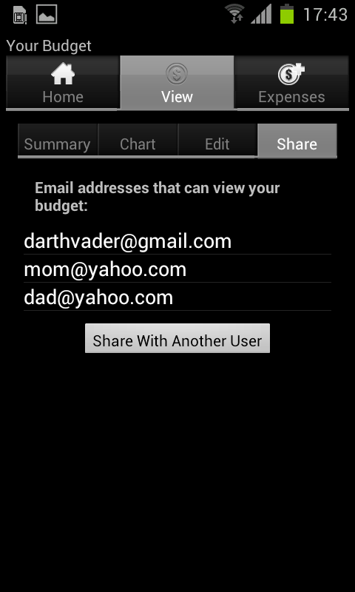
Introducing MoneyManager
Notes:
How often do you spend more money than you should? Apple releases their latest product, and BAM, your monthly budget’s spent.
To help you budget your money, we’ve created MoneyManager, an Android app that lets you input a monthly budget and enter your expenses, helping you keep track of what you’ve already spent and how much you have left. MoneyManager also lets you share your budget with others, so the next time you need money from your parents you can prove you spent what they already gave you on more than just beer.
So if you always run out of money before the month ends, try out MoneyManager!

