Slide 1
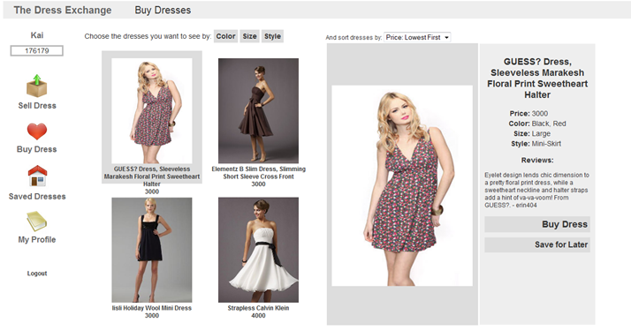
The Dress Exchange
Trade dresses with points!
Kaichen Ma, Peter Gilliland, Baiaboo Rai

