Slide 1
Caroline Ummenhofer
Woods Hole Oceanographic Institution
Physical Oceanography
Research Background:
Indo-Pacific climate variability, with a focus on rainfall and drought across the
Australasian region on seasonal to interannual and decadal timescales
Motivation:
Develop a mechanistic understanding of apparent statistical relationships based on climate dynamics using idealized climate model simulations
Aim:
Apply mechanistic understanding of teleconnections to improve predictions (seasonal to decadal) of use to society

Slide 2
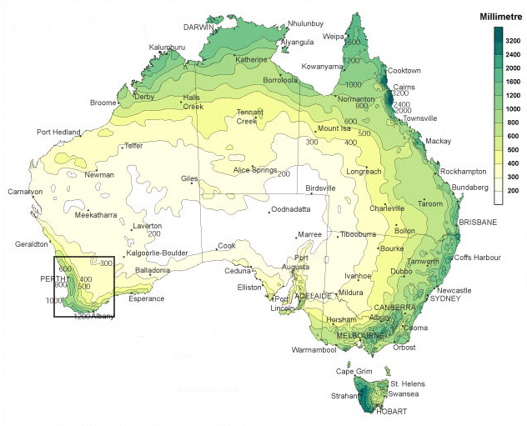
Australian annual precipitation
Southwest Western Australia (SWWA)
Characterized by Mediterranean climate with wet winters/dry summers
After Bureau of Meteorology
Accounts for ~40% of Australian wheat production
Experiencing considerable decline in rainfall since 1970‘s
→ Better understanding of interannual variability vital under these exacerbated conditions

Slide 3
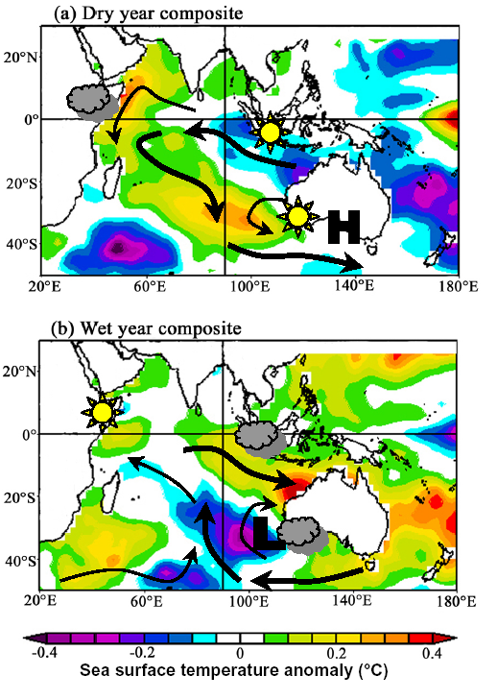
England et al. (2006) investigated extreme rainfall years in SWWA in observations and multi-century coupled climate model simulation:
DRY years
Characteristic dipole pattern in Indian Ocean SST anomalies
Acceleration of anticyclonic basin-wide wind field
Anomalous offshore moisture advection over SWWA
Situation reversed during WET years

Slide 4
Experimental design
AGCM experiments with NCAR‘s CAM3 run in T42 standard configuration, forced with SST
80-year CONTROL simulation with SST climatology;
Perturbation cases for dry years (PDRY) and wet years (PWET)
Based on monthly observed SST anomalies during extreme rainfall years in SWWA from England et al. (2006)
Superimposed on SST climatology
60 ensemble members of 1-year simulations for PDRY and PWET cases
SST perturbation for PDRY case

Slide 5
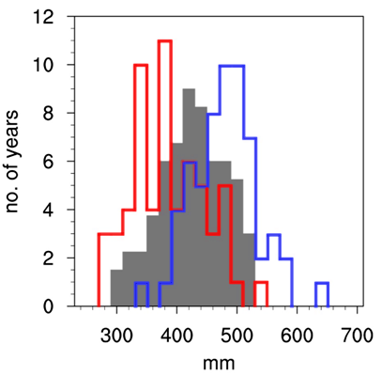
Rainfall changes over Western Australia
Total annual precipitation over Western Australia (excluding tropical north)
Shift of entire distribution, towards the lower (upper) end in PDRY (PWET)
PDRY
PWET
CNTRL

Slide 6
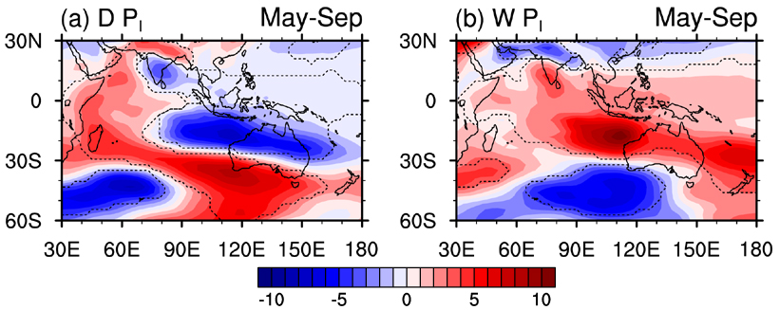
Thickness anomalies (1000-500hPa) – MJJAS
PDRY
PWET
negative/positive thickness anomalies across Indian Ocean reflect sign and position of SST poles

Slide 7
Thickness anomalies – cont‘d
PDRY
PWET
Reduced (increased) meridional thickness gradient leads to easterly (westerly) anomaly in thermal wind over southern regions of Australia
Southward (northward) deflection of strengthening southwesterly
jet to the south of Australia, along with rain-bearing fronts

Slide 8
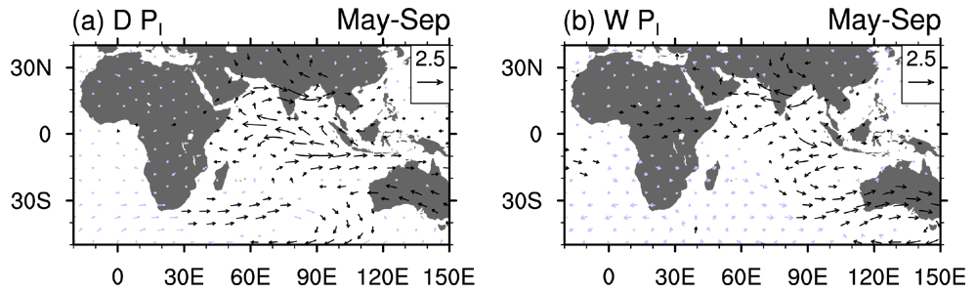
Wind anomalies (500hPa) - MJJAS
PDRY
PWET
Weakening (strengthening) of anticyclonic wind field over the Indian Ocean during PDRY (PWET)
Weakened (strengthened) onshore wind over southern regions of Australia during PDRY (PWET)

Slide 9
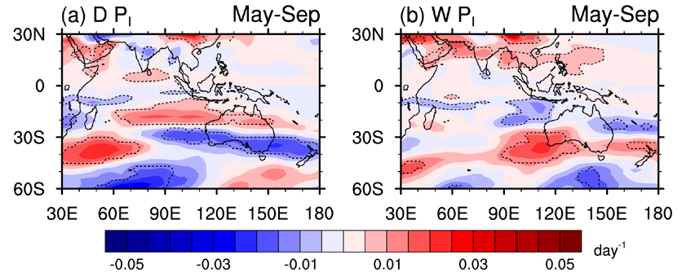
Anomalies in Eady growth rate
(= measure of baroclinic instability in atmosphere)
PDRY
PWET
- Reduction (increase) in baroclinic instability over southern regions of Australia during PDRY (PWET)

Slide 10
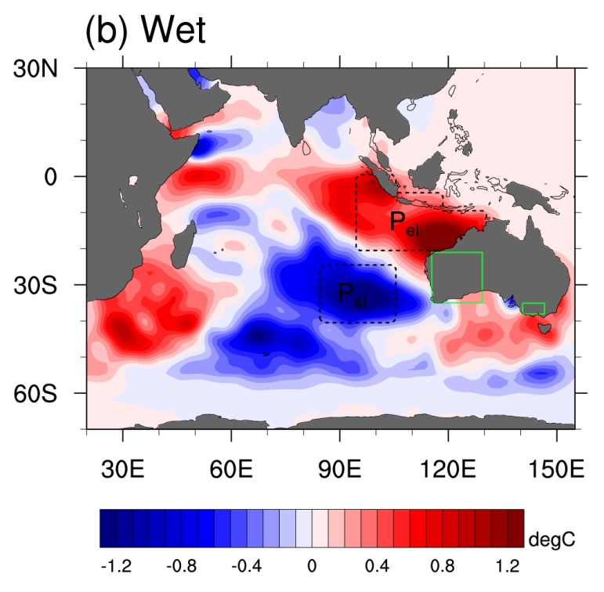
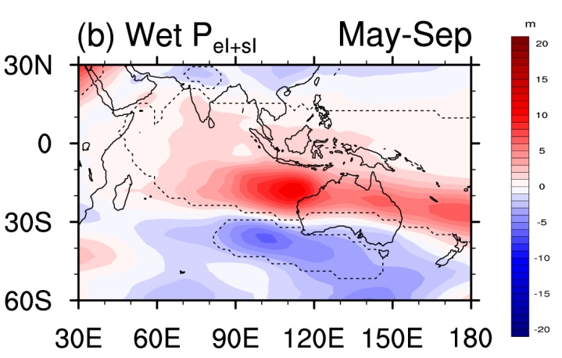
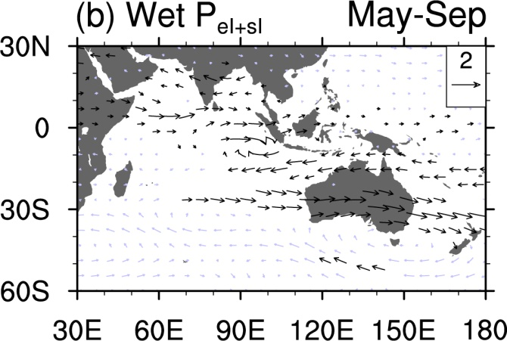
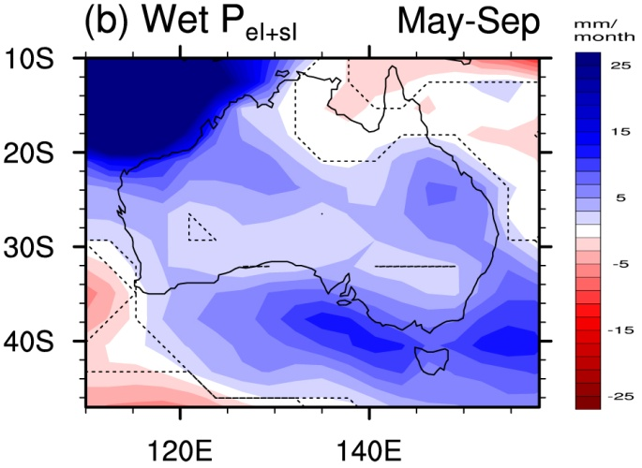
Relative importance of SST poles
SSTA (May-Sep)
Thickness anomalies
(1000-500hPa)
Wind anomalies
(500hPa)
Rainfall anomalies

Slide 11
Implications for seasonal forecasting
2006
SST anomalies April-July
2005

Slide 12
Implications for seasonal forecasting
2006
SST anomalies April-July
2005
Rainfall anomalies MJJAS
Characteristic SST pattern in Indian Ocean worked as indicator for rainfall in western regions of Australia (2005-2006)

Slide 13
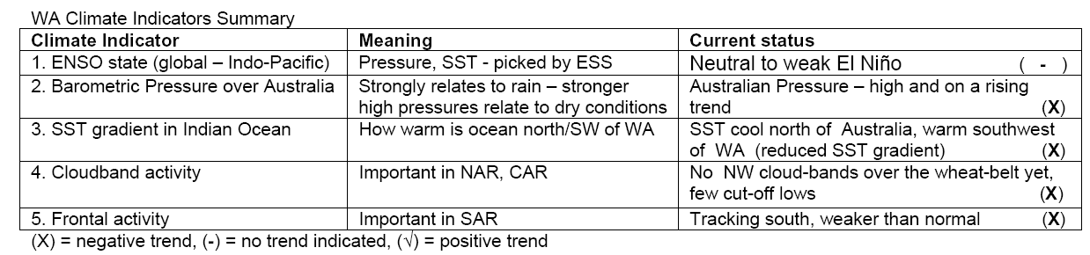
Implications for seasonal forecasting
Department of Agriculture and Food in Western Australia uses the meridional SST gradient across the eastern Indian Ocean in its monthly growing season outlook for farmers:
From Growing Season Outlook (July 2008)

Slide 14
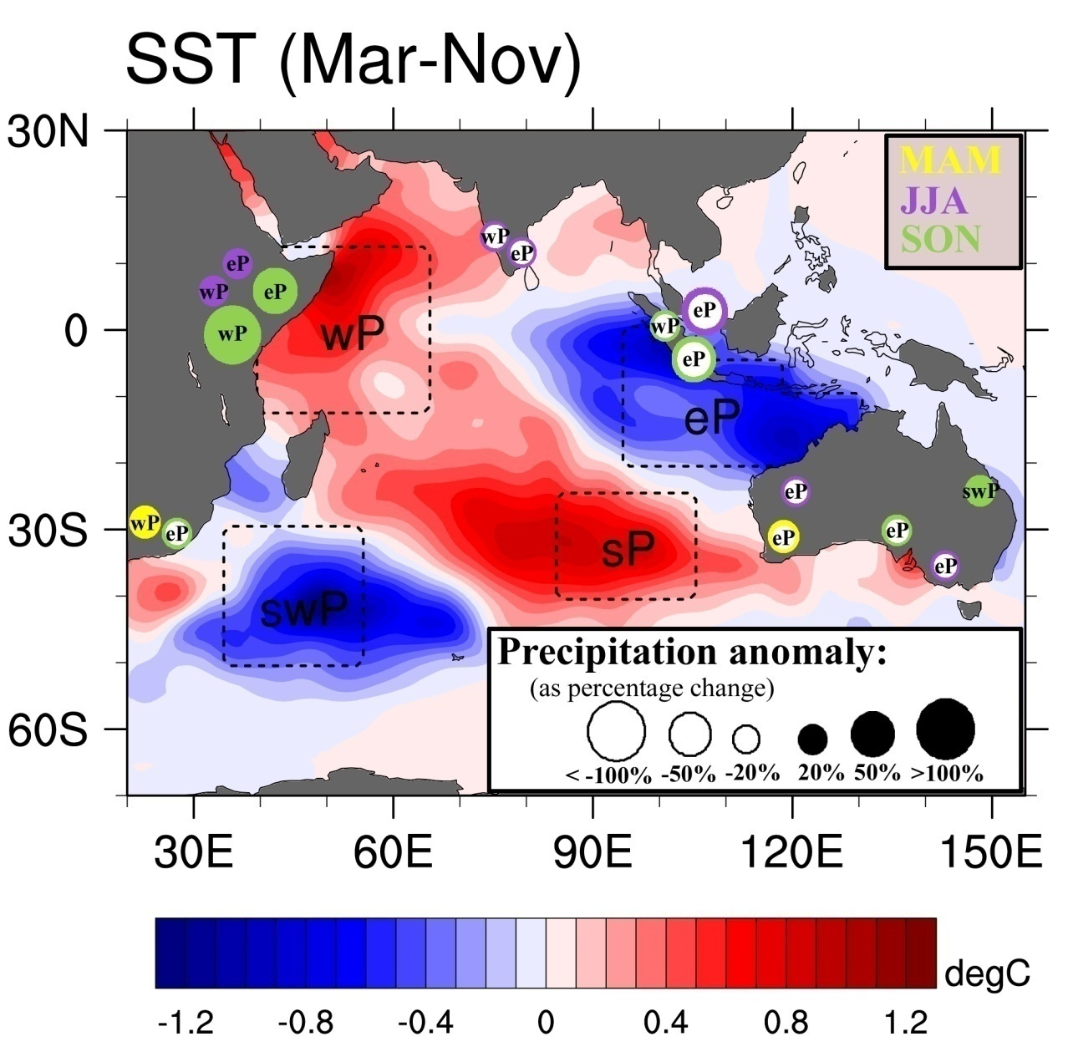
Rainfall changes associated with SST
anomalies – for
separate poles
Schematic of the impact of Indian Ocean SST anomalies on precipitation in Indian Ocean-rim countries in AGCM simulations during different seasons.

Slide 15
Application to NE US climate change
→Apply similar procedure to assess dry/wet years/periods (high/low agricultural yield/fishery yield etc) in observations
Idealized climate model experiments to better diagnose key climate drivers
In future model projections, assess frequency/severity of climatic situation corresponding to dry/wet years
Advantage: Uncertainties in model projections of rainfall could be circumvented by looking at large-scale circulation changes associated with climate drivers during dry/wet years, rather than at rainfall directly

Slide 16
References
England MH, Ummenhofer CC and Santoso A. (2006). Interannual rainfall extremes over southwest Western Australia linked to Indian Ocean climate variability. J. Clim., 19, 1948-1969
Ummenhofer CC, Sen Gupta A, Pook MJ and England MH. (2008). Anomalous rainfall over southwest Western Australia forced by Indian Ocean sea surface temperatures. J. Climate, 21, 5113-5134
Ummenhofer CC, Sen Gupta A, England MH and Reason CJC. (2009). Contributions of Indian Ocean sea surface temperatures to enhanced East African rainfall. J. Clim., 22, 993-1013
Ummenhofer CC, Sen Gupta A, Taschetto AS and England MH (2009). Modulation of Australian precipitation by meridional gradients in East Indian Ocean sea surface temperature. J. Clim., 22, 5597-5610

Slide 17
Assessment of climate change on crop yield
20th Century
BCCR BCM2
Murray Darling Basin, Australia
Wheat Yields
B1
(550 ppm)
MIROC3_medres
Agro-IBIS
Punjab, India
A1B
(717 ppm)
Iowa, USA
NCAR
CCSM3
Maize Yields
A2 (850ppm)
Free State, South Africa
Adaptations
Three CMIP3 GCMs
20th C Baseline + Three IPCC Emissions Scenarios
Process-based Agro-ecosystem Model
Crop Yield Projections
Four Major Cereal Producing Regions
Slide courtesy of K. Nicholas

Slide 18
Modeling best and worst yield years for corn in Iowa
Number of good years
Number of bad years
Defining Yield Thresholds (Kucharik & Ramankutty, 2005):
  Average variability: years exceeding average crop yield by ±8%
  Severe variability: years exceeding average crop yield by ±20%
  Asymmetrical variability: years exceeding average crop yield by
  +6% or -14%.
Slide courtesy of K. Nicholas

Slide 19
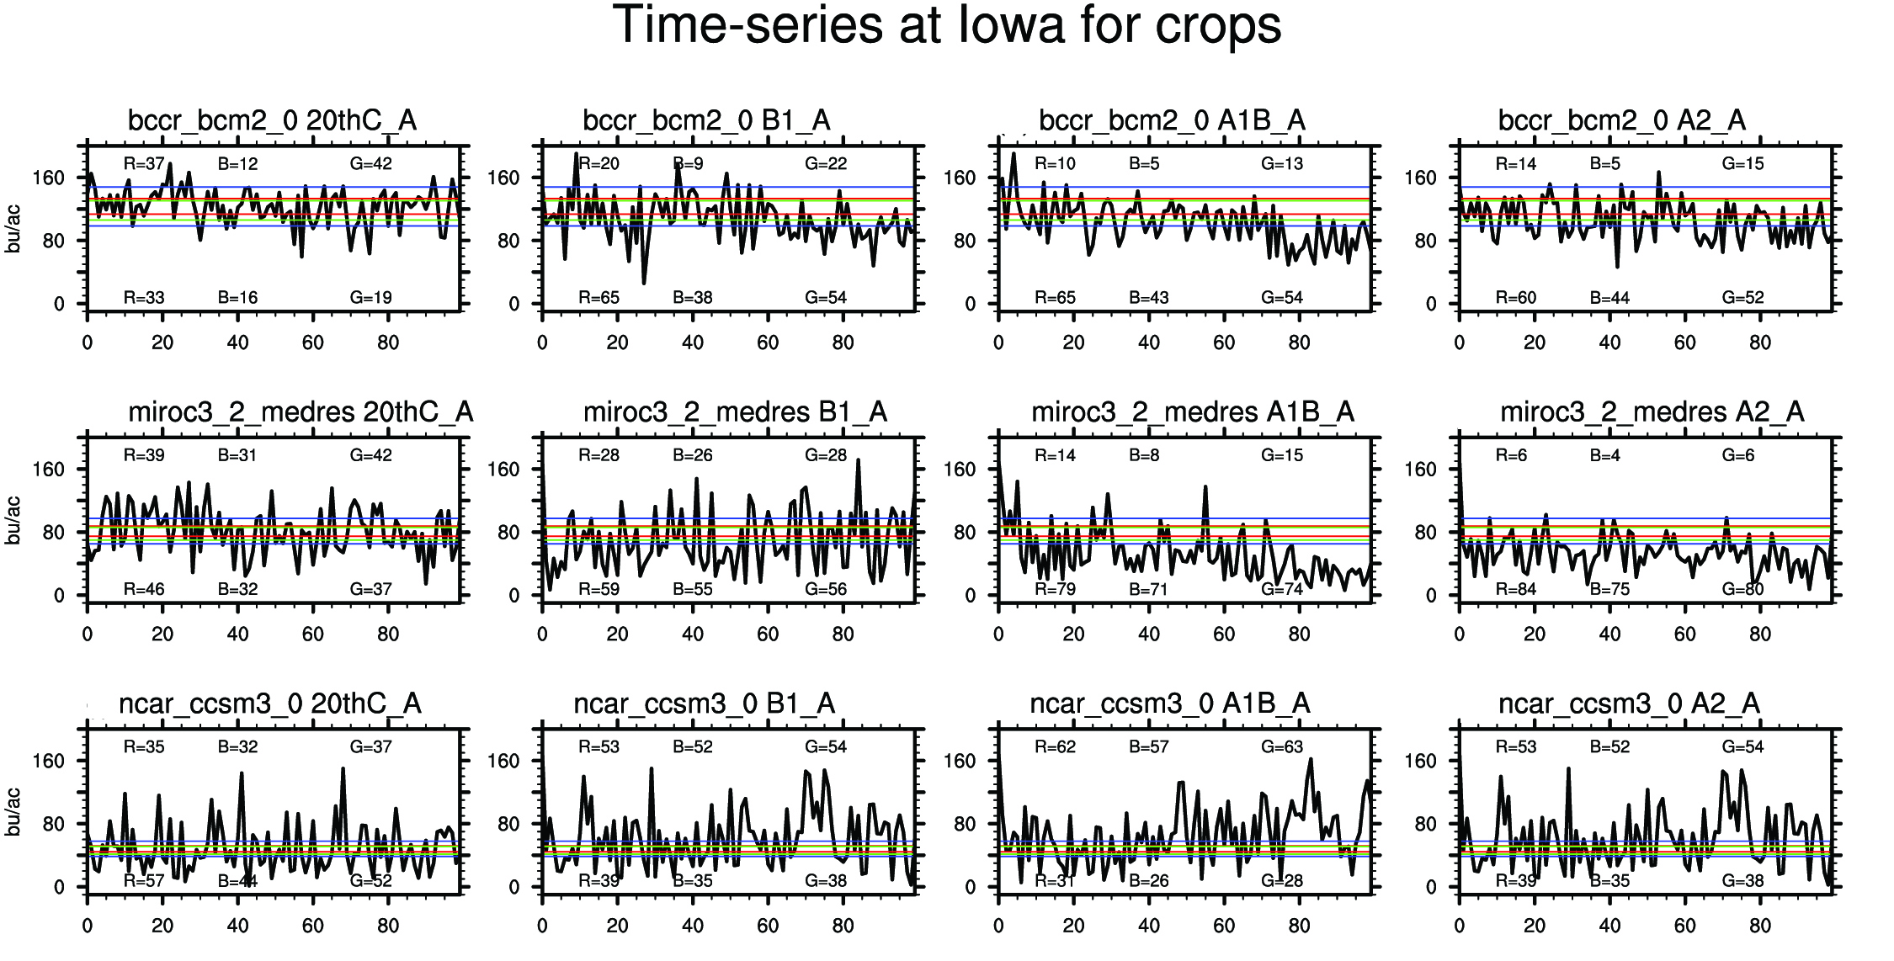
Warmer, drier, more variable climate
→ more extreme yields
low
Emissions & temperature
high
low
stddev
Scenarios: 20th C B1 A1B A2
wet
low
precipitation (annual/JJA)
temperature (JJA)
no. of extreme years
GCMs: CCSM3 MIROC3 BCM2
high
stddev
dry
high
low
no. years with low yield
high

Slide 20
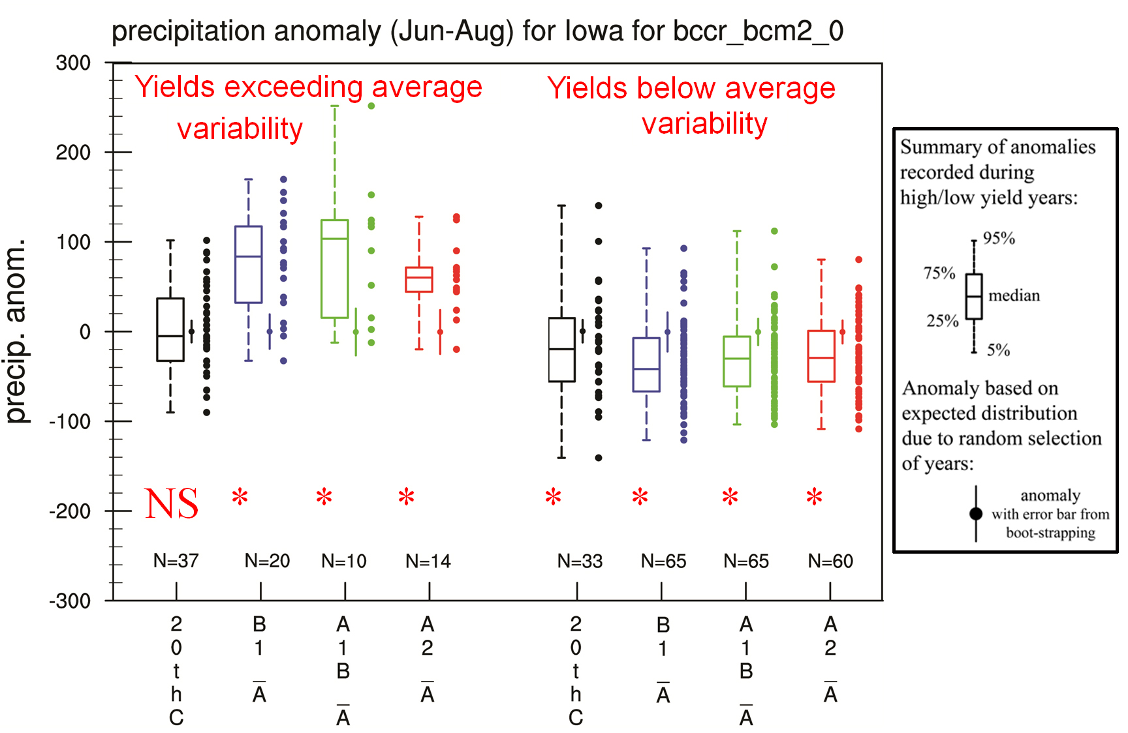
Rainfall anomalies in high/low yield years for corn in Iowa

Slide 21
Rainfall anomalies in high/low yield years for corn in Iowa

