Slide 1

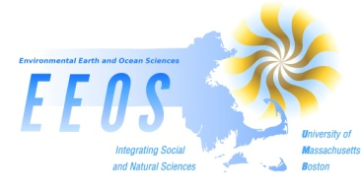
Climate Change in New England: Recent observations.
Ellen M. Douglas, PE, PhD
Environmental, Earth and Ocean Sciences University of Massachusetts, Boston
May 11, 2012

Slide 2
Our Changing Northeast Climate
#days with temps > 95th percentile daily maximum increased by 1.7 occurrences per decade since 1960 (Hayhoe et al, 2007)
#winter nights with temps >95th percentile daily minimum increased by 2.9 occurrences per decade since 1960 (Hayhoe et al, 2007).
Extreme cold day temps decreased but by < 1 occurrence per decade (DeGaetano and Allen 2002)

Slide 3
Our Changing Northeast Climate
Ice out date has advanced 9 days in northern lakes and 16 days in southern lakes since 1850 (Hodgkins et al 2002)
16% decrease in Mar/Apr snow pack and 11% increase in snow density at four long-term (1926+) monitoring stations (Hodgkins & Dudley 2006)
Timing of high flows in snow-melt dominated rivers has advanced 7-14 days since 1970 (Hodgkins et al 2003)

Slide 4
Highlights from NCA-New England
Continued shifts in hydroclimatic processes
  Increasing trends in annual maximum streamflow in climate-domintated rivers (Collins, 2009)
  Evidence of increasing groundwater table elevations over the last decade (Weider and Boutt, 2010),
  projected annual increases in evapotranspiration due to warming temperatures could offset increased annual precipitation, resulting in little projected change in annual streamflow (Campbell et al., 2011)
Attenuation of river regimes
  Kingston et al (2011) distinguished northern New England (NNE) and southern New England (SNE) rivers based on peak and low flow timing and magnitude. Changes in snowpack appears to be attenuating the difference in NNE and SSE regimes.

Slide 5
Highlights from NCA-New England
Marine and terrestrial ecosystem impacts
  regional warming will result in the loss of more than 70% (possibly 100%) of boreal conifer forest and a 26% decrease in northern deciduous hardwood in New England by the late 21st century. Over the same timeframe, mixed oak-hickory forests will shift northward by 100-200 km and will increase in area by 149-431% (Tang and Beckage, 2010).
  increase in growth rates from climate change will be more than offset by forest conversion (Thompson et al., 2011).
  forest management strategies that account for climate change could increase forest resiliency and carbon storage (Purschel, 2009).
  after seven years, warming-induced soil carbon losses were nearly compensated for by plant carbon gains in response to warming (Melillo et al., 2011).

Slide 6
Highlights from NCA-New England
Marine and terrestrial ecosystem impacts
  salt marsh communities may be resilient to modest amounts of warming and large changes in precipitation (Charles and Dukes, 2009).
  warming could reduce plant diversity in New England salt marshes (Gedan and Bertness, 2009)
  warming could impact Spartina patens, a foundation species in saltmarshes, by increasing biomass production but had little impact on the ecological role of this grass or on the saltmarsh community as a whole (Gedan and Bertness, 2010)
  combination of accelerating sea level rise and salt marsh die-off may overwhelm the natural compensatory mechanisms of salt marshes and increase their vulnerability to drowning (Gedan et al, 2011).

Slide 7
Highlights from NCA-New England
Recent increases in extreme events
  strong increases in the frequency of warm events (e.g., warm nights and warm summer days) and decreases in the frequency of cold events (e.g., ice days, frost days, and the cold spell duration indicator) were observed. A decreasing trend in frost days since 1870 was observed, with the strongest trends over the latter part of the 20th century (Brown et al., 2010).
  Significant increasing trends in days with 2-inch or greater precipitation at some stations in MA, VT and Eastern NY, and days with 4-inch or greater rain were generally increasing, but the statistical significance could not be assessed (Spierre and Wake, 2010).
  Significant increasing trends in 1-day annual maximum precipitation at stations in coastal NH, central and eastern MA since 1970. Increasing trends in 2- and 3-day annual maximum precipitation at some stations (Douglas and Fairbank, 2011).

Slide 8
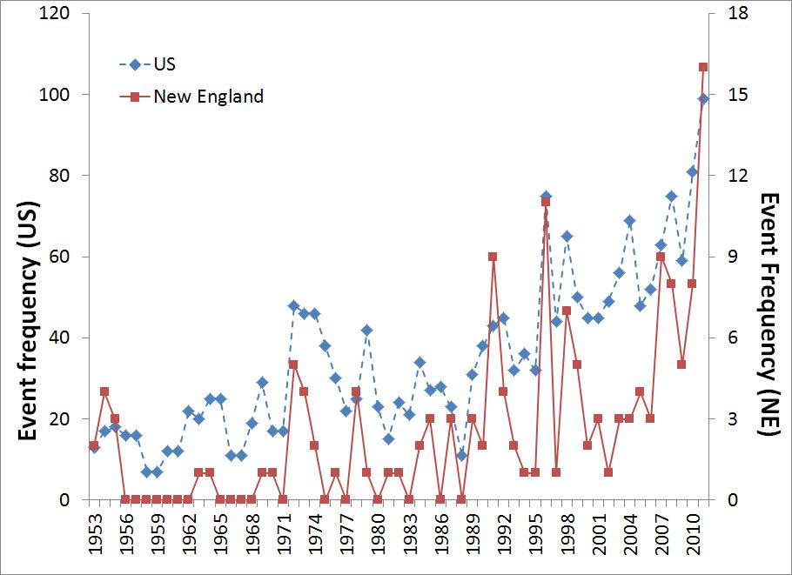
Federal disasters in New England
Source: FEMA (http://www.fema.gov/news/disasters.fema)

Slide 9
Some of these events include…
October 2005: Inland floods
May 2006: Inland floods
April 2007: inland and coastal floods (2006 & 2007 were “100-yr” floods)
December 2008: Ice storm
February 2010: “Snowicane”
March 2010: 3 weeks of rain & floods (wettest month on record at BHO)
August 2011: Hurricane Irene
October 2011: Halloween Blizzard
Winter 2011-12 and Feb 2012: almost driest on record (darned leap day!!)
Jan-Mar 2012: record number of heat records.

Slide 10
Small changes in the mean value can result in larger changes at the extremes.
A changing climate leads to changes in:
Frequency
Intensity
spatial extent
Duration
timing
of extreme weather and climate events, and can result in unprecedented extreme weather and climate events.
(IPCC SREX, 2011)

Slide 11
Source: http://www.ncdc.noaa.gov/img/reports/billion/timeseries2011.pdf

Slide 12
Why is understanding extreme events important for the US?

Slide 13
Observations according to SREX 2011
Extreme event observations in SREC (2011) show that changes in extremes are similar to observations in Karl et al (2008).
Settlement patterns, urbanization, and changes in socioeconomic conditions have all influenced observed trends in exposure and vulnerability.
There is evidence that some extremes have changed as a result of anthropogenic influences, including increases in atmospheric concentrations of greenhouse gases.
Economic losses are higher in developed countries, but fatalities and losses/GDP are higher in developing countries.

Slide 14
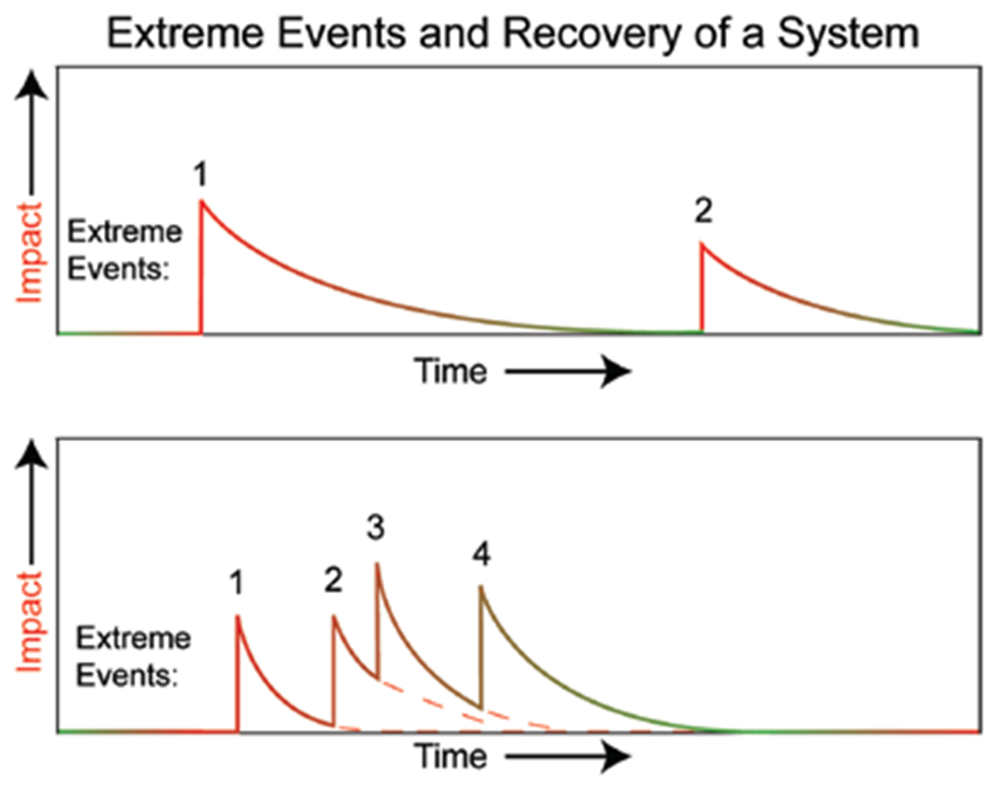
Exposure, vulnerability and resiliency (SREX 2011)
Exposure and vulnerability are key determinants of disaster risk and impacts
Extreme and non-extreme events affect vulnerability to future extreme events by modifying resilience, coping capacity, and adaptive capacity.

Slide 15
Climate change and sea level rise.
“Sea level rise under warming is inevitable.” (IPCC, 2007)
  Global sea level rise (SLR) is accelerating:
    1.6 mm/yr historical average (20th century)
    1.8 mm/yr average 1961-2003
    3.1 mm/yr average 1993-2003
  Arctic sea ice decreased 2.7% / decade since 1978
  Greenland and Antarctic Ice Sheets are thinning
  Mountain glaciers receding at unprecedented rates
→ Even with no change in storm frequency or magnitude, higher sea level means flooding further inland.

Slide 16
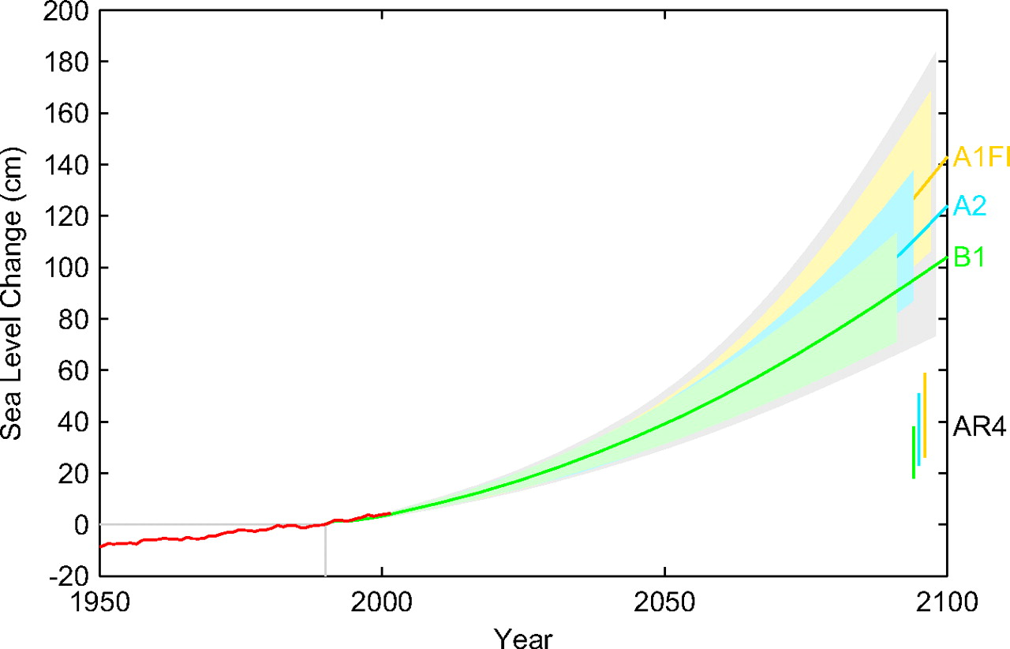
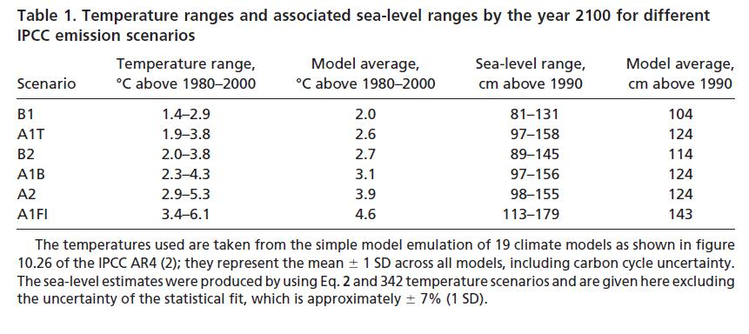
The most recent SLR projections
Source: Vermeer, M. and S. Rahmstorf, 2009. PNAS, 106:21527-21532
Notes:
Caption: This graph depicts the average or mid-range of a number of different sea-level rise (SLR) simulations: a continuation of recent observed SLR rates (green line), the mid-range of the most recent IPCC projections under the lower-emissions scenario (yellow line), the mid-range of the recent IPCC projections under the higher-emissions scenario (red line), and the midrange of a more recent set of projections under the higher-emissions scenario (blue line).
Projected Climate Change: Ocean temperatures and sea-level rise
Regional sea-surface temperatures have increased 1ºF since 1900 and are projected to continue increasing, though at a slightly slower rate than regional air temperatures. By the end of the century, regional sea-surface temperatures are projected to rise an additional 6°F to 8°F under the higher-emissions scenario and 4°F to 5°F under the lower-emissions scenario. These warmer temperatures may adversely affect native marine species in the Northeast, including the commercially important fisheries whose southernmost range is limited by warm temperatures.
Globally, sea levels have been rising since the end of the last ice age and are rising even faster now. This acceleration is caused by two different mechanisms related to increasing temperatures: thermal expansion of seawater as it warms and increasing inflow of water from melting ice sheets and glaciers.
Assuming no further warming, a continuation of the recent historical rate of global sea-level rise could lead to a nearly six-inch increase over 2005 levels by the end of the century. Factoring in further global warming, however, the IPCC projects that global sea levels will rise between 7 and 14 inches under the lower-emissions scenario and between 10 and 23 inches under the higher-emissions scenario.
A more recent analysis, however, has projected much greater end-of-century sea-level rise: on the order of 2 to 4.5 feet above 2005 levels under the higher-emissions scenario. Even these projections may be conservative in that they do not account for the rapid rate of ice breakup and melting currently being observed in the polar ice sheets (particularly those of Greenland), nor do they assess the potential for further acceleration of this melting.

Slide 17
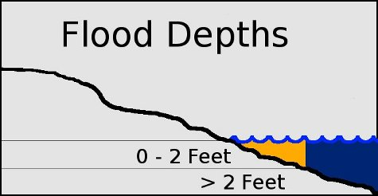
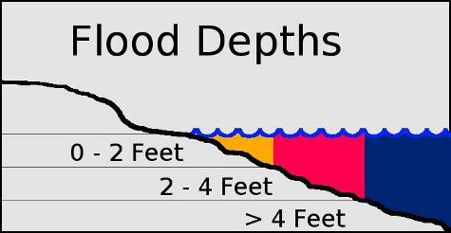
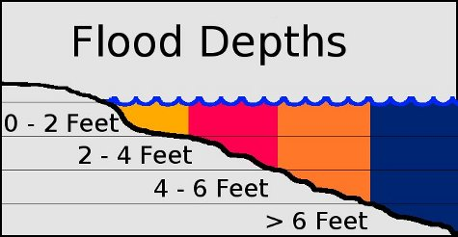
Mapping of potential flooding in Boston
Potential flooding at High Tide with
  2.5 ft SLR (lower range of possibility)
  5 ft SLR (upper range of possibility)
Potential flooding due to extreme coastal storm (5 ft surge) on top of SLR
All maps show flooding at WHT.

Slide 18
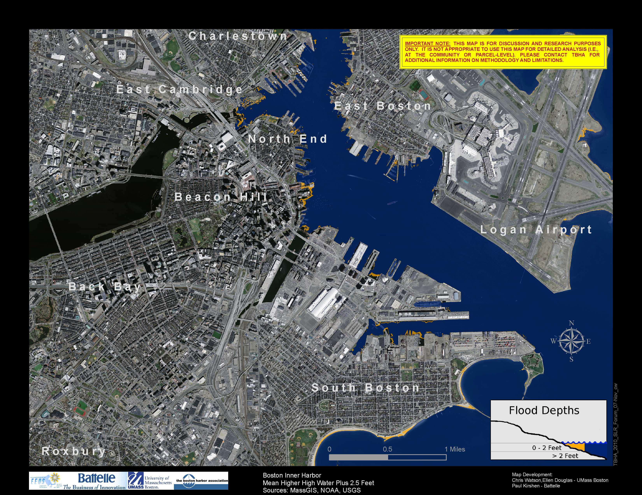
2.5 ft SLR

Slide 19
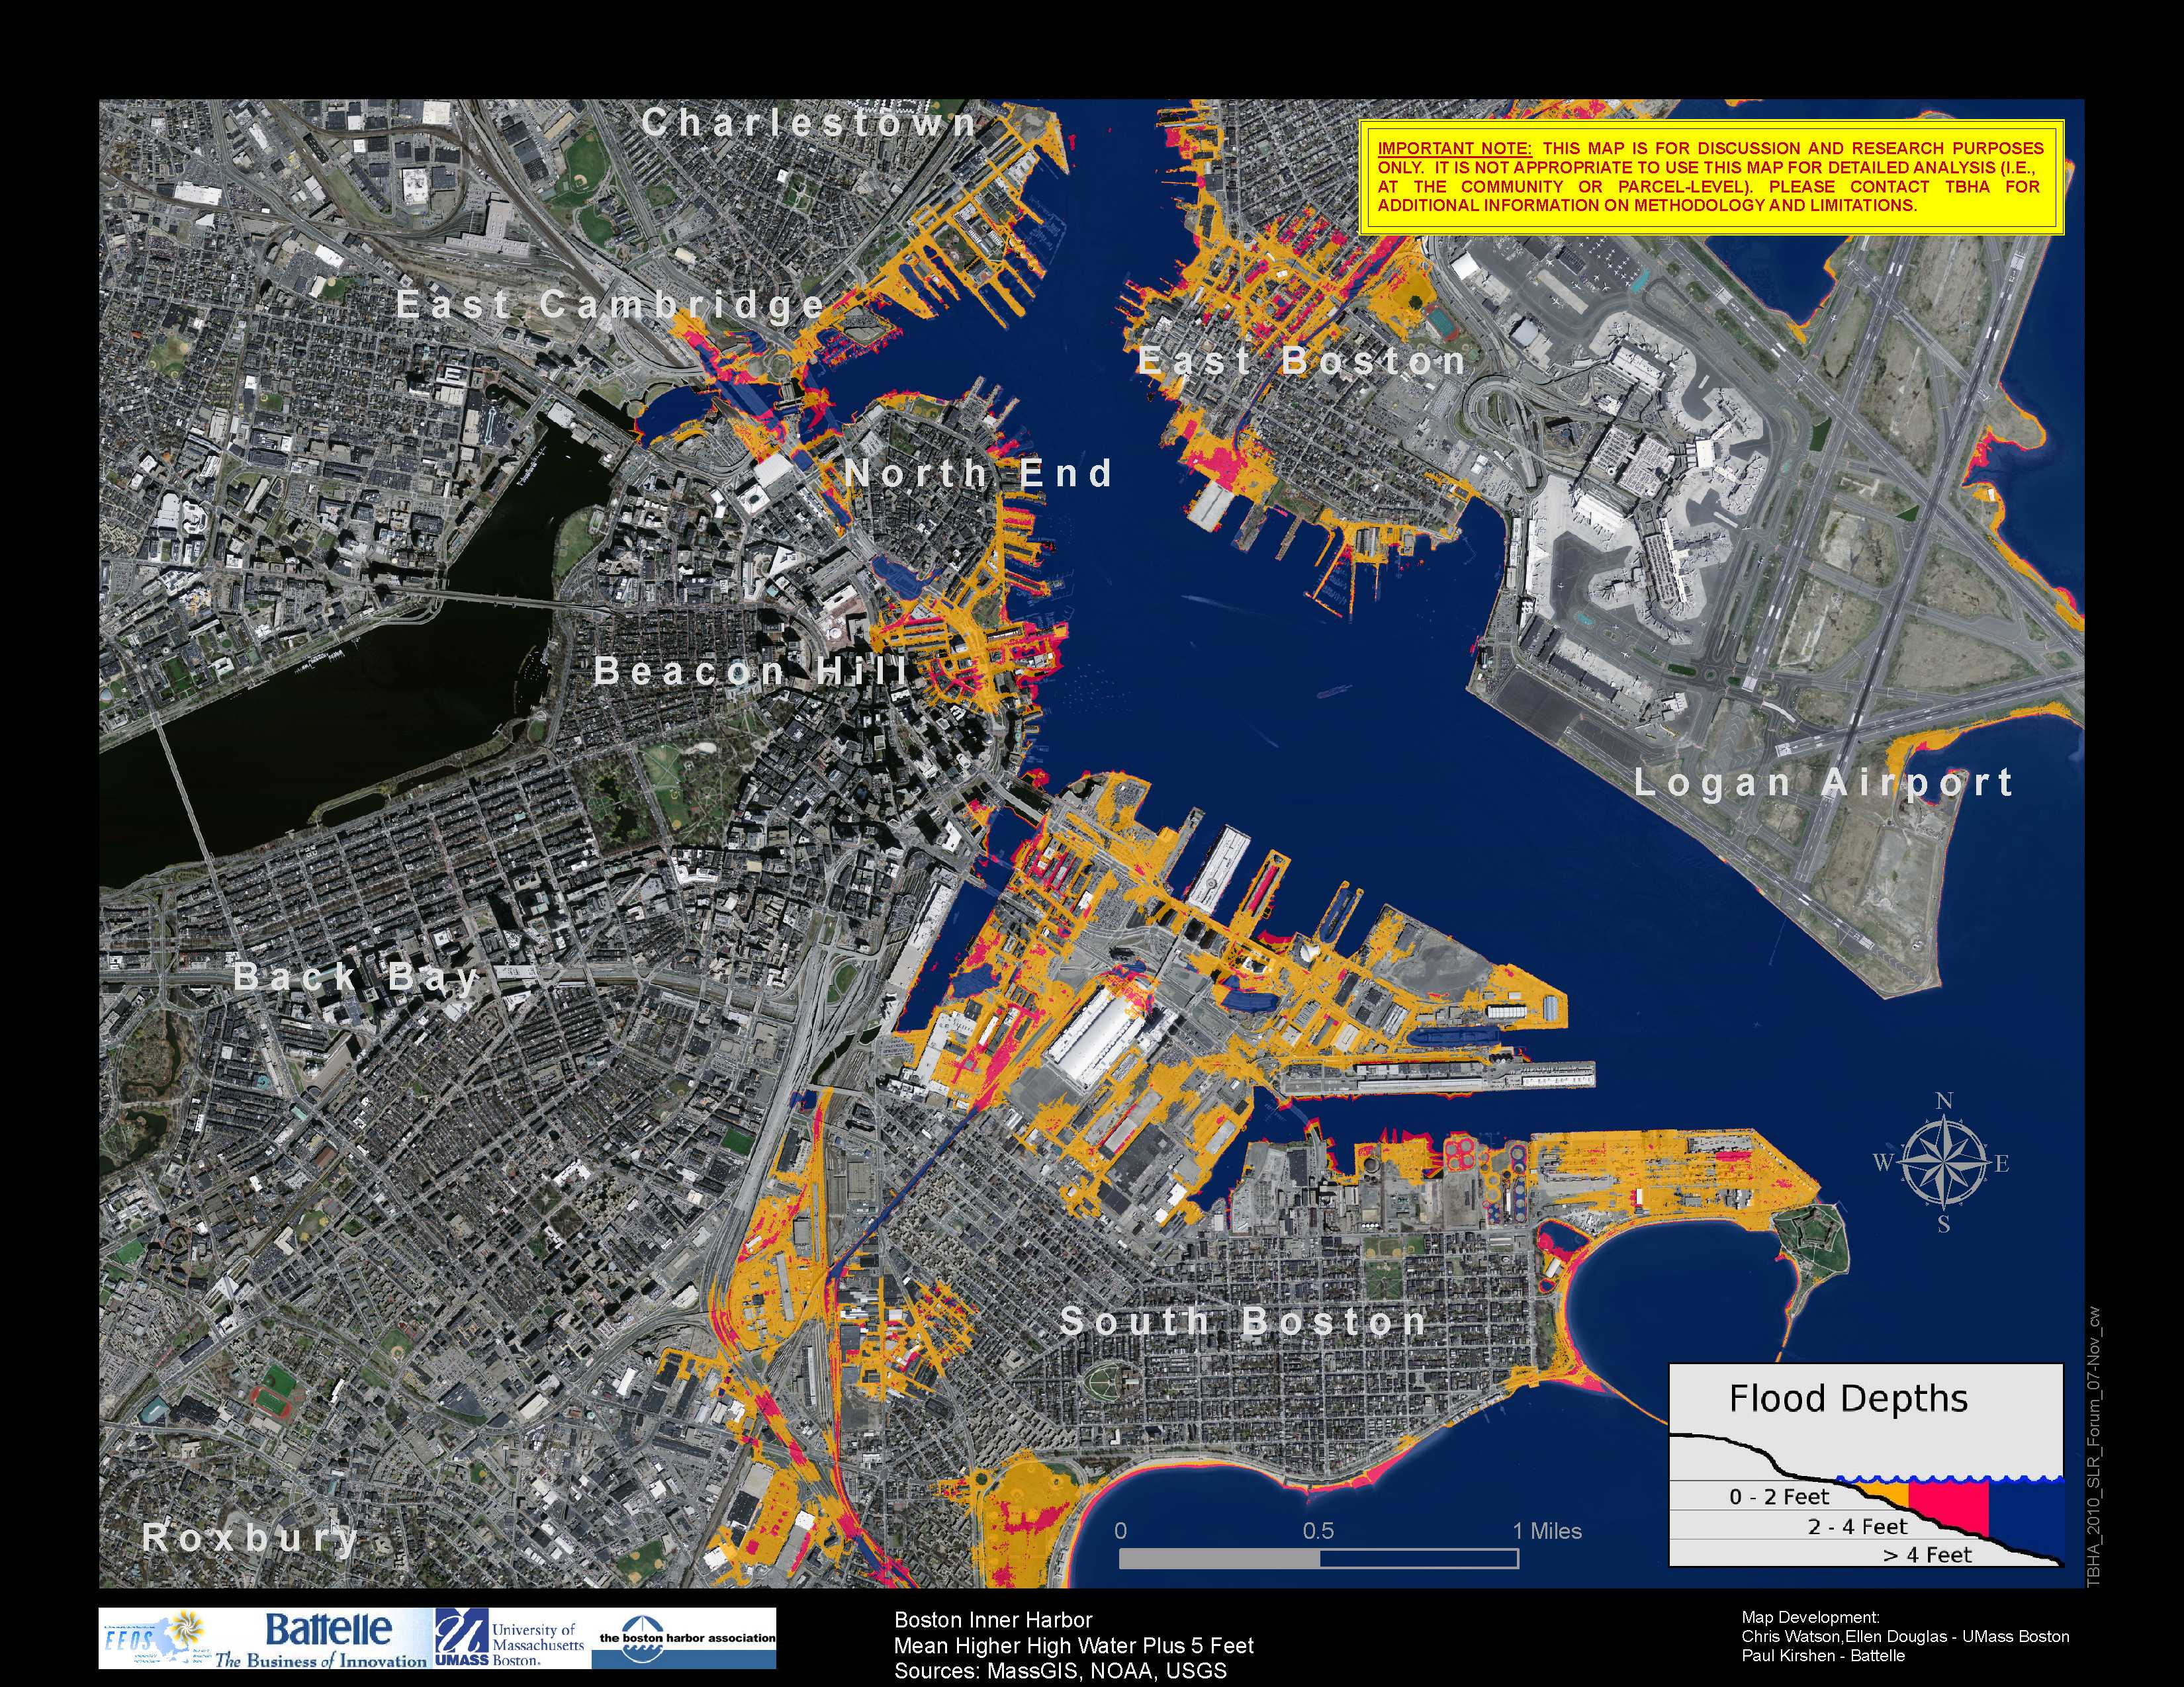
5 ft SLR

Slide 20
2.5 ft SLR

Slide 21
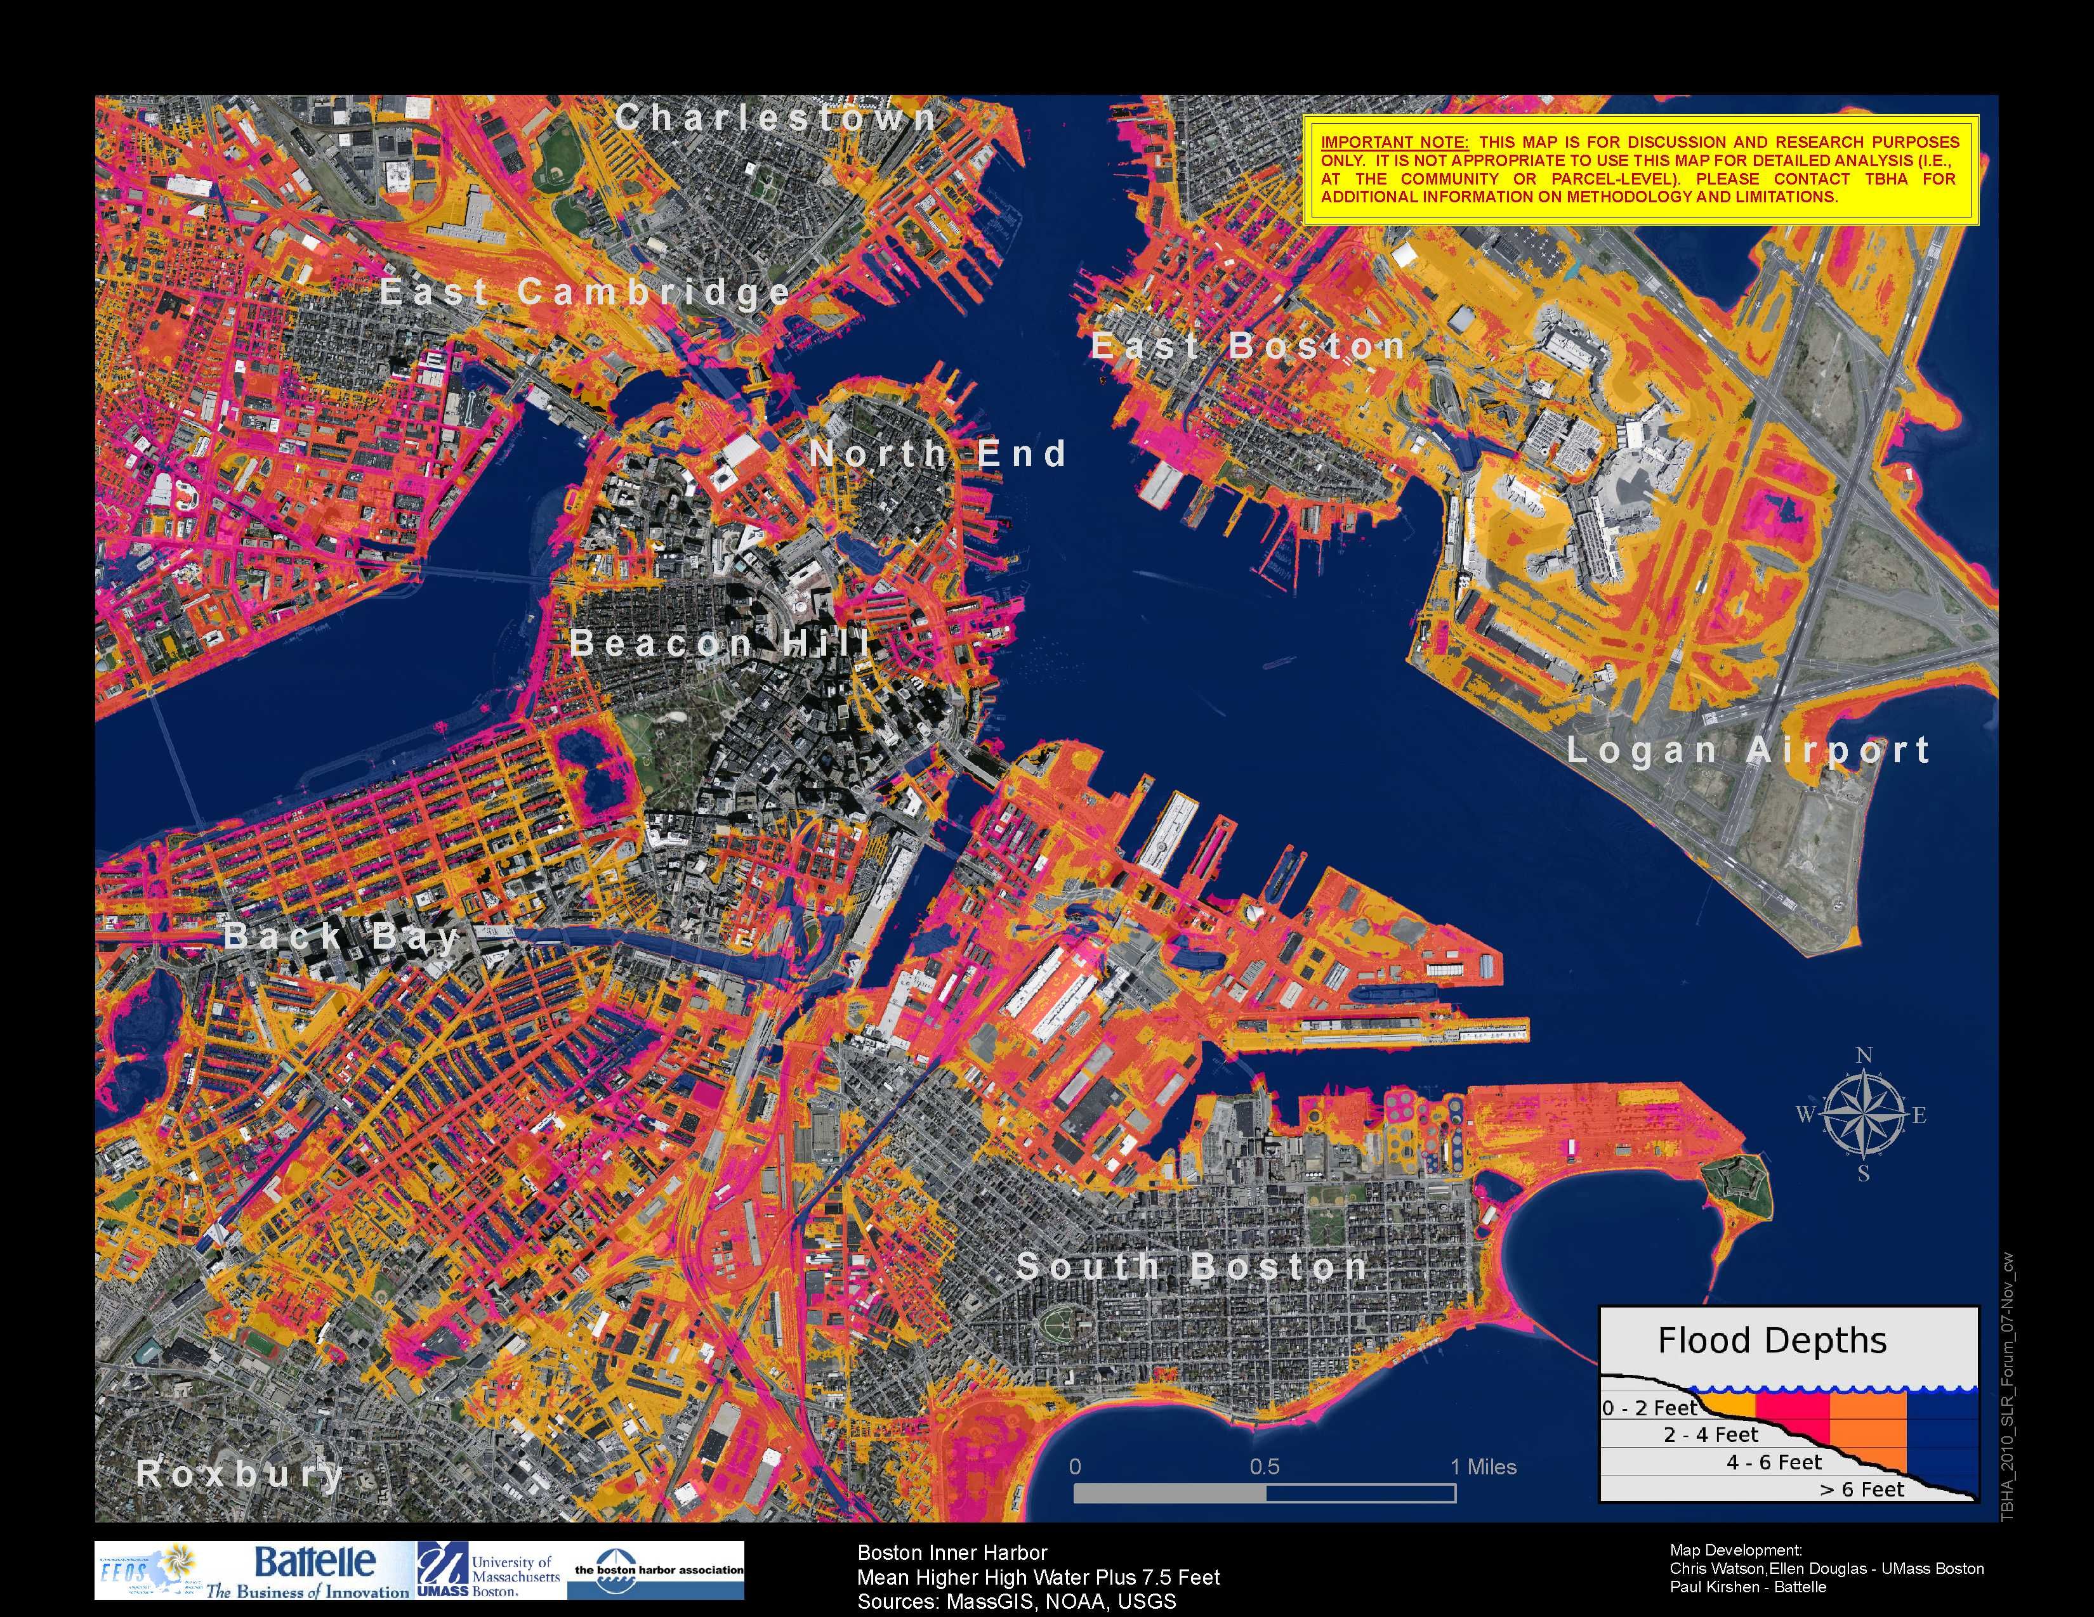
2.5 ft SLR+
5 ft surge

Slide 22
What’s next?
Linking MassBay model with GIS inundation mapping
  Incorporate hydrodynamics
  Expand analysis to Gulf of Maine
  Investigate a variety of storm scenarios
Evaluate record precipitation events
Adaptation planning and implementation

