Slide 1

“Communication and partnerships with stakeholders”
May 11, 2012
Paul Kirshen, PhD
Research Professor, UNH
Visiting Scientist, Tufts University

Slide 2
“Stakeholders” are all those persons/organizations who are affected by the project and whose behavior will ultimately affect its implementation (Mitchell et al., 1997; Tindall, 2003)

Slide 3
Why Involve Stakeholders ?
They must live with results.
Involving stakeholders throughout the project/research increases the likelihood that the results will be implemented.
- SHers are more aware of the analysis
- Analysis focuses on questions that are a high priority to SHers
-Analysis is informed by the knowledge possessed by SHers;
- Analysis generates knowledge in a way that is practical and useable (e.g., the timing is right)
- SHers trust the analysis
From NOAA NSC

Slide 4

HOW ?

Slide 5
Get Expert Help !
MAPC
Anthropologist
Health Assessment Expert
Participatory Modeler
More

Slide 6
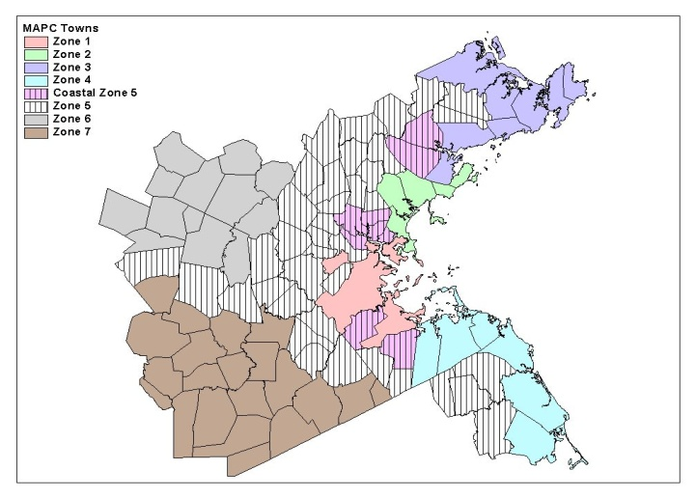
Climate‘s Long-Term Impacts on Metro Boston (1999-2004)
Project
Advisory
Group
University
Scientists
and Engineers
CLIMB
Project
Stakeholder
Advisory
Group
Metropolitan
Area Planning
Council
Stakeholders

Slide 7
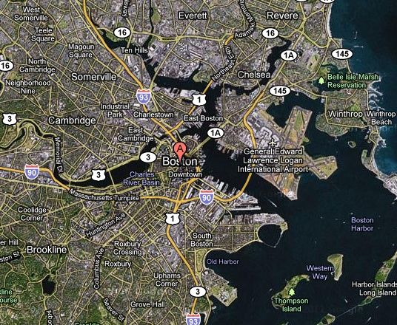
East Boston
Population is just over 50 percent minority
The neighborhood’s median household income is about $31,311 or 57 percent of the regional (metropolitan Boston) average
42% of residents are foreign-born, and some 60% of these have entered the United States after 1990
Nearly 40% of the population speaks only Spanish at home; and approximately 23% of the population is considered to be linguistically isolated
Over 20% of families in East Boston live below the poverty level

Slide 8
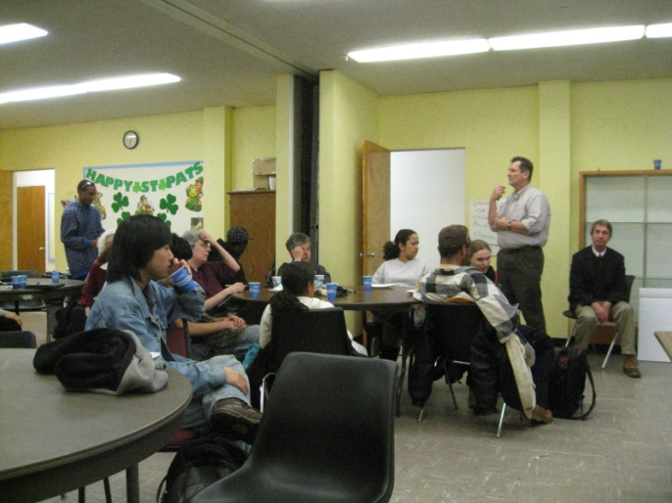
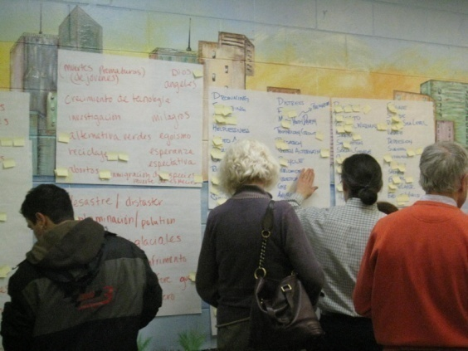
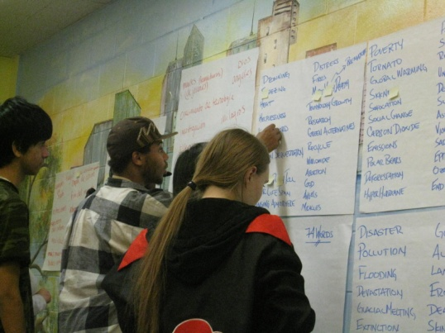
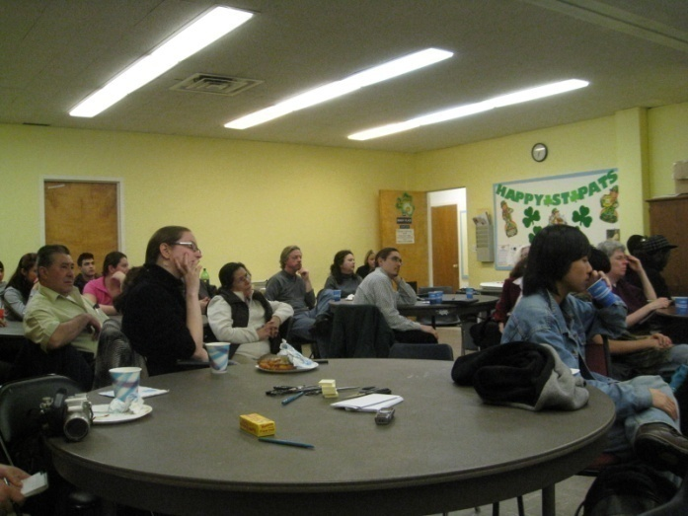
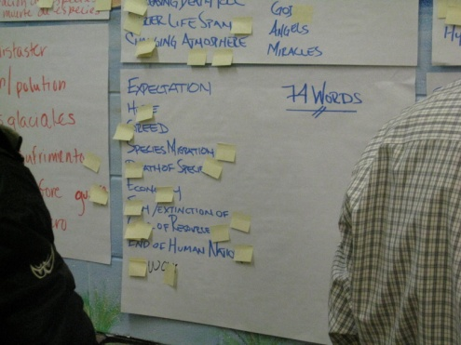
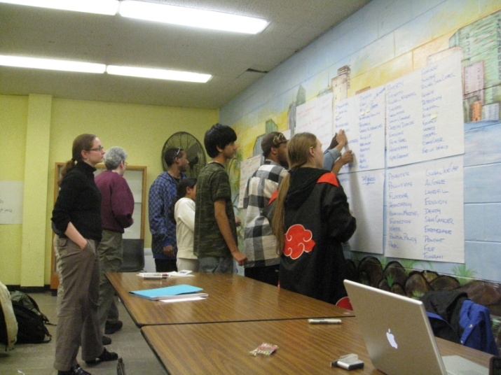
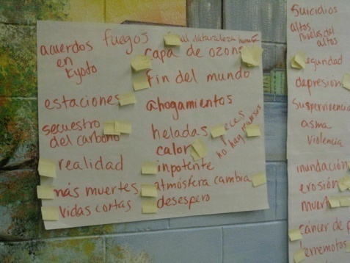
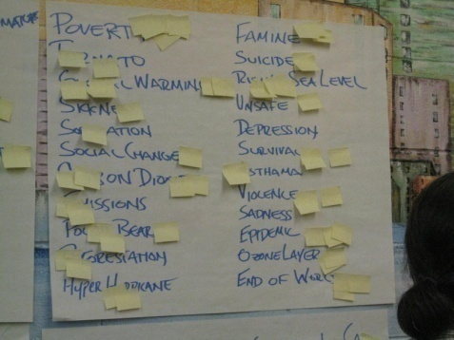
East Boston Workshops
Notes:
Photos from the March 9th East Boston workshop. Community members free listed a total of 74 words and terms they associated with “climate change”. Through ranking these terms the number of important aspects was reduced to 47. Each individual then pile sorted these 47 into groups they felt went together and why. Once analyzed through multi-dimensional scaling and statistical analysis we expect to have a solid understanding of how this community perceives how climate change might affect them. This data will also be compared to the data collected from the other urban and rural communities to understand the differences and similarities in understanding between these diverse communities.

Slide 9
Built Environment
Adaptation Responses
Do Nothing
Accommodate
Protect
Retreat
A mix of actions may be
taken over space and time

Slide 10
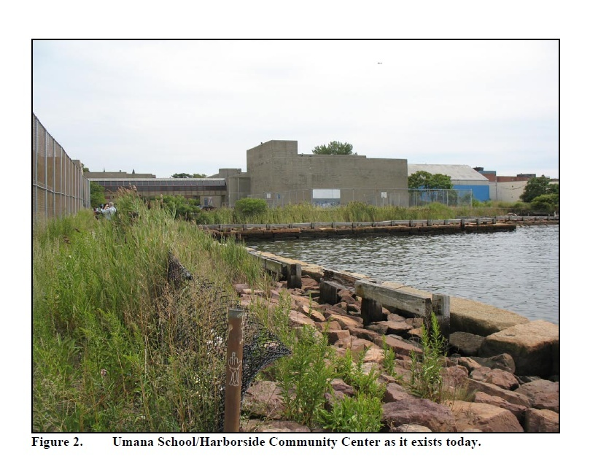
Notes:
A site located where Sea wall may go

Slide 11
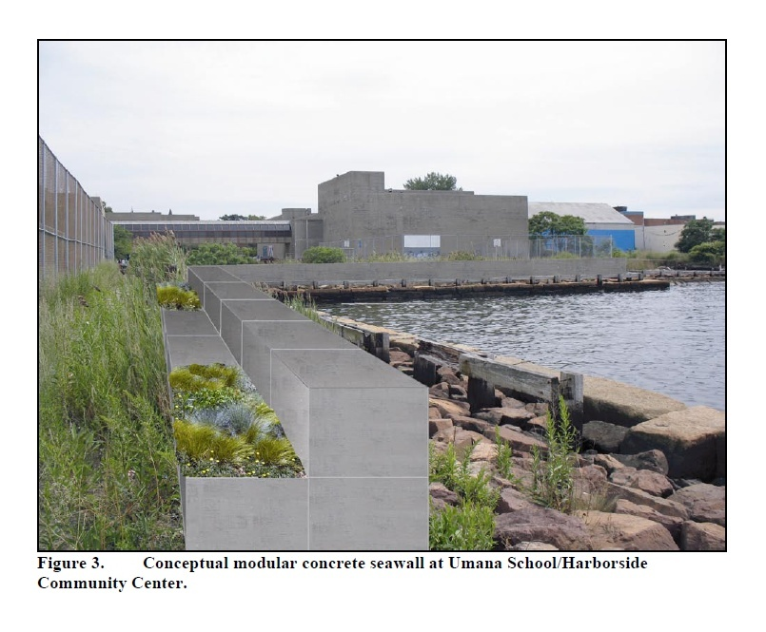
Notes:
This allows flexibility in the future

Slide 12
Final Workshop Questions
Which of the adaptation options seems most doable?
Which options would you object to and why?
What obstacles are in the way to getting the options in place?
What needs to happen to make adaptation a reality?

Slide 13
Some Adaptation Obstacles
Sea walls are generally unattractive and block views
Elevation of some buildings would be unattractive and difficult because many buildings are attached to each other. In addition, since many rented their residents, they would not be able to carry out these options
Evacuation is a concern because of the resulting traffic jams, the costs of staying outside of residents for any period of time, most residents not having cars, and a significant number of disabled and elderly people
Permanent retreat is not seen as an option because of desires of residents to remain close to family and friends and general difficulty of obtaining low priced housing; “permanent moving should not be on the table… People in East Boston have a real identity and roots… there needs to be a better plan for staying here”
Need to coordinate flood protection from multiple sources
Dealing with the local municipal bureaucracy is very difficult.

Slide 14
Some Incentives
They have a very broad ranging view of climate change impacts They do not appear to be climate change naysayers.
They are committed to their communities, out of choice and also a lack of other housing options; they don't want to leave.
Participants prefer options that enhance their present environment and will not require evacuation or permanently leaving the area.
At the end of the process they were eager to continue learning about climate change and recognized that there is the need for an integrated regional flood management strategy.
The participants stated stakeholder driven solutions are necessary, and are eager to engage any available institutions and resources to take action; they seemed less powerless than during the first workshop.

Slide 15
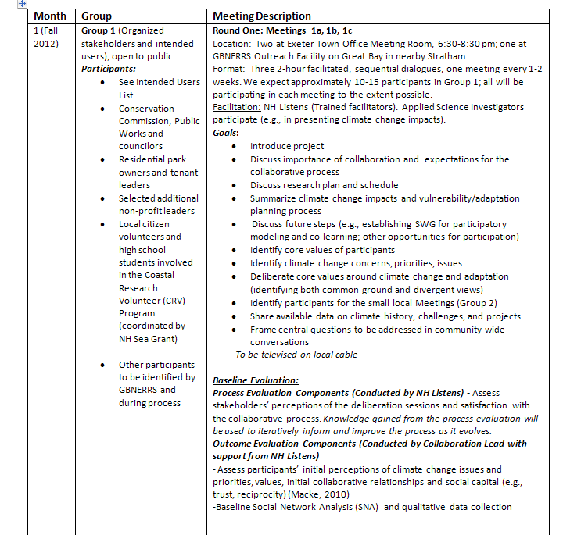
Potential
Collaboration
With Exeter NH
On Adaptation

Slide 16
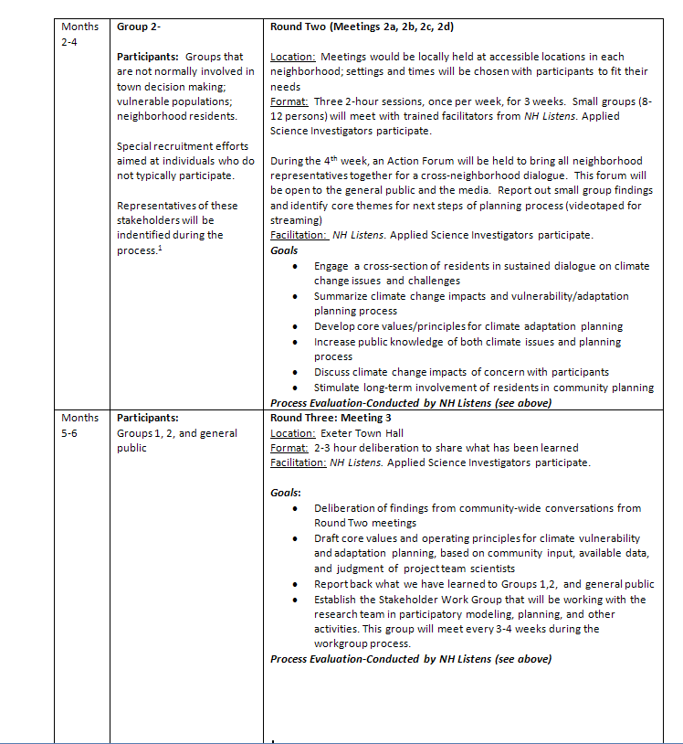

Slide 17
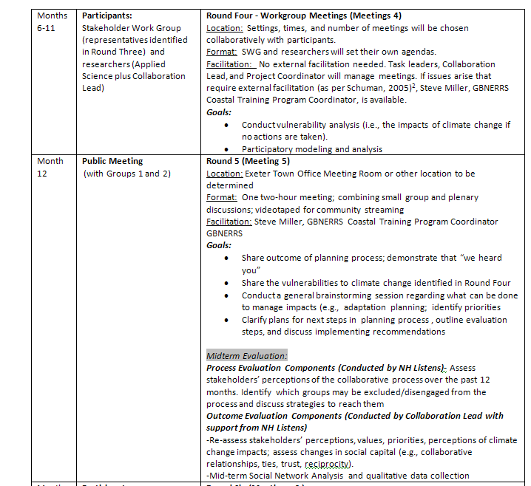

Slide 18
Some Communication Experience

Slide 19
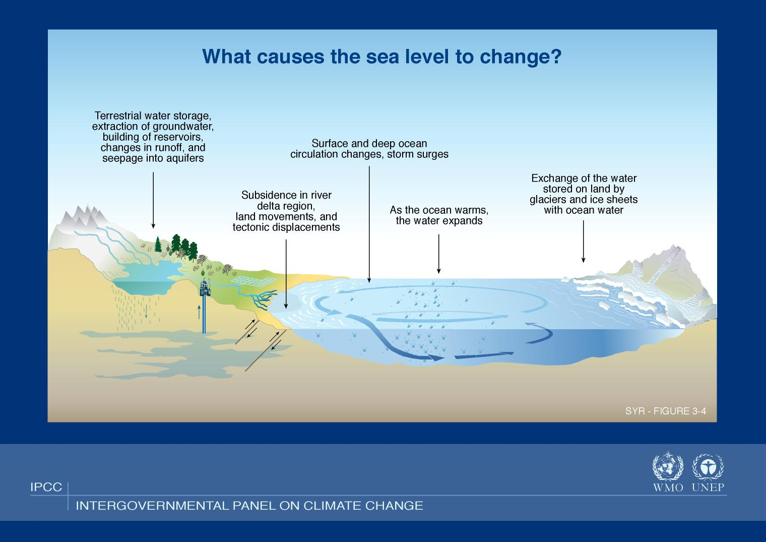
Notes:
What cause SLR To rise ? made up of the following components”
GLOBAL Thermal expansion of sea water
Melt of ice on land
REGIONAL Regional impacts due to changes in ocean currents due to secondary impacts of eg, Greenland ice sheet melt – eg may result in increase of 30 to 51 cm by 2100 in the NE USA
LOCAL Subsidence – exmaple of boston – approx 1 foot of SLR over last century – 6 in is subsidence.
Total effect is relative SLR – change in SLR relative to the land surface

Slide 20
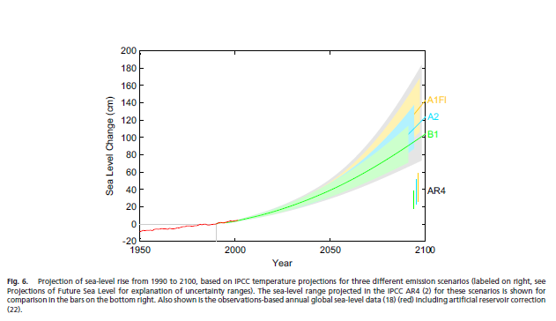
Scenario Projections for Eustatic SLR
Vermeer and Rahmstorf (2009)
Notes:
How much might the global SLR rise over the next century ? It is uncertain primarily due to future GHG emission scenarios (political and socio-economic issue) and sceintific uncertainty on impacts of GHG emissions on the Earth climate systems, particularly the rates of melting of ice on land. The uncertainty range is less in 2050 - ~20 to 50 cm. By 2100 the range based upon some research in 2007, increased to 50 cm to 140 cm. Some more recent work in 2009, increased the 2050 range to ~ 30 to 60 cm, 2100 range to 75 to 190 cm. Some research has suggested the maximum possible by 2100 is 2 meters.
USGCRP 2009 quote The Earth has major ice sheets on Greenland and Antarctica. These ice sheets are currently losing ice volume by increased melting and calving of icebergs, contributing to sea-level rise. The Greenland Ice Sheet has also been experiencing record amounts of surface melting, and a large increase in the rate of mass loss in the past decade.41 If the entire Greenland Ice Sheet melted, it would raise sea level by about 20 feet. The Antarctic Ice Sheet consists of two portions, the West Antarctic Ice Sheet and the East Antarctic Ice Sheet. The West Antarctic Ice Sheet, the more vulnerable to melting of the two, contains enough water to raise global sea levels by about 16 to 20 feet.29 If the East Antarctic Ice Sheet melted entirely, it would raise global sea level by about 200 feet. Complete melting of these ice sheets over this century or the next is thought to be virtually impossible, although past climate records provide precedent for very significant decreases in ice volume, and therefore increases in sea level.42,43
This also highlights the difficulty to climate change adaptation planning - we do not know the future climate and its impacts – but we have planning methods to deal with this – discussed later

Slide 21
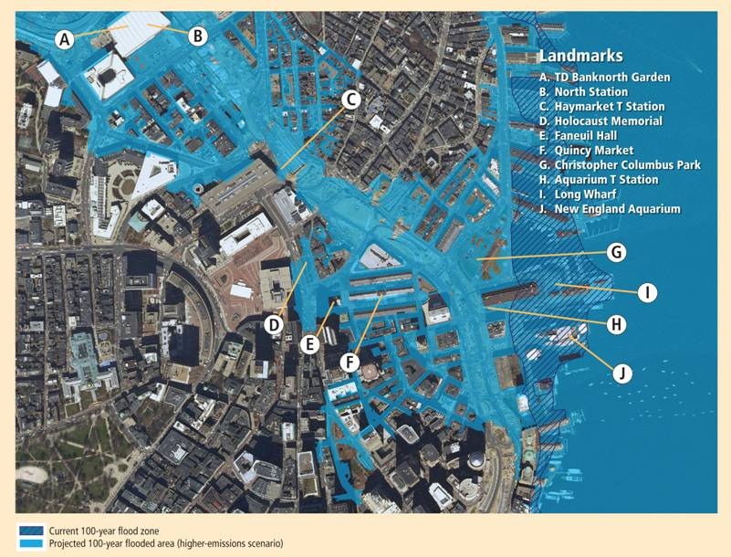
Boston: The Future 100-Year Flood under the Higher-Emissions Scenario
Notes:
Some local impacts we might see due to increased flooding:
Caption: This image shows the current Federal Emergency Management Agency (FEMA ) 100-year flood zone (hatched darker blue) as well as the extent of the projected 100-year flood zone in 2100 (lighter blue) under the higher-emissions scenario for the waterfront/Government Center area of Boston. Important Boston landmarks (such as Faneuil Hall) and transportation infrastructure currently not at great risk of flooding could witness repeated flooding in the future unless protected from such events. Flood elevations under the lower-emissions scenario are roughly half a foot lower than the flooding depicted here (but still 1.5 feet higher than the current 100-year flood).
ADDITIONAL INFORMATION PHK CHECK !
Coastal Flooding
By mid-century substantial changes in coastal flooding are already evident.
Substantial increases in the maximum elevation of major coastal floods are projected for all five locations, but particularly Boston and Atlantic City.
 Substantial increases in the frequency of today’s 100-year floods are expected at all five locations:
Every two to three years in Boston on average (under the higher- and lower-emissions scenarios, respectively)
By 2100, the significance of emissions choices for sea-level rise and coastal flooding become more apparent as both the maximum heights and recurrence intervals of coastal floods increase, particularly under the higher-emissions scenario.
 Most locations are projected to experience increases over the current 100-year-flood elevation of roughly 2.5 feet under the higher-emissions scenario and roughly two feet under the lower-emissions scenario.
Today’s 100-year coastal floods are projected to recur much more often. On average:
Under the higher-emissions scenario, every year or two in Boston
Under the lower-emissions scenario, every year or two in Boston
These projections are based on changes in sea-level rise alone and do not include other potential changes such as shifts in shoreline position or changes in storm frequency, intensity, or track. If storms strike the Northeast’s coast with greater frequency and intensity, for instance, the frequency of coastal floods (and associated damages) would be expected to rise even more.

Slide 22
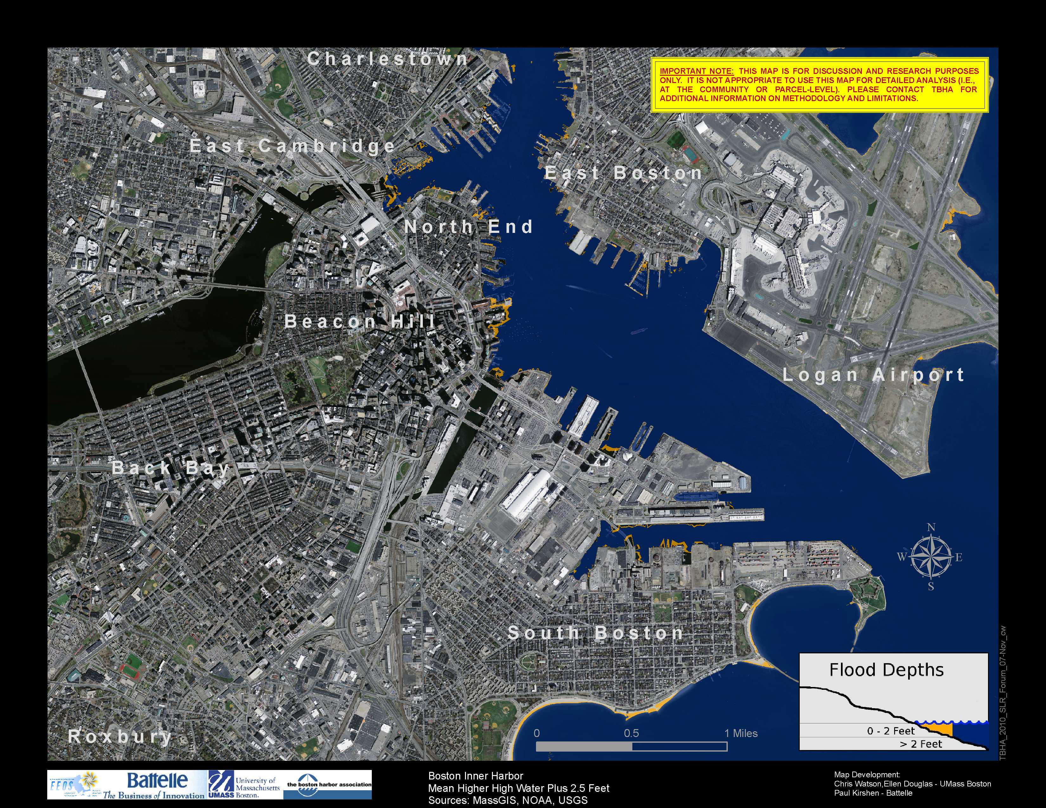
2.5 ft SLR

Slide 23
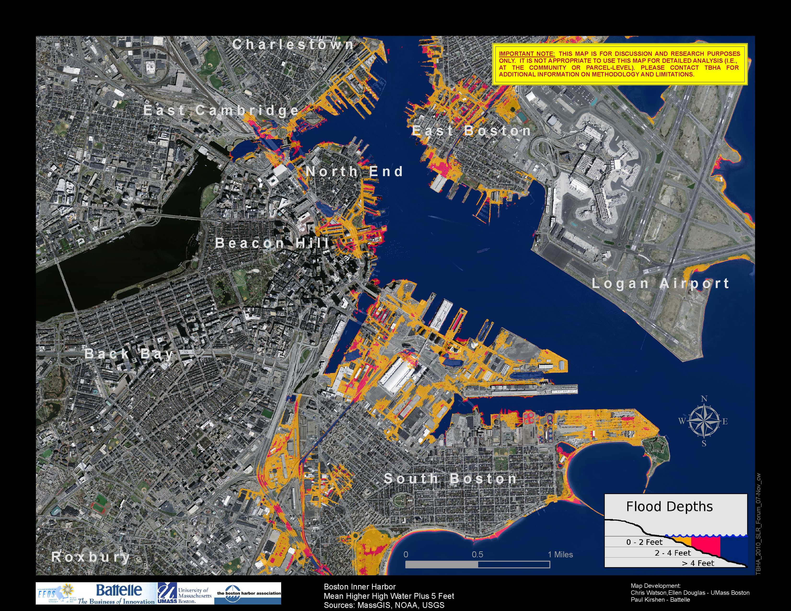
5 ft SLR

Slide 24
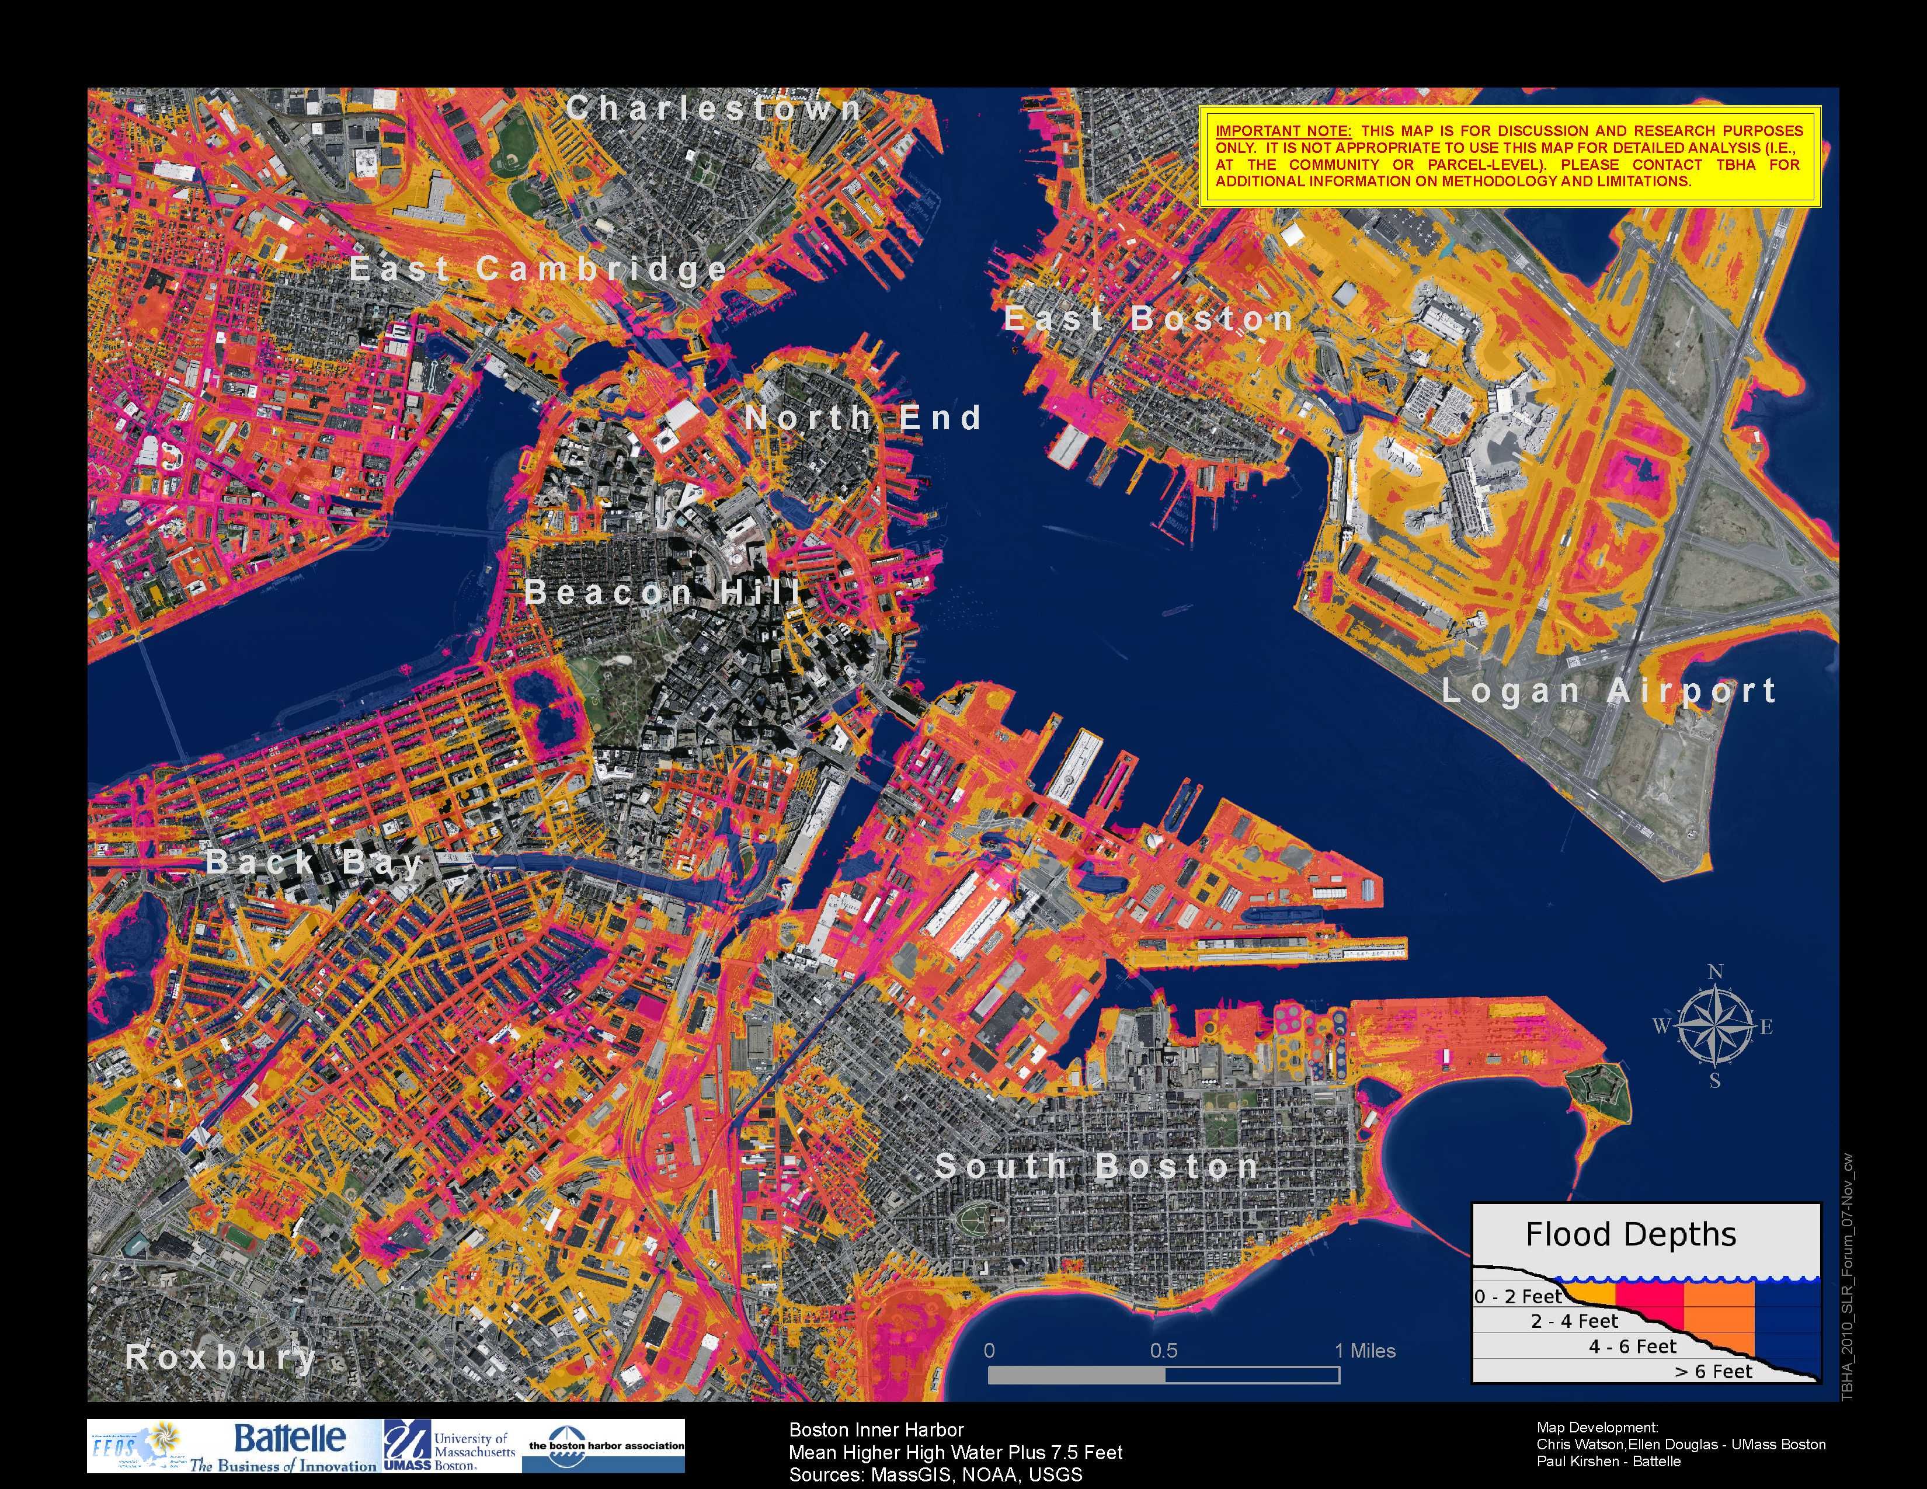
2.5 ft SLR+
5 ft surge

Slide 25
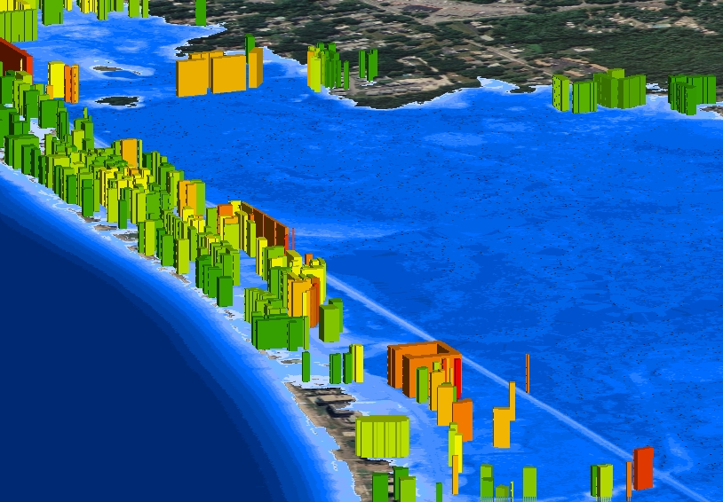

Slide 26
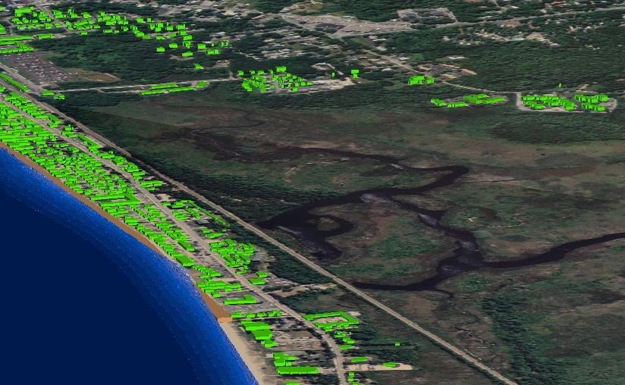

Slide 27
Expected Value Net Benefits (present to 2050)
SLR Scenario | Adptation Action | Expected Value of Residual Damages $million | Adaptation Cost $million | Total Damage and Cost $million | Damages Avoided (Benefit) $million | Net Benefits $million
No SLR | No Action | 680 | 0 | 680 | 0 | -680
 | 100 + | 0 | 60 | 60 | 680 | 620
 | 50 + | 3.4 | 52.4 | 55.8 | 676.6 | 620.8
Low | No Action | 899.3 | 0 | 899.3 | 0 | -899.3
 | 100 + | 0 | 60 | 60 | 899.3 | 839.3
 | 50 + | 28.3 | 52.4 | 80.7 | 871 | 790.3
High | No Action | 1016.6 | 0 | 1016.6 | 0 | -1016.6
 | 100 + | 37.6 | 60 | 97.6 | 979 | 881.4
 | 50 + | 67.8 | 52.4 | 120.2 | 948.8 | 828.6
Beach Nourishing to 100+ works
well over all SLR scenarios

Slide 28
Value Stakeholders
Projects takes longer
Do not underestimate them
Project is better
Thank you

Slide 29
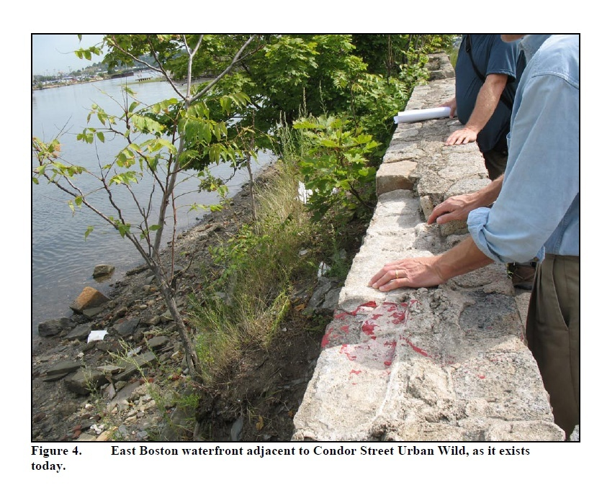
Notes:
Site for potential beach

Slide 30
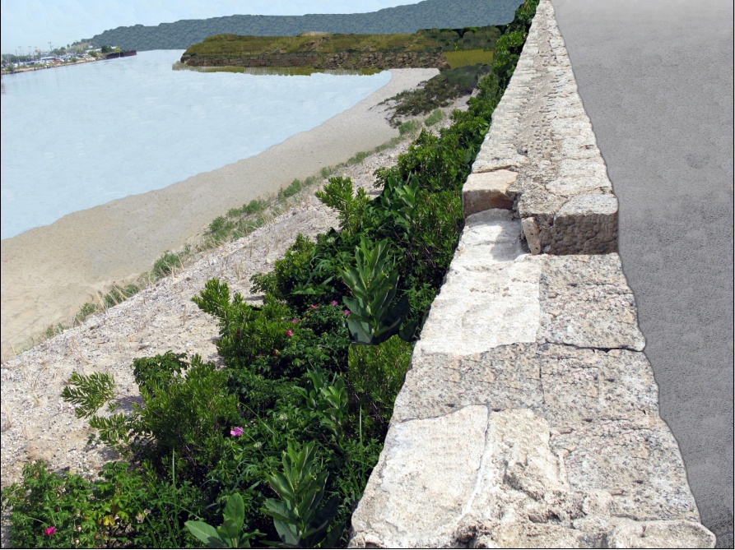
Notes:
Provides both protection and amenities to community and the environment – plus flexible design. WOW !

Slide 31
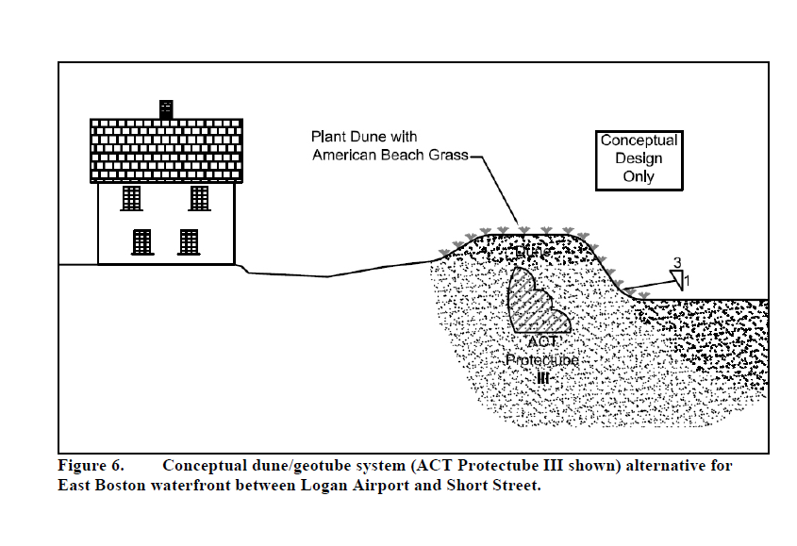

Slide 32
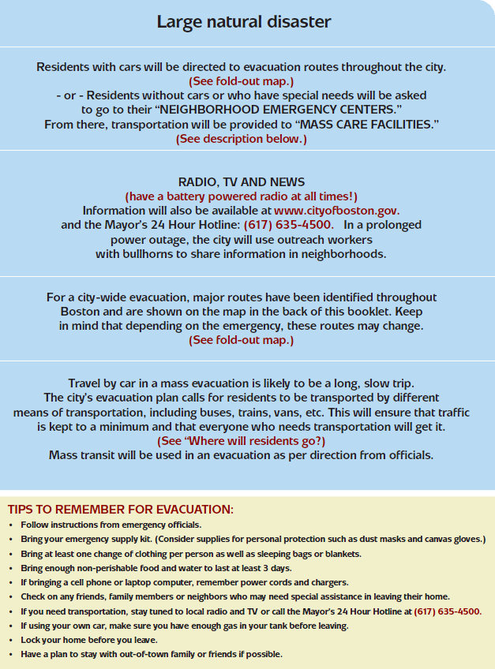
City of Boston
Evacuation
Procedure

Slide 33
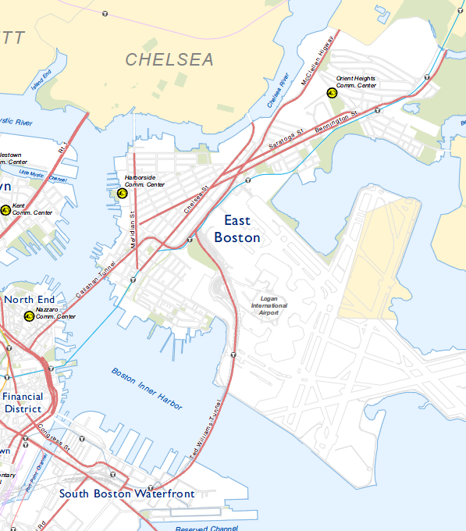
City of Boston Evacuation Routes
&
Emergency
Neighborhood
Centers
12/2005
112 Paris St

Slide 34
Permanent retreat ?

Slide 35
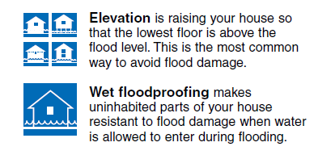

Floodproofing
http://www.fema.gov/library/viewRecord.do?id=1681

Slide 36
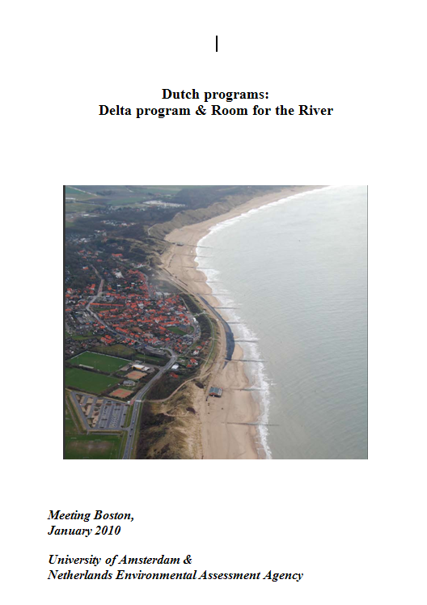
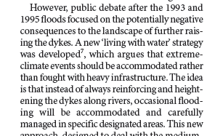
The Netherlands
“Living with Water”
Nature 11 17 05

Slide 37
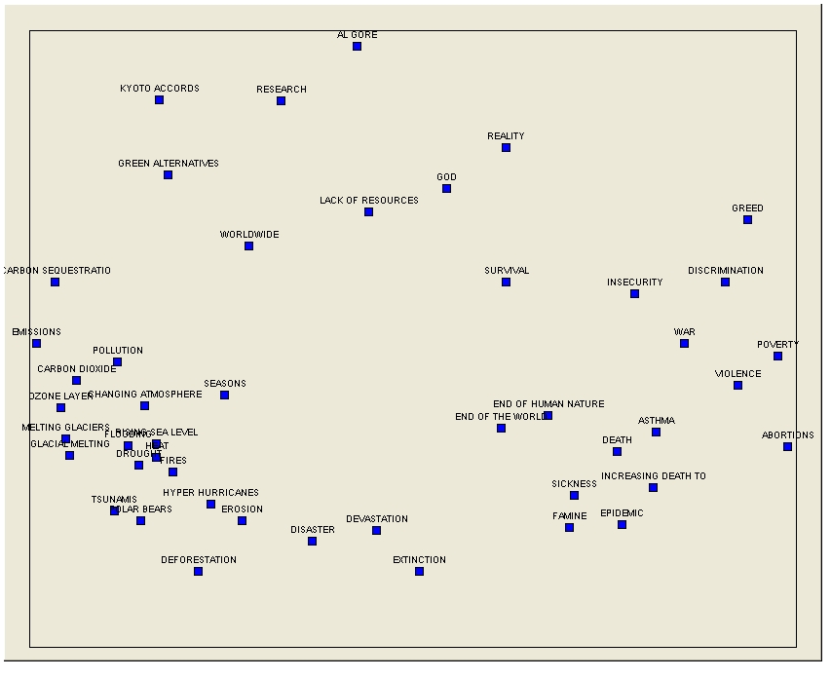
Notes:
Colleagues, Attached is a slightly better plot of the NOAH pile sort data. Some general guidance on how to interpret. First, look for broad patterns. I see a group of terms in the upper left quadrant (Al Gore, Kyoto, green alternatives, research) that suggest, to me, the human efforts to deal with climate change, and notice that God and Reality are close by. What is kinda of interesting is that we don't have that many terms of human efforts to address climate change. Hmmm. Also note that in the bottom left quadrant to center bottom we have the causes and immediate physical and ecological consequences of climate change. Then, in the lower right quadrant you have terms that suggest the health and human consequences of climate change. Overall, the way the terms plotted looked patterned. We could almost draw circles around key group clusters, such as the upper left quadrant terms, etc. and it would be useful to think about the terms that are listed. In addition, we used two dimensions to plot the terms. Thus, we should image two dimensions that might underlie the clusters of terms. So, for example, one possible dimension, going from left to right is physical cause/consequence to human consequence (poverty, violence, etc.). Restated, the implicit thinking is from physical impacts to human consequences, broadly defined. Is the opposite possible? Anyway, this is just a little more. We'll try to explain the plot more tomorrow during our conference call tomorrow morning. Michael and Scott Dr. Michael Paolisso Associate Professor Department of Anthropology 1111 Woods Hall University of Maryland

Slide 38
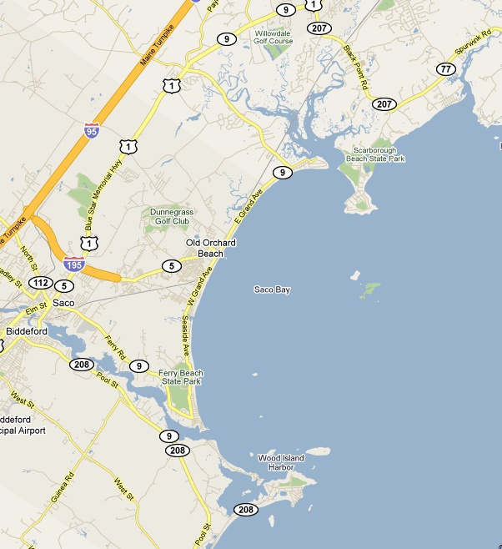
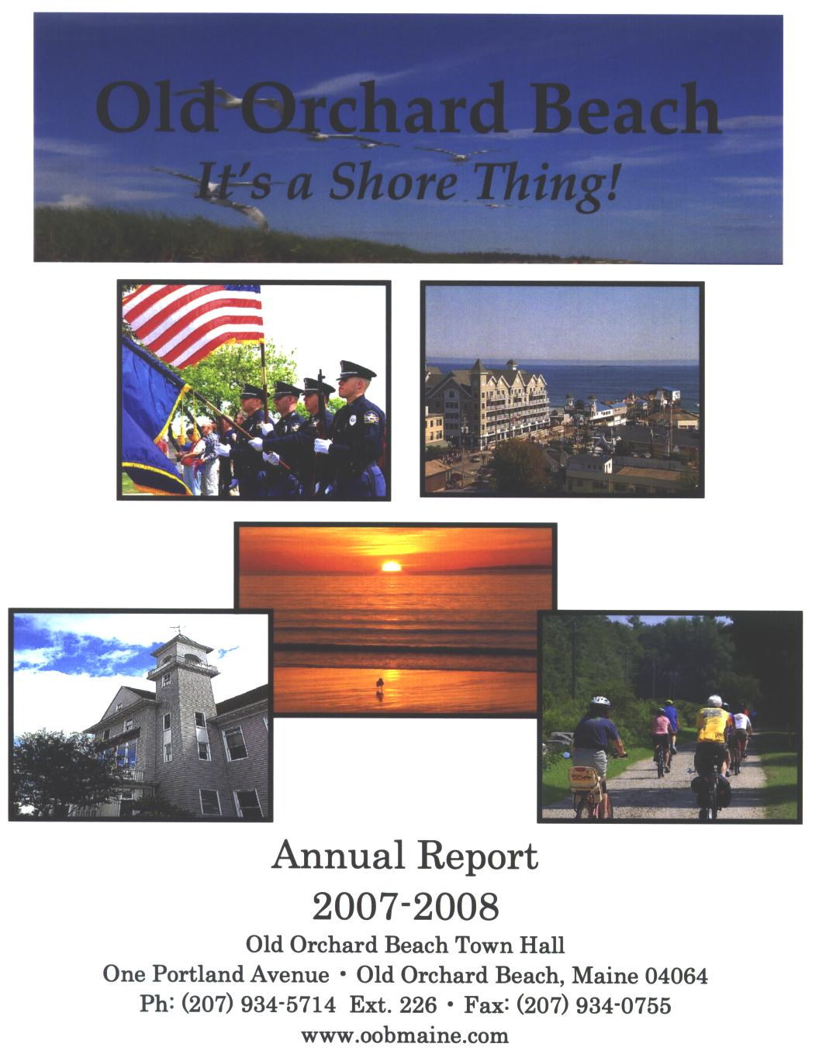
Robust Strategy: Example of Old Orchard Beach, Maine
Notes:
An illustrative example of the simplified scenario-based risk assessment is presented below as a case study for Old Orchard Beach (OOB), Maine in the northeastern USA, shown in Figure 4. This town has a population of 8,900 that swells to over 70,000 during peak tourism season and a long sandy beach along which most of the hotels, restaurants, and other commercial real estate are located

Slide 39
SLR Adaptation Options
Take no action
Nourish the beach in 2010 to an elevation of the present 100 year floodplain plus 0.305 m (action100+)
Nourish the beach in 2010 to an elevation of the present 50 year floodplain plus 0.305 m (action 50+)
Two SLR scenarios – high & low

Slide 40
Notes:
What cause SLR To rise ? made up of the following components”
GLOBAL Thermal expansion of sea water
Melt of ice on land
REGIONAL Regional impacts due to changes in ocean currents due to secondary impacts of eg, Greenland ice sheet melt – eg may result in increase of 30 to 51 cm by 2100 in the NE USA
LOCAL Subsidence – exmaple of boston – approx 1 foot of SLR over last century – 6 in is subsidence.
Total effect is relative SLR – change in SLR relative to the land surface

Slide 41
Scenario Projections for Eustatic SLR
Vermeer and Rahmstorf (2009)
Notes:
How much might the global SLR rise over the next century ? It is uncertain primarily due to future GHG emission scenarios (political and socio-economic issue) and sceintific uncertainty on impacts of GHG emissions on the Earth climate systems, particularly the rates of melting of ice on land. The uncertainty range is less in 2050 - ~20 to 50 cm. By 2100 the range based upon some research in 2007, increased to 50 cm to 140 cm. Some more recent work in 2009, increased the 2050 range to ~ 30 to 60 cm, 2100 range to 75 to 190 cm. Some research has suggested the maximum possible by 2100 is 2 meters.
USGCRP 2009 quote The Earth has major ice sheets on Greenland and Antarctica. These ice sheets are currently losing ice volume by increased melting and calving of icebergs, contributing to sea-level rise. The Greenland Ice Sheet has also been experiencing record amounts of surface melting, and a large increase in the rate of mass loss in the past decade.41 If the entire Greenland Ice Sheet melted, it would raise sea level by about 20 feet. The Antarctic Ice Sheet consists of two portions, the West Antarctic Ice Sheet and the East Antarctic Ice Sheet. The West Antarctic Ice Sheet, the more vulnerable to melting of the two, contains enough water to raise global sea levels by about 16 to 20 feet.29 If the East Antarctic Ice Sheet melted entirely, it would raise global sea level by about 200 feet. Complete melting of these ice sheets over this century or the next is thought to be virtually impossible, although past climate records provide precedent for very significant decreases in ice volume, and therefore increases in sea level.42,43
This also highlights the difficulty to climate change adaptation planning - we do not know the future climate and its impacts – but we have planning methods to deal with this – discussed later

