Slide 1

Scheduling – Requirements Project
Project Kick-off Meeting
June 16, 2010

Slide 2
Agenda
Project Overview
Project Phases
Requirements Phase
Solution Decision Phase
Detail Design Phase
Scheduling Requirements – Scope
Requirements Gathering – Meetings
Project Roles
Review and Sign-off Responsibilities
Communication Plan
Timeline and Milestones
Requirements Phase - Success Metrics
Next Steps

Slide 3
Project Overview
The Scheduling Requirements project is the first step in replacing the existing Classroom and Student Scheduling system. This new system will:
  Meet the current needs of the Registrar’s Office and Academic Departments
  Be flexible enough to support future changes
To accurately define and document the requirements for the new system, the project team has outlined all phases for both the Requirements and Implementation Projects. That way, there is a consistent understanding of the functions and decisions needed in the new system.

Slide 4
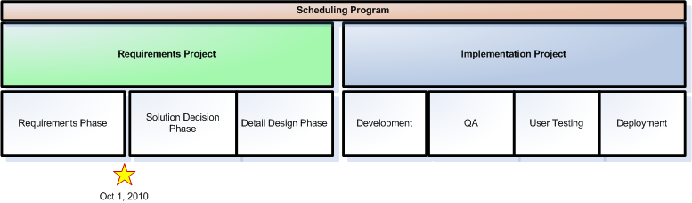
Project Phases
Scheduling Requirements Project
  Requirements Phase
  Solution Decision Phase
  Detail Design Phase
Scheduling Implementation Project
  Development
  QA
  User Testing
  Deployment

Slide 5
  Requirements Phase
Goals:
  Gather requirements from Registrar and all affected departments for a new Scheduling system. This work will be done without any bias towards a particular solution.
Deliverables:
  Requirements Documentation
    Scope Statement
    Business Requirements Document
    Sponsor Sign-Off: Scope Statement
    Sponsor Sign-Off: Business Requirements
  Solution Decision Planning
    Detailed steps for completing the Solution Decision Phase
    Estimate, resources and schedule for Solution Decision phase

Slide 6
  Solution Decision Phase
Goals:
  Using the documents from the Requirements Phase, document potential solution options, perform a gap analysis and recommend a solution for the new Scheduling system. Options to be researched are:
    Packages
    Open-Source
    Custom Build
    Hybrid
Deliverables:
  Solution Decision
    Document potential solutions with recommendations
    Decision: Selected Solution
    Sponsor Sign-off: Solution Decision
  Detail Design Phase Planning
    Detailed steps for completing the Detail Design Phase
    Estimate, resources and schedule for Detail Design phase

Slide 7
  Detail Design Phase
Goals:
  Analyze and document the Functional Specifications and Technical Design for the selected solution. This includes screen mockups, database design, technical implementation approach and integration needs.
Deliverables:
  Detail Design
    Functional Specifications
    Sponsor Sign-off: Functional Specifications
    Technical Specifications
    Internal SAIS Sign-off/Review: Technical Specifications
  Implementation Project Planning
    Estimate, resources and schedule for Implementation Project
    Testing Strategy Document
    High-level Rollout Plan

Slide 8
Scheduling Requirements – Scope
Currently, the Scheduling system is used to define many different processes, interfaces and systems. To be sure that the work is focused through all phases of the Requirements and Implementation projects on what’s needed for the Scheduling system, a Scope Statement has been created. This clearly identifies what’s in-scope and out-of-scope.
This document will be reviewed by the Sponsors for feedback and sign-off.
The Scope Statement is a separate document that will be reviewed after the Kick-Off presentation

Slide 9
Requirements Gathering – Meetings
Registrar/Scheduling Office
Selected Departments
  To be determined with input from the Registrar’s Office
Interface Groups and Applications
  CIS (already held)
  WTW
  Stellar
  HASS Lottery (Meet with SAIS Team and Registrar)
  Sloan Bidding (Meet with SAIS Team and Registrar)
  Online Grading Project Team (already held)
  Data Warehouse
Who should be included in the meetings?

Slide 10
Project Roles
Sponsors
  Mary Callahan
  Eamon Kearns
Project Team
  Subject Matter Experts
    Mary Callahan
    Brian Canavan
    Jo Flessner-Filzen
    Wayne Johnson
  SAIS
    Stuart Brown (Technical Lead)
    Bob Principato (Business Analyst)
    Lori Singer (Project Manager)
    Joanne Stevenson (Business Lead)

Slide 11
Review and Sign-off Responsibilities
Determine who will review document and how feedback will be incorporated
  Project Team (SAIS and DUE)
  Sponsors
  Departments?
  Groups identified as interfaces?
Determine who will sign-off on documents
  Sponsors
  Anyone else?
Who will be the Functional Decision Maker?

Slide 12
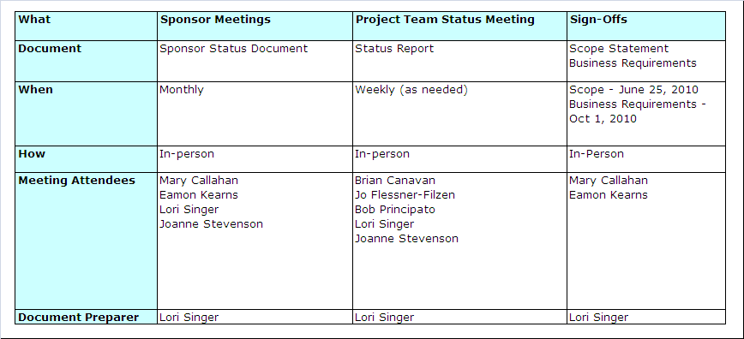
Communication Plan

Slide 13
Timeline and Milestones
Requirements Gathering
  Now – July 30
  Meetings
    Registrar
    Selected Departments
    Interface Groups
Requirements Documentation
  Create Business Requirements Document: Aug 2-Aug 20
  SAIS Document Review and Update: Aug 23 – Sept 3
  User Document Review and Update: Sept 13 – Oct 1
Solution Decision Phase Planning
  Document Steps for Solution Decision Phase: July 12 – July 23
  Develop Schedule, Estimate and Resource Needs for Solution Decision Phase: Aug 16 – Oct 1

Slide 14
Requirements Phase - Success Criteria
All Scheduling Requirements will be Documented
  Will provide a consistent understanding of the functions included in the project
  Will help in future project phases since the team will be able to reference decisions and information without having to re-open questions
Clear Plan for the Solution Decision
  Will have a clear plan for comparing the requirements to potential solutions to be able to make the best decisions

Slide 15
Next Steps
Review and Sign-off Scope Document
Determine Departments to include in the requirements gathering
Schedule meetings

