Slide 1
Hourly Student Appointment Automation Project
Project Kick-Off
March 31, 2011
1, 2011

Slide 2
Agenda
Welcome/Introductions
Project Sponsors
Project Background
Business Goals and Objectives
Benefits to User Community
Project Scope Overview / Out of Scope
High Level Project Timeline
Project Processes
Project Roles
Critical Success Factors
Next Steps

Slide 3
Welcome/Introductions
Name
Department
Project Perspective/Role

Slide 4
Opening Remarks
Project Sponsors

Slide 5
Project Background
Each year the HR Payroll Service Center manually processes 7000 hourly-paid MIT student appointments, including 600-700 graduate student hourly appointments.
The current process involves:
  Manual entry of hourly-paid student appointments in SAP
  Dual data entry and in the case of UROPs, triple data entry
This project will automate the existing manual process, moving MIT one step closer to achieving the strategic goal of becoming a ‘digital MIT’.

Slide 6
Business Goals and Objectives
Improve customer service and customer satisfaction
Increase accuracy
Improve operational efficiency
Eliminate dual/triple data entry
Automate workflows
Improve compliance with MIT policy and immigration regulations regarding the maximum hours a student is allowed to work (2009 Audit Finding)
Reduce labor and printing costs by a minimum of $30,000/year

Slide 7
Benefits to the User Community
Improved data entry tool that addresses problems with the existing electronic student personnel (eSPAF) form
Quicker turnaround processing times
Replace manual approvals with electronic approvals
Increased student administrators’ visibility to processing status of the hourly student appointment
Fewer errors
Service Center has more time for customer support
Faster, more accurate payment to students
Improved visibility to students working more than maximum allowed hours
Notes:
Examples of improvements;
Data entry tool – right now there is no distinction between activate, change, terminate. User must enter all fields required for a new position;
e.g extension, only need to change end date and provide cost object. Right now you would have to complete start and end date, position title, job title, time group etc.
Quicker turnaround times
In future we will have direct update; HR-Pay Service Center is agreeing to provide 24 hour processing in most cases
Replace paper approvals – e.g. if hourly rate is >$25, user adds a comment during data entry, then Lilian (Svc Ctr) gets ODGE approval
Increased visibility - Right now there is no confirmation the position request was processed in SAP. We want to provide a feedback loop so users know where the request is at each point of the process
Fewer errors – build validations on the front end to help prevent bad data from getting into the system; eliminate human error associated with data entry
Customer support – automation frees up Service Center Reps so they have more time to focus on customer support

Slide 8
Project Scope Overview
IMPROVE WEB-BASED DATA ENTRY (ESPAF) FORM
REPLACE EXISTING MANUAL DATA ENTRY BY AUTOMATING:
  New hires
  Changes (e.g. appointment extensions, hourly rate, position title)
  Terminations
AND:
  Add new routing and approvals to monitor compliance with MIT Policy and immigration regulations
  Provide a central override capability for allowed exceptions

Slide 9
Out of Scope
Cost object changes
  Continue to process through ESDS
Processing appointments for MIT students who work at Lincoln Laboratories
  Continue to process through the Lincoln interface

Slide 10
High Level Project Timeline / Deliverables
Discovery
  Requirements 03/02/2011 - 03/31/2011
  Design 04/04/2011 - 04/30/2011
Key Deliverables
  Business Requirements
  Technical Design Specifications
  Technical Solution and Implementation Estimates
Next Steps
  ASPCC Update
  Implementation

Slide 11
Project Processes
Status Updates
  Weekly project team meeting
  Weekly email to key stakeholders, IS&T managers, project team
Project Steering Committee Check-Ins
  Conducted monthly
Change Control & Issue Resolution Process
  Changes will be approved by Business Owners
  Major issues will be resolved by the project’s Steering Committee
Project Notebook
  Project Wiki
  https://wikis.mit.edu/confluence/display/HrlyStdtAppts/Home

Slide 12
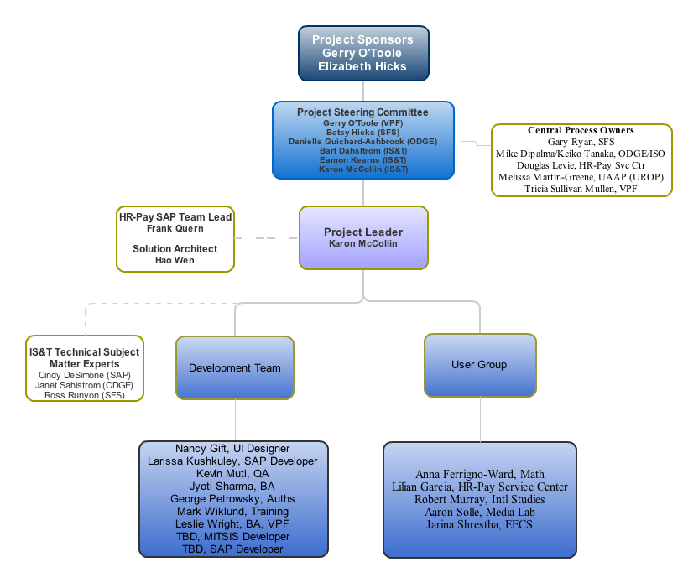
Project Roles

Slide 13
Key Success Criteria
Business Process Owners involvement is essential and required
Upfront input and frequent user feedback to the development team is essential
Key decisions need to be made in a timely fashion

Slide 14
Next Steps on Project Calendar
Activity | Target Completion Date
Requirements Review and Sign-off | 4/10/2011
Complete Design | 4/30/2011
Provide implementation estimates | 4/30/2011
Quick Win – Automated generation of reports to monitor maximum hours a student works | 05/2011
Update ASPCC | 05/2011
Start development | 05/2011

Slide 15

QUESTIONS

Slide 16


