Slide 1

Andrew Watchorn, Academic Field Engineer

Slide 2
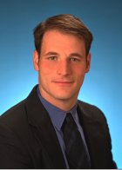
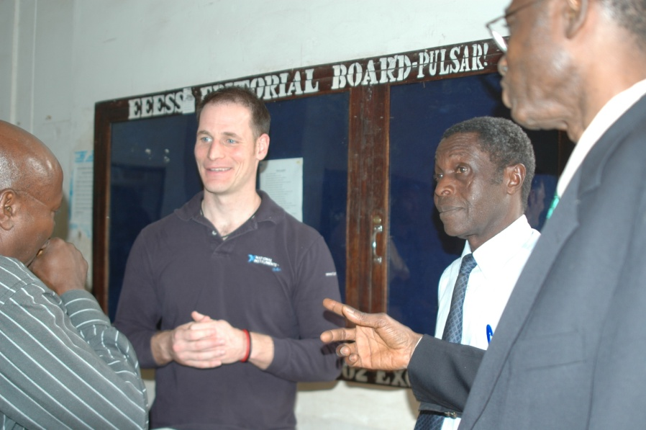
Who am I?
Academic Field Engineer:
    Support Universities activities in the Curriculum for Engineering Disciplines
    Since 2004 close contact with 30+Universities From VA-MA-MN
Education and other work:
University of Michigan
BSE Engineering – Physics
BMus Education
Delco(GM, Delphi, Hughes, etc..)
Student engineer (7 years)
National Instruments
Support/Support Manager (2years)
Salesman (3 years, Virginia)

Slide 3
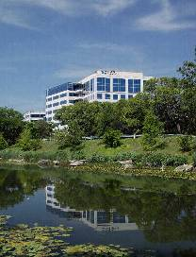

National Instruments
30 Year Leaders in Computer-Based Measurement and Automation
5100 Employees
  2500 Engineers and Technicians
Corporate Headquarters in Austin, Texas
  Direct Operations in 40 Countries
10 Years
$821M in 2008
Direct Sales Offices
Distributors
Notes:
Headquartered in Austin, Texas, NI has more than 3,800 employees and direct operations in more than 40 countries. Along with the more than 1,000 measurement, control, and automation tools we offer, NI recognizes more than 600 members in our National Instruments Alliance Partner Program (a network of independent consultants and integrators) ready to assist you in assembling and implementing an NI measurement and automation solution. These Alliance Partners offer domain expertise from process control to discrete manufacturing for oil and gas, aerospace, automotive, electronics, communications, and semiconductor industries.

Slide 4
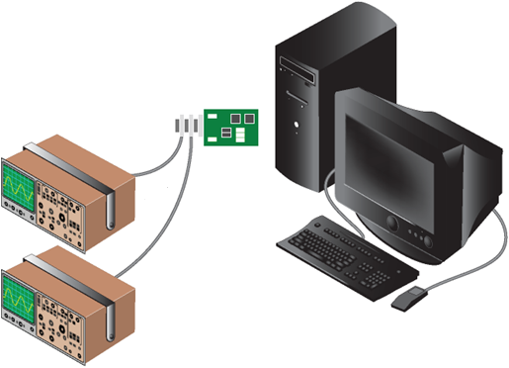
Instrumentation to Innovation
(1976) Boards that help computers talk to Instruments
GPIB (general purpose interface bus) is a standard interface for communication between instruments and controllers from various vendors

Slide 5
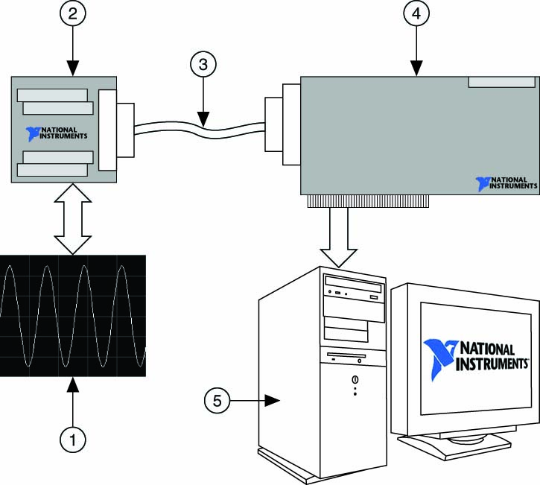
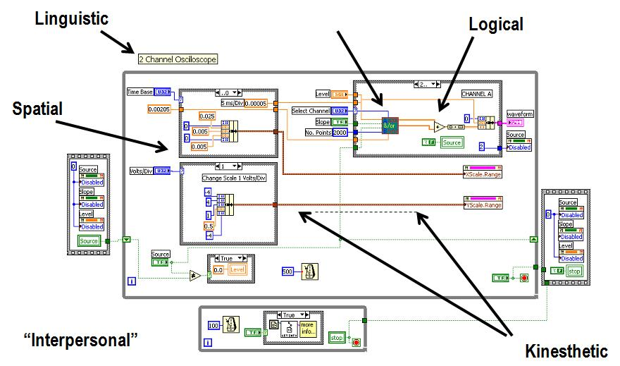
Instrumentation to Innovation
(1986) Graphical Programming and DAQ
DAQ

Slide 6
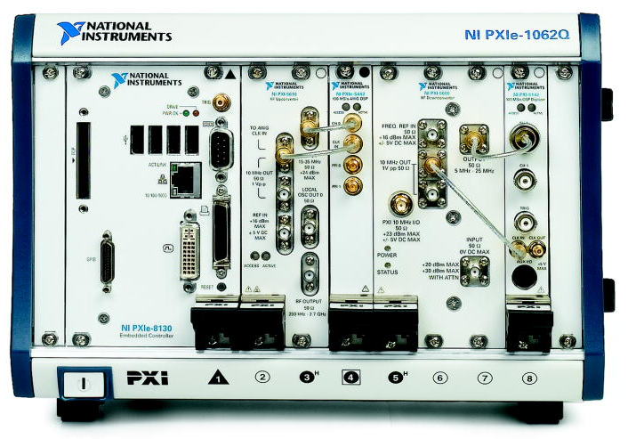
Instrumentation to Innovation
(1995) Computers as an Industrial Platform (PXI)

Slide 7
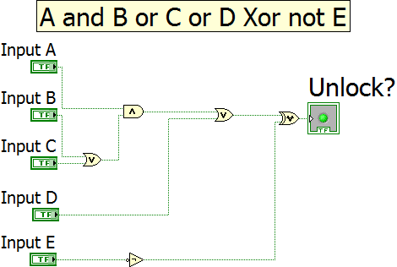
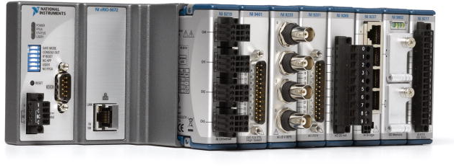
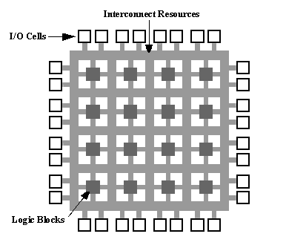
Instrumentation to Innovation
(2002) Graphical Programming for System Design
Real Time Controller + FPGA + I/O

Slide 8
Message to the FIRST Robotics teams
PRACTICE
(On real systems by the way, not just by doing Math…)
…p.s. the first person to 10,000 hours wins
Notes:
So, from the engineering p.o.v. what will it take to tackle these problems?

Slide 9
Practice makes perfect: “Outliers Summarized”
It takes about 10,000 hours to become world class at something
The first people who are able to act on their 10,000 hours spent working in an area can make the biggest impact in that area
Notes:
So, from the engineering p.o.v. what will it take to tackle these problems?

Slide 10
How long is 10,000 hours?
10 years spending 2.71 hours a day
People spend 2.71 hours a day watching TV (on or offline)
How old will the FTCer’s be when they get 10,000?
24 years old
Notes:
So, from the engineering p.o.v. what will it take to tackle these problems?

Slide 11
Comparisons
Bill Gates founds Microsoft: 20 years old
Zuckerberg starts Facebook: 20 years old
Mozart writes K 165: 18 years old
Notes:
So, from the engineering p.o.v. what will it take to tackle these problems?

Slide 12
NI + iLabs = Personal Learning

Slide 13
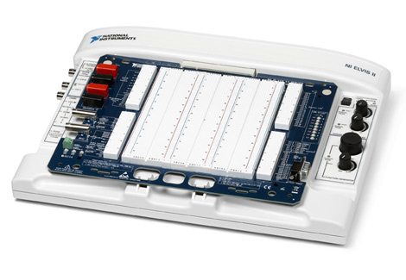
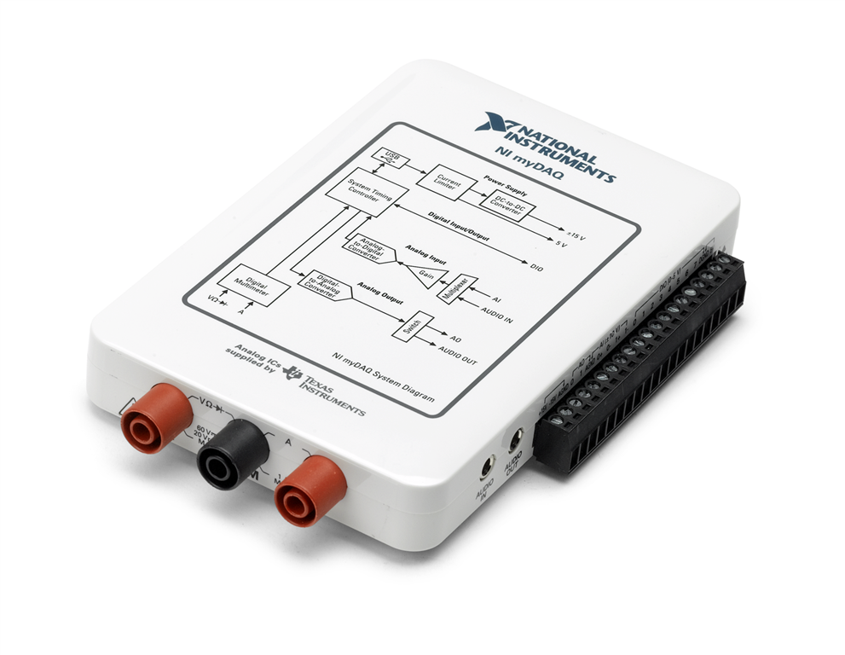
iLabs and NI (Circuits+Computer Eng)
iLabs and in HAND
NI myDAQ ~$200
(student purchased)
NI ELVIS
Cost $2500
Number of students served w/ilabs
1000s

Slide 14

iLabs and NI (RF)
iLabs and in HAND
NI myDAQ ~$200
(student purchased)
NI USRP (Universal Software Radio)
Cost $2500
Number of students served w/ilabs
1000s

Slide 15
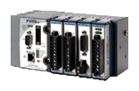
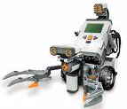
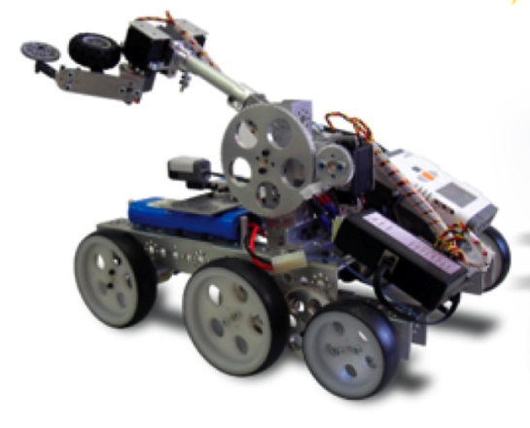
iLabs and NI (Robotics)
iLabs and in HAND
FLL Kit ~$500
(H.S. purchased)
CompactRIO
NI cRIO-9024
LabVIEW Robotics + cRIO
Cost $4000
Number of students serverd w/ilabs
1000s

Slide 16
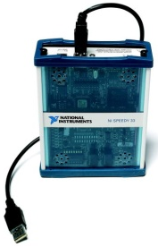
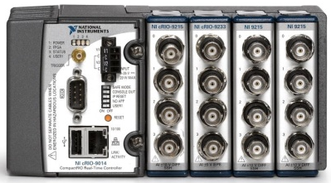
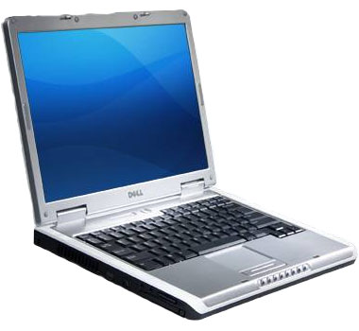

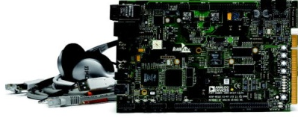
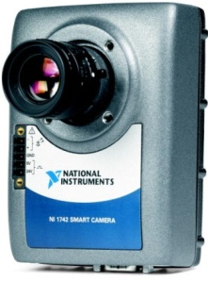
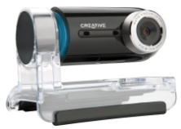

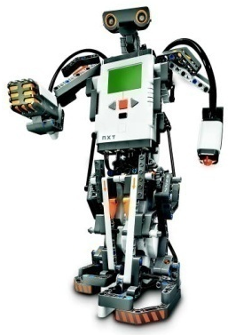
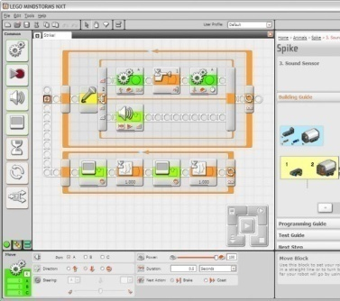
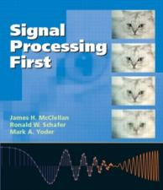
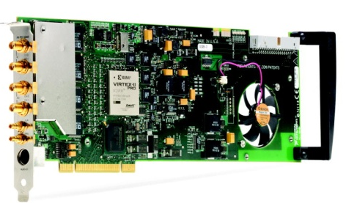
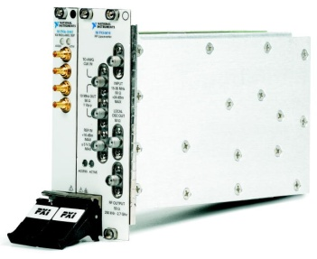
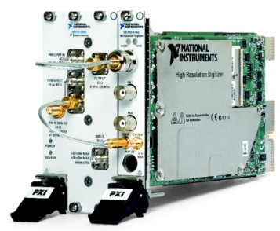
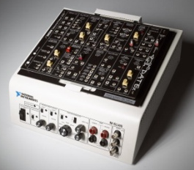
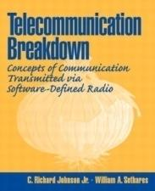

Age Appropriate Practice’s end result
K-12
Science and Engineering Education
Research
Industry
Repetition
Relevance
Ownership

Slide 17
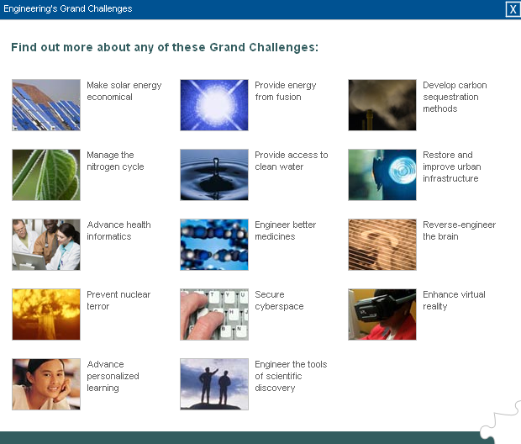


Slide 18
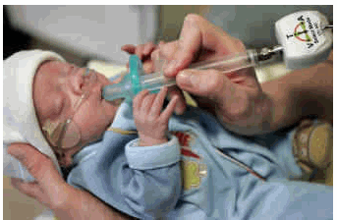
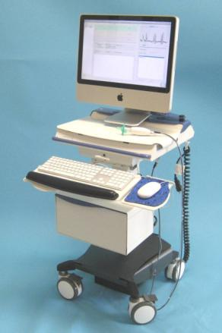
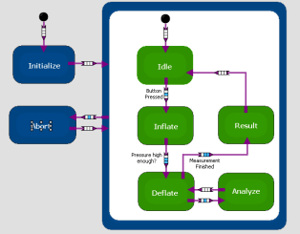
Biomedical Companies
Over 200,000 premature infants born in the U.S. each year with feeding problems
  Ntrainer System® teaches babies to feed
NTrainer System® Prototyped on NI CompactRIO and LabVIEW Statechart Module
  Pressure monitoring/control
“With National Instruments LabVIEW and NI CompactRIO, we were able to reduce our development cost by $250,000…from 4 months to 4 weeks”
Dave Stalling, Chief Technical Officer, KCBioMediX
Notes:
Image:
Born at just 24 weeks gestation, tiny Marshall Pence learned to suck with the aid of the new computerized pacifier developed by KC BioMediX.
The Challenge:
Up to one-third of the more than 600,000 premature infants born in the United States each year have feeding problems when their brains struggle to coordinate sucking, swallowing and breathing. Infants born prematurely often spend weeks, and sometimes months with tubes taped to their face or in masks to help them breathe. That hinders them from learning how to eat at a critically important stage of brain development.
The Solution:
KCBioMediX,Inc.-----a start-up medical device company based in Shawnee, KS, is creating a product called the NTrainer System® that will help premature babies learn to oral feed and greatly increase the chances for survival. The device is essentially is a computerized pacifier that makes the pacifier tip pulse with gentle bursts of air. Doctors or nurses can use the device to get a far more accurate assessment of a baby’s feeding ability, and then begin therapy to help the baby learn to suck.
Research studies have demonstrated that the NTrainer System® therapy actually trains the brain of a premature infant, speeding their ability to eat without feeding tubes, and boosting their chances to thrive. The company’s leaders, and the scientist who invented the technology, contend this is a vast improvement over previous methods of placing a gloved finger in a baby’s mouth.
“When the baby just gets it, it’s like a switch,” said Michael Litscher, a co-founder and chief executive officer of the company. “They are not sucking, and all of a sudden they are sucking. Getting them to that point quickly is what the NTrainer System® is all about.”
About the Design:
Initially, KCBioMediX , Inc. began their design process by using a custom embedded solution, and worked with a 3rd party company to commercialize the treatment. When it became clear that the cost was too high, they decided to bring the development in house.
In only three weeks, the lead software engineer was able to use National Instruments LabVIEW and NI Compact RIO to create proof of concept demonstrating the ability of the cRIO to replace the custom embedded solution. The software architecture was developed with LabVIEW Real-Time, LabVIEW FPGA, and the LabVIEW Statechart modules. For the first round of commercial devices, KCBioMediX, Inc. decided to deploy NI CompactRIO. For high-volume deployment, they will use Single-Board RIO to create a more cost-optimized version while fully maintaining their software development investment.
“With National Instruments LabVIEW and NI CompactRIO, we were able to reduce our development cost by $250,000” said Dave Stalling, Chief Technical Officer, of KCBioMediX, Inc. “In addition, we were able to reduce our development time from 4 months, to 4 weeks, and avoid the necessity of developing custom control software and drivers.”
Authors:
Barry Price
Director Sales, Marketing New Business Development, KCBioMediX, Inc.
Daryl Farr
Mechanical and Electrical Engineer, KCBioMediX,Inc.

Slide 19
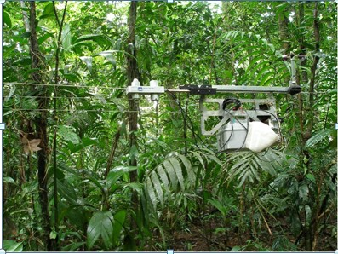

Green Companies
Measure fluxes of carbon between forest & atmosphere
One device for
  Robotic controls, remote configuration & data sharing
NI technology used
  NI LabVIEW
  NI CompactRIO
"Because of the flexibility of LabVIEW, we can configure measurement types, select channels, and even add scaling from a laptop connected to the system. “
Environmental Monitoring
Costa Rica

Slide 20
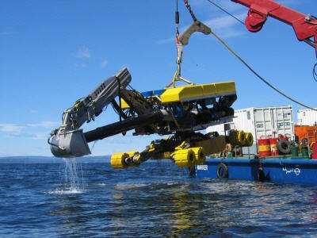
Energy Companies
Nexans uses NI LabVIEW and CompactRIO to control hydraulic systems on the Spider, a remote operated vehicle designed to operate on the ocean floor.
Nexans Spider Dredging System

Slide 21
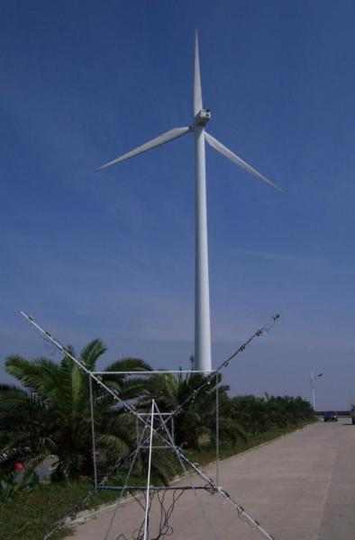
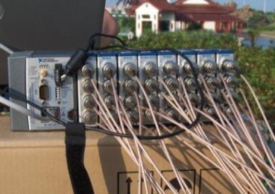
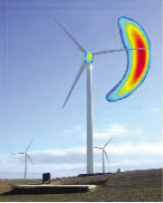
Green-Energy Companies
Wind Turbine Sound Characterization
East China Power Administration
Acoustic beamforming:
  Identifies sound sources
  Estimates sound field distribution
Obtains sound distribution by scanning different spatial directions
Requirements
  High channel-count acquisition from a microphone array
  Realtime processing and visualization
Notes:
The wind turbine shown in the large image was tested by our LV-FPGA based online beamformer as a proof of concept demonstration for East China Power Administration (ECPA). ECPA is responsible for installation and service. NI wants to convince ECPA that an online acoustic beamforming application can improve their installation quality.

Slide 22

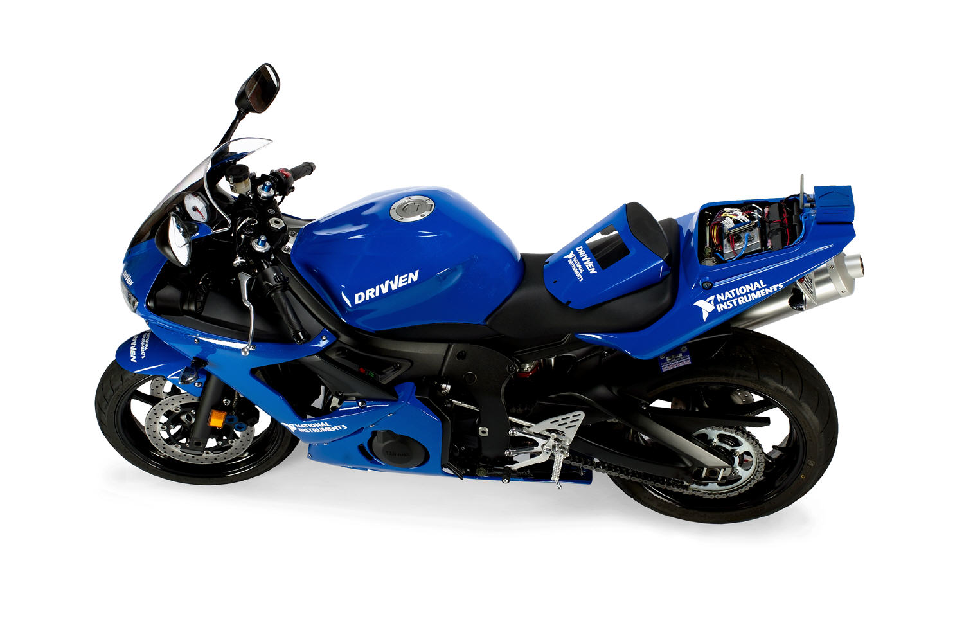
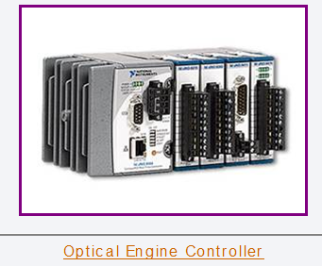
Automotive Companies
Yamaha YZF-R6
Prototype and Engine controller…
…then sell it
Notes:
The wind turbine shown in the large image was tested by our LV-FPGA based online beamformer as a proof of concept demonstration for East China Power Administration (ECPA). ECPA is responsible for installation and service. NI wants to convince ECPA that an online acoustic beamforming application can improve their installation quality.

Slide 23
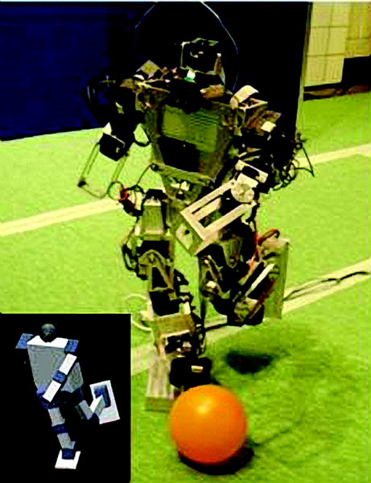

Robotics Companies
Developed a robotic system to act as a research platform for studies on novel locomotion and to serve as the first United States entry into RoboCup, a soccer competition for autonomous robots.
Build a humanoid soccer playing robot…
…and compete
Notes:
The wind turbine shown in the large image was tested by our LV-FPGA based online beamformer as a proof of concept demonstration for East China Power Administration (ECPA). ECPA is responsible for installation and service. NI wants to convince ECPA that an online acoustic beamforming application can improve their installation quality.

Slide 24
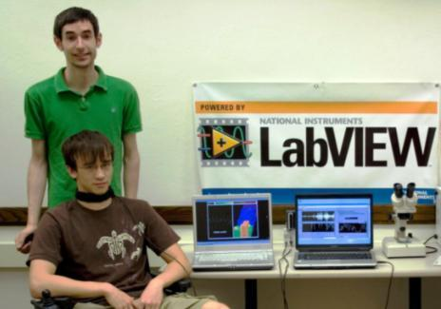

Biomedical Robotics Companies
Application: University of Illinois at Urbana-Champaign (UIUC) engineering students developed a device that translates thought into speech or commands for control over wheelchairs and other devices. They used LabVIEW to develop the signal processing algorithms for translation algorithms and implement prototypes.
NI Products: Signal Processing in LabVIEW, cRIO
www.theaudeo.com
“Working with LabVIEW simplifies development and encourages innovation by offering an intuitive graphical programming approach that allows you to focus on innovation rather than programming details.”
Michael Callahan, CEO, Ambient Corporation
Notes:
Michael Callahan, a recent graduate of the systems and entrepreneurial engineering program at the University of Illinois at Urbana-Champaign (UIUC), recently received the prestigious Lemelson-Illinois Student Prize. The award recognizes Callahan for developing a device that will profoundly benefit people with amyotrophic lateral sclerosis (ALS / Lou Gherig's Disease), Cerebral Palsy, spinal cord injury, or other neurological disorders. The device, dubbed "The Audeo," acquires and translates neurological signals, so subjects who could not speak or move can communicate. Callahan has teamed up with Thomas Coleman and other UIUC colleagues to start their own company – Ambient Corporation – to develop and commercialize the technology. National Instruments LabVIEW has played a key role in doing so.
The Audeo is a sensory device that is placed around the neck of an afflicted individual. In operation, it intercepts the signals from the brain that control the vocal chords and the vocal tract. These signals then are sent to a computer that filters out the noise from any background sources, processes it using a complex signal processing algorithm and then interprets the individual’s meaning from the signals to produce speech. The speech can then either be output directly or used to control external devices, such as a motorized wheelchair.
The team has implemented prototypes that rely on an application built using LabVIEW to control the acquisition and apply the signal processing that translates the nerve impulse signal samples into commands for wheelchair control, or to be spoken.
To control a wheelchair, the system needs to identify directional commands – forward, right, left and stop. For it to do so, the software identifies those singular commands from the speech patterns - rather than process the data to produce continuous speech.
The continuous speech processing strategy that would allow the user to hear what they are producing as they are doing so is still in development. “One of the challenges,” explained Callahan, “is to develop a universal mathematical transformation of the data that would work well for everyone - not just for a specific individual.”
The job requires sophisticated signal processing algorithms that can adapt to nerve impulse patterns, which vary between individuals and over time. Using native LabVIEW graphical programming has aided the development process allowing Callahan and his team to perform rapid trials using live signals with varying algorithms and parameters.
"LabVIEW simplifies development and encourages innovation by offering an intuitive graphical programming approach that allows you to focus on innovation rather than programming details," Callahan said. He and his colleagues implemented the software with LabVIEW to build an initial prototype in 2005 and have been making great improvements ever since.
The developers are continuing to use LabVIEW throughout the development process. Callahan and Coleman have collected a large amount of data from numerous individuals and have developed a system around LabVIEW that can generate such transformation algorithms and evaluate their effectiveness on the fly. As the developers discover the optimum processing algorithms, and fix the specific design parameters of the system, then they intend to commit the entire acquisition and processing into hardware that will be self-contained in The Audeo device itself. That way, there will be no need for an external computer in the system.
The result, they say, will not just be one device, but a range of devices that will target the needs of a number of different users. One such device, for example, might simply be dedicated to speech production, while another might be used to enable a disabled person to control a variety of different devices such as a wheelchair, computer or even a mobile phone.

Slide 25

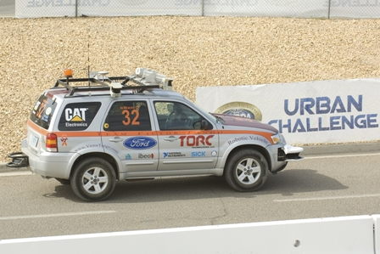

Automotive Robotics Companies
Application: Torc created an autonomous vehicle to complete the Defense Advanced Research Projects Agency (DARPA) Urban Challenge, an autonomous ground vehicle race through an urban environment.
Hardware: Touch Panel Module, LabVIEW, FPGA Module, Real-Time Module, Industrial PC Embedded OS, Vision Development Module, Control Design and Simulation Module, cRIO-9104, TPC-2006, cRIO-9012
Notes:
Michael Callahan, a recent graduate of the systems and entrepreneurial engineering program at the University of Illinois at Urbana-Champaign (UIUC), recently received the prestigious Lemelson-Illinois Student Prize. The award recognizes Callahan for developing a device that will profoundly benefit people with amyotrophic lateral sclerosis (ALS / Lou Gherig's Disease), Cerebral Palsy, spinal cord injury, or other neurological disorders. The device, dubbed "The Audeo," acquires and translates neurological signals, so subjects who could not speak or move can communicate. Callahan has teamed up with Thomas Coleman and other UIUC colleagues to start their own company – Ambient Corporation – to develop and commercialize the technology. National Instruments LabVIEW has played a key role in doing so.
The Audeo is a sensory device that is placed around the neck of an afflicted individual. In operation, it intercepts the signals from the brain that control the vocal chords and the vocal tract. These signals then are sent to a computer that filters out the noise from any background sources, processes it using a complex signal processing algorithm and then interprets the individual’s meaning from the signals to produce speech. The speech can then either be output directly or used to control external devices, such as a motorized wheelchair.
The team has implemented prototypes that rely on an application built using LabVIEW to control the acquisition and apply the signal processing that translates the nerve impulse signal samples into commands for wheelchair control, or to be spoken.
To control a wheelchair, the system needs to identify directional commands – forward, right, left and stop. For it to do so, the software identifies those singular commands from the speech patterns - rather than process the data to produce continuous speech.
The continuous speech processing strategy that would allow the user to hear what they are producing as they are doing so is still in development. “One of the challenges,” explained Callahan, “is to develop a universal mathematical transformation of the data that would work well for everyone - not just for a specific individual.”
The job requires sophisticated signal processing algorithms that can adapt to nerve impulse patterns, which vary between individuals and over time. Using native LabVIEW graphical programming has aided the development process allowing Callahan and his team to perform rapid trials using live signals with varying algorithms and parameters.
"LabVIEW simplifies development and encourages innovation by offering an intuitive graphical programming approach that allows you to focus on innovation rather than programming details," Callahan said. He and his colleagues implemented the software with LabVIEW to build an initial prototype in 2005 and have been making great improvements ever since.
The developers are continuing to use LabVIEW throughout the development process. Callahan and Coleman have collected a large amount of data from numerous individuals and have developed a system around LabVIEW that can generate such transformation algorithms and evaluate their effectiveness on the fly. As the developers discover the optimum processing algorithms, and fix the specific design parameters of the system, then they intend to commit the entire acquisition and processing into hardware that will be self-contained in The Audeo device itself. That way, there will be no need for an external computer in the system.
The result, they say, will not just be one device, but a range of devices that will target the needs of a number of different users. One such device, for example, might simply be dedicated to speech production, while another might be used to enable a disabled person to control a variety of different devices such as a wheelchair, computer or even a mobile phone.

Slide 26
You get my point

