Slide 1





Online Laboratories: Enhancing the Quality of Higher Education in Africa
Creating an African Higher Education Space
Presented by
O.B. Akinwale
Dept of Electronic and Electrical Eng.
Obafemi Awolowo University, Ile-Ife
Nigeria

Slide 2
Outline
Requirements for Higher Education Space
What are iLabs
Benefits of iLabs
Concerns / issues for creating an African iLabs Space
Conclusion

Slide 3
Requirements for Higher Education Space
Lectures:
  Lecturers and lecture theatres
Laboratories
Libraries
Discussion forum for students
Forum for collaboration by students on specific projects

Slide 4
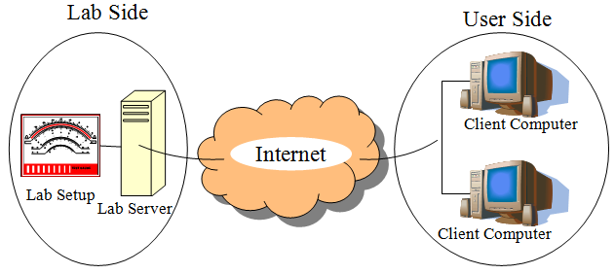
What are iLabs
Online labs are labs performed over internet
Remote labs / virtual labs

Slide 5


Slide 6
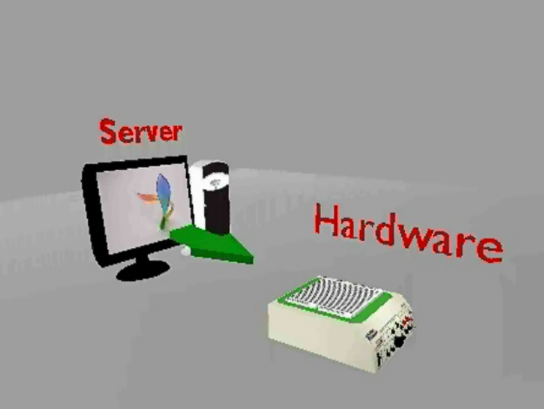

Slide 7
INTERNET

Slide 8
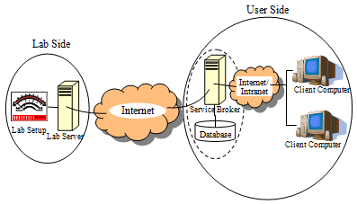
iLabs
Online labs which make use of the ISA (iLab Shared Architecture) developed by MIT

Slide 9
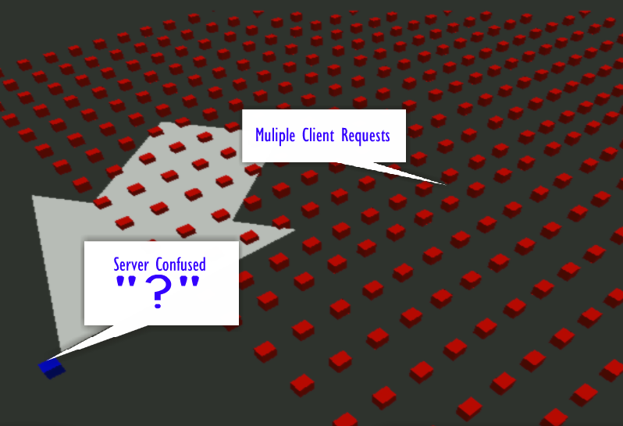

Slide 10


Slide 11
Benefits of iLabs
Possible to share labs between institutions
Foster inter-institution collaboration
Foster inter institution student collaboration
Higher quality laboratory education for cash-strapped schools
Reduced lab cost per institution
Increased no of labs available per student
Easier to extend to secondary and high schools

Slide 12
Re: Requirements for Higher Education Space
Lectures:
  Lecturers and lecture theatres
Laboratories – solved by iLabs
Libraries
Discussion forum for students – promoted by iLabs
Forum for collaboration by students on specific projects

Slide 13

African iLabs Space

Slide 14
To Set up an African iLabs Space
Provision of iLabs
  How to guarantee iLab availability
  Who “owns” each iLabs
Terms of use of iLabs
  Payment?
  MOU?
Infrastructural Requirements
  Service Broker (required)
  Campus-wide network (strongly recommended)

Slide 15
To Set up an African iLabs Space
Foreseeable “challenges”
  Power Supply
  Bureaucracy
  Cost of ownership / cost of use of iLabs
  Assessing quality of developed iLabs

Slide 16
Conclusion
iLabs have been useful to MAK, OAU and UDSM and just might be useful for you too.

Slide 17
Appreciations
Carnegie Corporation, New York
National Instruments
Massachusetts Institute of Technology
Science and Technology Education Post-Basic (STEP-B), Nigeria

Slide 18

Thank You!
olawale.akinwale@oauife.edu.ng;
olawale.akinwale@gmail.com
ilaboau@oauife.edu.ng – iLab OAU
ilabs@tech.mak.ac.ug – iLabs@MAK
nkomo98@yahoo.com – iLab UDSM

