Slide 1

Fifth Annual iLab and National Instrument Conference
Theme:
“Online Laboratories: An Icon Educational Technology for a Richer Pedagogical Experience”
July, 2011
Ishola Babatunde I.
Obafemi Awolowo University, Nigeria

Slide 2
Operational Amplifier iLab
To inspect the properties of various configuration of an operational amplifier
Used in EEE310 (Operational Amplifiers and Active Networks)

Slide 3
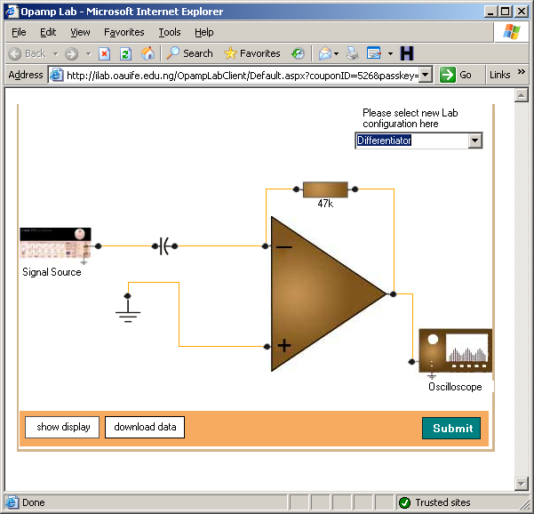
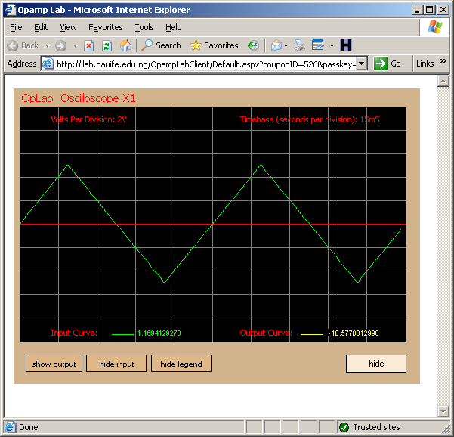
Previous version(s)
The greater the expectation, the better performance (Pygmalion effect)
Inability to relate iLab experience to real world application

Slide 4
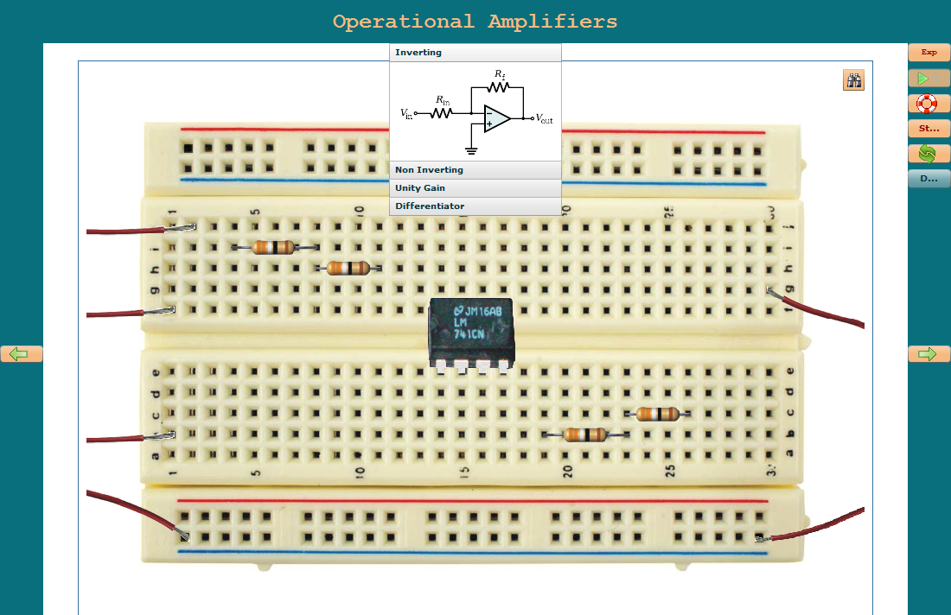
Lab Client
Lab Client developed with Adobe Flex Framework (Flex 3)
Realistic Interface, Richer Pedagogical Experience, flexible and intuitive

Slide 5
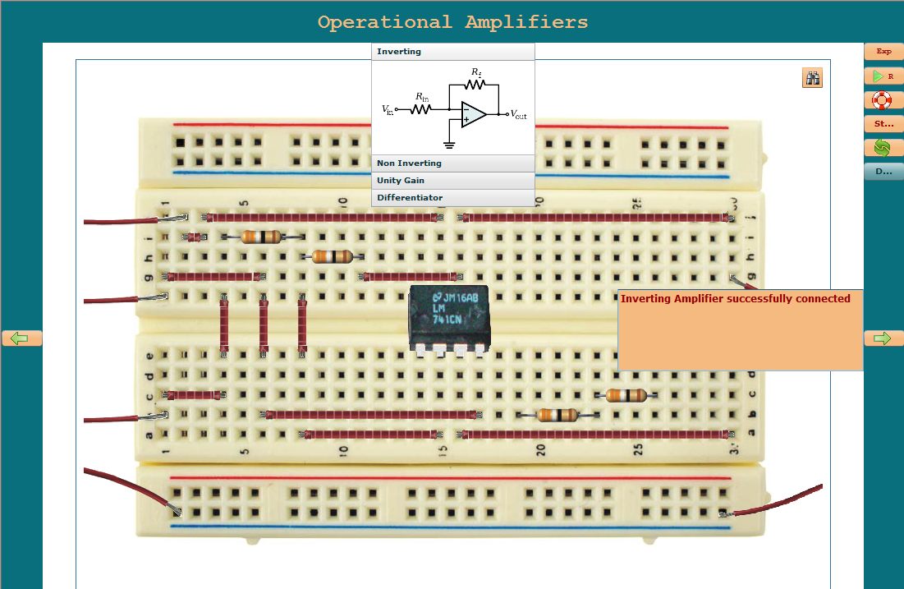
Lab Client
Verify Button
Help Button
Teaches use of datasheet, colour coding, breadboard, oscilloscope etc.
Depth First Search to verify connections on the circuit
Displays current status of the lab

Slide 6
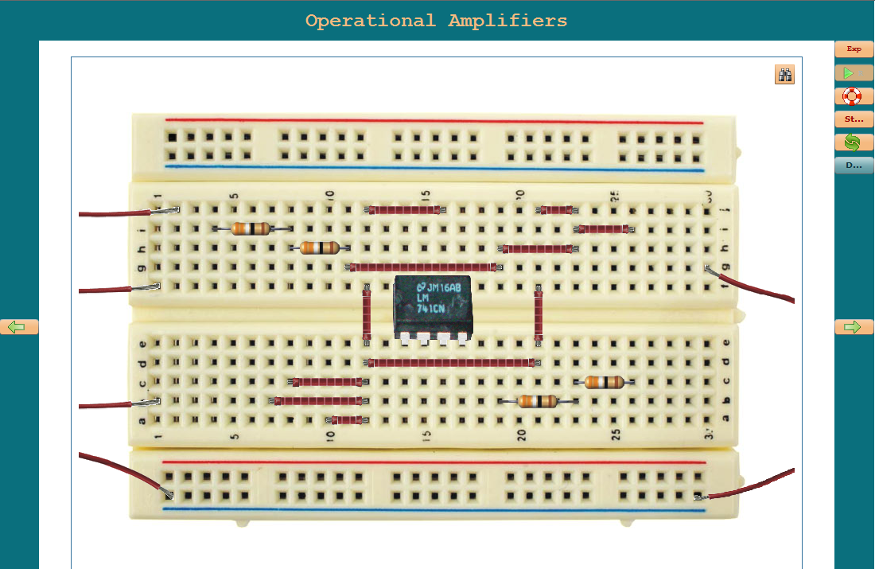
Connecting Rf (node 11) to Vout (node 16)
DFS employed to search the connection tree
determines if node 11 is ultimately connected to node 16
Rf (node 11)
Vout (node 16)

Slide 7
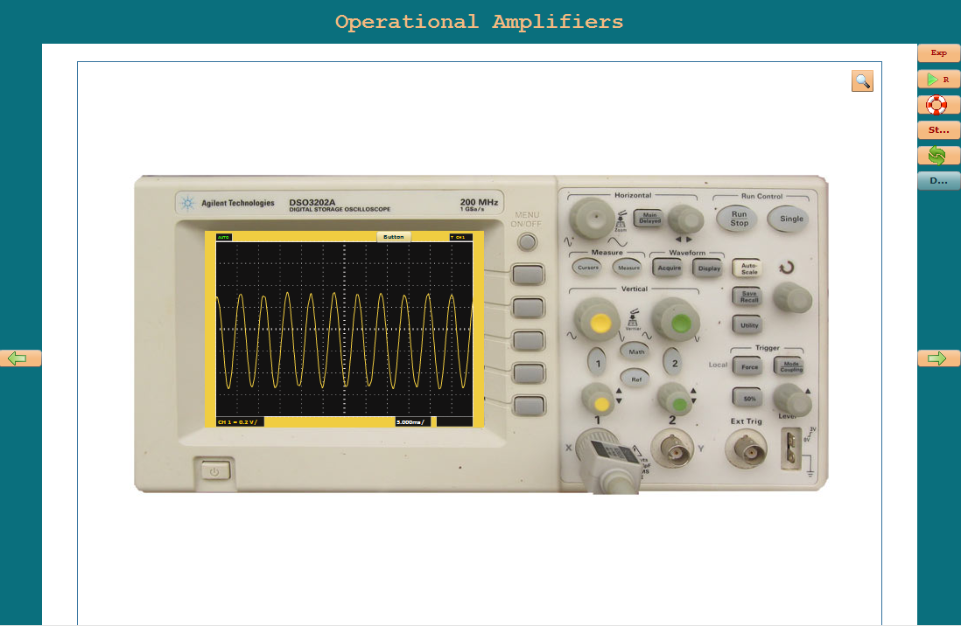
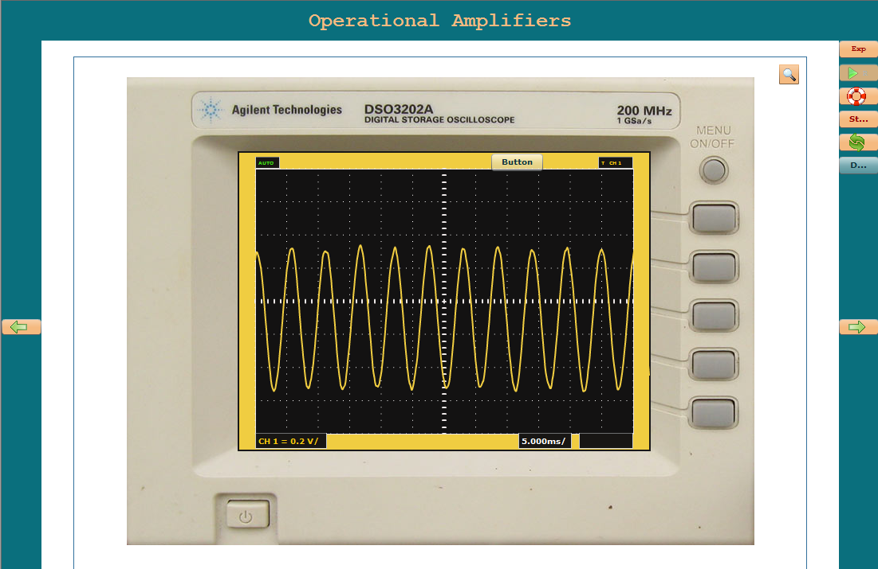
Lab Client (Oscilloscope Interface)
few buttons enabled for now
Zoomed out
Zoomed In

Slide 8
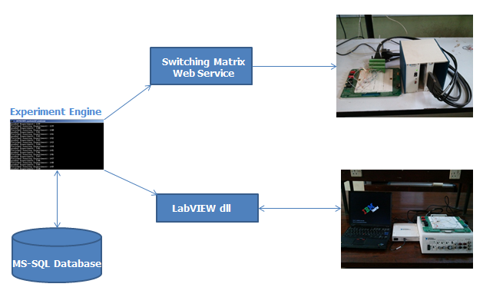
Lab Server
Switch Matrix
SUT on NI ELVIS I

Slide 9
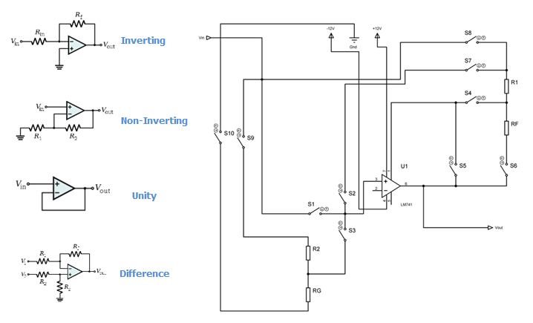
Reconfigurable OpAmp circuit
Experiment | S1 | S2 | S3 | S4 | S5 | S6 | S7 | S8 | S9 | S10
Inverting | open | close | open | close | open | close | open | close | open | open
Non-Inverting | open | close | open | close | open | close | close | Open | Open | open
Unity Gain | close | open | Open | Open | close | Open | Open | Open | Open | Open
Differentiator | Open | Open | close | close | open | Close | Open | close | Close | close

Slide 10
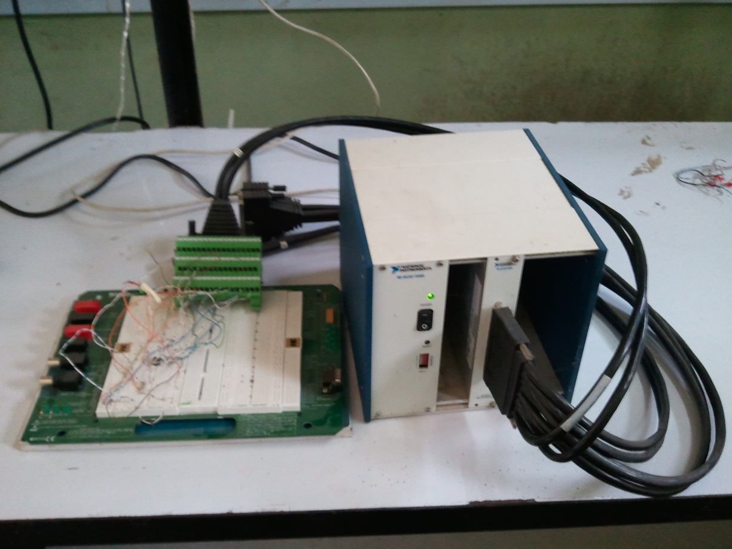
Web service (Microsoft.NET) allows the switches in the array to be remotely configured
NI SCXI 1169 100-channel SPST switch array
NI TBX DB-50
Reconfigurable OpAmp Circuit
LFH200 Cable
NI SCI 1000 Chassis

Slide 11
Finishing touches
Function Generator interface
More controls to be enabled
3D/isometric view of client interface
More experiments coming:
  Integrator
  Summer
  Instrumentation Amplifier

Slide 12
Bandwidth Issues
File Size 1.6Mb
iLabs Multi-tiered topology makes them suitable for
bandwidth constrained environment
Universities could host the client on their local Service Broker
Program developed in modules reduces load-time considerably

Slide 13
THANK YOU

