Slide 1


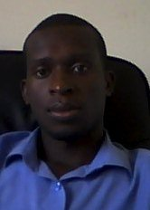
State of iLabs@MAK Project
Cosmas Mwikirize
iLabs@MAK Graduate Fellow
Teaching Assistant-Dept. of Electrical and Computer Engineering
5th iLabs Partners’ Meeting, July , 2011

Slide 2
Our Focus Today
Team Membership
New iLabs and Related Research
Publications
Conferences and Workshops
Graduate Fellowships
Support from the Government
Prospects
Challenges
Tracing iLabs@MAK Alumni
Acknowledgements

Slide 3
The iLabs@MAK Team at a Glance
Principal Investigator
Project Administrator
Research Coordinator
Graduate Researchers (6)
Undergraduate Researchers (17, 9 male, 8 Female)

Slide 4
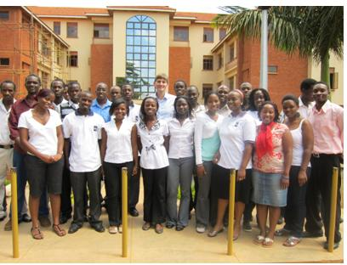
The iLabs Team with Prof. Del Alamo

Slide 5
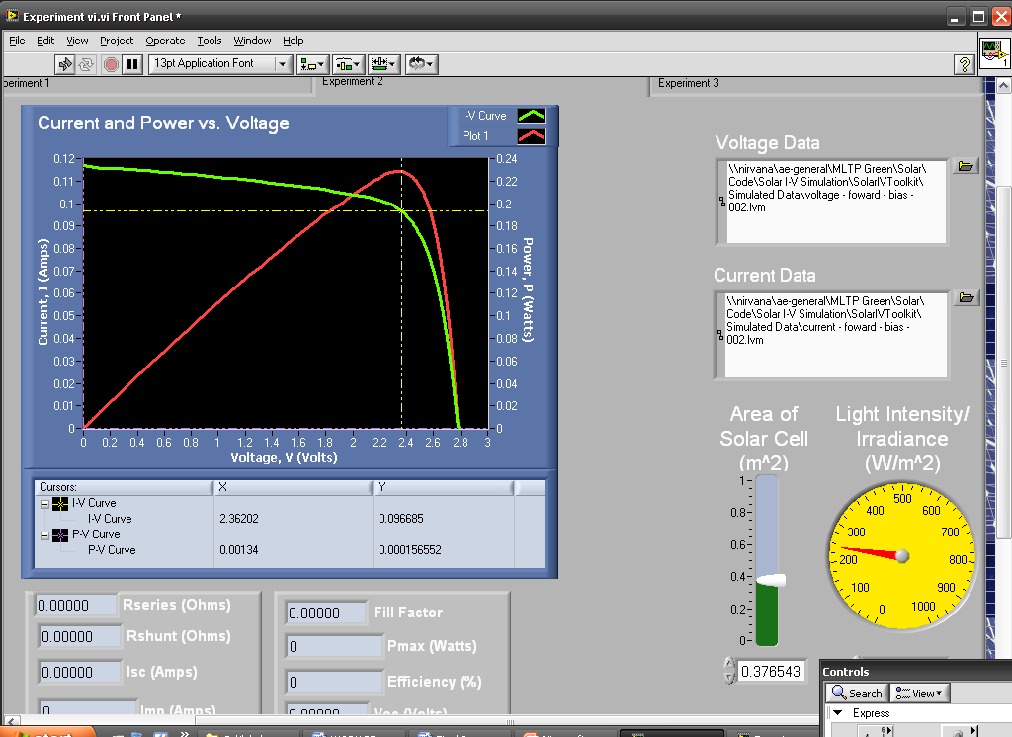
New iLabs Developed
  Solar PV Tracking

Slide 6
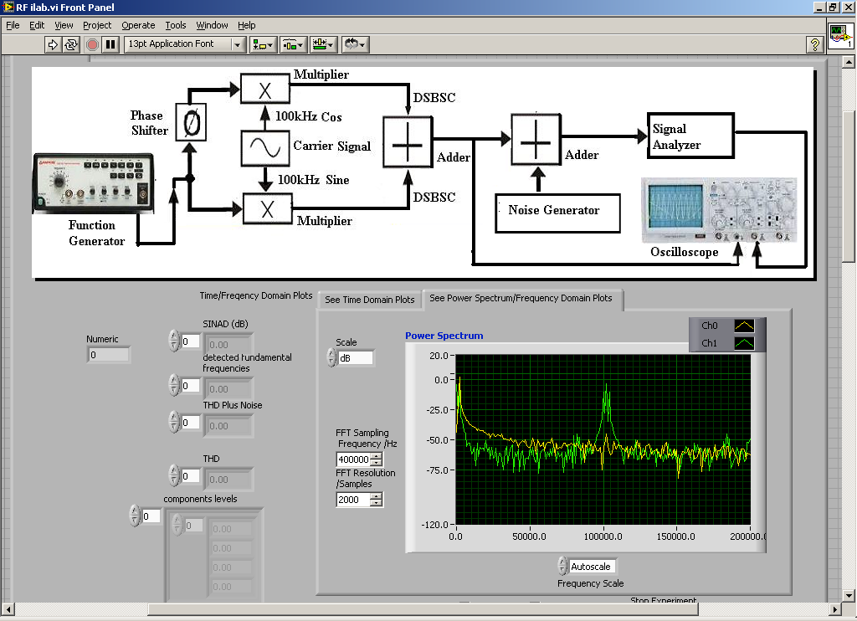
New iLabs Developed
  RF Spectrum Analysis

Slide 7
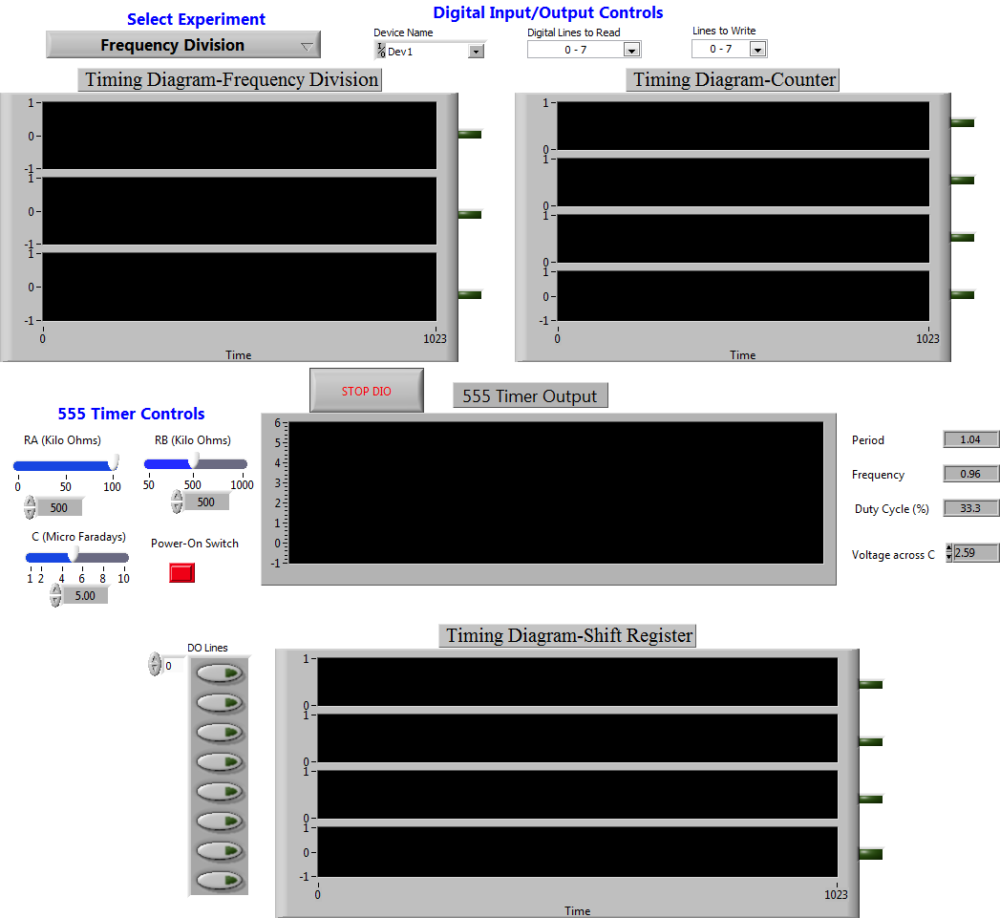
New iLabs Developed
  Sequential Logic Lab

Slide 8
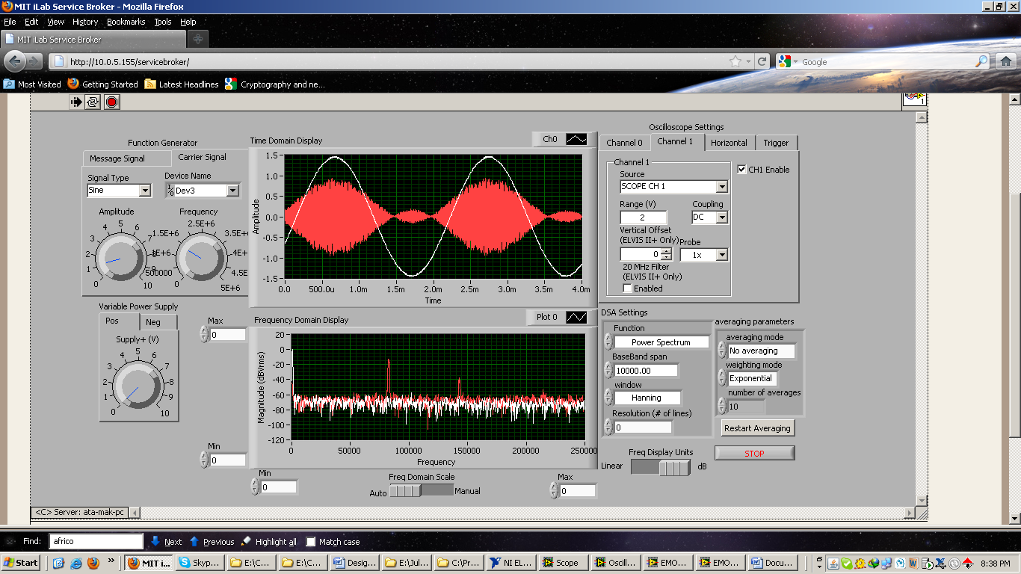
New iLabs Developed
  Frequency and TD Analysis in AM Lab

Slide 9
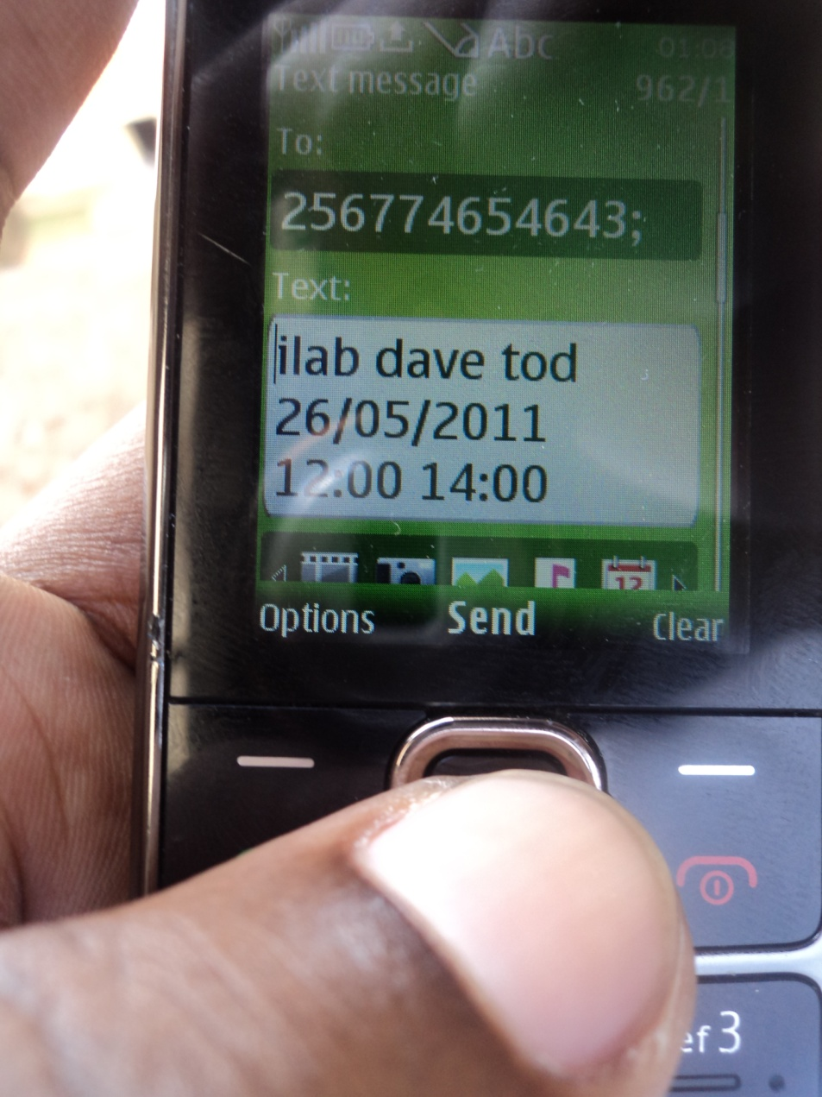
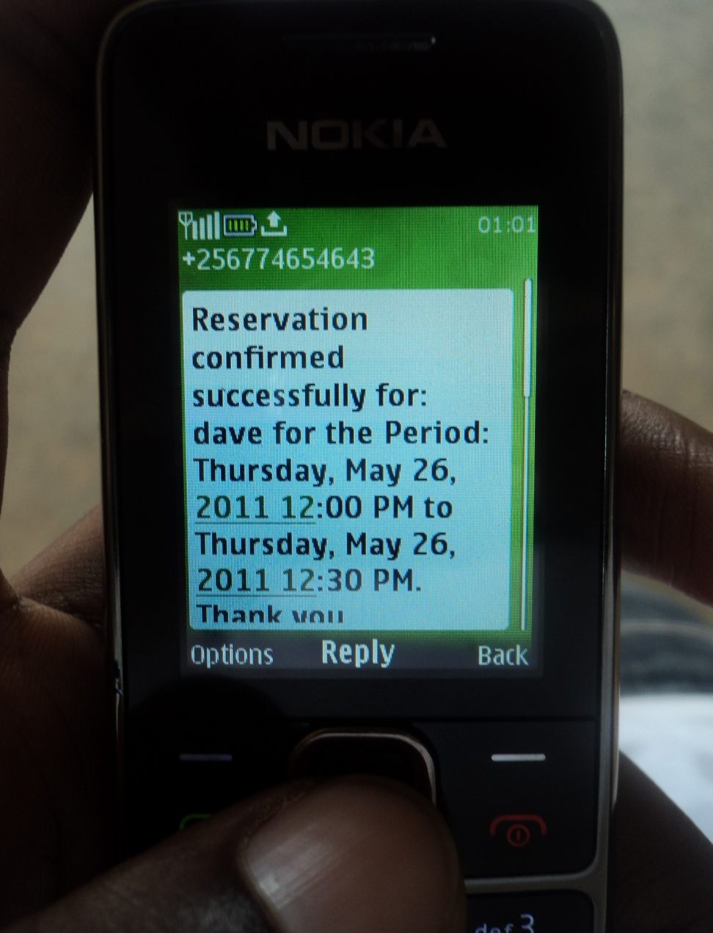
iLab Services: SM Scheduling Application

Slide 10
  iLabs Available
Field | Labs | Hardware Platform
Analogue Electronics | Basic Semiconductor Device Analysis, Operational Amplifiers and Associated Circuits | NI ELVIS II+ with the Free Scale Prototyping Board
Digital Electronics | Logic Gate Characterization and Application, Combinational Logic Circuits, Memory Elements, Counters and Shift Registers | NI ELVIS II+ with the Fee Scale Prototyping Board and the Field Programmable Gate Array (FPGA) Board
Communications Engineering | Amplitude Modulation, Frequency Modulation, Pulse Code Modulation, Radio Frequency Techniques, Fiber Optics Transmission | NI ELVIS II+ with the Emona DATEx and Emona FOTEx Board
Digital Signal Processing | Digital Filters and Sound Effects | NI SPEEDY
Control Systems Engineering | Motor Modeling and Speed Control | Quanser 010 DC Motor Control Trainer
Renewable Energy | Solar PV Tracking | NI cRIO

Slide 11
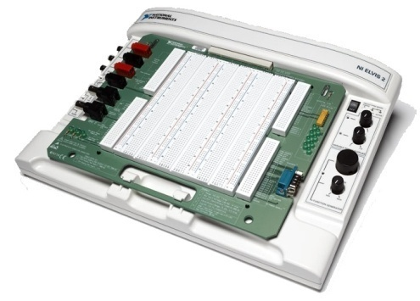
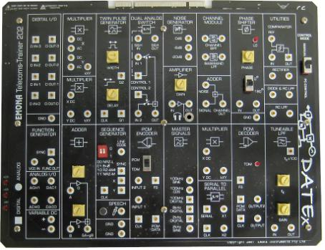
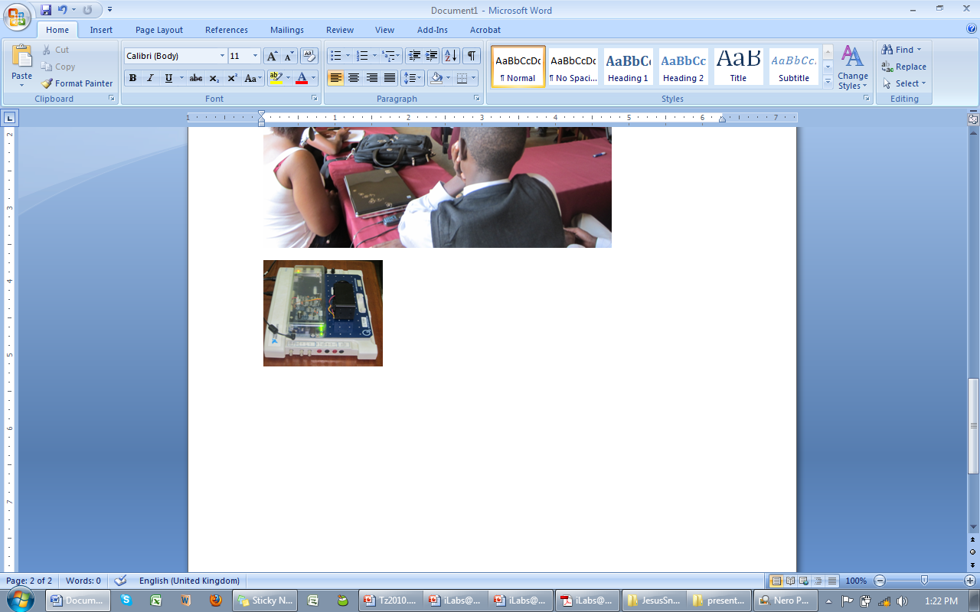
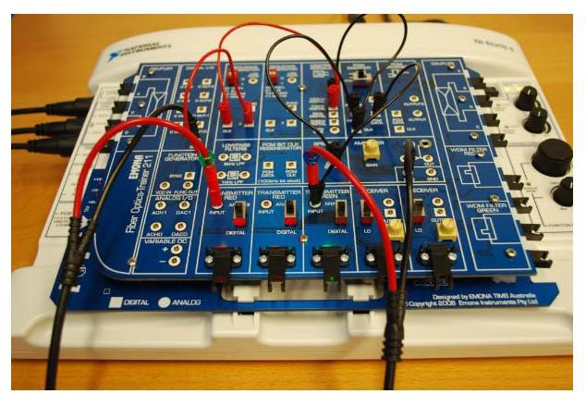
iLab Hardware at MAK
5 NI ELVIS II boards
2 NI ELVIS I Boards
3 EMONA DATEX Boards
1 EMONA FOTEX Board
1 NI MyDAQ
1 M Series DAQ
1 NI Field Programmable Gate Array Board
2 NI cRIO Boards
NI Speedy 33 – Digital Signal Processing
QNET DC Motor Trainer – Control Systems Engineering Experimentation
LabVIEW ARM – Digital Electronics

Slide 12
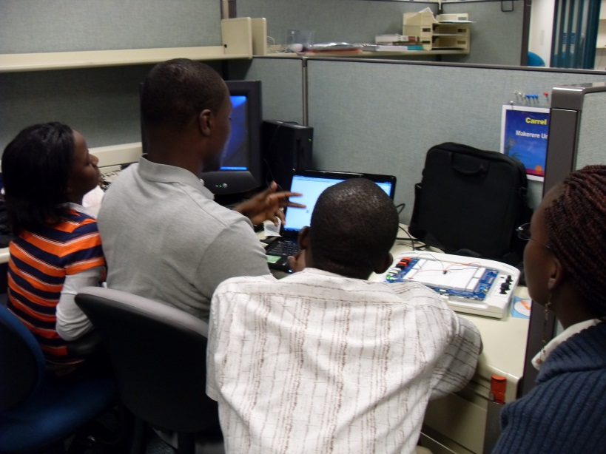
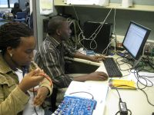
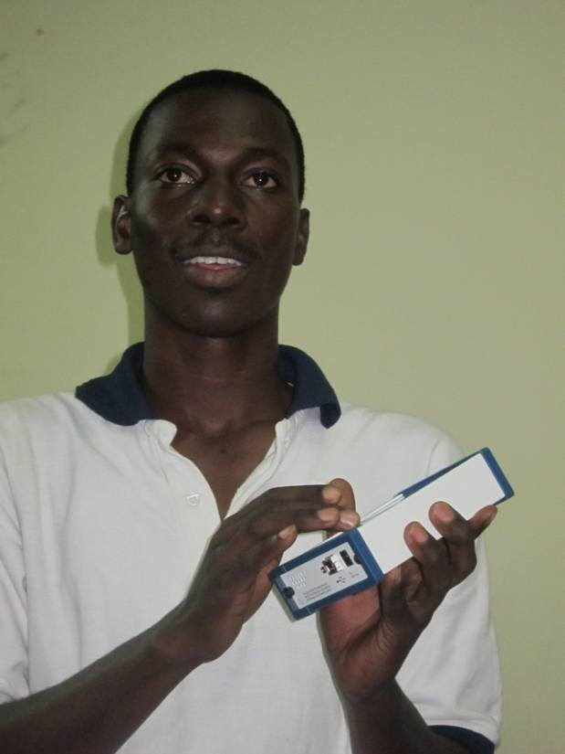
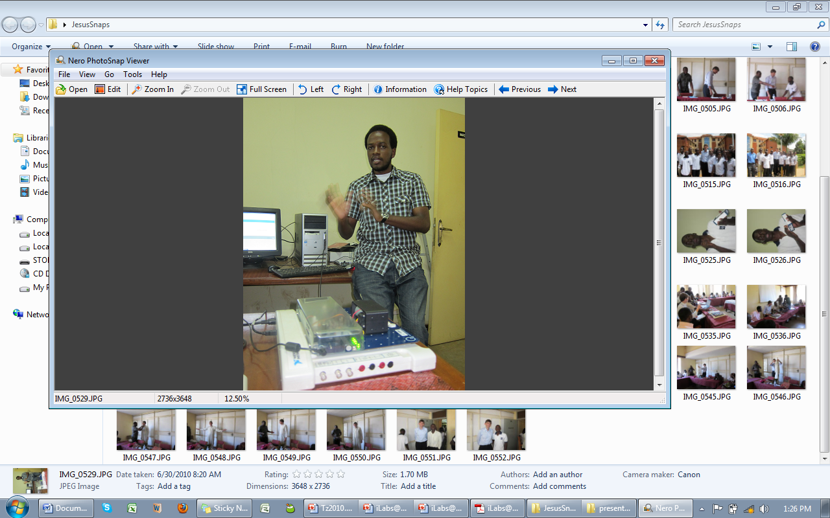
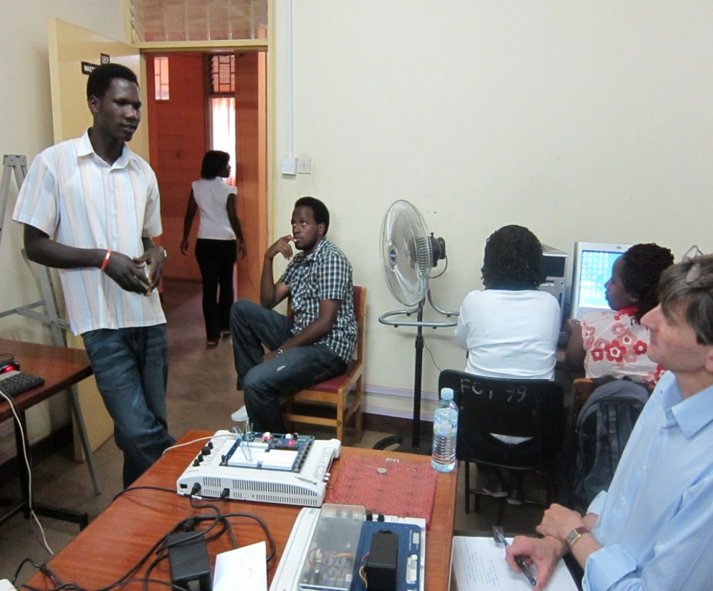
They did it all!

Slide 13
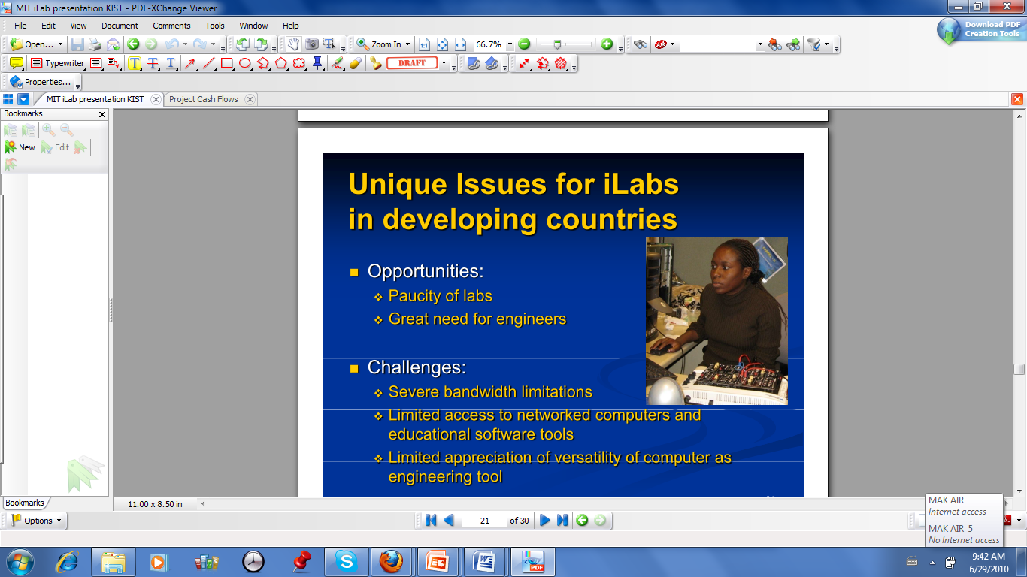
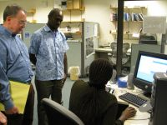
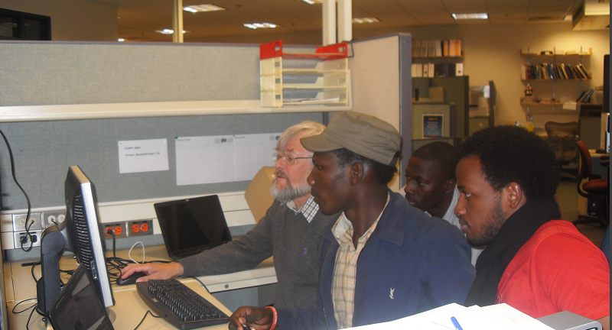
They did it all!!

Slide 14
Publications
“Developing Online Laboratories for Modulation and Combinational Logic Circuit Analysis Using NI ELVIS IITM Platform” presented at ITNG2010 Conference, 12th – 14th April 2010, Nevada, Las Vegas, Published by IEEE-CS, June 2010
“New Dimensions in Teaching Digital Electronics: A Multimode Laboratory Utilizing NI ELVIS IITM, LabVIEW and NI Multisim” presented at REV2010 Conference, 30th June – 2nd July 2010, Stockholm Sweden, Published by IJOE, November 2010
“An Online Digital Filters and Sound Effects Laboratory Utilizing NI SPEEDY 33 and LabVIEW DSP Module” Presented at ITNG2011, Nevada, Las Vegas. To be published by IJOE

Slide 15
Publications
“Design of a Bi-directional Fiber Optic Link and Wavelength Division Multiplexing iLAB”-Presented at REV2011 Conference, June 28-July 01, Brasov Romania. To be published by IJOE
“An Interactive Control Systems Online Laboratory Utilizing the NI ELVIS IITM and Quanser 010 DC Motor Control Trainer”, Presented at REV2011 Conference, June 28-July 01, Brasov Romania. To be published by IJOE
Collaborative Development and Utilization of iLabs in East Africa -> Chapter conditionally accepted in Book Project about Internet-Based Remote Laboratories, Published by IGI Global

Slide 16
Publications
“Presenting the Test Cell Algorithm for Solving Sudoku Puzzles”, To be presented at 2011 International Conference on Foundations of Computer Science -July 18-21,2011, Las Vegas
“Design of a Time-Frequency Domain Analysis Online Laboratory Utilizing the EMONA DATEx Board”, To be presented at IEEE AFRICON Conference, Lusaka, Zambia September 13-15, 2011.
“A Sequential Logic iLab Utilizing NI ELVIS II+ and the Interactive iLab Architecture”, Submitted for Peer Review, toward the exp.at 2011 Conference, November 17-18, Lisbon, Portugal

Slide 17
Workshops and Conferences

Slide 18
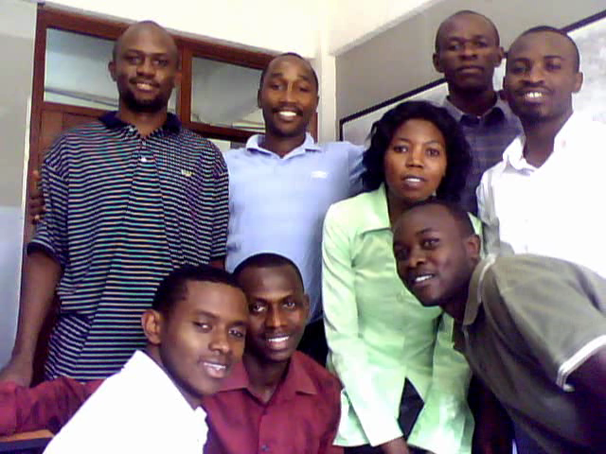
Collaborative Training with KIST at KIST

Slide 19
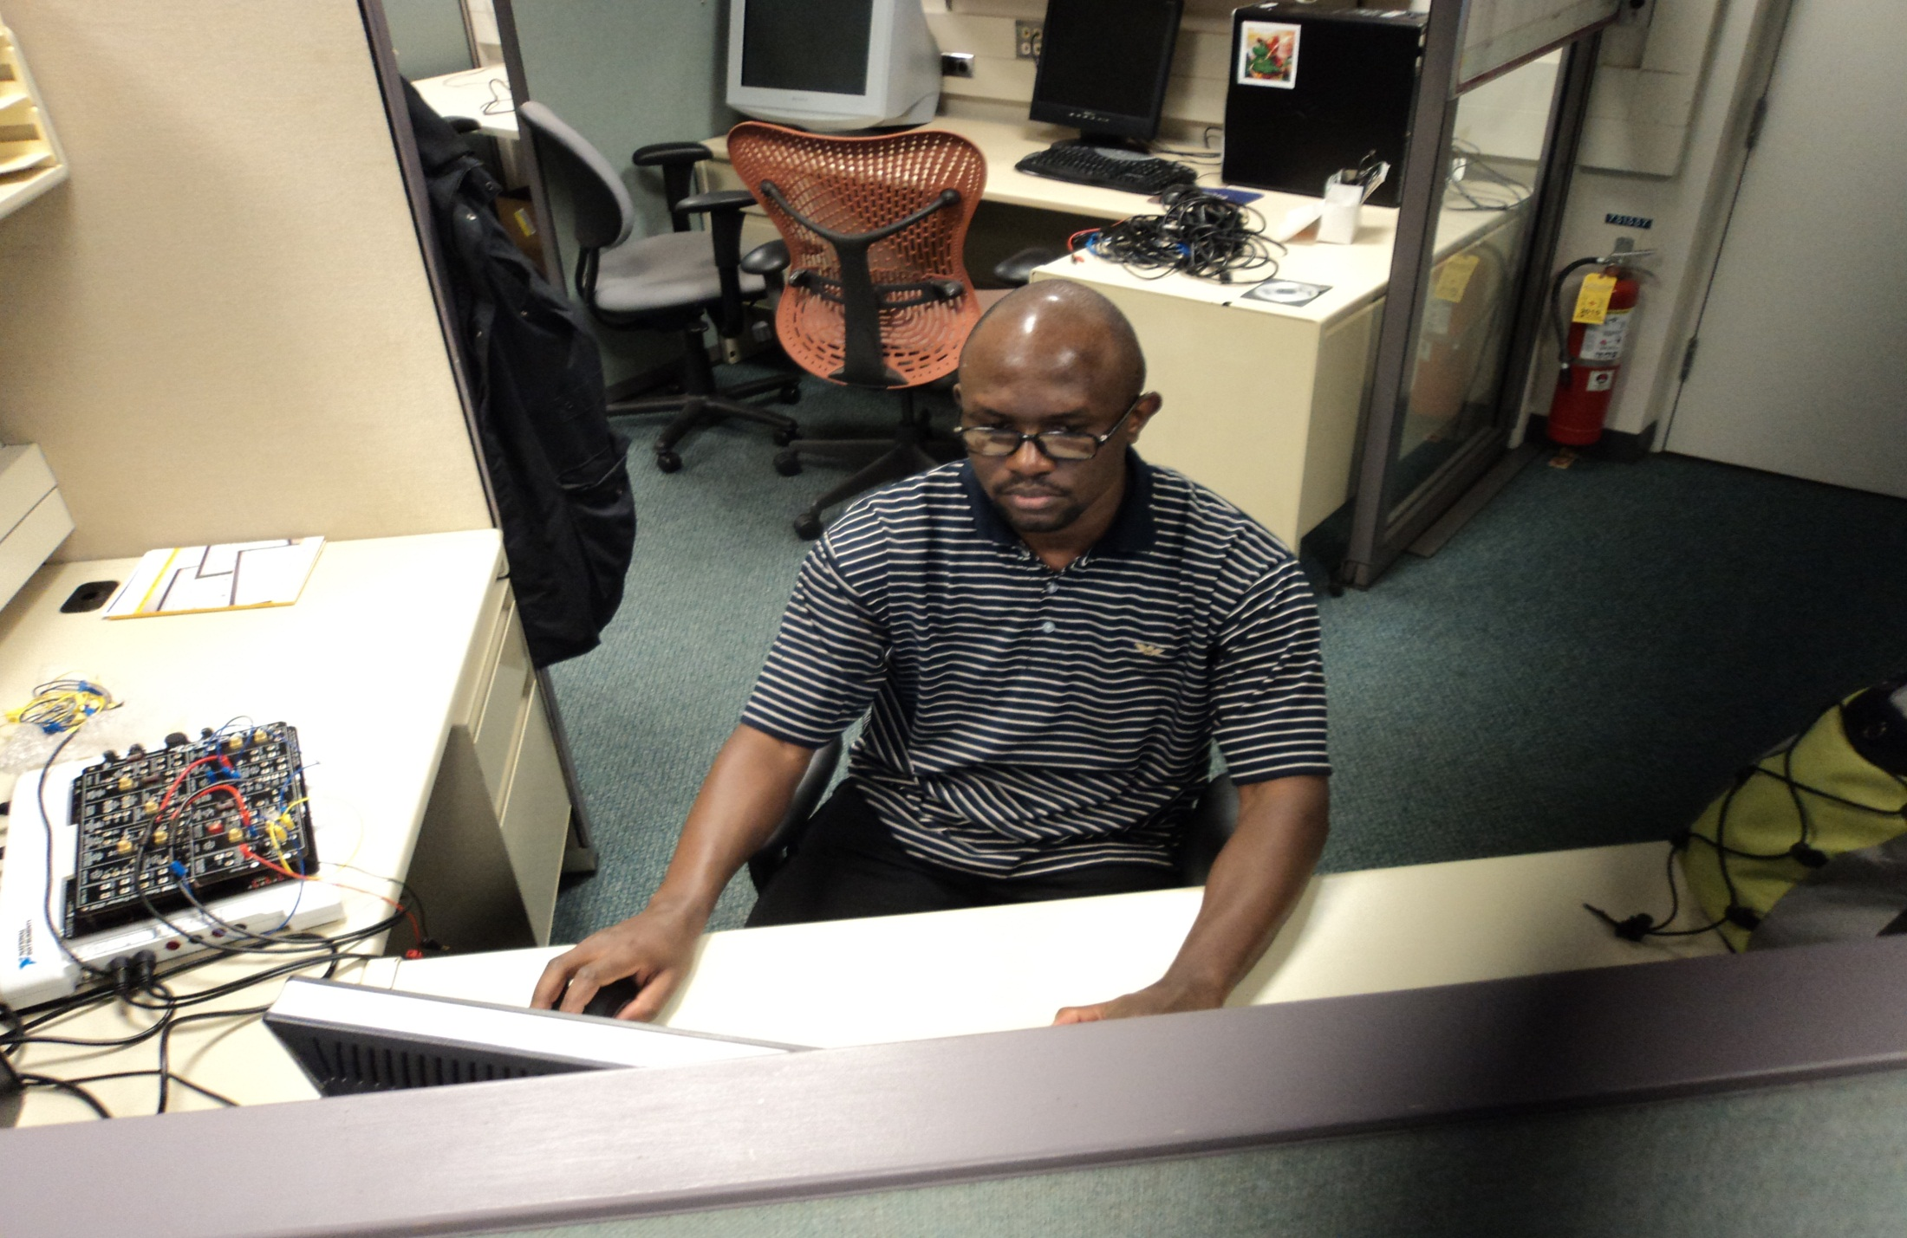
Graduate Researchers at MIT, November 2010

Slide 20
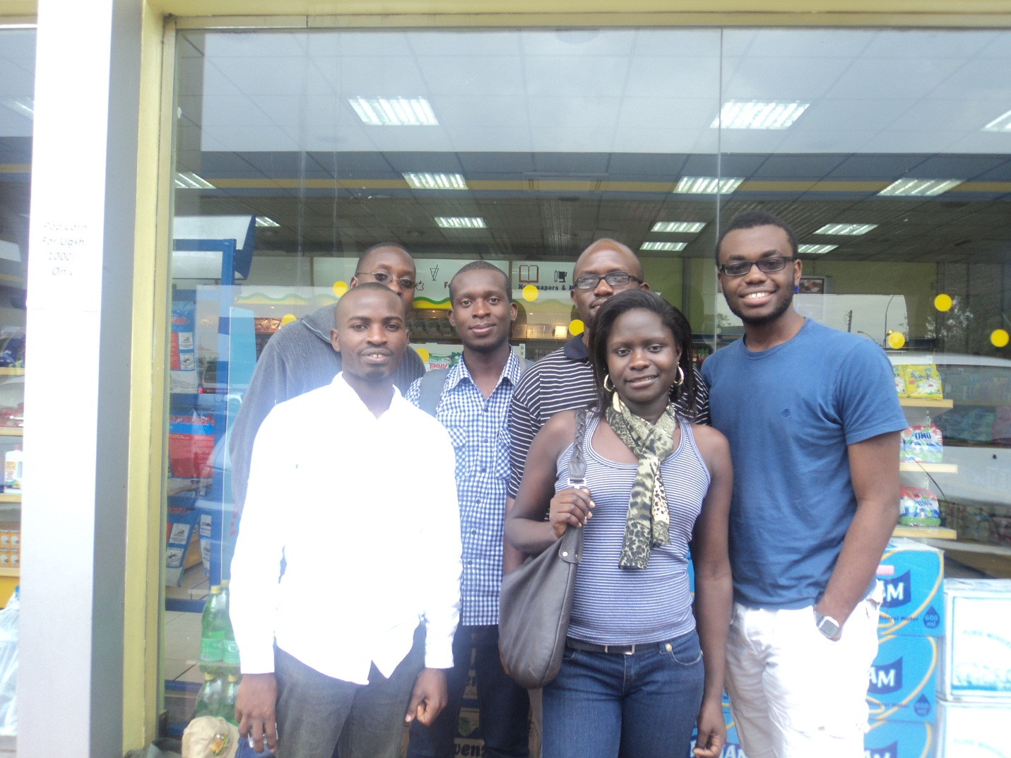
iLabs@MAK and MIT Training at MAK

Slide 21
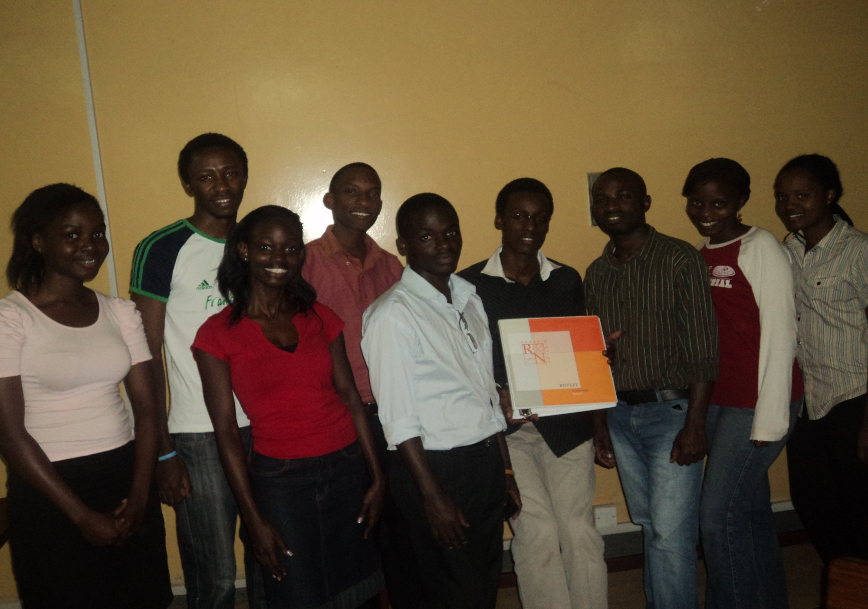
RRTN Training at MAK

Slide 22
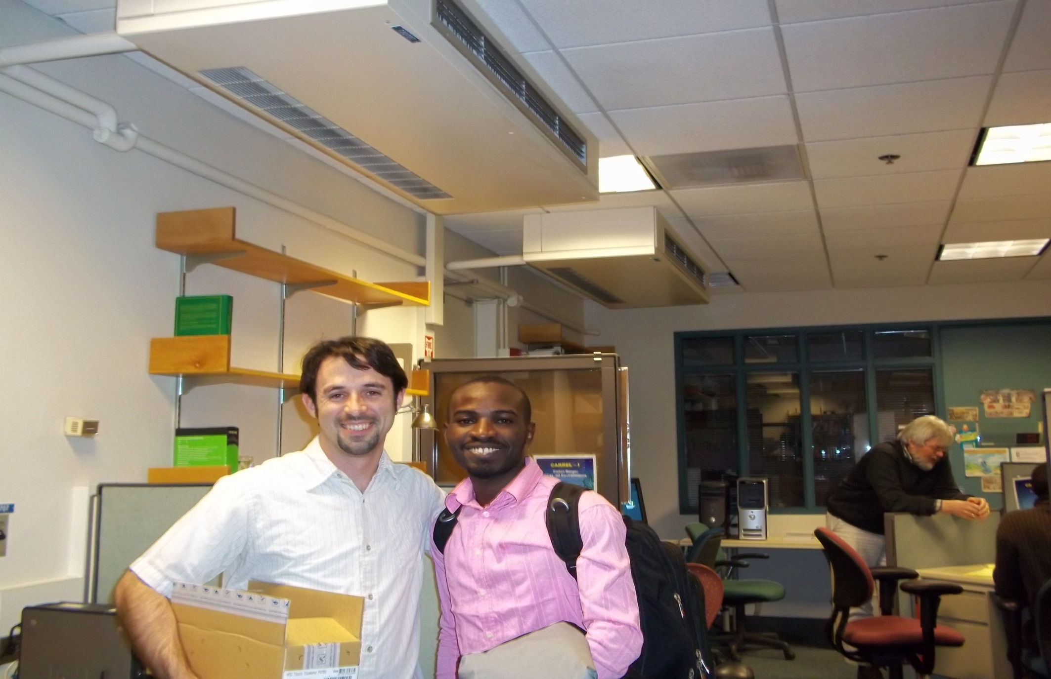
Undergraduate Researchers at MIT, March 2011

Slide 23
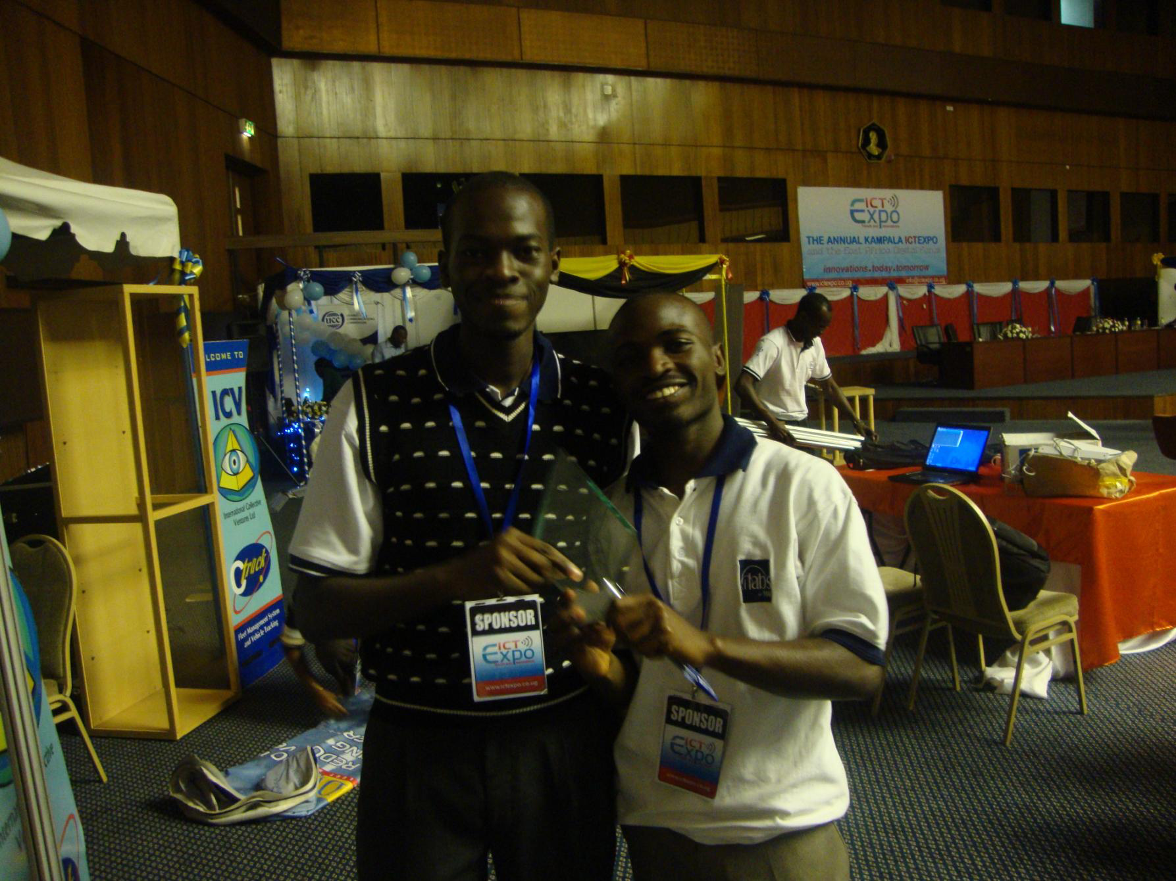
ICT Expo 2011

Slide 24
Graduate Fellowships
2 Graduate Fellowships won in the first round
One Graduate Fellowship and One Post Doctoral research Fellowship won in last round
Graduate Fellowships have facilitated retention and growth of junior Faculty
This kind of support should be sustained

Slide 25
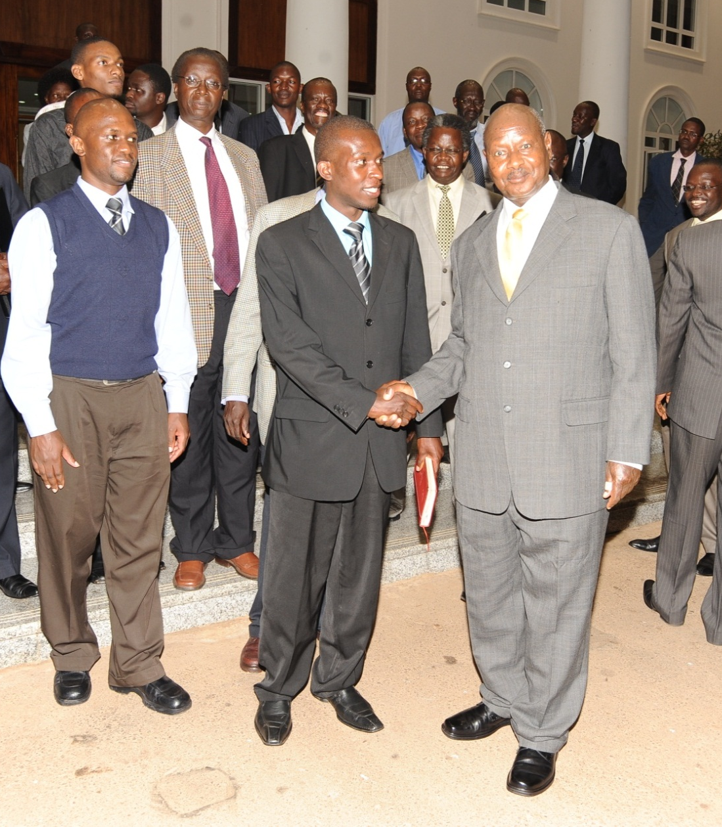
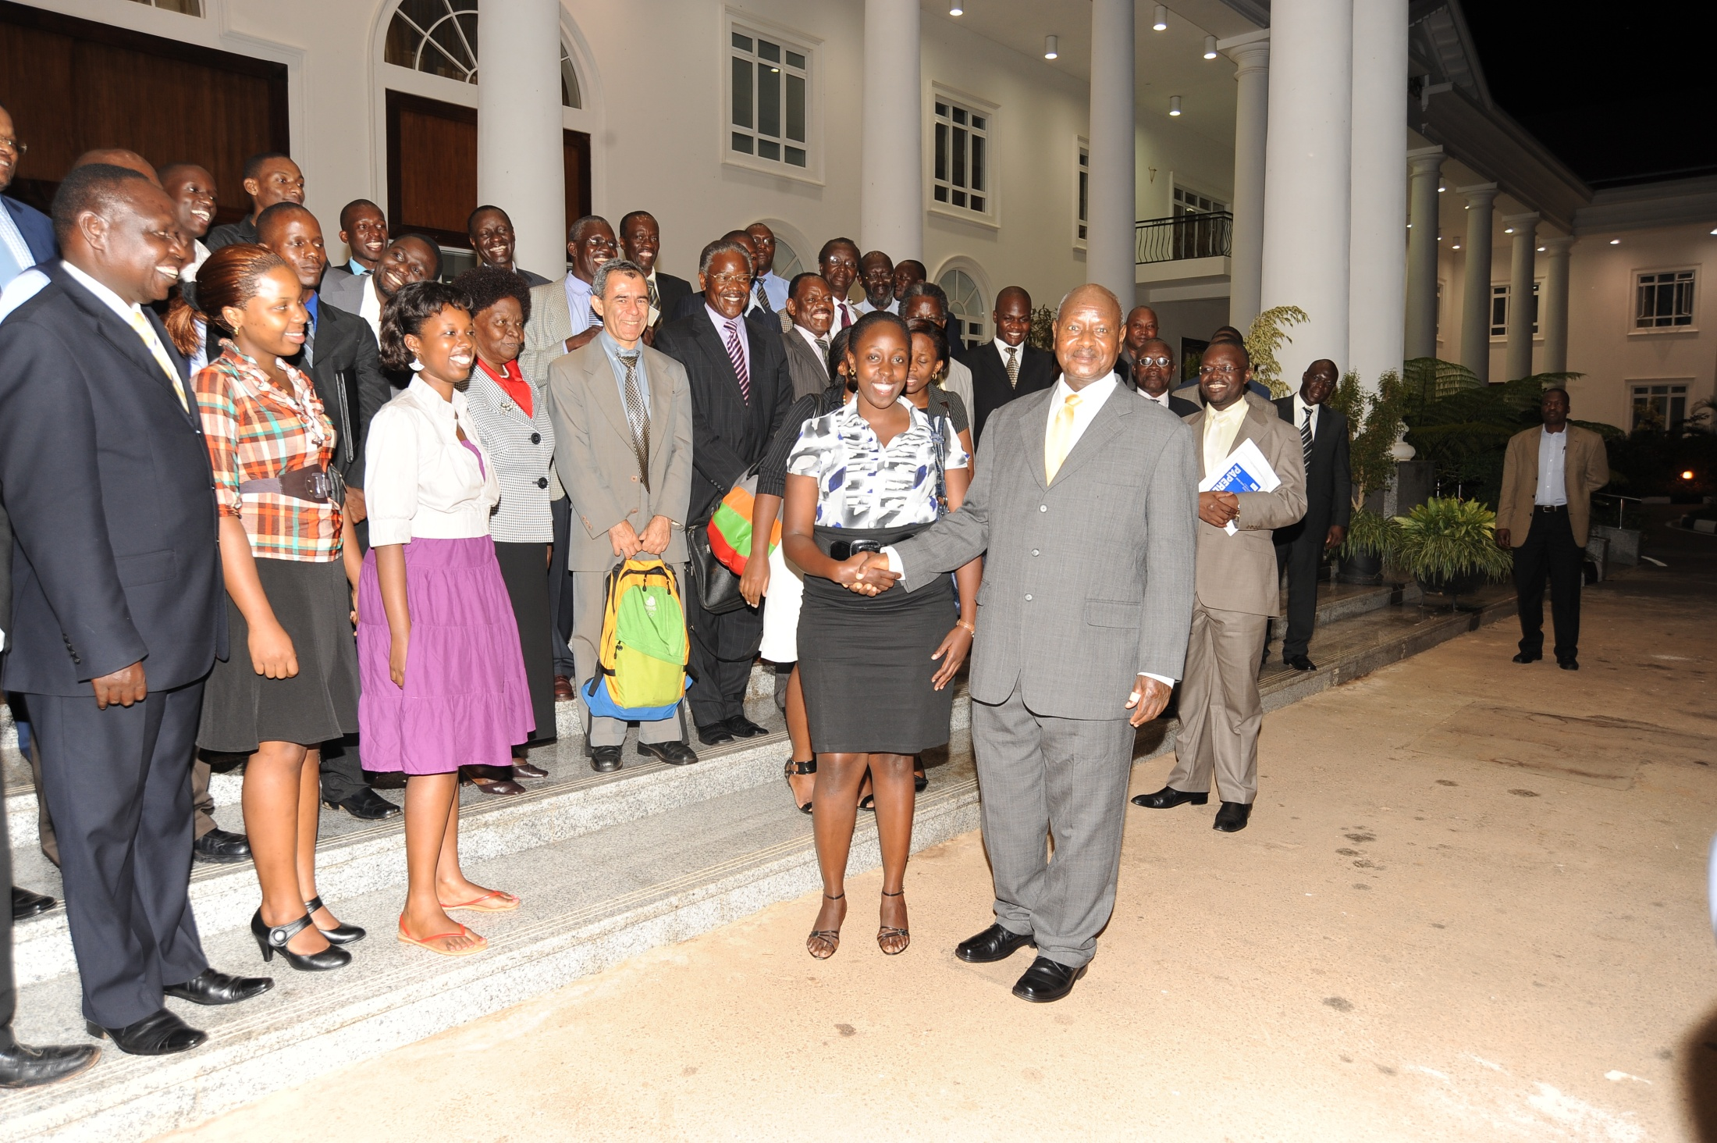
Government Support

Slide 26
Data Center Setup

Slide 27
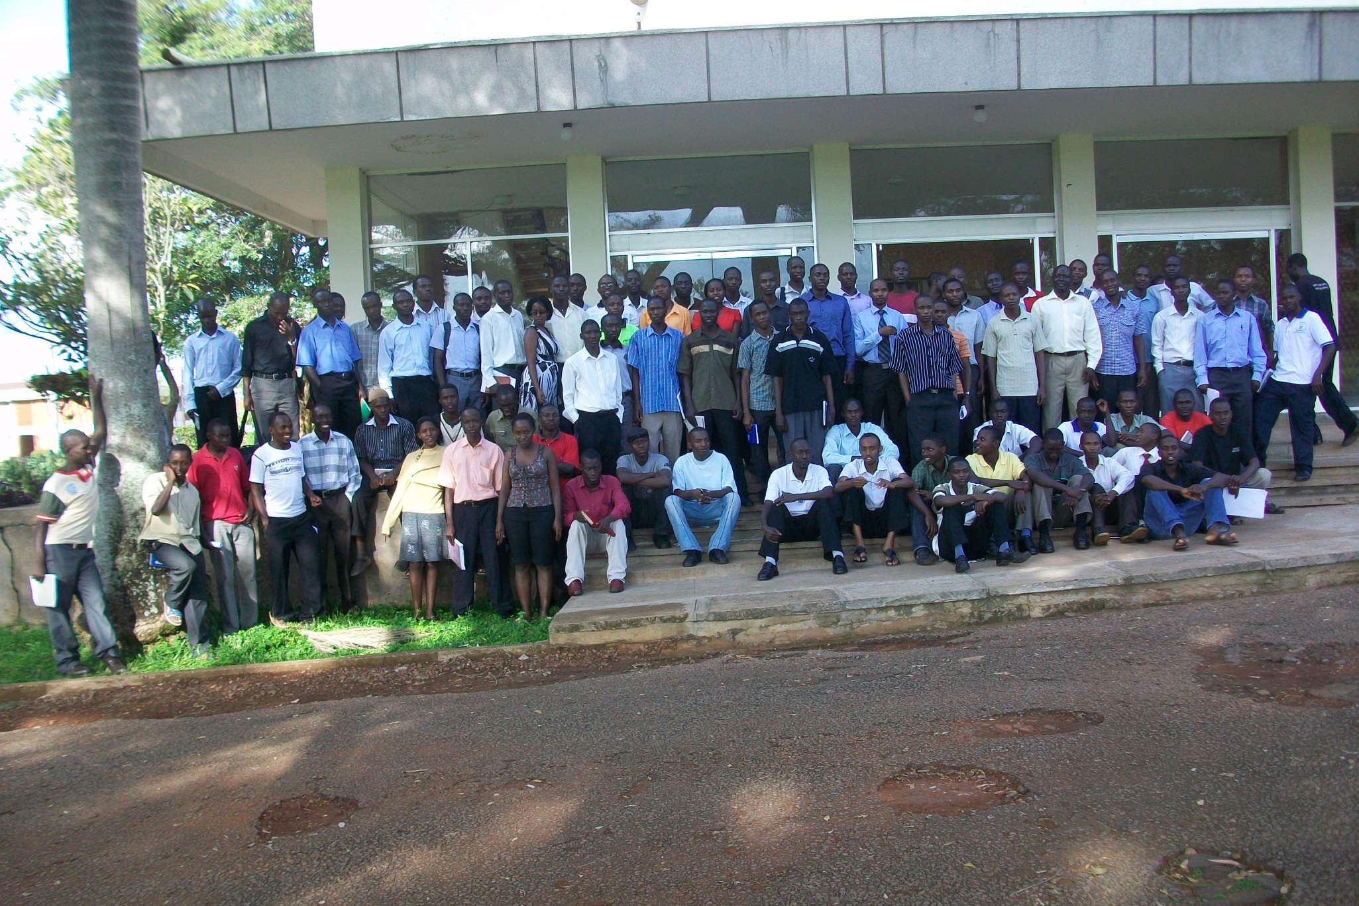
Extension of Online Laboratories to Busitema University

Slide 28
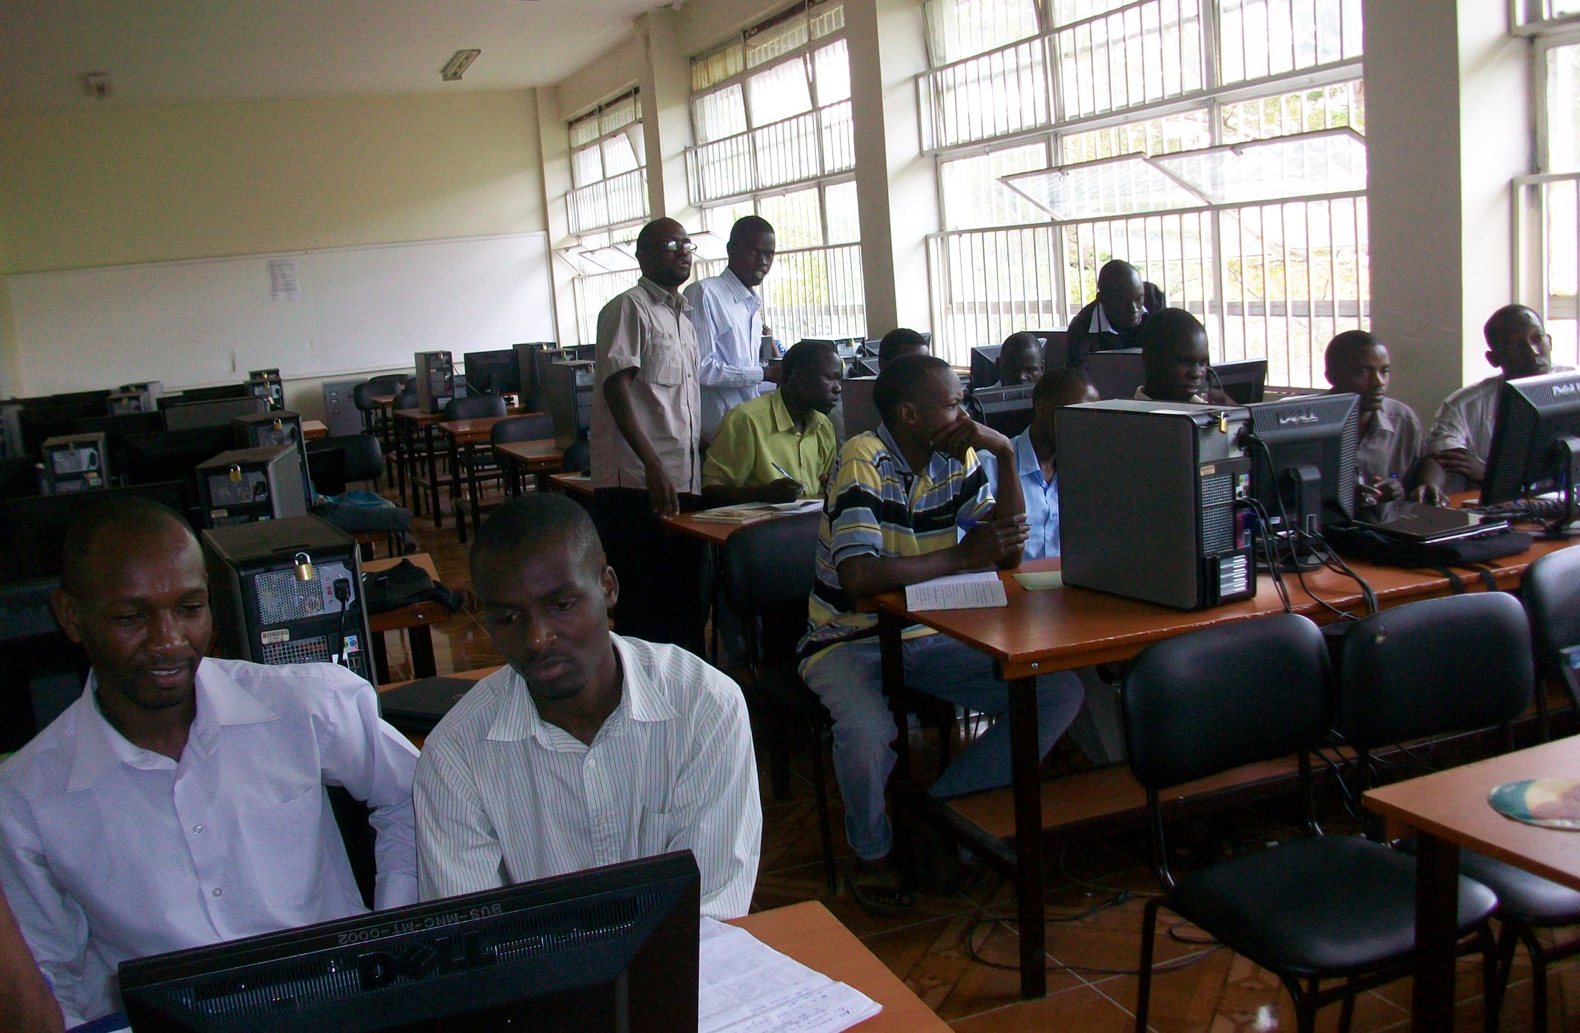
Extension of Online Laboratories to Busitema University

Slide 29
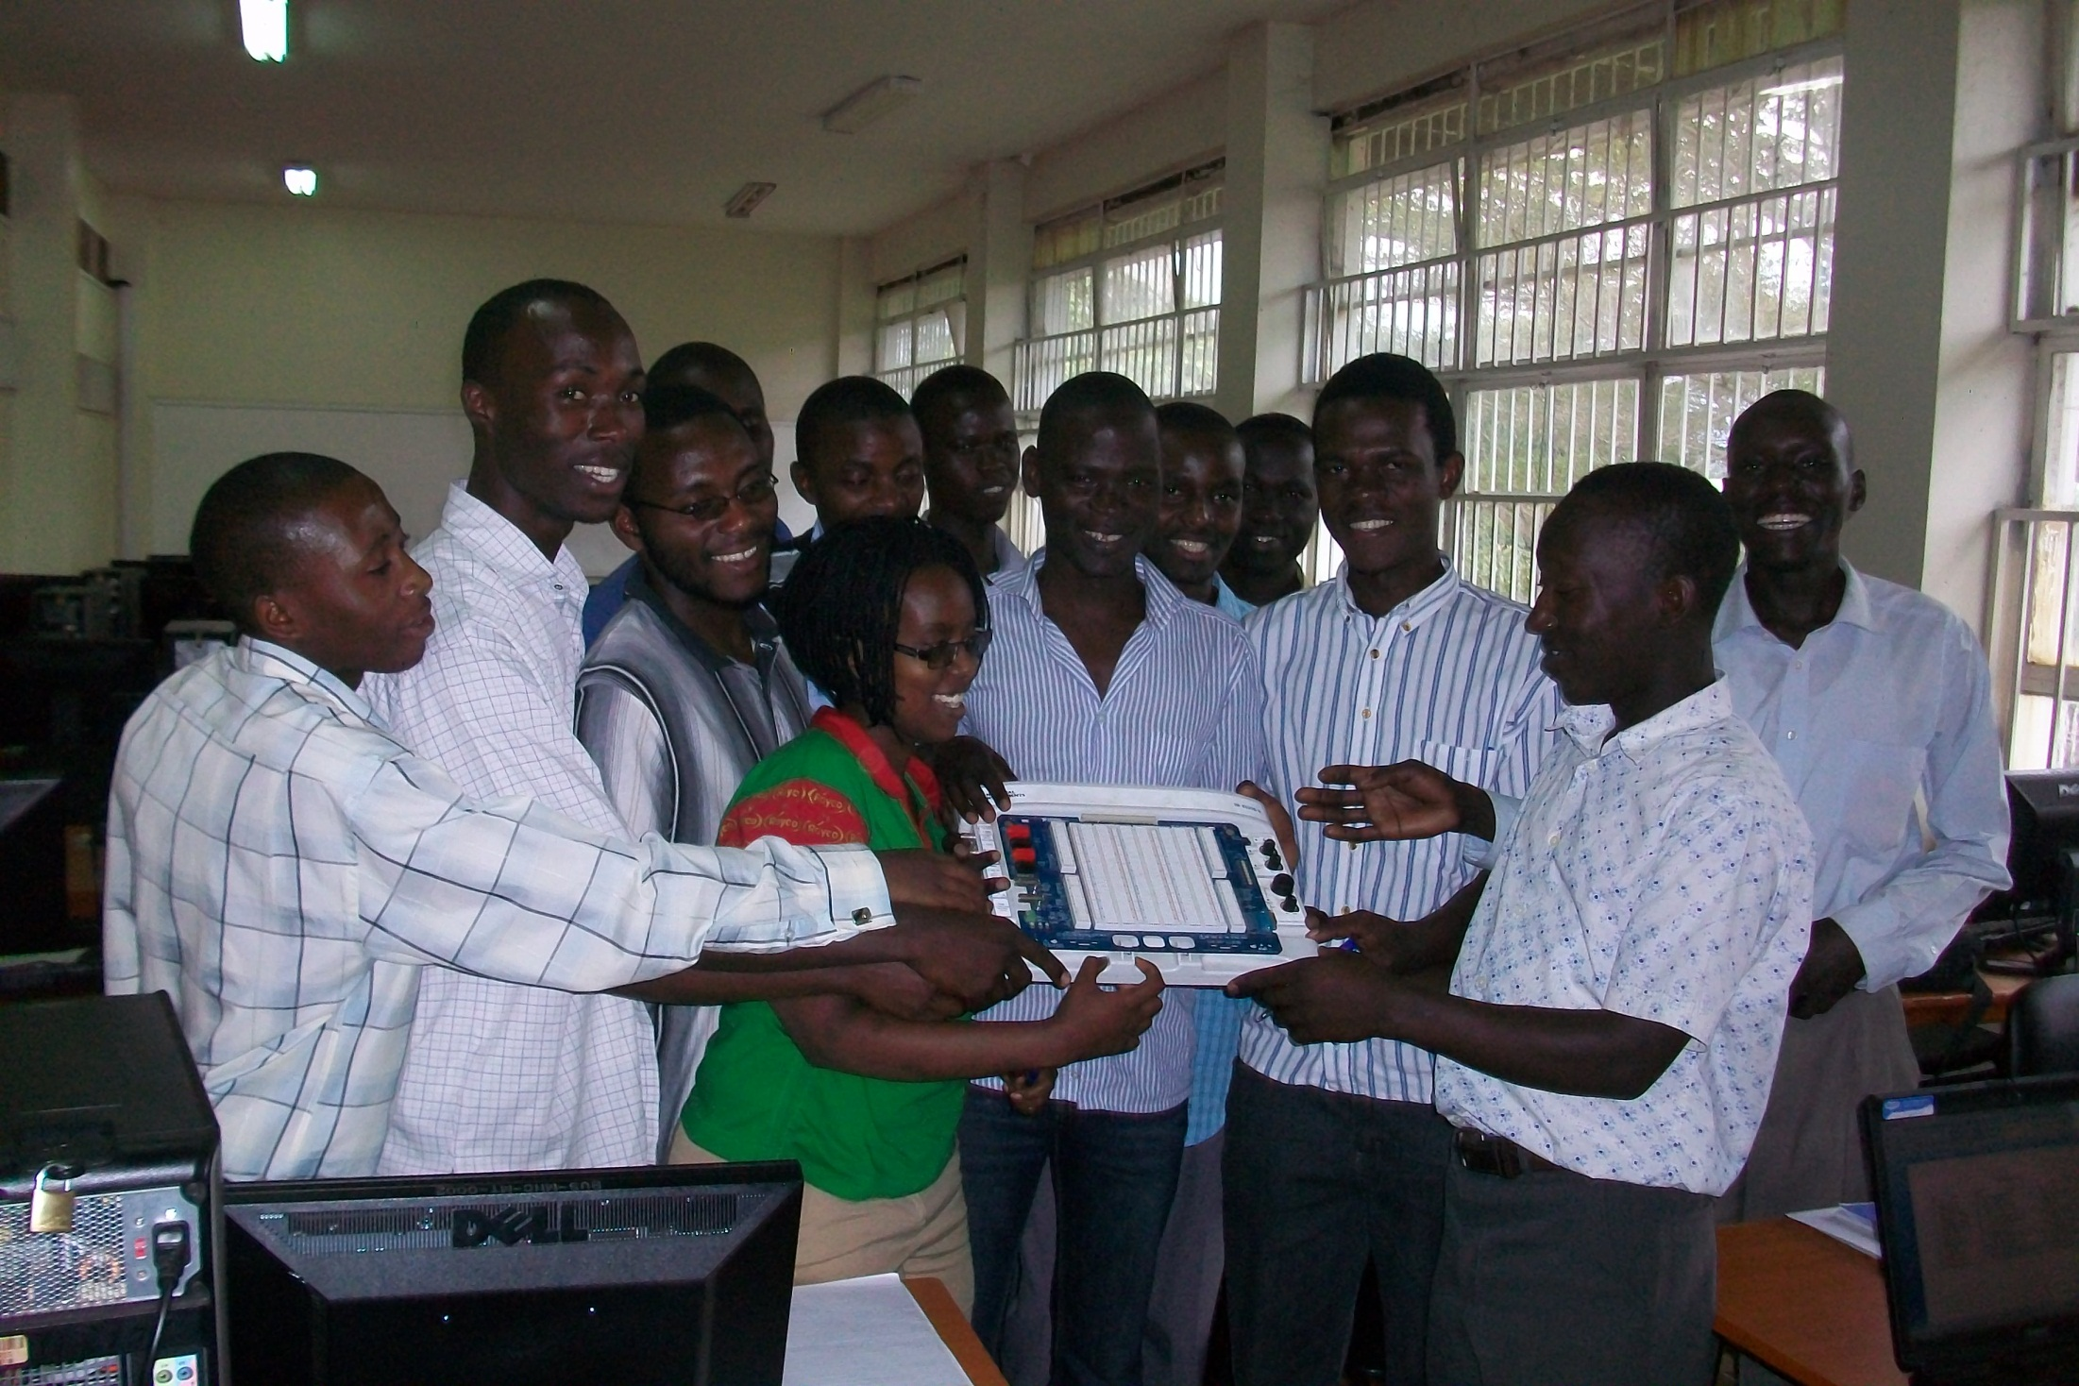
Extension of Online Laboratories to Busitema University

Slide 30
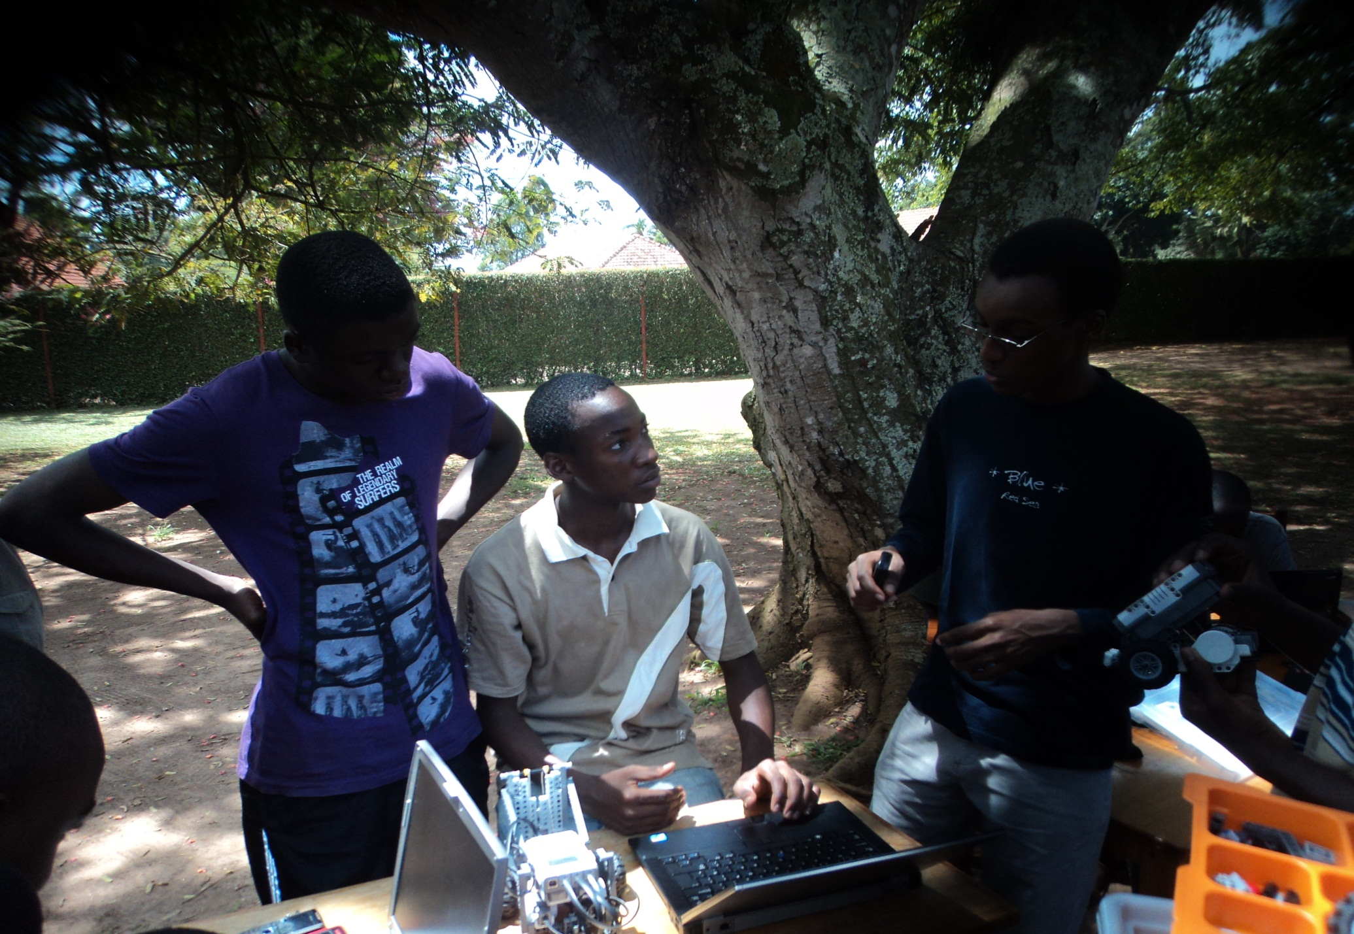
Supporting Innovation in Secondary Schools-SMACK

Slide 31
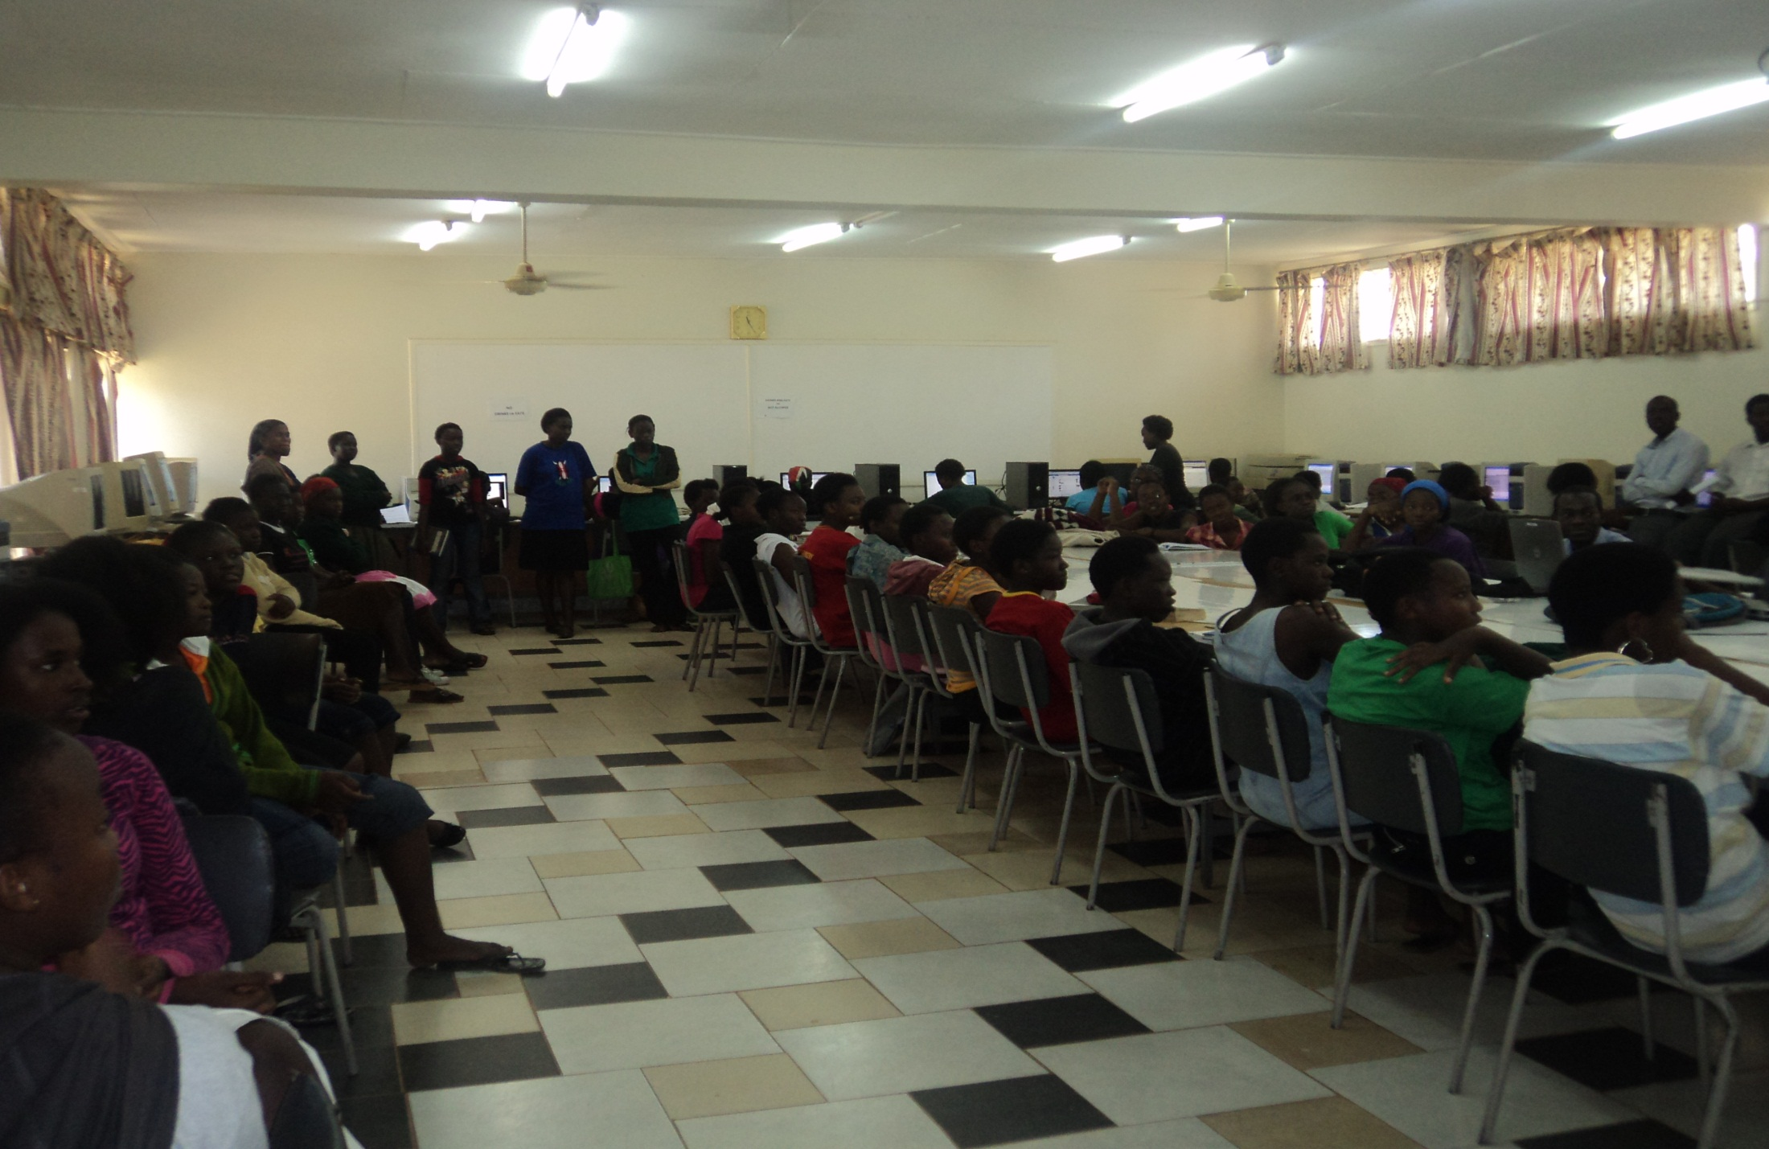
Supporting Innovation in Secondary Schools-Gayaza HS

Slide 32
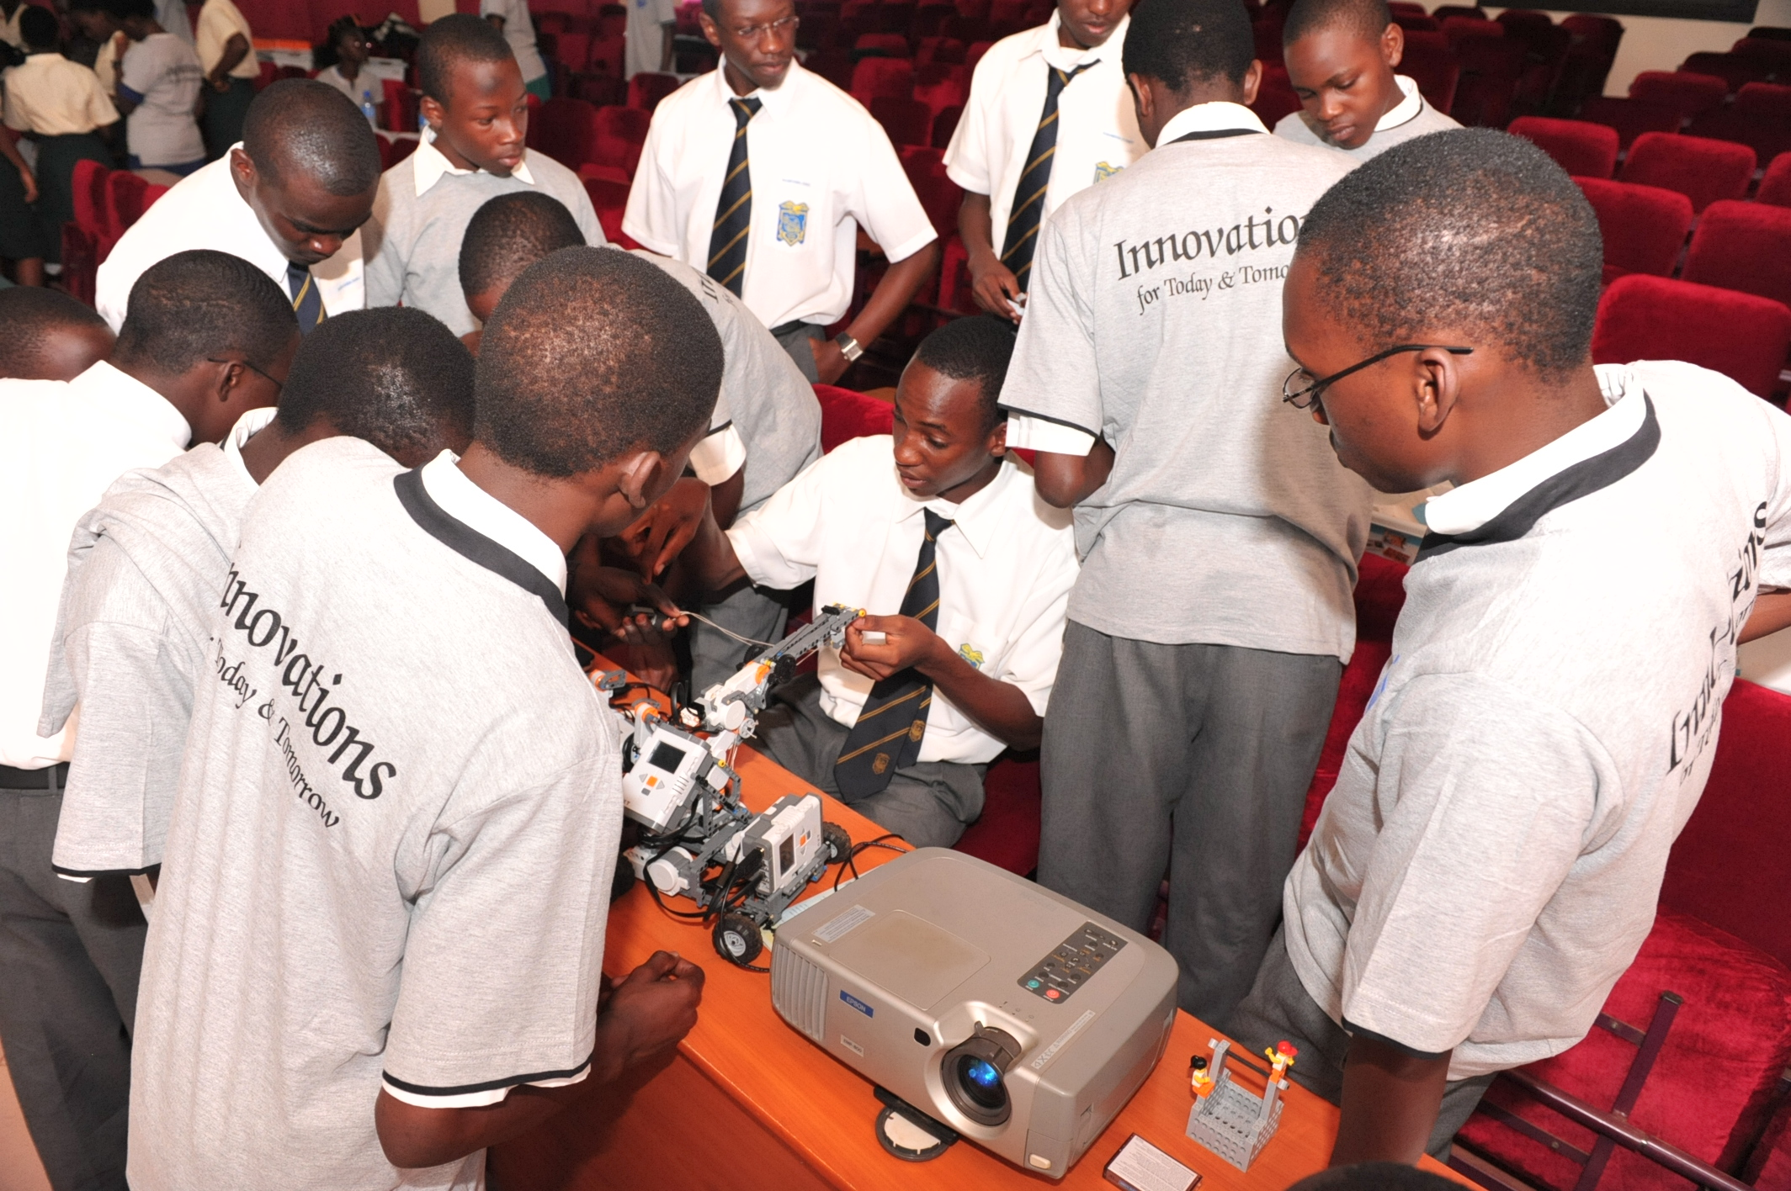
The Schools’ Robotics Challenge

Slide 33
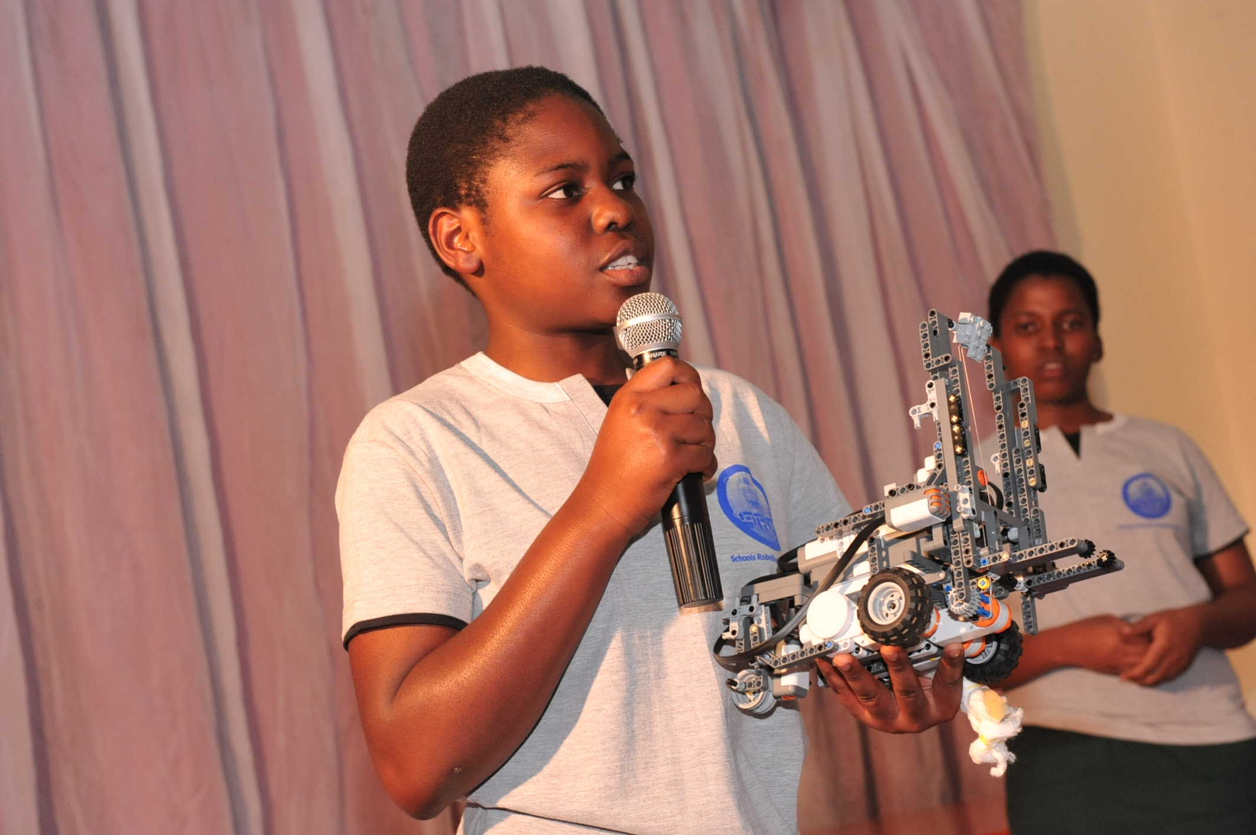
The Schools’ Robotics Challenge

Slide 34
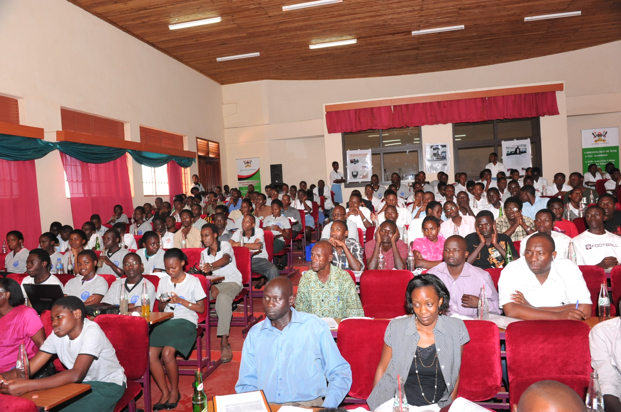
The Schools’ Robotics Challenge

Slide 35
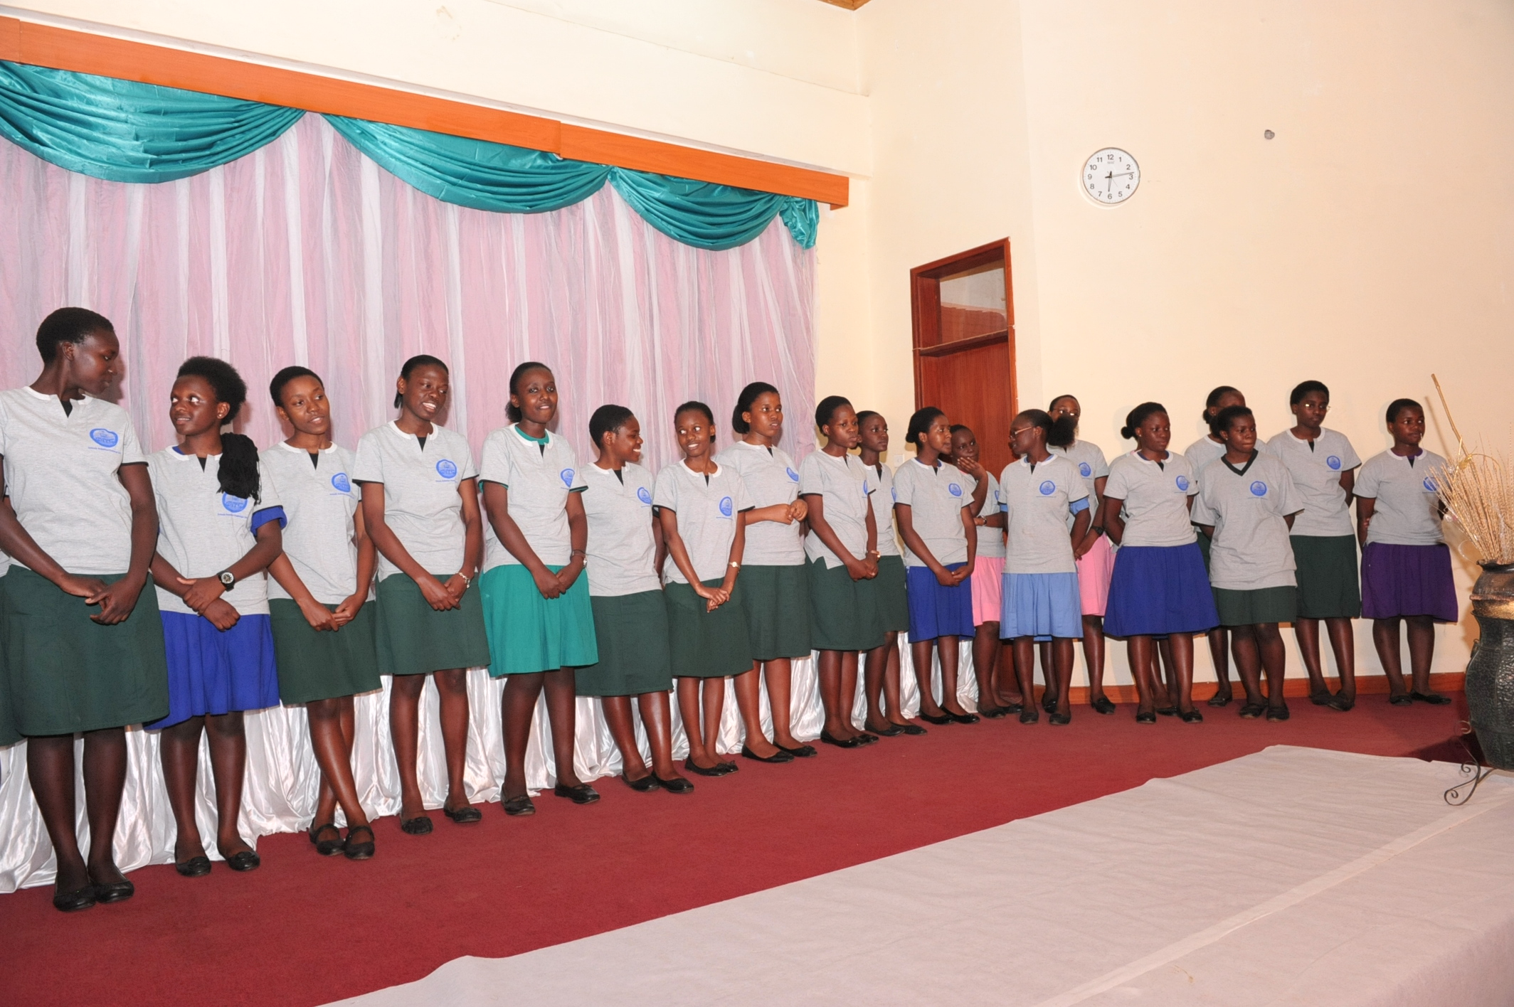
The Schools’ Robotics Challenge-Victors!!

Slide 36
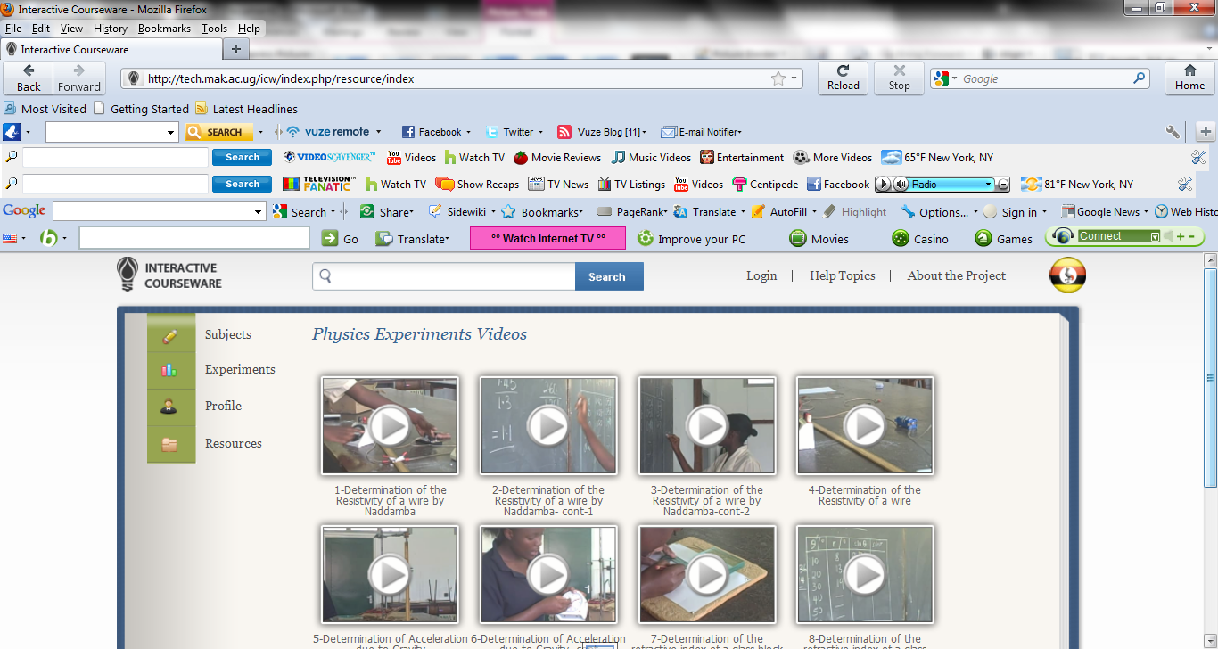
Development of Interactive Courseware

Slide 37
Prospects

Slide 38
2011/2012 Activities
Interactive Courseware in Secondary Schools
More support for Technology Innovation in Secondary Schools, Robotics Challenge Extended to Kings College Buddo and Mt. St. Mary’s Namagunga
iLabs in Busitema and Kyambogo Universities
Completion of Data Centre; Permanent deployment of iLabs
More facilitated Retention and Growth of Junior Faculty
Research and Publications

Slide 39
Challenges
Bandwidth Limitations- iLabs developed not permanently accessible on internet
Brain Drain: Low retention
Mobilisation of Partners

Slide 40
Tracing iLabs@MAK Alumni

Slide 41
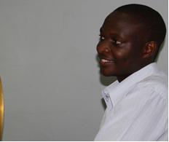
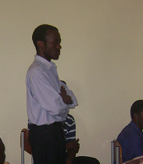
Albert Lumu
CGPA: 4.43 (first Class)
Graduate Fellow – iLABS@MAK Project
Msc. Electrical Engineering - MAK
Andrew Katumba
CGPA: 4.60 (first Class)
Graduate Fellow – iLABS@MAK Project
Teaching Assistant – ECE

Slide 42
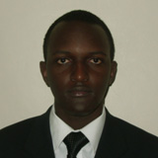
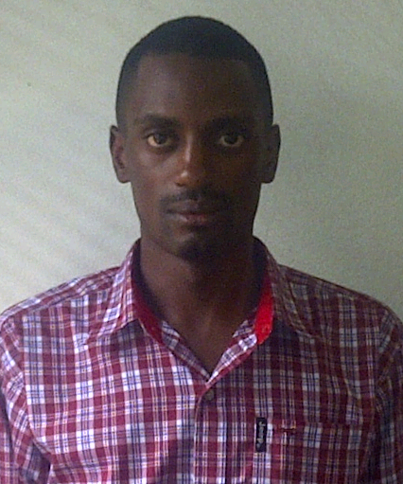
Michael Lutalo
GPA: 3.65 (Second Class Upper)
MSc. Telecom-University of Sydney
Australia
Lordewin Muhwezi
CGPA: 4.11 (Second Class Upper)
Network Engineer–Spescom Ltd.

Slide 43
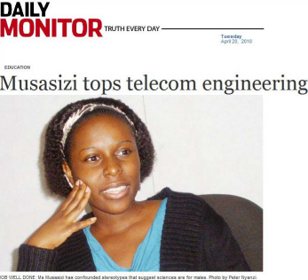
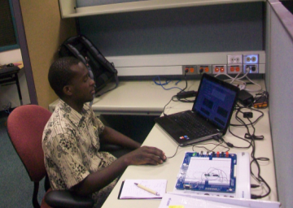
Lea Musasizi
CGPA: 4.41 (first Class)
MSc. Telecommunications Eng. Leeds University
Cosmas Mwikirize
CGPA: 4.67 (first Class)
Teaching Assistant –ECE
Graduate Fellow – iLABS@MAK Project
Msc. Electrical Engineering - MAK

Slide 44
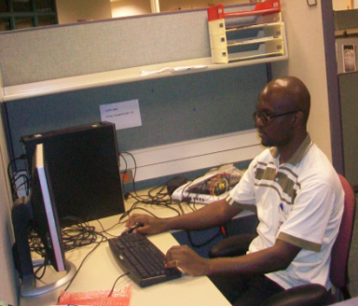
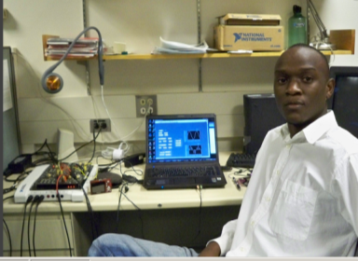
Arthur Asiimwe
CGPA: 4.25 (Second Class Upper)
Teaching Assistant – ECE Graduate Fellow – iLABS@MAK Project
Msc. Electrical Engineering – MAK
Raymond Besiga
CGPA: 3.8 (Second Class Upper)
Research Assistant – ECE
Ambassador-Global Health Corps, IDE, Uganda

Slide 45
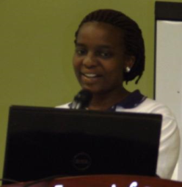
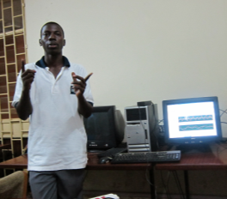
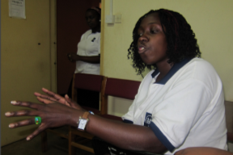
Doreen Orishaba
CGPA: 3.60 (Second Class Upper)
Internship with Muhlbuer, Germany
Michael Kyesswa
CGPA: 4.66 (First Class)
Graduate Research Assistant, ECE
Proscovia Nakazinga
CGPA: 4.12 (Second Class Upper), Graduate Research Assistant, ECE

Slide 46








Acknowledgments

Slide 47




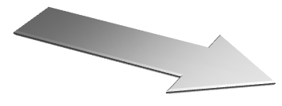

THANK YOU!

