Slide 1
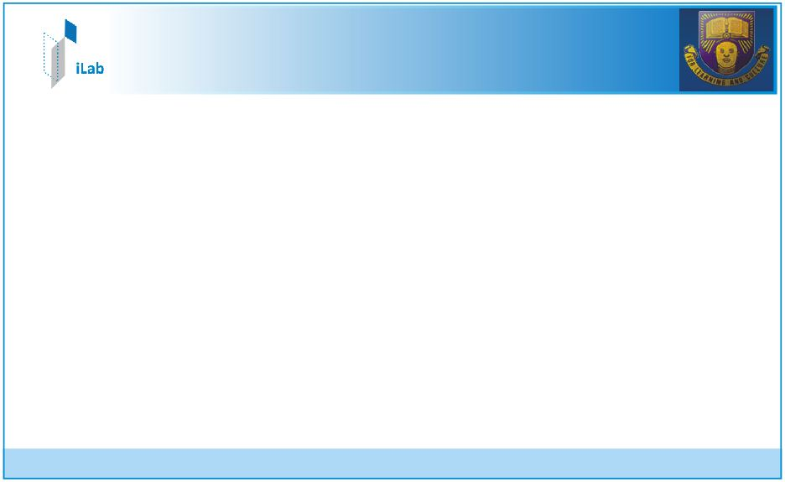
Fifth Annual iLab and National Instrument Conference
Theme:
“Online Laboratories: An Icon Educational Technology for a Richer Pedagogical Experience”
July, 2011
Aboluwarin Oluwapelumi.
Obafemi Awolowo University, Nigeria

Slide 2
Emona Datex iLab
Development of a framework for rapid development of telecoms experiments on Emona DATEx
To be used in EEE407 (Pulse & Digital Techniques), EEE411 (Communication Principles) and EEE509 (Communication Theory)
Enhanced UI to make user experience comparable to that of real lab
Programming languages used are JavaFX Script, Java, LabVIEW & C#

Slide 3
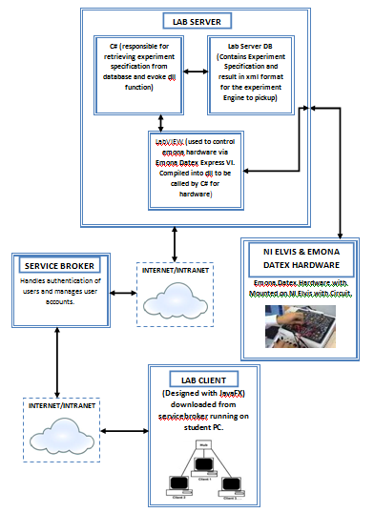

Slide 4
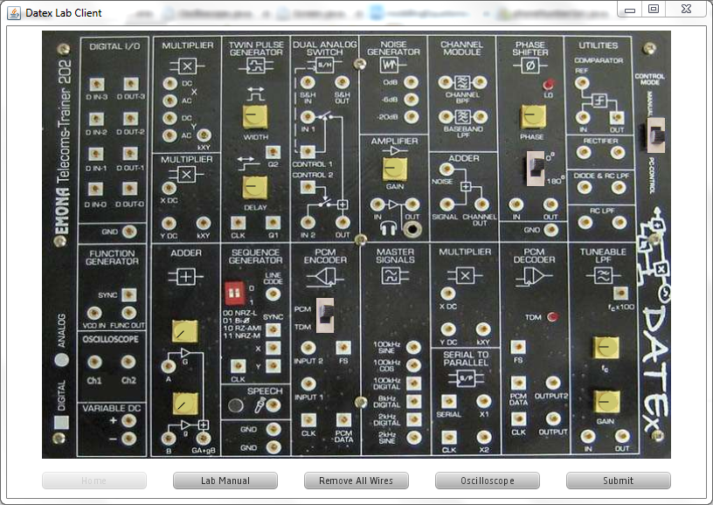
Lab Client
Lab Client developed with JavaFX Script, a platform for Rich Internet Applications
It gives users a richer experience, highly interactive, flexible & involving
Mimics actual Emona interface to give a ‘Richer Pedagogical Experience’

Slide 5
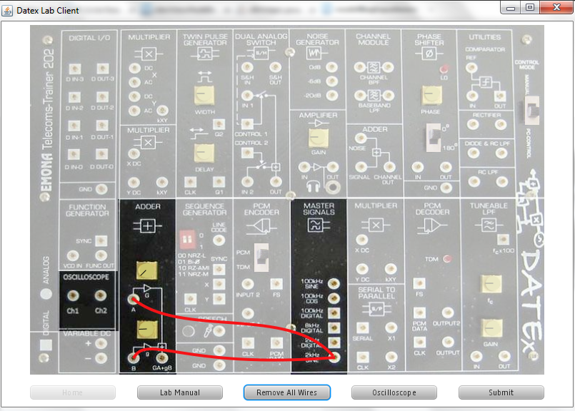
Connections are made through mouse action (press & drag) on nodes
Knobs and switches are adjustable through press & drag mouse actions
Can match wire connection with experiment configuration
Programmatically activated switches
Programmatically activated knobs
Wire Connecting Nodes
Node 1 (Adder B input)
Node 2 (2KHz Sine)

Slide 6
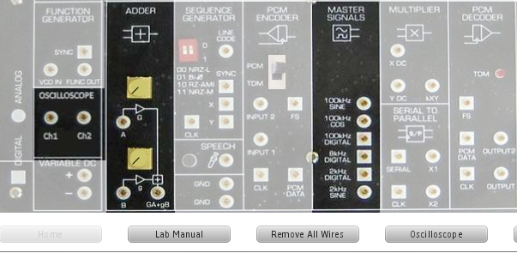
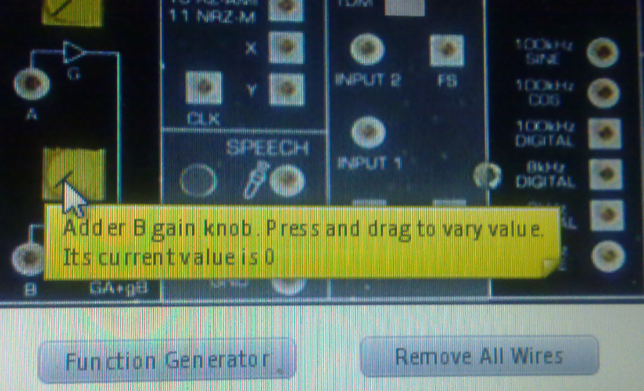
Use of fade mechanism to gray out unused regions in specific experiments to reduce cluster and confusion on user interface
Use of tooltip text to describe important components when mouse hovers such components
Mouse cursor
Tooltip text
Greyed region, Inactive area
Adder Knob
Active region, Not greyed

Slide 7
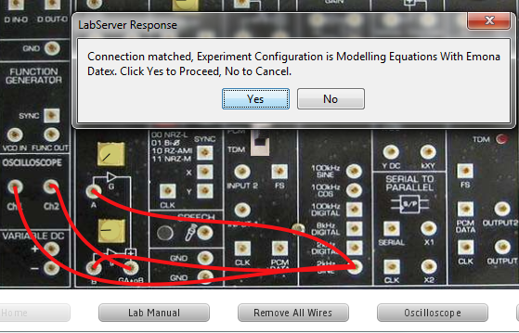
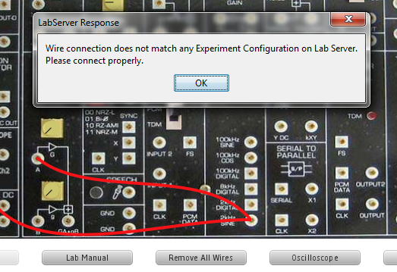
On clicking submit button, wiring is verified & validated to gain access to LabServer
Correct Wiring Response
Wrong Wiring Response

Slide 8
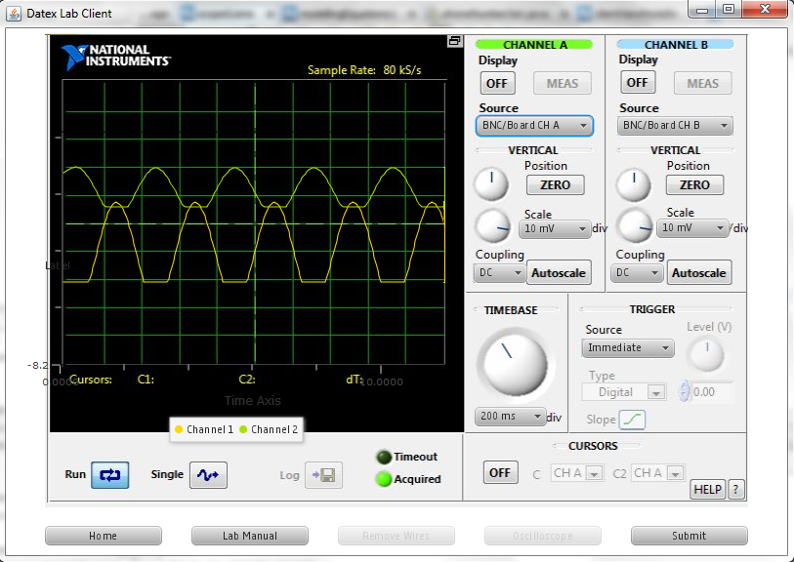
Emona DATEx Client Scope displaying a waveform with controls activated
Waveform channel 1 & 2
Enabled controls for adjusting scope properties

Slide 9
Lab Server
Experiment Engine built on C#.
Communication with hardware is achieved through custom built LabVIEW dll
VI’s were developed as standalone capable of handling all desired interaction with hardware before exporting as dll
C# class developed as an interface for communication between dll and remaining part of experiment engine
VI’s developed with LabVIEW 8.5 but final release will be ported to 8.6

Slide 10
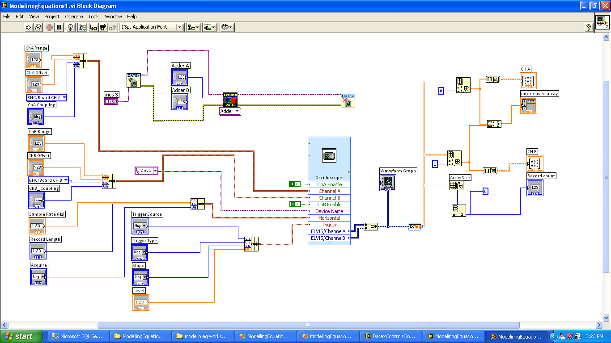
Experiment Block Diagram
Block diagram showing device drivers (NI Elvis & Emona) used
Emona Datex Device drver. Current selection is adder module
NI Elvis oscilloscope device driver

Slide 11
Further Work
Alpha release features deployment of 5 labs; AM, DSBSC, AM & DSBSC Demodulation, Modelling Equations with Emona
Addition of more labs: SSB, FM, FM Demodulation, PCM Decoding & Encoding
Switching matrix service will be implemented into the system
Optimization of images used so as to reduce jar size
Porting of existing JavaFX Script code to pure Java since JavaFX 2.0 libraries are now accessible within Java

Slide 12
THANK YOU
All life is an experiment. The more experiments you make, the better.
-Ralph Waldo Emerson

