Slide 1
Government ICT Plans to Support High Speed Internet Educational Technologies
Through National Information Technology Authority – Uganda (NITA-U)

Slide 2
Background
Established under the NITA-U Act, 2009
Acts as an operator, coordinator and regulator of Information Technology services for the Govt and country at large
Still very young with less than 50 employees

Slide 3
Objectives
Provide high quality technology services to Govt
To promote standardization in the planning, acquisition, implementation, delivery, support and maintenance of Information technology equipment and services
To promote access to and utilization of information technology by special interest groups
To promote and be a focal point of cooperation for information technology users and providers at regional and international level

Slide 4
Objectives continued
promote cooperation, coordination and rationalization among users and providers of Information technology at National and local levels
To provide guidance and other assistance as may be required to other users and providers of information technology

Slide 5
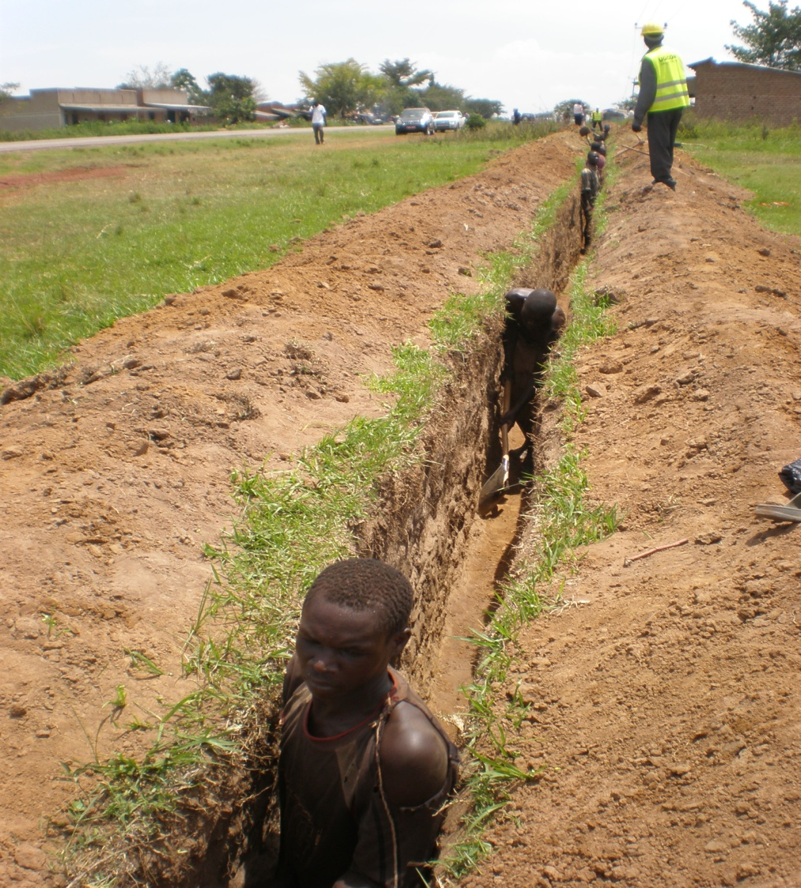
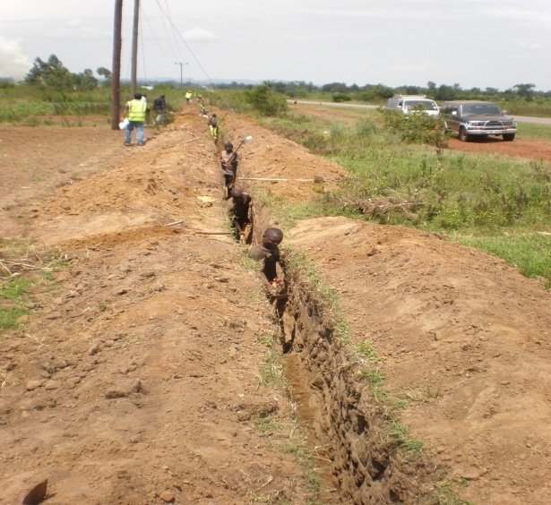
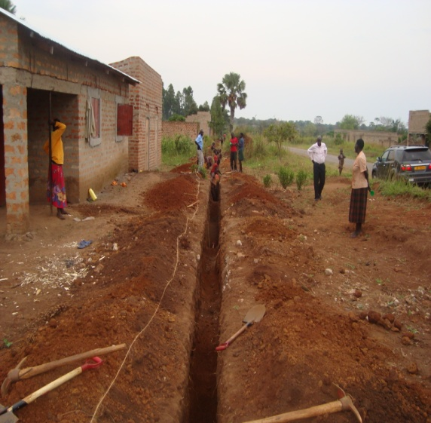
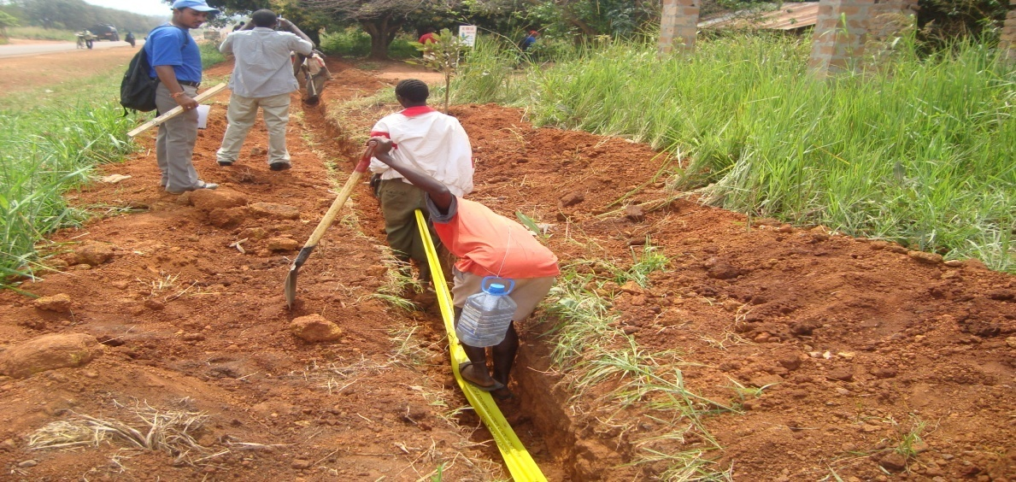
Physical laying of the NBI

Slide 6
Plans to support high speed internet access to Educational Institutions
Completion of National Backbone Infrastructure (1477kms laid so far) will provide ;
  High speed internet to educational and Government MDA’s
  Cheap internet access
Bulk procurement of internet bandwidth to benefit government MDAs and educational institutions

Slide 7
Planned support continued
Plans underway to set up Government Portal to boost visibility of Educational Institutions in Uganda
Connectivity of high speed internet to districts through NBI and DBICs thereby providing cheap, fast country wide internet access
Government to provide for last mile solution

Slide 8
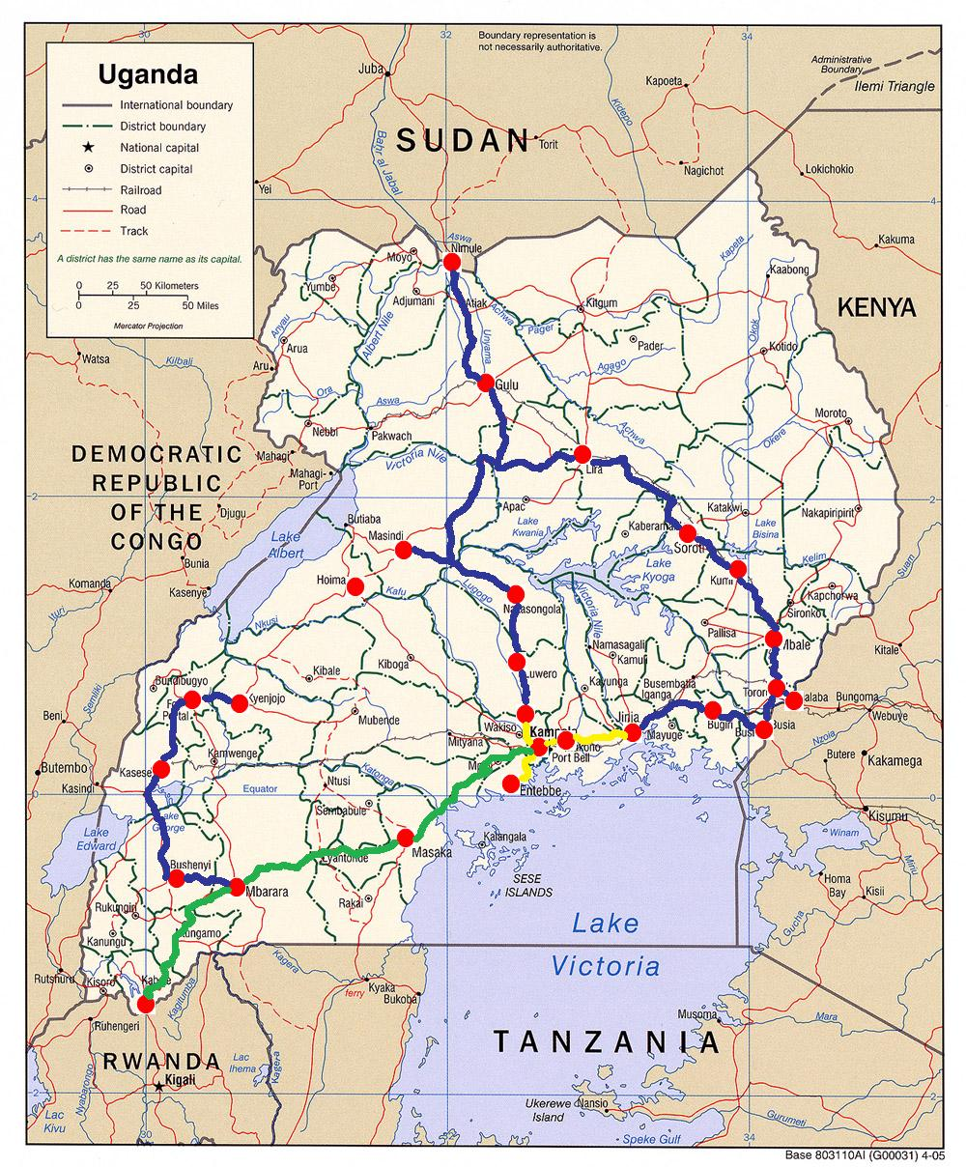

Slide 9
Planned support continued
Messaging & Collaboration System (when rolled out) will assist in improved communications for MDAs (amongst others)
NBI will be operational in September, 2011 and educational institutions will be able to tap in.

Slide 10
Expected benefits after completion of planned activities
Provision of cheap internet to medical and educational institutions
Easy access to government services
Support of educational research online
Easy collaboration with education institutions in benchmarking and impact studies
Cost savings and QoS improvement in educational institutions

Slide 11
Benefits continued
Support of online education through fast and reliable internet
Support of educational institutions in taking their services closer to their clients through decentralization

Slide 12
Other projects we are involved in
Creation of Business Processing outsourcing centres
Development of ICT parks
Development of National Databank
Development of District Business Information centres – one point stop for electronic services for rural communities
E-readiness survey etc.

Slide 13
Thank you for listening
Gerald Kisongoch
Programme Officer – NITA-U
(On behalf of Executive Director -NITA-U)
For more info send mail to: info@nita.go.ug
Website: www.nita.go.ug

