Slide 1

State of iLabs Project at UDSM
By
Alfred Mwambela
College of Information and Communication Technology (CoICT)
5th Annual iLabs and NI Conference, MAK University, 4th – 5th July, 2011
Slide 1

Slide 2
State of iLabs Project at UDSM
The Organizational Structure - 2010
University of Dar es Salaam
College of Engineering and Technology (CoET)
School of Informatics & Communication Technologies (SICT)
Department of Electrical and Computer System Eng (ECSE)
Power Engineering
Electronics & Comm. Technologies
Computer Systems Eng.
Computer Science
Telecommunication Eng.
Center for Virtual Learning
5th Annual iLabs and NI Conference, MAK University, 4th – 5th July, 2011
Slide 2

Slide 3
State of iLabs Project at UDSM
The Organizational Structure - 2011
University of Dar es Salaam
College of Information and Communication Technology
Department of Electronics and Telecommunication Engineering
Department of Computer Science and Engineering
Center for Virtual Learning
5th Annual iLabs and NI Conference, MAK University, 4th – 5th July, 2011
Slide 3

Slide 4
State of iLabs Project at UDSM
Capacity Building
University of Dar es Salaam
Principal Investigator (PI)
Assistant PI
Assistant PI
System Administrator UCC
iLabs Developers
Undergraduate Students (12)
Graduate Students (5)
Staff (4)
5th Annual iLabs and NI Conference, MAK University, 4th – 5th July, 2011
Slide 4

Slide 5
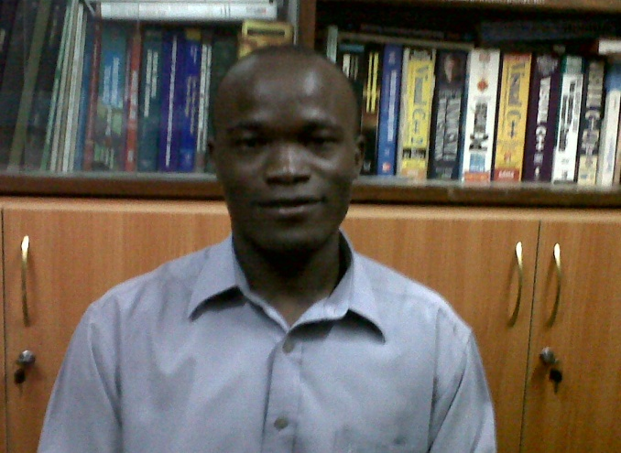
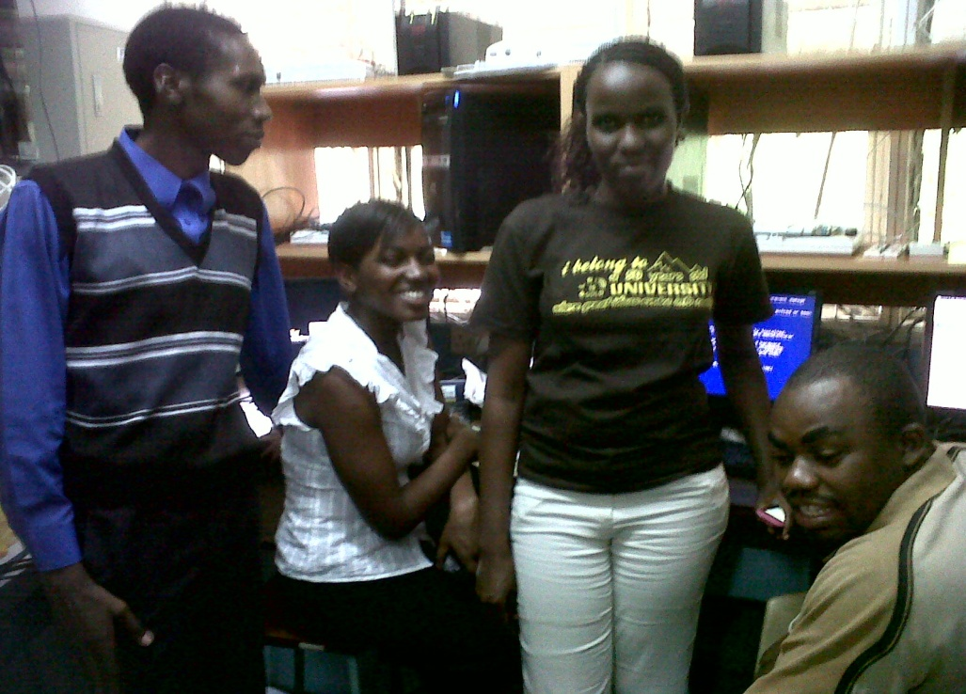
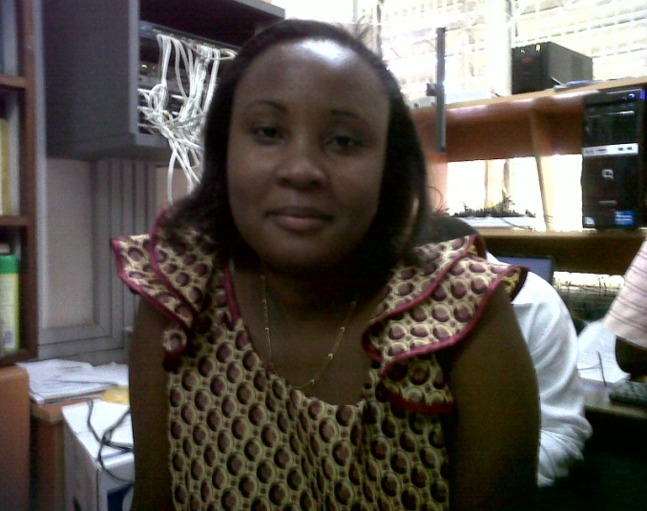
State of iLabs Project at UDSM
Capacity Building
5th Annual iLabs and NI Conference, MAK University, 4th – 5th July, 2011
Slide 5

Slide 6
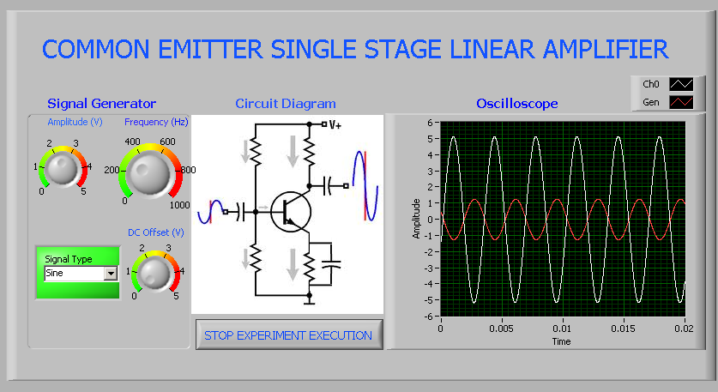
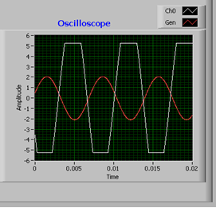
State of iLabs Project at UDSM
Converting Existing Experiments into iLabs
5th Annual iLabs and NI Conference, MAK University, 4th – 5th July, 2011
Slide 6

Slide 7
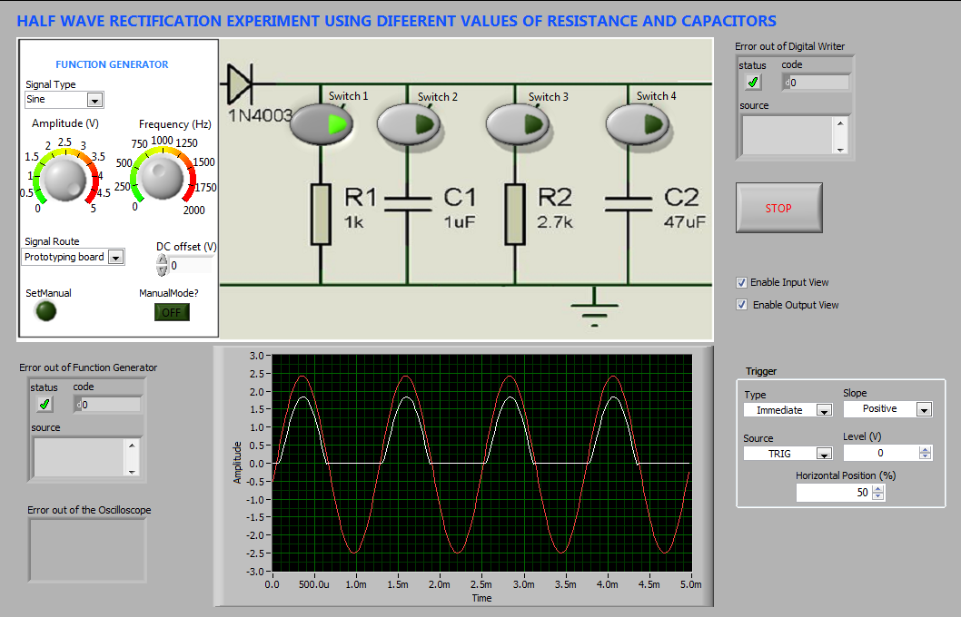
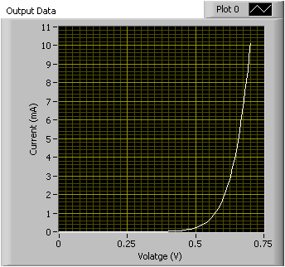
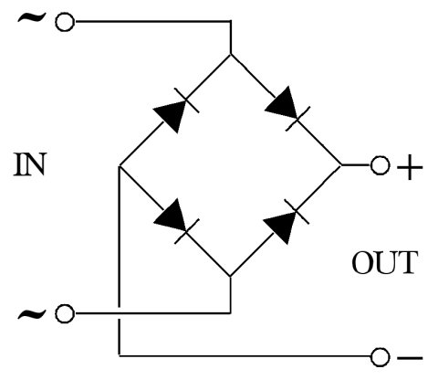
State of iLabs Project at UDSM
Converting Existing Experiments into iLabs
5th Annual iLabs and NI Conference, MAK University, 4th – 5th July, 2011
Slide 7

Slide 8
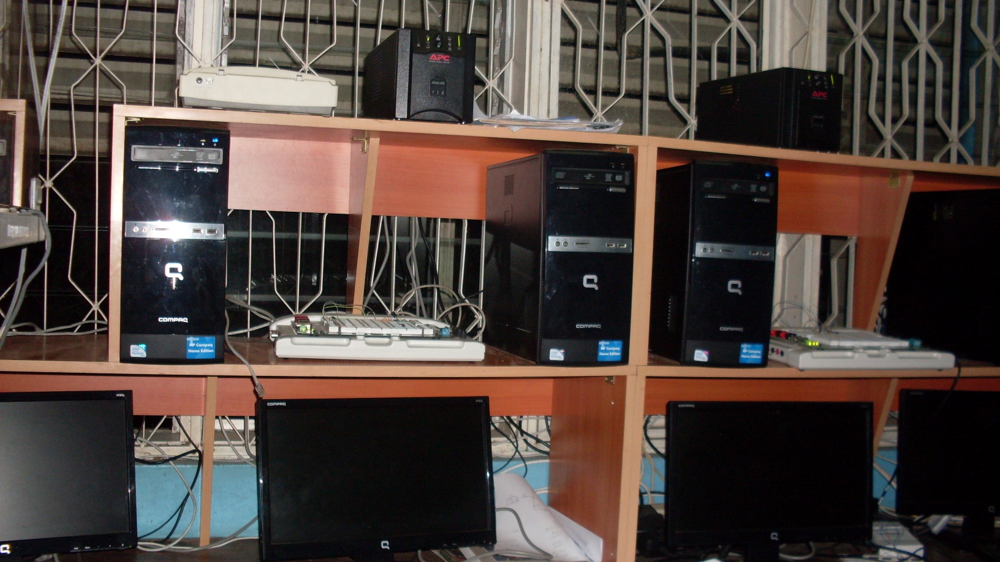
State of iLabs Project at UDSM
Managing Deployed iLabs Experiments
5th Annual iLabs and NI Conference, MAK University, 4th – 5th July, 2011
Slide 8

Slide 9
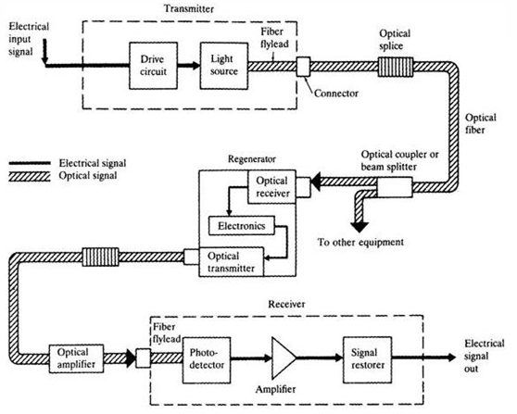
State of iLabs Project at UDSM
Introducing New iLabs Experiments
  EMONA DATEx
  EMONA FOTEx.
5th Annual iLabs and NI Conference, MAK University, 4th – 5th July, 2011
Slide 9

Slide 10
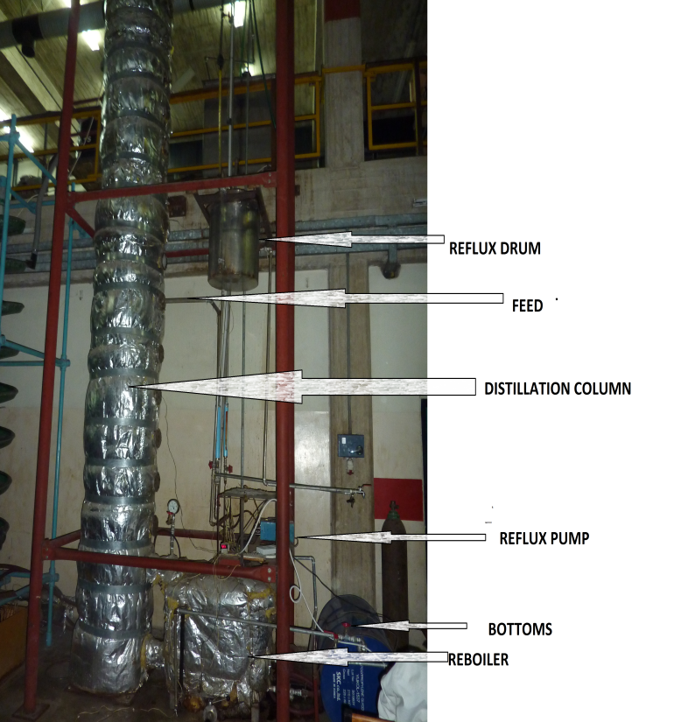
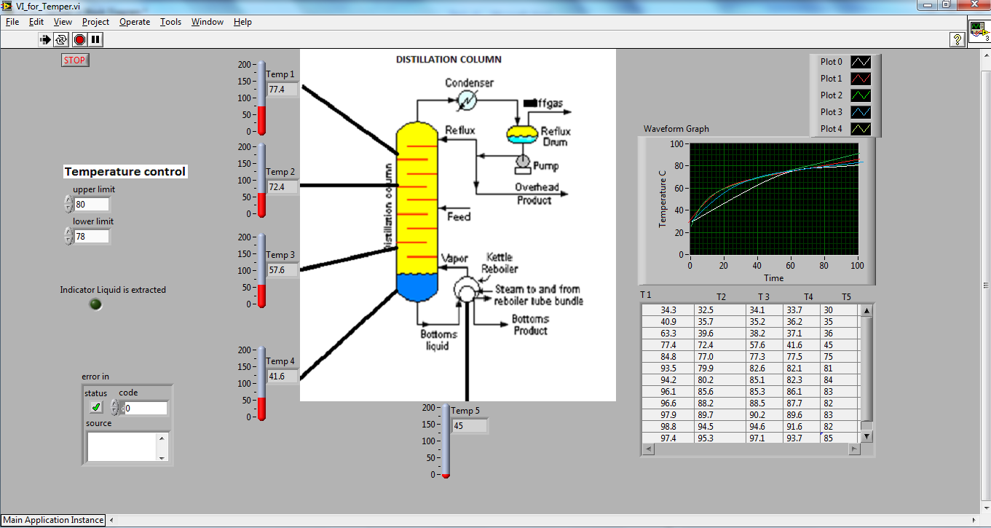
State of iLabs Project at UDSM
iLabs in Chemical and Process Engineering
5th Annual iLabs and NI Conference, MAK University, 4th – 5th July, 2011
Slide 10

Slide 11
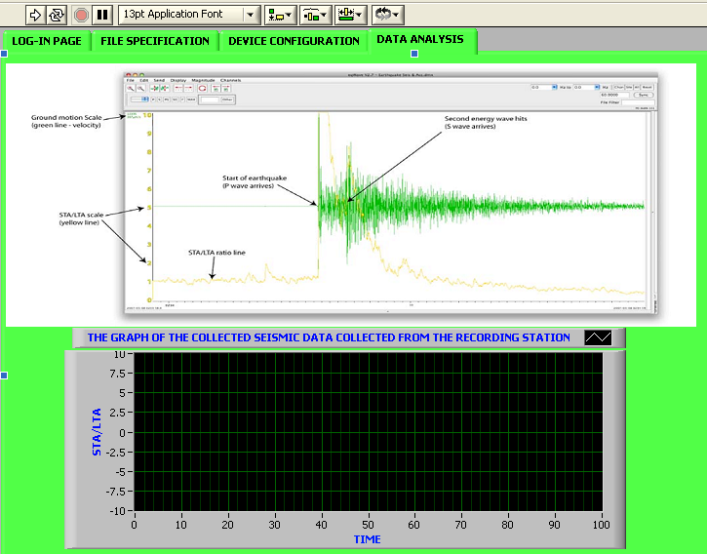
State of iLabs Project at UDSM
iLabs in Seismology
5th Annual iLabs and NI Conference, MAK University, 4th – 5th July, 2011
Slide 11

Slide 12
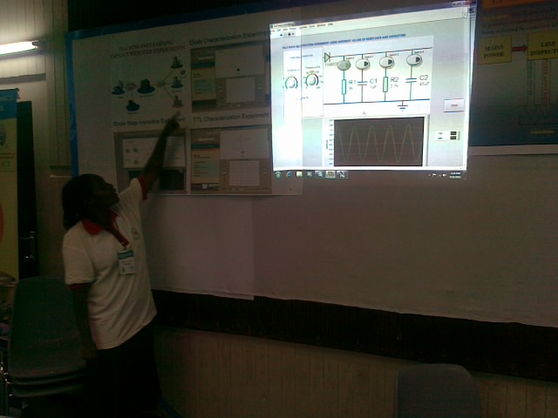
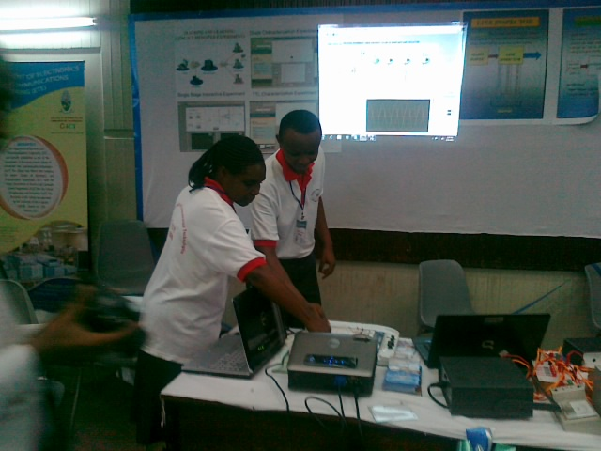
State of iLabs Project at UDSM
Dissemination
5th Annual iLabs and NI Conference, MAK University, 4th – 5th July, 2011
Slide 12

Slide 13

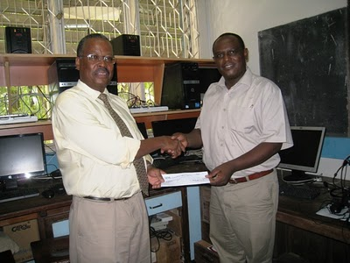
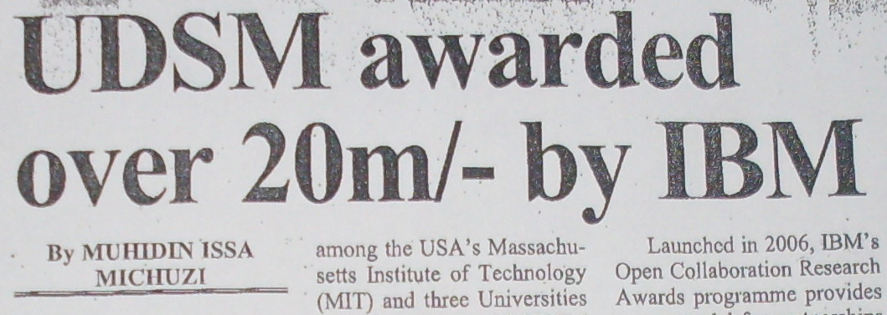
State of iLabs Project at UDSM
Extra Funding
5th Annual iLabs and NI Conference, MAK University, 4th – 5th July, 2011
Slide 13

