Slide 1

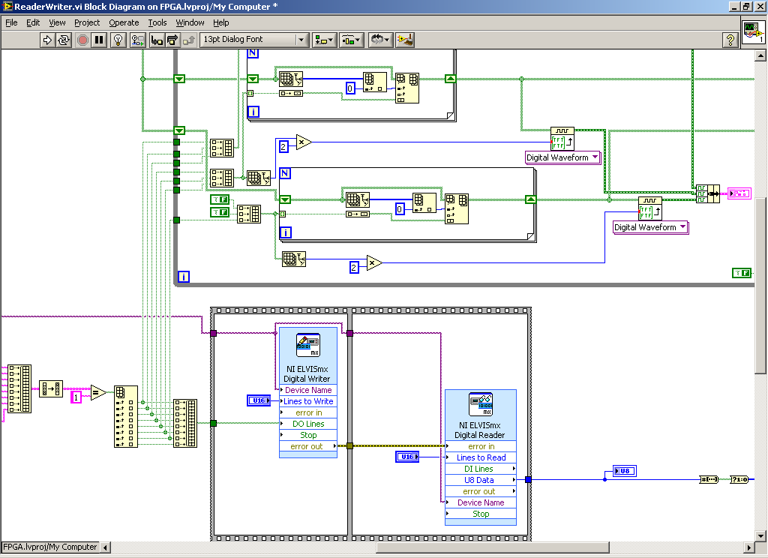
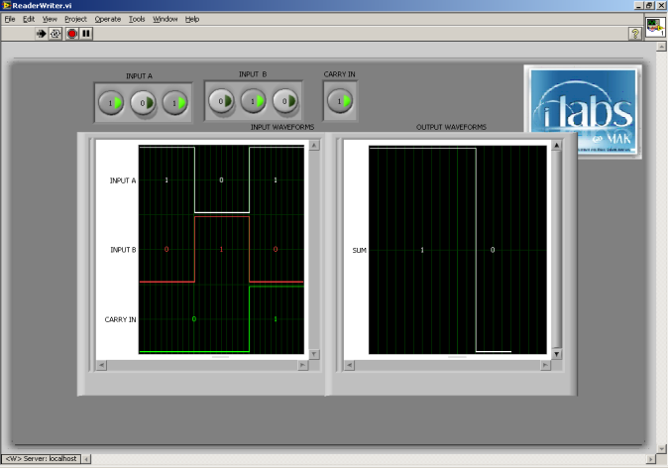
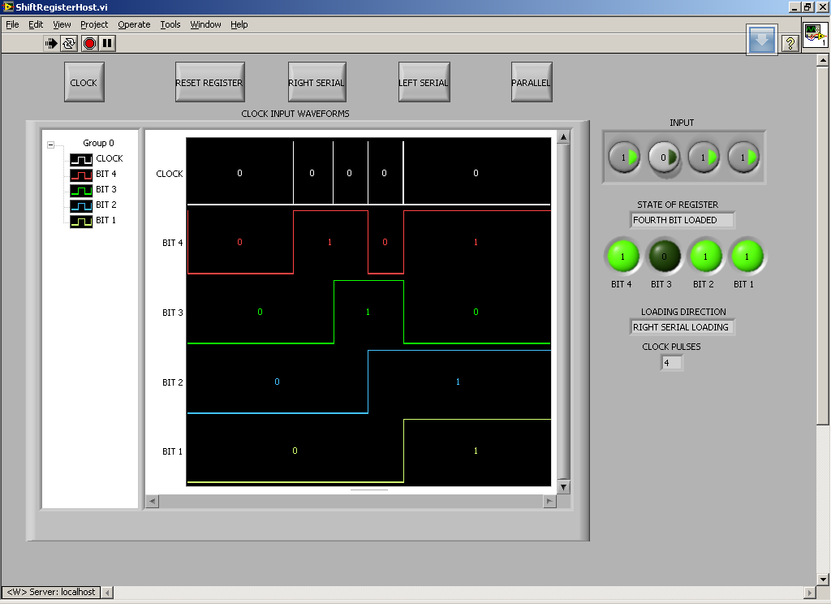
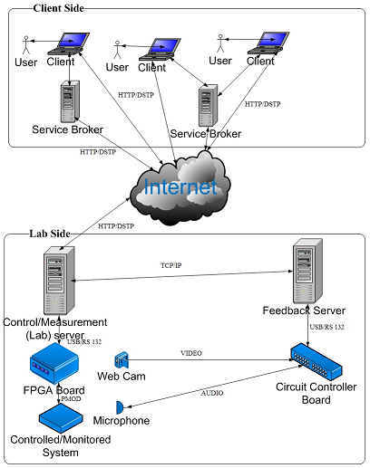
Integrating Data Acquisition, Control and Monitoring Capabilities into the online FPGA Laboratory
Dr. Julius Butime, Head of Department, Electrical and Computer Engineering, CEDAT, MAK
Raymond Besiga, Research Asst., ECE, CEDAT
ABSTRACT
RESULTS
This Poster presents the background, rationale, objectives, methodology, and the results of integrating Data Acquisition, Control and Monitoring Capabilities into the FPGA Lab. The research built from the activities carried out in 2010, where the researcher and to undergraduate students built a laboratory of three (3) online experiment i.e. 3-bit full adder (with carry in), 4-bit universal shift register and 4-bit Up/Down synchronous counter. The research is ongoing to integrate data acquisition, monitoring and control capabilities using the NI FPGA and CompactRIO modules.
INTRODUCTION
FPGAs are reprogrammable silicon chips. Using prebuilt logic blocks and programmable routing resources, you can configure these chips to implement custom hardware functionality without ever having to pick up a breadboard or soldering iron. You develop digital computing tasks in software and compile them down to a configuration file that contains information on how the components should be wired together.
With the LabVIEW FPGA Module, you can create custom measurement and control hardware without low-level hardware description languages or board-level design. You can use this custom hardware for unique timing and triggering routines, ultrahigh-speed control, interfacing to digital protocols, digital signal processing (DSP), and RF communications.
FPGA s are a new area of research here at Makerere University. With this laboratory in place, teaching and learning the introductory concepts of Digital Electronics in the Electrical and Computer Engineering Department has become more engaging and thus the need to add more functionality to the lab using the NI FPGA and CompactRIO.
The MAK FPGA laboratory that was developed was limited to supporting experiments fields of digital adders, shift registers and counters. The laboratory was not multi-dimensional and did not allow for more advanced concepts in Digital Electronics and the use of Field Programmable Gate Arrays. As such, this research was motivated by the need to build a comprehensive platform to enhance the versatility of the lab through integration of support for Data Acquisition, Monitoring and Control in the fields of Digital Signal Processing and Motor Control.
OBJECTIVES
To determine the requirements for the FPGA laboratory covering Digital Signal Processing and Motor Control.
To develop the architecture for integrating Data Acquisition, Monitoring and Control into the iLabs Shared Architecture based on the specified requirements.
To implement the architecture into a fully functional Prototype. The prototype shall be deployed on the public infrastructure at Makerere University for access by iLabs – Africa partners and other institutions in Uganda.
CONCLUSION
METHODOLOGY AND MATERIALS
With all equipment available, the laboratory will support Digital Signal Processing with parallel execution on both the FPGA and the NI CompactRIO using high-speed digital inputs and output modules. Also, the laboratory will feature a Motor Control experiment using Servo-state drive modules on the CompactRIO. Students will now have an interactive and engaging pedagogical experience as they learn Digital Electronics and Field Programmable Gate Arrays
This section elaborates the steps that were taken to achieve the objectives of the research. It highlights the methods and processes that were used so as fulfill the design and implementation of an advanced FPGA-based laboratory.
The researcher did literature review in the field of FPGA technology and derived a Requirements Specification Document that was used to come up with the System Architectural Description based on the pre-existing laboratory.
Translation of the system architecture into a functional laboratory prototype was then done against the requirements specification. There was an improvement in the system block diagram and virtual instruments in order to combat network latency and slow bandwidth within the College intranet.
LITERATURE CITED
Judy, T. (2005). Design and Implementation of an Online Laboratory for Introductory Digital Systems). Massachusetts Institute of Technology.
Reza Hashemian, J. R. (2006). FPGA e-Lab, a Technique to Remote Access a Laboratory to Design and Test.
Miloš Drutarovský, J. Š. (2009). Remote Laboratory For Fpga Based Reconfigurable Systems Testing. Technical University of Košice.
Haward. (2004). iLab: A Scalable Architecture for Sharing Online Experiments. Florida: International Conference on Engineering Education.
Dayo. (2009). Logic Design Lab Project. Obafemi Awlowo University, Nigeria.
Doru Ursutiu, M. G. (2009). FPGA LabVIEW Programming, Monitoring and Remote Control. iJOE , Volume 5, Issue 2.
Agelidis, V. G. (1997). Incorporating Inctructional Feedback in Electrical Engineering Laboratory Experiments—An Example. Perth: IEEE.
Andreas Koch, U. G. (1993). FPGA Application in Education and Research. Braunschweig, Germany: Technical University of Braunschweig.
SYSTEM ARCHITECTURE
ACKNOWLEDGEMENTS
I would like to thank the following for the assistance they have rendered me as I pursued this research:
CEDAT, Makerere University
National Instruments
MIT Center of Educational Computing Initiatives
Carnegie Corporation of New York

