Slide 1

The iLab-Africa Project:
Looking Back, Looking Forward
Makerere University Project Meeting, 2011
Jud Harward, CECI, MIT, jud@mit.edu
4 July 2011

Slide 2
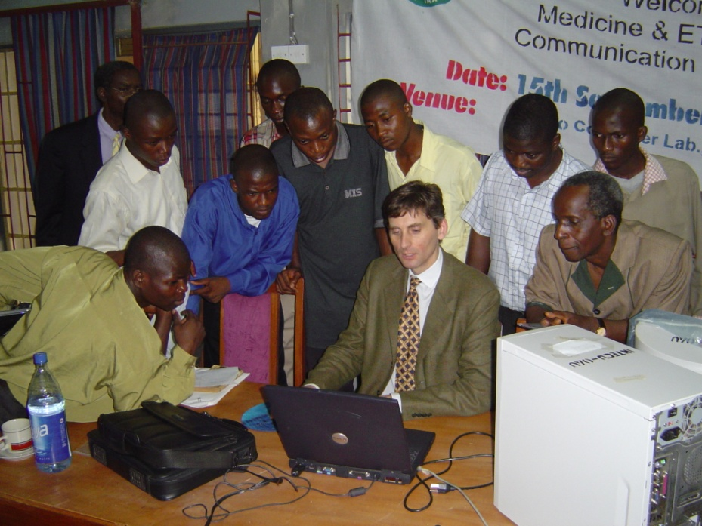
Birth of an Idea
Vice-Chancellors’ visit to MIT, 14 April 2003:
  Roger Makanjuola, Vice-Chancellor, OAU
  Matthew Luhanga, Vice Chancellor, UDSM
  P.J.M. Ssebuwufu, Vice Chancellor, Makerere
One event that day was an iLab presentation by Jesus del Alamo on the iLab Project
A spark was lit, Prof. del Alamo had
a sabbatical year, Carnegie funded a
feasibility study, and the results were
two trips in spring of 2004 to East
and West Africa
Jesus del Alamo at OAU, 2004

Slide 3
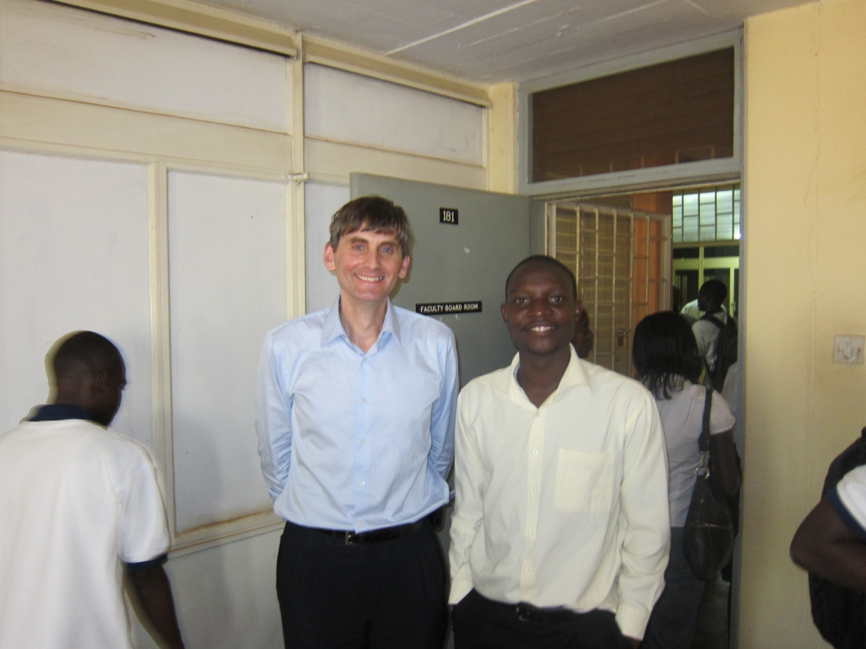
Are We Dreaming?
Under the feasibility study, Prof. del Alamo and a recent graduate of Makerere, Albert Lumu, also carried out careful testing of the accessibility of MIT iLabs from the MAK campus.
Jesus and Albert Lumu

Slide 4
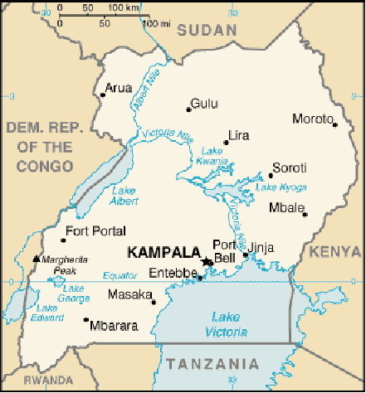
Bandwidth limitations
(example: Makerere University, Kampala, 2006)
campus wide single-mode optical fiber (2 Gb/s)
satellite gateway to Internet (total bandwidth of Uganda=25 Mb/s)
metropolitan network (total campus bandwidth=2.5 Mb/s)
MIT 2006 total campus bandwidth ~ 2.3 Gb/s)
academic buildings networked at 10/100 Mb/s

Slide 5
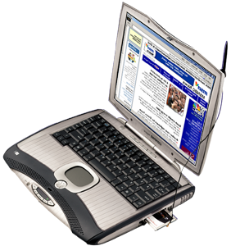


The Solution
First External Service Broker Installed at Makerere (Sept. ‘04)
http://emuklabs.mak.ac.ug

Slide 6
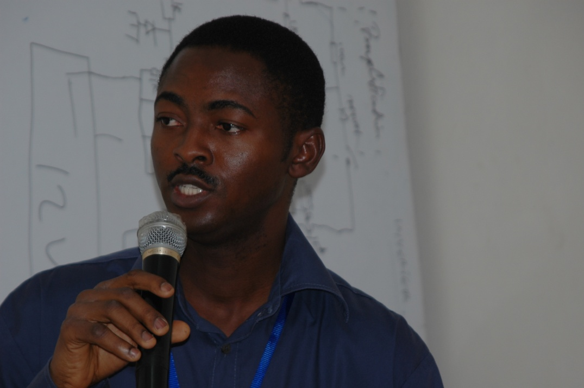
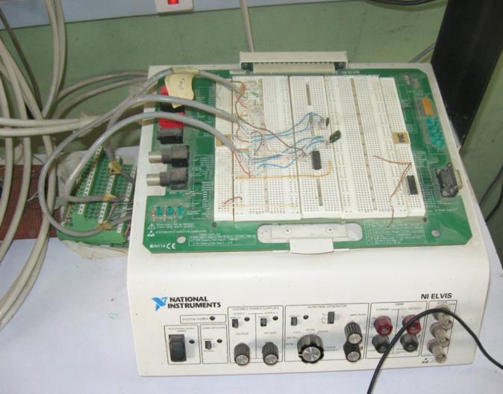
Early Successes
Already by December 2005, an OAU team led by Kayode Ayodele with strong help from Olutola Jonah had created the first iLab designed and implemented totally in Africa.
Lab incorporated a switching matrix which introduced an element of design. MIT soon picked up the idea.

Slide 7
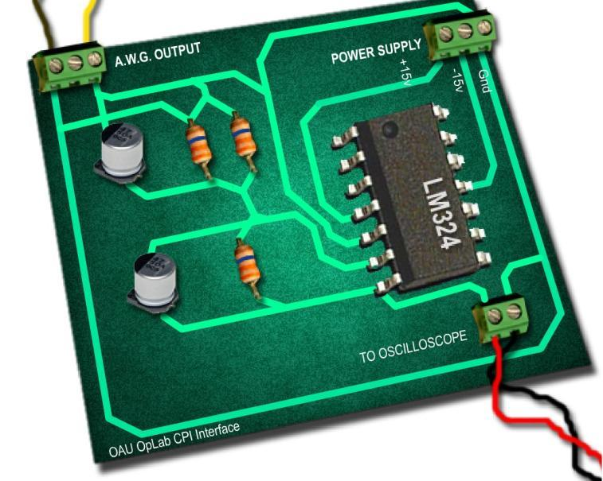
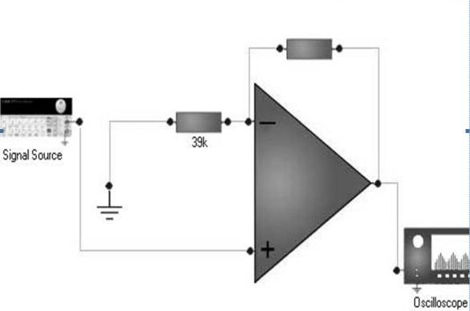
Early Successes, II
OAU over the next several years worked on different approaches to graphic user interfaces.
Led to a series of 3 papers at the American Society of Engineering Education in 2008
Development continues in FLEX in work by Tunde Ishola.

Slide 8
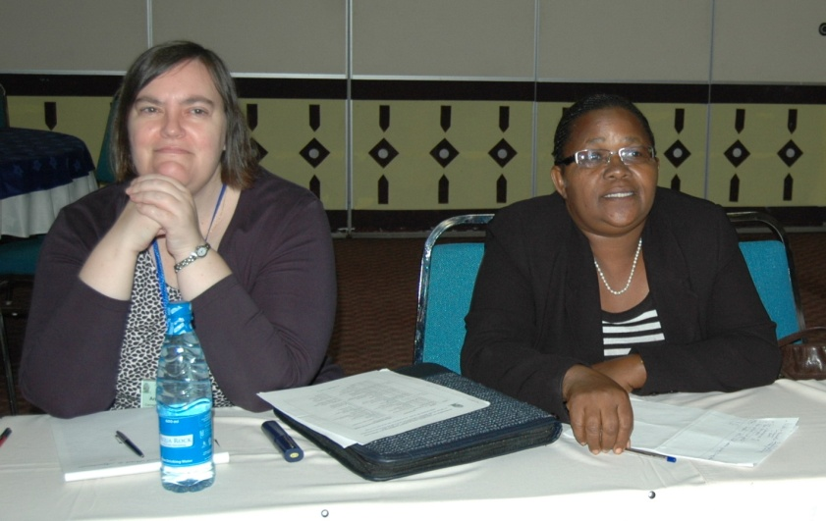
The Pioneers
Many people contributed to launch the work, both as mentors and as developers.
The challenges as we took our first steps were immense:
  We didn’t know each other well, personally or professionally.
  The technology from MIT was raw, buggy and evolving.
  We thought we knew what we wanted to do, but we didn’t understand the costs and best path to our goals.
A major reason for our success lay in Carnegie’s support and mentorship
  Andrea Johnson’s steady advice
Andrea Johnson at UDSM
July 2010

Slide 9
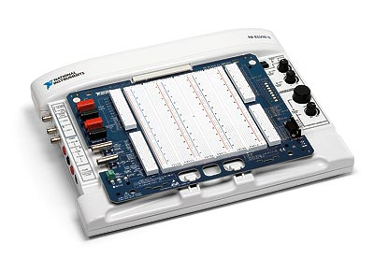
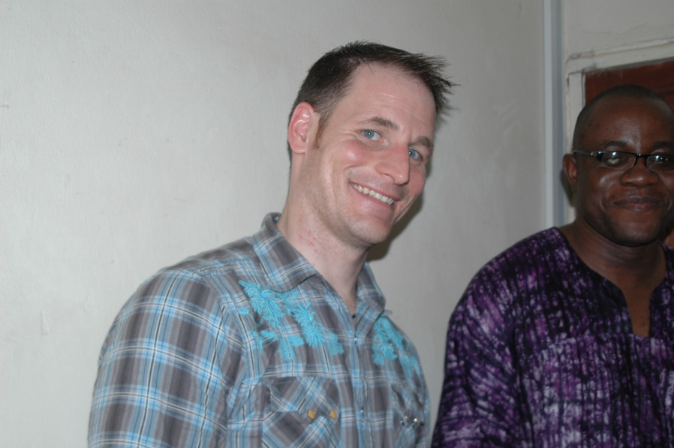
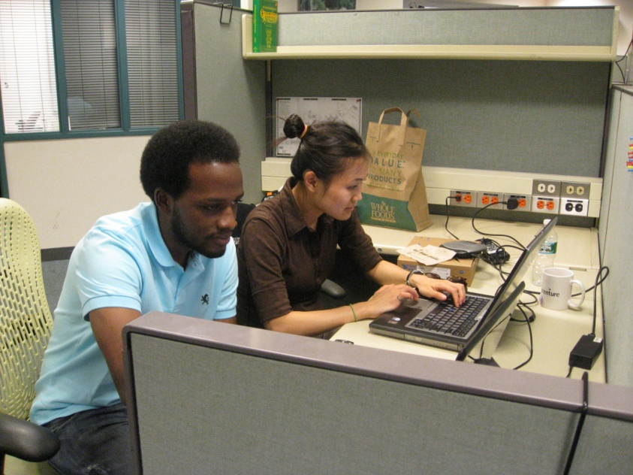
Turning Point:
Partnership with National Instruments
The quest for a low cost, universal EE lab platform was answered by the NI ELVIS and Labview
The personal commitment of MIT’s two NI academic field engineers: Andrew Watchorn and Lesley Yu have broadened this effort far beyond iLabs.
Andy Watchorn and Soji Ilori, OAU
Lesley Yu and Philip Karumuna, MIT

Slide 10
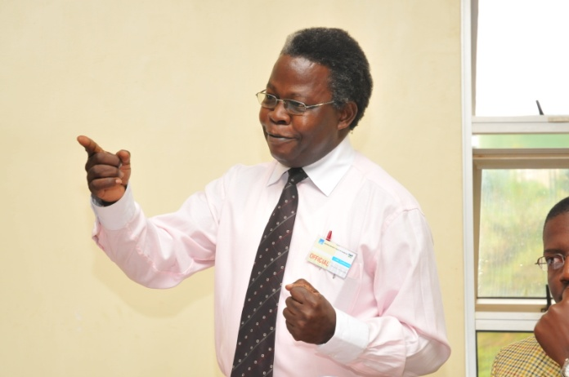
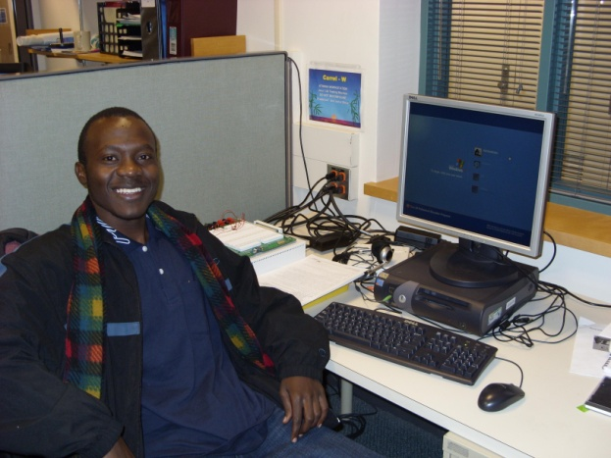
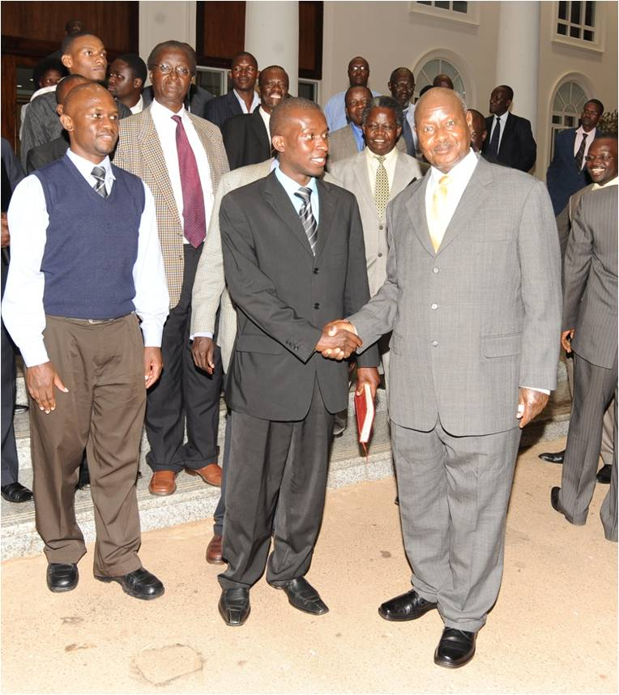
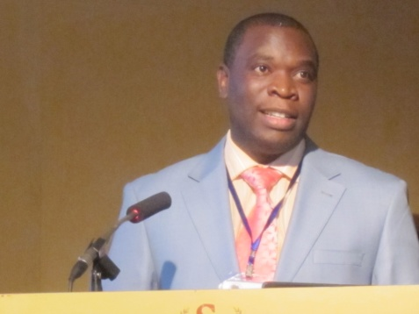
Turning Point:
Return of Makerere, 2007-2008
After dropping out of the project, Makerere returned under the mentorship of Sandy Tickodri-Togboa with a student team led by Andrew Katumba.
Sandy’s unique leadership style, “I just get out of the way!”
Andrew’s willingness to take responsibility
Paul Musasazi’s nurturing management as the team has grown.
Sandy Tickodri-Togboa
Andrew Katumba, MIT, 2009
Cosmas, Arthur, and others present to President Museveni
Paul Musasazi, Entebbe Telecom
Conference, 2010

Slide 11
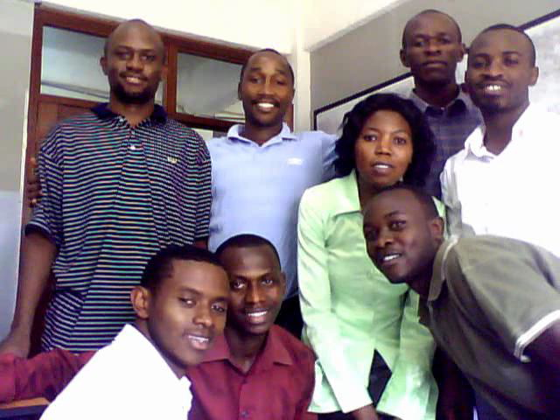
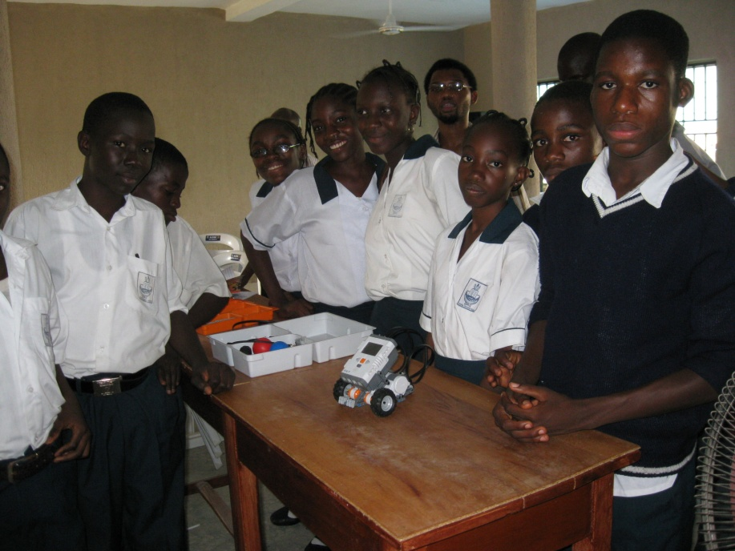
Makerere’s Innovations
The importance of undergraduates and capstone projects
Large, well-organized teams producing many iLabs
(With OAU) A renewed emphasis on outreach not only to neighboring universities, but to secondary schools and to partners in other African countries.
Arthur and Nicolas teaching workshop at KIST
OAU Robotics Competition at Secondary School

Slide 12
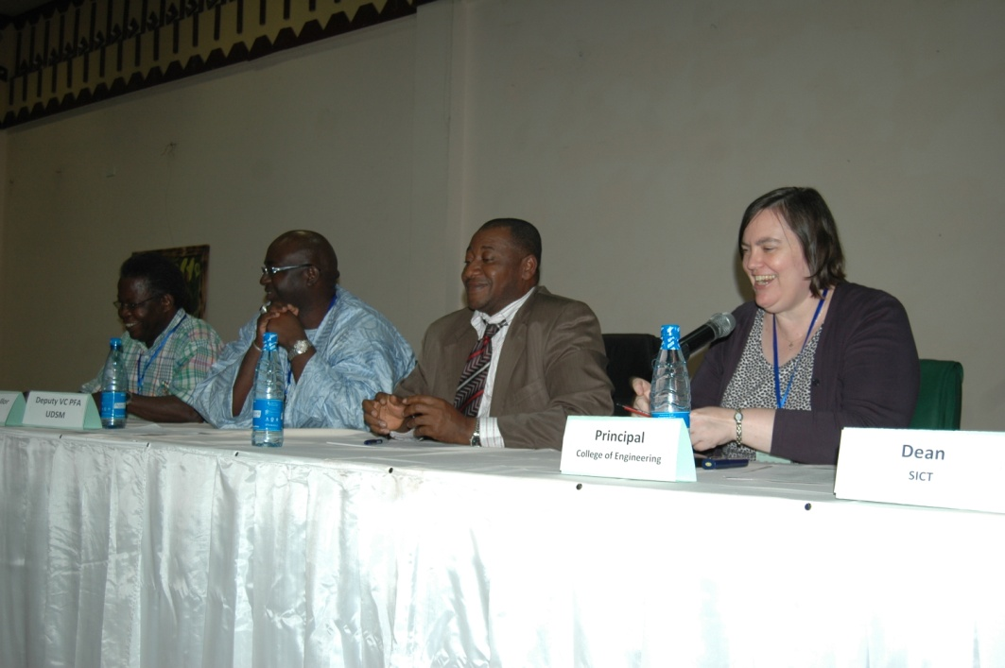
iLabs Increasing Impact on Africa
African outreach efforts:
  OAU: Mali, Ghana, South Africa
  Makerere: Kenya, Rwanda
Last year’s project meeting hosted by UDSM attracted guests from Kenya, Ghana, and the Gambia.
Also iLabs are increasing the visibility of African research. Conference and workshop presentations:
  OAU: USA
  Makerere: USA, Sweden, Romania, Austria, Australia
  UDSM: USA, Italy
Sandy, VC UGambia, President GTUC, & Andrea, UDSM, 2010

Slide 13
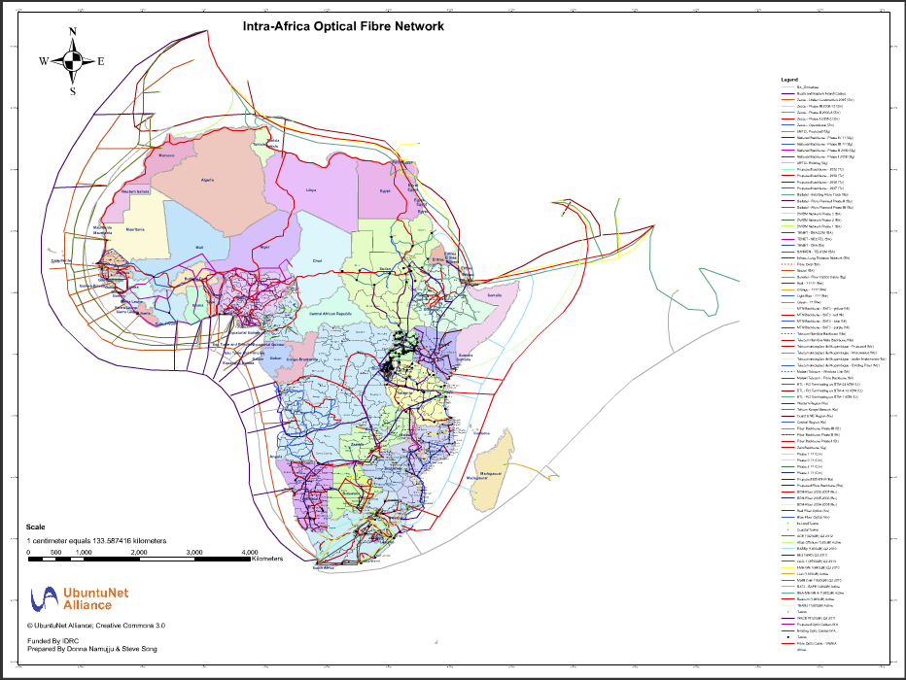
The Present Opportunity
The recent landing of submarine fibre cables on the coasts of East and West Africa have led to the build-out of intra-African broadband networks.
Bandwidth vendors want to open regulatory doors, governments want to justify infrastructure investment, and universities at the moment have the applications and content.

Slide 14
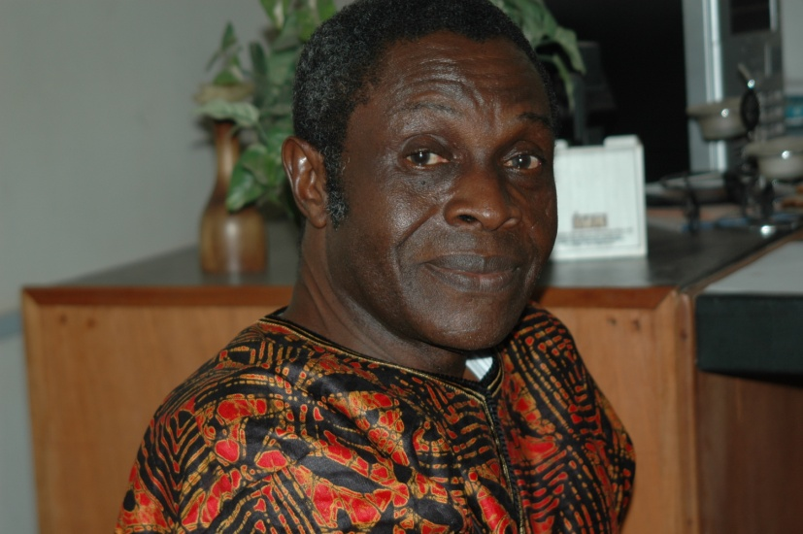
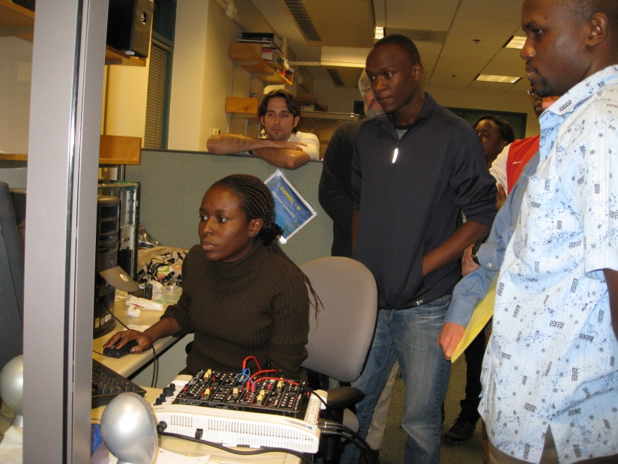
(My) Most Important Lessons for the Future
The best research depends on experienced mentors and energetic students.
Africa is now tightly integrated into the world knowledge economy, and no one is better prepared to build on that than iLab trained engineers.
MIT will find a way to continue to partner, but this is now truly your project!
Prof. Ajayi, OAU
Lea, Raymond, Arthur and Jim at MIT, 2009

