Slide 1
What To Do When You Catch on Fire
aka, knowledge management advice from G.I. Joe
Notes:
We do have a presentation, but we’ll keep it fairly short, so that we can have time for the question, answer and discussion period, which is really the most important part of today’s café talk

Slide 2
Café talk - knowledge management
An emerging model for IS&T Knowledge Management
The Knowledge Base as a tool for the capture, sharing and reuse of knowledge.
Notes:
Emerging because best practices for IS&T knowledge management is a work in progress, which we are looking to refine through your participation
Note that we are not here to present the KB as the only valid IS&T tool for KM, but as a tool which is easy to use and for which authoring assistance is available

Slide 3
Café talk - knowledge management
A look at three projects and their approach to knowledge management
  Migration of SAPweb help documentation to the KB
  RAFT
  Mac OS 10.9 release

Slide 4

Don’t swim during a thunderstorm
Notes:
KM Core team members will introduce themselves.
Before they do, Deep Six is here to emphasize one of the key principles of KM
Introductions

Slide 5
KM Core Mission
Make the capture, sharing and maintenance of information technology knowledge easy and reliable for the MIT Community.
Notes:
Instroductions

Slide 6
KM Core Guiding Principles
IS&T is a learning organization. We are creators and consumers of knowledge.
Knowledge management system is easily accessible, easy to use.
Knowledge management processes and systems are coordinated and streamlined to decrease duplication of effort.
Notes:
Learning organization. We value knowledge
The value that we bring to the Institute is dependent on our knowledge
Remarkably talented staff within IS&T and central admin are amazing ability to gain and apply knowledge.
Our capacity to be truly successful depends on our ability to make our knowledge shareable and reusable.

Slide 7
KM Core Guiding Principles
Content is easily searchable and navigable.
Distributed authorship is a key component of the knowledge management system
Knowledge management is a service and has a lifecycle.
Notes:
Success of a kms is measured by whether content being findable
Distributed authorship is key
Knowledge management is a service and has a lifecycle

Slide 8
http://kb.mit.edu
Over 12,000 pages, from Android to Zephyr.
Have you used it?
Have you contributed to it?
Have you commented or left feedback?
  Did you know you could comment or leave feedback?

Slide 9
The knowledge base is…
community-focused
open and inclusive
distributed authorship
focus on lightweight content (Q&A or short articles)
technology-focused

Slide 10
The knowledge base is not…
a private wiki
a content management system
a place for documents with complex formatting requirements
a place for content with complex approval workflows

Slide 11
Authorship & Feedback
Authorship is distributed
  We are curators, not gatekeepers
Members of MIT community can leave detailed comments
  Reviewed and incorporated into articles
Feedback buttons for quick feedback from anyone

Slide 12
What will the KB look like in 5 years?

Slide 13

What to do if someone passes out
Notes:
And now a word from Airtight

Slide 14
SAPweb Help Documentation
Notes:
Frank and Alison are going to talk about a recent success in moving content from an outdated web server location to the Knowledge Base.

Slide 15
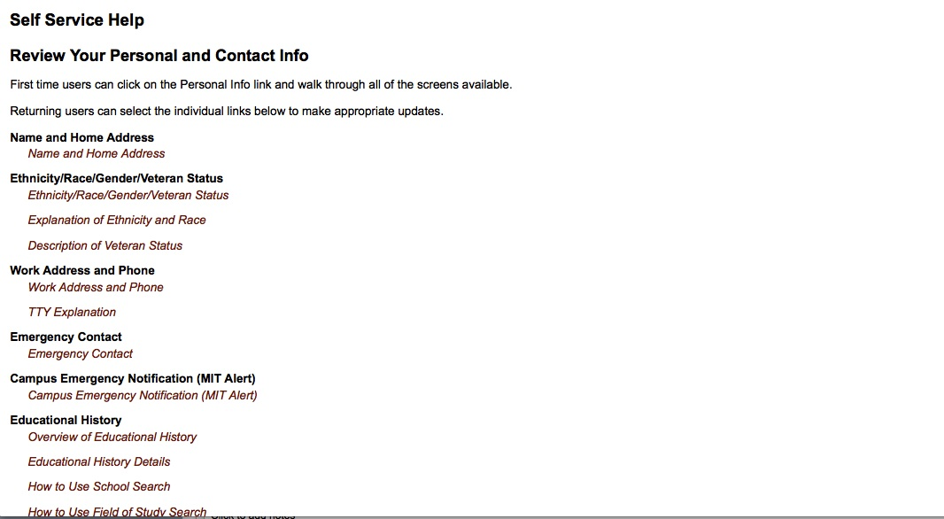
SAPweb Help Documentation

Slide 16
Atlas User Guide

Slide 17
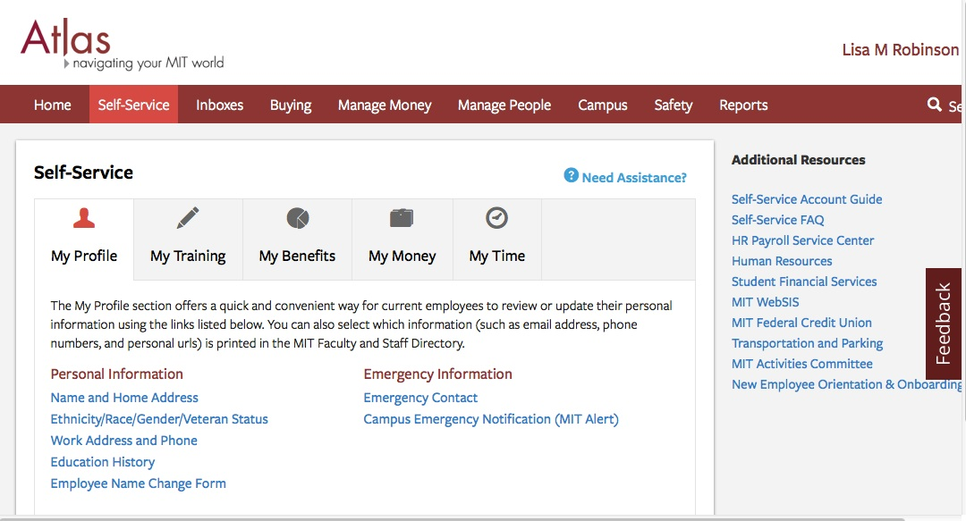
Atlas Self-Service

Slide 18
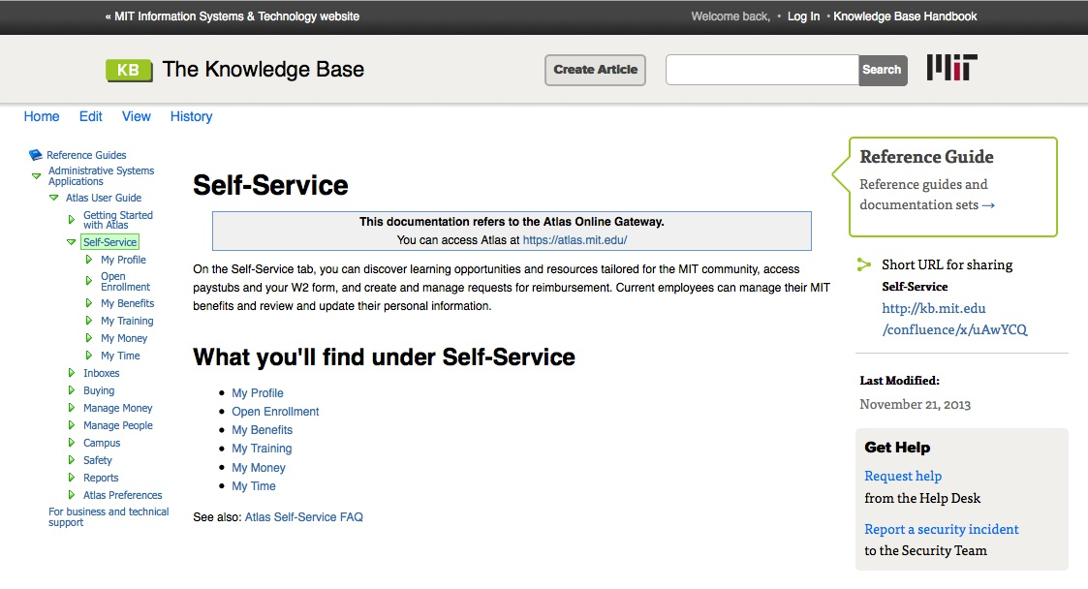
Atlas Self-Service Guide

Slide 19
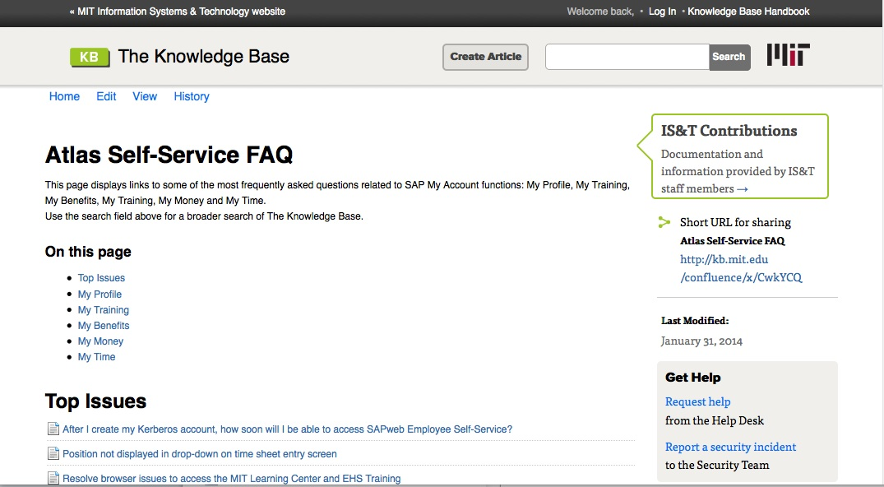
Self-Service FAQ

Slide 20

You’ll never learn without trying
Notes:
An important message from Scarlett

Slide 21
RAFT Knowledge Needs
RAFT, the Reporting and Forecasting Tool, is a typical administration application
It has end-user knowledge management needs
It has sponsor and business knowledge management needs
It has project knowledge management needs
It has development and support knowledge management needs

Slide 22
RAFT Documentation
Help documentation stored in the KB
End-user feature requests stored in Jira
Design documentation stored in the Wiki
Project documentation stored in the Wiki
Development tasks stored in Jira.mit.edu
Support documentation stored in the KB

Slide 23
What should go where and when?
RAFT Style Guide - Wiki or KB or?
RAFT Pattern Guide – Wiki or KB or?
RAFT Developer Documentation?
RAFT Design Documentation?
RAFT Project Documentation?

Slide 24
RAFT Lessons
It’s work to move content around, so pick the best spot ahead of time if you can
It’s a moving target, so roll with it
We have good tools that work

Slide 25

How to stop a nosebleed
Notes:
Some advice from Footloose

Slide 26

OS X 10.9
Mavericks Release

Slide 27
Problem: New Operating System
Problem:
The Good:
Rapidly changing environment
High impact to community
Quick adoption rate
We have been at this a while – we have a process guideline
Most of the knowledge could be re-used
Built-in process for audit of old information for deprecation/archive
Direction to the knowledge base provided at project close.
Notes:
Cut in here
Dependent upon Operating Systems here at MIT
Windows (7, 8, 8.1) 32 bit and 64 bit
Linux
Android
iOS
Mac
Many people like to be early adopters, and the Mac community in particular.
Increase in Mac use at MIT over the past several years. “Mac Fanclub”
Annual releases starting after 10.7. (lion)
We used to have the cost gatekeeping factor
Now it’s free. People want it yesterday, and it’s a Mac so “It should just work”
The Release Team is charged with understanding and evaluating the impact of these drastic changes on our business: Administrative, Education, and Research.
Basic software:
virus protection
Email
Certificates & CertAID
system backups
Business Software:
SAPgui
Kerberos Extras
Citrix
Research & Education
MatLab
Mathematica
Autocad
We get the knowledge of how to use the new operating system in the MIT environment established.
In addition we need to evaluate the software that works—or doesn’t work—to our community and communicate that knowledge in a timely manner.

Slide 28
KM Core Guidelines
Procedural information: The Knowledge Base
Project notes, organizational information: Wikis
Project conclusions, project information that is relevant to IS&T: The Knowledge Base
Notes:
KM Core guidelines that particularly affect our release process are Procedural Info, Project Notes, and Conclusions
For procedural information, several years ago a working group in IS&T created the IS&T Library of Procedures and, within that is our Product Release Checklist
For Project information during the project, Using the SWRT Space within Wikis, we have the Release Project Space
This space, is used while the project is active for notes, tracking information, and is ever-changing during the release process with multiple contributors but the Project Manager in charge of curation.
The conclusion of the project creates/revises current knowledge within the knowledge base and transitions the working information from the Project into production articles in the IS&T Website for the product page and The Knowledge base for many help articles.

Slide 29
Knowledge Workflow
What knowledge do we need to track?
How do we track it & who needs what?
What already exists?
What new knowledge should (or can) be created?
Launch
Edit?
Copy?
Kill?
Library of Procedures,
Past Projects
Wikis Project Space
Search the KB, Past Projects Lists
Wikis Project Space, KB Draft Space
IS&T Website,
KB
Notes:
Software Release Checklist
What Is This?
Project Wiki
How is this used—why don’t you just go to the KB?
KB Audit
Critical to not duplicate content. Also generate an awareness of what is there/what might need to go away now or in the near future
KB Draft Space
This is our pre-launch area. Some of the documentation can be created based on prereleases or the gold-master version of the software
IS&T Website
Product Page. The central landing space for how to get.
KB IS&T Contribution Space
Move info from Draft to Production after vetting
Landing page for the Product with references to supporting documentation
LESSONS LEARNED
It’s important that we loop back on ourselves to improve the process as a whole and with the particular information on the project. Project-specific process can be learned and then reflected on for next year’s release

Slide 30
Process
Project Wiki
KB Audit
Create articles (including copies of updated info)
KB Public Space
Software Release Checklist
IS&T Library of Procedures
Available in the Knowledge Base
What’s new
What’s old
What can be borrowed
Make sure nothing is blue
KB Draft Space
Prep space before launch
Coordinate with Launch
IS&T Website
General Project Docs: Meeting Minutes, Team members, Timelines
Tracking Old & New Knowledge & Responsibilities
Notes:
Software Release Checklist
What Is This?
Project Wiki
How is this used—why don’t you just go to the KB?
KB Audit
Critical to not duplicate content. Also generate an awareness of what is there/what might need to go away now or in the near future
KB Draft Space
This is our pre-launch area. Some of the documentation can be created based on prereleases or the gold-master version of the software
IS&T Website
Product Page. The central landing space for how to get.
KB IS&T Contribution Space
Move info from Draft to Production after vetting
Landing page for the Product with references to supporting documentation
LESSONS LEARNED
It’s important that we loop back on ourselves to improve the process as a whole and with the particular information on the project. Project-specific process can be learned and then reflected on for next year’s release

Slide 31
How did it work?
Strong use of tools
Built upon prior knowledge
  Repurpose
  Reuse
  Deprecation
Distributed content generation
  IS&T Website & KB Team used as editors not producers
Knowledge Lifecycle paired with the Software Lifecycle
Fairly mature model for knowledge management but contains continual process improvement
Notes:
STRONG USE OF TOOLS
KB, Wikis, KB again.
Built Upon Prior Knowledge
Repurpose
Can we copy this documentation and tweak it?
Does it need new screen shots?
Are the steps different?
Reuse
Can we just tack on “and Mavericks too” and call it a day?
Deprecation
Flagged for future thoughts. What do we do about old information? Edit? Remove? Confusing?
Distributed Content Generation
This time around we distributed the content generation to the whole team including outsiders from IS&T.
This allowed for socialization of the Knowledge Base as a repository, and, because we have the Contrib space, might encourage people to publish their own applicable knowledge in that area.
Knowledge Lifecycle is part of Software Lifecycle
There is a point where we have to begin deprecating knowledge.
Do we really need information about 10.5 or 10.6 clogging up peoples’ search results?
What about Windows 98?
XP? Begins to get a little bit hazy.
At times we can rely on the Manufacturer, other times we have to rely on our own justification.
But with the launch of something new we don’t have just a chance, but really a responsibility to think about our user segmentation and see how we can make his/her life easier.

Slide 32

Don’t call the fire department from a burning building
Notes:
One of the burning questions which brought you here today

Slide 33
Q and A
What tools are you using?
What barriers prevent you from putting your content in the KB?
What would make it easier?
What are the benefits of putting your content in the KB?

Slide 34
Would you refer to these documents if they were available in the KB?
Project charter
Project requirements
Business case
RFP
System requirements
System feed information
Server information
Application architecture

Slide 35
Did you know?
Authoring assistance is available.
  kb-help@mit.edu
You can use a “landing page” to organize your documents.
You can add a watch to your pages
You can tag pages, and create dynamic listings based on tags.

Slide 36
IS&T Knowledge Management Core
Alison Bell – Systems Engineering
Mike Berger – Data Management
Monique Buchanan – Operations and Infrastructure
Dave Conlon – Systems Engineering
Heather Anne Harrison – Systems Engineering
Frank Quern – Administrative Systems
Jon Reed – Customer Support
Lisa Robinson – Customer Support
Oliver Thomas – Customer Support
Mark Wiklund - Systems Engineering

Slide 37

What to do if you catch on fire

Slide 38

Because….

