Slide 1

Symbolic Execution and Automated Exploit Generation
David Brumley
Carnegie Mellon University
Notes:
Name, security research, Carnegie Mellon, talk title.

Slide 2

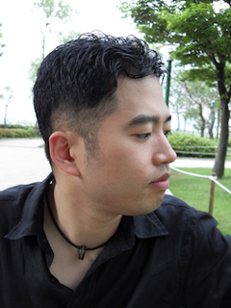




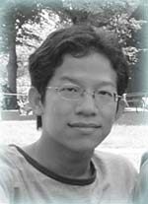
Joint Work With
Brent Hao
Thanassis Averginos
Sang Kil Cha
Ed Schwartz
Pongsin Poosankam
Ivan Jager
Dawn Song
And Jiang Zheng, no picture available

Slide 3

Find Bugs
Exploit Systems
Evil David

Slide 4
Automatic Exploit Generation
Given program, find bugs and demonstrate exploitability

Slide 5
My Research Agenda
Tools and Systems for Real Code
Verification and Program Analysis
Formalize “Exploit”

Slide 6
Overview
Automatic Patch-based Exploit Generation
  IEEE Security and Privacy 2008
Automatic Exploit Generation
  NDSS 2011 and beyond
Symbolic execution, taint analysis, and binary analysis lessons learned
  2003 - now

Slide 7
B
Buggy Program
P
Patched New Program
“Regularly Install Patches”
− US Dept. of Homeland Security
Notes:
How many of you have experience with buggy programs?
How many of you automatically download and install patches when they become available for your buggy programs?
Installing patches is important for your cyber-security. In fact, buggy programs are the leading cause of hacked computers.
In fact, the department of homeland security says one of the most important things you can do to make cyber-security a habit is to
Regularly install patches.

Slide 8
Patches can help attackers
Evil David
Notes:
However, today I am going to show you that patches can help attackers. Now take a moment to appreciate the irony. Although the DHS states that installing patches is essential to improving security, I’m going to show you that patches help attackers, thus can also decrease security. How is this?

Slide 9
Delayed
Patch
Attack
Use Patch to Reverse Engineer Bug
Gets
Patch
Attack Unpatched Users
T1
T2
Evil David’s Timeline

Slide 10
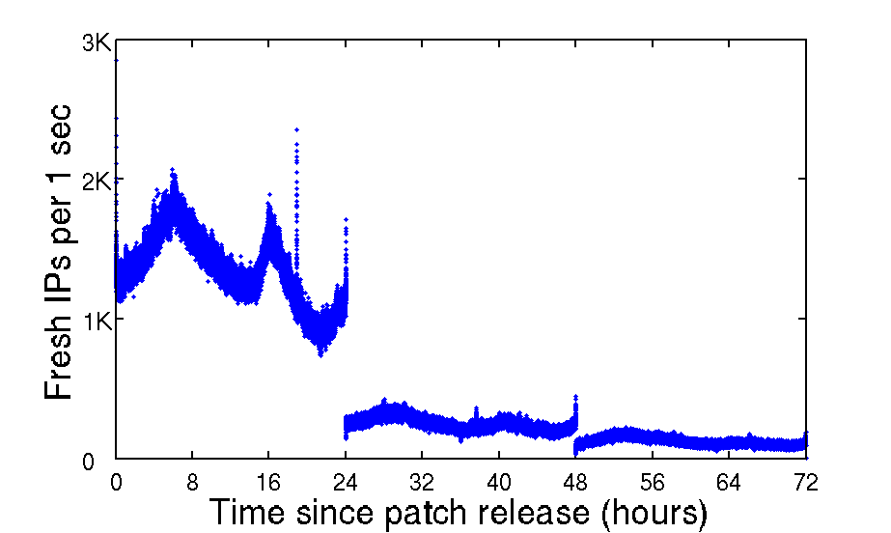
Patch Delay
N. America
gets patched version P
Asia gets P
[Gkantsidis et al 06]

Slide 11
Automatic
Patch-Based
Exploit Generation
Minutes
Attack Unpatched Users
T1
T2
Evil David’s Timeline

Slide 12
APEG Example
B
read input
All integers unsigned
32-bits
All arithmetic mod 2³²
B is binary code
if input % 2==0
F
T
s := input + 3
s := input + 2
ptr := realloc(ptr, s)

Slide 13
Understanding semantics is challenging:
x86 is complex
100’s of instructions
a = a+b
parity flag = …
carry flag = …
auxiliary carry flag = …
zero flag = …
signed flag = …
overflow flag = …
x = x << a
set carry flag if a <> 0
add a,b
shl x << a
goto L if carry
… Jump if carry set …
all control flow determined by flags

Slide 14
BAP: Binary Analysis Platform
Faithful Binary Code Analysis
Faithful
  Accurately model low-level semantics
Simplified
Fewer cases
BAP Intermediate Language
lval := exp
| goto exp
| if exp then goto exp₁ else exp₂
| return exp
| call exp
| assert exp
| special exp
| unknown (effects)

Slide 15
B
read input
input = 2³²-2
if input % 2==0
2³²-2 % 2 == 0
F
T
s := input + 3
s := input + 2
s := 0 (2³²-2 + 2 % 2³²)
ptr := realloc(ptr, s)
ptr := realloc(ptr,0)
Using ptr is a problem

Slide 16
B
read input
Wanted:
s > input
Integer Overflow when:
¬(s > input)
if input % 2==0
F
T
s := input + 3
s := input + 2
ptr := realloc(ptr, s)

Slide 17
B
read input
P
read input
if input % 2==0
if input % 2==0
F
T
F
T
s := input + 3
s := input + 2
s := input + 3
s := input + 2
ptr := realloc(ptr, s)
if s > input
F
T
Error
ptr := realloc(ptr, s)

Slide 18
B
read input
P
read input
if input % 2==0
if input % 2==0
F
T
F
T
s := input + 3
s := input + 2
s := input + 3
s := input + 2
ptr := realloc(ptr, s)
if s > input
F
T
Error
ptr := realloc(ptr, s)
Exploits for B are inputs that fail
new safety condition check in P
(s > input) = false

Slide 19
APEG
Diff B and P to identify location of new safety check
Create input that fails safety condition in P using Vine
Verify input is exploit on original buggy program B
P
read input
if input % 2==0
F
T
s := input + 3
s := input + 2
if s > input
F
T
Error
ptr := realloc(ptr, s)
1 & 3 performed using off the shelf tools
Notes:
the new check may not be a real new check because we are using off-the-shelf tool

Slide 20
APEG
Diff B and P to identify location of new safety check
Create input that fails new safety check in P
Verify input is exploit on original buggy program B
P
read input
if input % 2==0
F
T
s := input + 3
s := input + 2
if s > input
F
T
Error
ptr := realloc(ptr, s)
Weakest Precondition: Backwards computation of condition to fail check
Notes:
the new check may not be a real new check because we are using off-the-shelf tool

Slide 21
WP:
Derive condition at step i-1 to execute line i
P
read input
if input % 2==0
F
T
s := input + 3
s := input + 2
C₀ = ¬(s > input)
if s > input
F
T
Error
ptr := realloc(ptr, s)
WP C₀
Bad

Slide 22
C₃ =
(input % 2 == 0) ➔
¬(input + 2 % 2³² > input) &&
¬(input % 2 == 0) ➔
¬ (input + 3 % 2³² > input)
P
read input
if input % 2==0
F
T
s := input + 3
s := input + 2
if s > input
F
T
Error
ptr := realloc(ptr, s)

Slide 23
P
read input
Exploit is input s.t.
C₃(input) = true
if input % 2==0
F
T
s := input + 3
s := input + 2
if s > input
F
T
Error
ptr := realloc(ptr, s)
Bad
Use STP or other solver to find
exploit

Slide 24
Problem 2: Loops
Safe
Consider a fixed number of times
How many times? No good answer.
Bad

Slide 25
Problem 1:
WP not suitable for programs with gotos (unstructured programs)
Final C is exponential in size
  Due to substitution for assignment
  Duplication of condition in branches
Substitution rule
Condition Rule
Developed variant of Flanagan and Saxe appropriate for unstructured code with O(n²) VC guarantee where n is size of program
- Leino also has nice work on this.

Slide 26
Problem: State Space Still too Huge
Our solution:
Mixed dynamic + static approach

Slide 27
Concolic, concretizies
basic program state
Weakest precondition, covers
many program paths

Slide 28
APEG Results
ASPNet_Filter | Information Disclosure | 29 sec
GDI | Hijack Control Possible | 135 sec
PNG | Hijack Control Possible | 131 sec
IE COMCTL32 (B) | Hijack Control Possible | 456 sec
IGMP | Denial of Service | 186 sec
No public exploit for 3 out of 5
Exploit unique for other 2
STP optimizations implemented by Vijay reduced solve time by 1/2

Slide 29
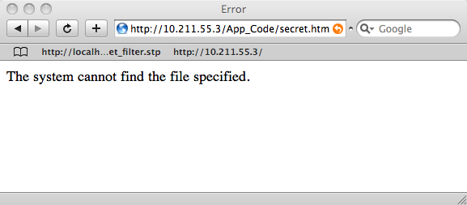
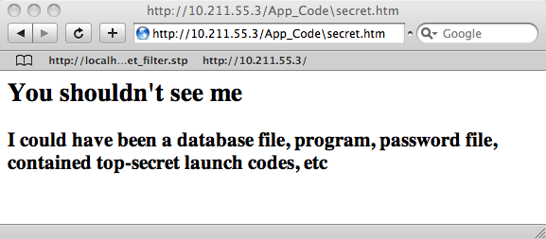
Demo
Flip ‘/’ to ‘\’
to reveal hidden
files

Slide 30
New Research Problem:
Prevent Patches From Helping Attackers
Research Ideas:
Code Analysis: Obfuscate patches
  Prevents diffing in our approach, no changes to current update schemes
  Con: May slow down program, may be insufficient
Crypto: Encrypt patch initially, broadcast decryption key
  Fair: Everyone applies patch simultaneously
  Con: Which patches to encrypt? Requires changes to current update schemes, offline hosts?
Others
Notes:
Co-equality.

Slide 31
APEG Lessons
Pro
Con
Work with your SMT. STP optimizations cut cost of APEG by ½
WP creates relatively small VC
WP is goal driven from where we know there is a (potential) problem
Backward calculation makes it harder to concretize variables with values
  E.G., system calls, external environment, configuration

Slide 32
Recall
B
read input
[Brumley07] only automatically
generated inputs that violated
new checks.
Not control flow hijacks
if input % 2==0
F
T
s := input + 3
s := input + 2
ptr := realloc(ptr, s)
Using ptr is a problem

Slide 33
*fpp = &foo
function foo() { … }
read input
B
fpp
addr
of
foo
if input % 2==0
ptr
0, 1, or 2
bytes
s := input + 3
s := input + 2
ptr := realloc(ptr, s)
copy(ptr, input2)
call func at *fpp

Slide 34
*fpp = &foo
function foo() { … }
read input
A
addr
of
foo
B
fpp
user-chosen func
if input % 2==0
ptr
0, 1, or 2
bytes
s := input + 3
s := input + 2
ptr := realloc(ptr, s)
copy(ptr, input2)
copy over *fpp
with user input
call func at *fpp

Slide 35
User input
changes
called function!
*fpp = &foo
function foo() { … }
read input
B
fpp
user-chosen func
if input % 2==0
ptr
0, 1, or 2
bytes
s := input + 3
s := input + 2
ptr := realloc(ptr, s)
copy(ptr, input2)
call func at *fpp

Slide 36
Automatic Exploit Generation
Given program, find bugs and demonstrate exploitability
-
APEG find bugs:
P
B
AEG without patch?
Hijack control experiments?
P

Slide 37
The iwconfig vulnerability

Slide 38
iwconfig: setuid wireless config
1 int get_info(int skfd, char * ifname, …){
2 ...
3 if(iw_get_ext(skfd, ifname, SIOCGIWNAME, &wrq) < 0)
4 {
5 struct ifreq ifr;
6 strcpy(ifr.ifr_name, ifname);
7 }
8 print_info(int skfd, char *ifname,…){
9 ...
10 get_info(skfd, ifname, …);
11 }
12 main(int argc, char *argv[]){
13 ...
14 print_info(skfd, argv[1], NULL, 0);
15 }
Inputs triggering bug:
length(argv[1]) > sizeof(ifr_name)
struct ifreq {
char ifr_name[32]
…
}
Can you spot
the bug?

Slide 39
Is it exploitable?

Slide 40
get_info stack frame
1 int get_info(int skfd, char * ifname, …){
2 ...
3 if(iw_get_ext(skfd, ifname, SIOCGIWNAME, &wrq) < 0)
4 {
5 struct ifreq ifr;
6 strcpy(ifr.ifr_name, ifname);
7 }
8 print_info(int skfd, char *ifname,…){
9 ...
10 get_info(skfd, ifname, …);
11 }
12 main(int argc, char *argv[]){
13 ...
14 print_info(skfd, argv[1], NULL, 0);
15 }
Return address
…
< locals >
…
68 bytes
ifr.ifr_name
Memory Layout

Slide 41
get_info stack frame
1 int get_info(int skfd, char * ifname, …){
2 ...
3 if(iw_get_ext(skfd, ifname, SIOCGIWNAME, &wrq) < 0)
4 {
5 struct ifreq ifr;
6 strcpy(ifr.ifr_name, ifname);
7 }
8 print_info(int skfd, char *ifname,…){
9 ...
10 get_info(skfd, ifname, …);
11 }
12 main(int argc, char *argv[]){
13 ...
14 print_info(skfd, argv[1], NULL, 0);
15 }
Return address
…
< locals >
…
68 bytes
ifr.ifr_name
Memory Layout

Slide 42
get_info stack frame
1 int get_info(int skfd, char * ifname, …){
2 ...
3 if(iw_get_ext(skfd, ifname, SIOCGIWNAME, &wrq) < 0)
4 {
5 struct ifreq ifr;
6 strcpy(ifr.ifr_name, ifname);
7 }
8 print_info(int skfd, char *ifname,…){
9 ...
10 get_info(skfd, ifname, …);
11 }
12 main(int argc, char *argv[]){
13 ...
14 print_info(skfd, argv[1], NULL, 0);
15 }
Return address
…
< locals >
…
68 bytes
User Input
ifr.ifr_name
Memory Layout

Slide 43
get_info stack frame
1 int get_info(int skfd, char * ifname, …){
2 ...
3 if(iw_get_ext(skfd, ifname, SIOCGIWNAME, &wrq) < 0)
4 {
5 struct ifreq ifr;
6 strcpy(ifr.ifr_name, ifname);
7 }
8 print_info(int skfd, char *ifname,…){
9 ...
10 get_info(skfd, ifname, …);
11 }
12 main(int argc, char *argv[]){
13 ...
14 print_info(skfd, argv[1], NULL, 0);
15 }
Return address
User Input
68 bytes
ifr.ifr_name
Memory Layout

Slide 44
get_info stack frame
1 int get_info(int skfd, char * ifname, …){
2 ...
3 if(iw_get_ext(skfd, ifname, SIOCGIWNAME, &wrq) < 0)
4 {
5 struct ifreq ifr;
6 strcpy(ifr.ifr_name, ifname);
7 }
8 print_info(int skfd, char *ifname,…){
9 ...
10 get_info(skfd, ifname, …);
11 }
12 main(int argc, char *argv[]){
13 ...
14 print_info(skfd, argv[1], NULL, 0);
15 }
User Input
68 bytes
ifr.ifr_name
Memory Layout

Slide 45
DEMO

Slide 46
Problem Domain
All Inputs
length(input) > sizeof(ifr_name)
(Bugs)
Control Hijack
length(input) > sizeof(ifr_name)
Λ
“execute shellcode”
AEG

Slide 47
The goal
Compile
Exploit Generator
Bug Finder
AEG
Prog
Exploits

Slide 48
Current Approach
Exploit Generation
Vulnerability
Discovery
Bugs
Prog
Exploits
Symbolic Execution on source code
Dynamic Binary Analysis

Slide 49
Vulnerability Discovery
Technique:
Symbolic Execution on source code

Slide 50
Symbolic Execution: How it works
x is input
char buf[42];
x can be anything
Buggy Path Predicate
(x > 0)
if x > 0
f
t
if x*x = 0x42424242
(x > 0) Λ (x*x = 0x42424242)
t
f
buf[45] = x;
Bug!

Slide 51
Traditional symbolic execution: cover all paths is too slow to find exploitable bugs

Slide 52
Traditional Symbolic Execution
strcpy(ifr_name, ifname);
If (ifname[0] != 0)
t
f
If (ifname[1] != 0)
for (i = 0 ; ifname[i] != 0 ; i++)
ifr_name[i] = ifname[i];
ifr_name[i] = 0;
t
f
…
If (ifname[n] != 0)
t
f

Slide 53
Traditional Symbolic Execution
If (ifname[0] != 0)
t
f
If (ifname[1] != 0)
20 min
exploration
t
f
…
30 min
exploration
If (ifname[n] != 0)
t
f
x min
exploration
Exploitable
Bug found
KLEE [Cadar’08] does
this

Slide 54
Problem:
Forward symbolic execution blindly checks program paths
(Slow to find exploitable bugs)
Our Intuition for Exploit Generation:
only explore buggy paths (Fast)

Slide 55
Insight: Precondition Symbolic Execution to only (likely) exploitable paths
All Inputs
Bugs
Precondition
length(input) > n
where n is the size of the smallest buffer
Control Hijack

Slide 56
AEG: Preconditioned Symbolic Execution
Precondition Check:
length(input) > n
Λ
ifname[0] == 0
Unsatisfiable
If (ifname[0] != 0)
t
f
Unsatisfiable
If (ifname[1] != 0)
Not explored.
Saved 20 min
Precondition Check:
length(input) > n
Λ
Ifname[1] == 0
t
f
…
Not explored.
Saved 30min
If (ifname[n] != 0)
t
f
Not explored.
Saved x min
Exploitable
Bug found

Slide 57
Static Analysis Infers Preconditions
Size of the largest statically allocated buffer
Type of arguments
Known prefix on input

Slide 58
Second Insight
Not all paths are equally likely to be exploitable

Slide 59
Path Prioritization
Buggy-path first
  Paths containing bugs are more likely to be exploitable
…
…
…
Bug
…
…
Prioritize Higher
Exploit

Slide 60
Buggy Path First: Example
char buffer[1024];
…
Sometimes non-trivial
to “fix up”
execution to proceed.
…
/* bug */
memset(buffer, 0, strlen(input));
…
…
/* exploitable bug */
strcpy(buffer, input);

Slide 61
Given the path to a bug, how do you create an exploit?

Slide 62
Exploit
Generation
Technique:
Dynamic Binary Analysis
Goal: Test exploitability of buggy path

Slide 63
get_info stack frame
Control Hijack for bug found:
length(input) > sizeof(ifr_name)
User Input
Λ
length(input) > 68 bytes
68 bytes
Λ
input[0-63] == <shellcode>
ifr.ifr_name
Λ
input[64-67] == <shellcode addr>
Memory Layout

Slide 64
Generating Exploits
Control Hijack for bug found:
length(input) > sizeof(ifr_name)
SMT Solver
Λ
length(input) > 68 bytes
Λ
input[0-63] == <shellcode>
Λ
input[64-67] == <shellcode addr>
Example:

Slide 65
Results Overview

Slide 66
AEG vs Real-world applications
Analyzed 14 applications for 3 hours and generated 16 working control-hijack exploits

Slide 67
Name | Advisory ID | Time | Exploit Type | Exploit Class
Iwconfig | CVE-2003-0947 | 1.5s | Local | Buffer Overflow
Htget | CVE-2004-0852 | < 1min | Local | Buffer Overflow
Htget | - | 1.2s | Local | Buffer Overflow
Ncompress | CVE-2001-1413 | 12. 3s | Local | Buffer Overflow
Aeon | CVE-2005-1019 | 3.8s | Local | Buffer Overflow
Tipxd | OSVDB-ID#12346 | 1.5s | Local | Format String
Glftpd | OSVDB-ID#16373 | 2.3s | Local | Buffer Overflow
Xserver | CVE-2007-3957 | 31.9s | Remote | Buffer Overflow
Aspell | CVE-2004-0548 | 15.2s | Local | Buffer Overflow
Corehttp | CVE-2007-4060 | < 1min | Remote | Buffer Overflow
Exim | EDB-ID#796 | < 1min | Local | Buffer Overflow
Socat | CVE-2004-1484 | 3.2s | Local | Format String
Xmail | CVE-2005-2943 | < 20min | Local | Buffer Overflow
Expect | OSVDB-ID#60979 | < 4min | Local | Buffer Overflow
Expect | - | 19.7s | Local | Buffer Overflow
Rsync | CVE-2004-2093 | < 5min | Local | Buffer Overflow

Slide 68
What AEG is NOT

Slide 69
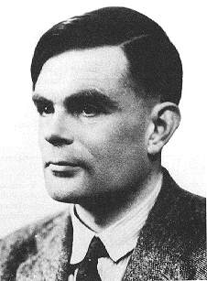
Not Complete
We do not claim to find all exploitable bugs
Given an exploitable bug, we do not guarantee we will always find an exploit
But AEG is sound: if AEG outputs an exploit, the bug is guaranteed to be exploitable

Slide 70
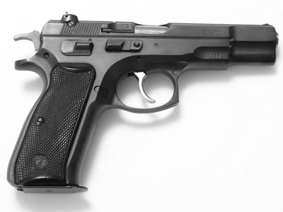
Not A Weapon
AEG does not consider defenses, which may defend against otherwise exploitable bugs.
But a typical conservative security posture should still consider the bug “exploited”.

Slide 71
However…

Slide 72
Other Great Work
KLEE [OSDI 08], SAGE [NDSS 08], DART[Godefroid 05], etc.
  Goal: Generate inputs achieving high code coverage
  Main Difference: AEG focuses on exploitable paths
Heelan [MS Thesis’09]
  Goal: Automatic Generation of Control-Flow Hijacking Exploits
  Main Difference: Focuses on generating exploit once path to bug known.
Hand-made tools [Medeiros et al, Toorcon’07]
  Goal: Automated Exploit Development

Slide 73





Thank you!
dbrumley@cmu.edu
http://security.ece.cmu.edu/
Made possible with support in part from:

