Slide 1

Calculus of Data Structures for Verification and Synthesis
Ruzica Piskac
EPF Lausanne

Slide 2
Calculus of Data Structures
Problem: solve for x: F(x) = y
arguments are not only numbers and functions, but also can be lists, sets, trees, relations
Motivation:
  in program synthesis:
    finding a program that satisfies the given specification
  in verification:
    find an input that crashes the program
    find an invariant that proves the program correct

Slide 3
Software Synthesis
val bigSet = ....
val (setA, setB) = choose((a: Set, b: Set) ) =>
( a.size == b.size && a union b == bigSet && a intersect b == empty))
Code
val n = bigSet.size/2
val setA = take(n, bigSet)
val setB = bigSet −− setA

Slide 4
Software Synthesis
val bigSet = ....
val (setA, setB) = choose((a: Set, b: Set) ) =>
( a.size == b.size && a union b == bigSet && a intersect b == empty))
Code
assert (bigSet.size % 2 == 0)
val n = bigSet.size/2
val setA = take(n, bigSet)
val setB = bigSet −− setA

Slide 5
Software Verification
class List {
private List next;
private Object data;
private static List root;
private static int size;
public static void addNew(Object x) {
List n1 = new List();
n1.next = root;
n1.data = x;
root = n1;
size = size + 1;
}
}
Set of stored objects:
{data(n). next*(root,n)}
ensure |{data(n). next*(root,n)}| = |old({data(n). next*(root,n)})| + 1
root
next
next
next
data
data
data
data
size:
4
3
x

Slide 6
Generated Verification Condition
¬next₀*(root₀,n) ∧ x ∉ {data₀(v) | next₀*(root₀,v)} ∧ next=next₀[n:=root₀] ∧ data=data₀[n:=x] →
|{data(v) . next*(n,v)}| =
|{data₀(v) . next₀*(root₀,v)}| + 1
“The number of stored objects has increased by one.”
Expressing this VC requires a rich logic
  transitive closure * (in lists and also in trees)
  unconstraint functions (data, data₀)
  cardinality operator on sets | ... |
Is there a decidable logic containing all this?

Slide 7
Outline
Software Synthesis
  Basic idea
  Complete functional synthesis
  Synthesis for integers
Combination of non-disjoint logics
  Basic idea
  BAPA-reducible theories
  BAPA reduction for reasoning about lists

Slide 8
Finding a Program That Satisfies Specification:
Complete Functional Synthesis
Joint work with Viktor Kuncak, Mikael Mayer, and Philippe Suter

Slide 9
Software Synthesis
val bigSet = ....
val (setA, setB) = choose((a: Set, b: Set) ) =>
( a.size == b.size && a union b == bigSet && a intersect b == empty))
Code
assert (bigSet.size % 2 == 0)
val n = bigSet.size/2
val setA = take(n, bigSet)
val setB = bigSet −− setA

Slide 10
Software Synthesis
Software synthesis = a technique for automatically generating code given a specification
Why?
ease software development
increase programmer productivity
fewer bugs
Challenges
synthesis is often a computationally hard task
new algorithms are needed
Notes:
add slide

Slide 11
Outline
Software Synthesis
  Basic idea
  Complete functional synthesis
  Synthesis for integers
Combination of non-disjoint logics
  Basic idea
  BAPA-reducible theories
  BAPA reduction for reasoning about lists

Slide 12
Synthesis as programming language construct
…
val x = readInteger() + 4
val y1 =
println(“y1 = “ + y1)
…
choose(y ⇒ 5*x + 7*y == 31)

Slide 13
“choose” Construct
specification is part of the Scala language
two types of arguments: input and output
a call of the form
corresponds to constructively solving the quantifier elimination problem
where a is a parameter
val x1= choose(x ⇒ F( x, a ))

Slide 14
Complete Functional Synthesis
Definition (Synthesis Procedure)
A synthesis procedure takes as input formula F(x, a) and outputs:
  a precondition formula pre(a)
  list of terms Ψ
such that the following holds:
Note: pre(a) is the “best” possible

Slide 15
From Decision Procedure to Synthesis Procedure
based on quantifier elimination /
model-generating decision procedures
implemented for logic of linear integer (rational, real) arithmetic, for Boolean Algebra with Presburger Arithmetic (BAPA)

Slide 16
Complete Functional Synthesis
complete = the synthesis procedure is guaranteed to find code that satisfies the given specification
functional = computes a function that satisfies a given input / output relation
Important features:
  code produced this way is correct by construction – no need for further verification
  a user does not provide hints on the
  structure of the generated code

Slide 17
Outline
Software Synthesis
  Basic idea
  Complete functional synthesis
  Synthesis for integers
Combination of non-disjoint logics
  Basic idea
  BAPA-reducible theories
  BAPA reduction for reasoning about lists

Slide 18
Synthesis for Linear Integer Arithmetic – Example / Overview
choose((h: Int, m: Int, s: Int) ⇒ (
h * 3600 + m * 60 + s == totalSeconds
&& h ≥ 0
&& m ≥ 0 && m < 60
&& s ≥ 0 && s < 60 ))
Returned code:
assert (totalSeconds ≥ 0)
val h = totalSeconds div 3600
val temp = totalSeconds + (-3600) * h
val m = min(temp div 60, 59)
val s = totalSeconds + (-3600) * h + (-60) * m

Slide 19
Synthesis Procedure by Example
process every equality: take an equality E_{i}, compute a parametric description of the solution set and insert those values in the rest of formula
Code:
<further code will come here>
val h = lambda
val m = mu
val val s = totalSeconds + (-3600) * lambda + (-60) * mu

Slide 20
Synthesis Procedure by Example
process every equality: take an equality E_{i}, compute a parametric description of the solution set and insert those values in the rest of formula
Resulting formula (new specifications):
0 ≤ λ, 0 ≤ μ, μ ≤ 59, 0 ≤ totalSeconds – 3600λ - 60μ,
totalSeconds – 3600λ - 60μ ≤ 59

Slide 21
Processing Inequalities
process output variables one by one
0 ≤ λ, 0 ≤ μ, μ ≤ 59, 0 ≤ totalSeconds – 3600λ - 60μ,
totalSeconds – 3600λ - 60μ ≤ 59
expressing constraints as bounds on μ
0 ≤ λ, 0 ≤ μ, μ ≤ 59, μ ≤ ⌊(totalSeconds – 3600λ)/60⌋ ,
⌈(totalSeconds – 3600λ – 59)/60⌉ ≤ μ
Code:
val mu = min(59, (totalSeconds -3600* lambda) div 60)

Slide 22
Fourier-Motzkin-Style Elimination
0 ≤ λ, 0 ≤ μ, μ ≤ 59, μ ≤ ⌊(totalSeconds – 3600λ)/60⌋ ,
⌈(totalSeconds – 3600λ – 59)/60⌉ ≤ μ
combine each lower and upper bound
0 ≤ λ, 0 ≤ 59, 0 ≤ ⌊(totalSeconds – 3600λ)/60⌋ ,
⌈(totalSeconds – 3600λ – 59)/60⌉ ≤ ⌊(totalSeconds – 3600λ)/60⌋ ,
⌈(totalSeconds – 3600λ – 59)/60⌉ ≤ 59
basic simplifications
Code:
val lambda = totalSeconds div 3600
Preconditions: 0 ≤ totalSeconds
0 ≤ λ, 60λ ≤ ⌊totalSeconds /60⌋,
⌈(totalSeconds –59)/60⌉ – 59 ≤ 60λ

Slide 23
Generated Code May Contain Loops
val (x1, y1) = choose(x: Int, y: Int =>
2*y − b =< 3*x + a && 2*x − a =< 4*y + b)
val kFound = false
for k = 0 to 5 do {
val v1 = 3 * a + 3 * b − k
if (v1 mod 6 == 0) {
val alpha = ((k − 5 * a − 5 * b)/8).ceiling
val l = (v1 / 6) + 2 * alpha
val y = alpha
val kFound = true
break } }
if (kFound)
val x = ((4 * y + a + b)/2).floor
else throw new Exception(”No solution exists”)
Precondition: ∃k. 0 ≤ k ≤ 5 ∧ 6|3a + 3b − k (true)

Slide 24

From Data Structures to Numbers
Observation:
  Reasoning about collections reduces to reasoning about linear integer arithmetic!
a.size == b.size && a union b == bigSet && a intersect b == empty
a
b
bigSet

Slide 25

From Data Structures to Numbers
Observation:
  Reasoning about collections reduces to reasoning about linear integer arithmetic!
a.size == b.size && a union b == bigSet && a intersect b == empty
a
b
bigSet

Slide 26
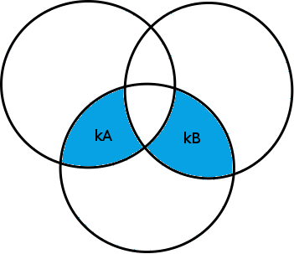
From Data Structures to Numbers
Observation:
  Reasoning about collections reduces to reasoning about linear integer arithmetic!
a.size == b.size && a union b == bigSet && a intersect b == empty
a
b
bigSet

Slide 27
From Data Structures to Numbers
Observation:
  Reasoning about collections reduces to reasoning about linear integer arithmetic!
a.size == b.size && a union b == bigSet && a intersect b == empty
New specification:
kA = kB
a
b
bigSet

Slide 28
From Data Structures to Numbers
Observation:
  Reasoning about collections reduces to reasoning about linear integer arithmetic!
a.size == b.size && a union b == bigSet && a intersect b == empty
New specification:
kA = kB && kA +kB = |bigSet|
a
b
bigSet
because of quantifier elimination

Slide 29
Combining Theories Sharing Set Operations
Joint work with Thomas Wies and Viktor Kuncak

Slide 30
Generated Verification Condition
¬next₀*(root₀,n) ∧ x ∉ {data₀(v) | next₀*(root₀,v)} ∧ next=next₀[n:=root₀] ∧ data=data₀[n:=x] →
|{data(v) . next*(n,v)}| =
|{data₀(v) . next₀*(root₀,v)}| + 1
“The number of stored objects has increased by one.”
Expressing this VC requires a rich logic
  transitive closure * (in lists and also in trees)
  unconstraint functions (data, data₀)
  cardinality operator on sets | ... |
Is there a decidable logic containing all this?

Slide 31
Decomposing the Formula
Consider a (simpler) formula
|{data(x). next*(root,x)}|=k+1
Introduce fresh variables denoting sets:
A = {x. next*(root,x)} ∧
B = {y. ∃ x. data(x,y) ∧ x ∈ A} ∧
|B|=k+1
1) WS1S
2) C²
3) BAPA
Good news: conjuncts are in decidable fragments
Bad news: conjuncts share more than just equality
(they share set variables and set operations)
Next: explain these decidable fragments

Slide 32
WS2S: Monadic 2nd Order Logic
Weak Monadic 2nd-order Logic of 2 Successors
F ::= x=f1(y) | x=f2(y) |
x∈S | S⊆T | 9S.F |
F₁ Æ F₂ | :F
- quantification is over finite sets of positions in a tree
- transitive closure encoded using set quantification
Decision procedure using tree automata (e.g. MONA)
f1
f2
f1
f2
f1
f2

Slide 33
C² : Two-Variable Logic w/ Counting
Two-Variable Logic with Counting
F ::= P(v₁,...,v_{n}) | F₁ Æ F₂ | :F | 9^{count} v_{i}.F
where
P : is a predicate symbol
  v_{i} : is one of the two variable names x,y
  ^{count} : is =k, ≤k, or ≥k for nonnegative constants k
We can write (9 ^{≤k} v_{i}.F) as |{v_{i}.F}|≤k
We can define 9,8 and axiomatize total functions: 8x9⁼¹y.R(x,y)
Decidable sat. and fin-sat. (1997), NEXPTIME
even for binary-encoded k: Pratt-Hartman ‘05

Slide 34
BAPA (Kuncak et al. CADE’05):
Boolean Algebra with Presburger Arithmetic
S ::= V | S₁ [ S₂ | S₁ Å S₂ | S₁ n S₂
T ::= k | C | T₁ + T₂ | T₁ – T₂ | C¢T | |S|
A ::= S₁ = S₂ | S₁ µ S₂ | T₁ = T₂ | T₁ < T₂
F ::= A | F₁ Æ F₂ | F₁ Ç F₂ | :F | 9S.F | 9k.F
BAPA decidable in alternating time (V. Kuncak et al. JAR’06), QFBAPA decidable in NP (V. Kuncak et al. CADE’07)
Also decidable: qf fragment of multisets w/ cardinalities
(R. Piskac and V. Kuncak VMCAI’08,CAV’08,CSL’08)
New: role of BAPA in combination of theories sharing sets
Notes:
34

Slide 35
Combining Theories by Reduction
Satisfiability problem expressed in HOL:
(all free symbols existentially quantified)
∃ next,data,k,root. 9 A,B.
A = {x. next*(root,x)} ∧
B = {y. ∃ x. data(x,y) ∧ x ∈ A} ∧
|B|=k+1
We assume formulas share only:
  - set variables (sets of uninterpreted elems)
  - individual variables, as a special case - {x}
1) WS2S
2) C²
3) BAPA

Slide 36
Combining Theories by Reduction
Satisfiability problem expressed in HOL,
after moving fragment-specific quantifiers
∃ A,B.
∃ next,root. A = {x. next*(root,x)} ∧
∃ data. B = {y. ∃ x. data(x,y) ∧ x ∈ A} ∧
∃ k. |B|=k+1
F_{WS2S}
F_{BAPA}
F_{C2}
Extend decision procedures for fragments into
projection procedures that reduce each conjunct to a decidable shared theory
applies 9 to all non-set variables

Slide 37
Combining Theories by Reduction
Satisfiability problem expressed in HOL,
after moving fragment-specific quantifiers
∃ A,B.
∃ next,root. A = {x. next*(root,x)} ∧
∃ data. B = {y. ∃ x. data(x,y) ∧ x ∈ A} ∧
∃ k. |B|=k+1
Check satisfiability of conjunction of projections
F_{WS2S}
F_{BAPA}
F_{C2}
∃ A,B. F_{WS2S} Æ F_{C2} Æ F_{BAPA}
Conjunction of projections satisfiable → so is original formula

Slide 38
Decision Procedure for Combination
Separate formula into WS2S, C², BAPA parts
For each part, compute projection onto set vars
Check satisfiability of conjunction of projections
BAPA - target theory for expressing the projections onto set variables

Slide 39



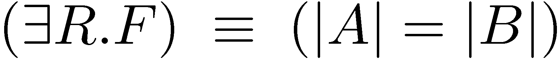
Reduction to BAPA
Consider the C² formula
F expresses “R is bijection between A and B”
Projection of F onto A and B gives
Cardinalities are needed to express projections ! BAPA

Slide 40
Outline
Software Synthesis
  Basic idea
  Complete functional synthesis
  Synthesis for integers
Combination of non-disjoint logics
  Basic idea
  BAPA-reducible theories
  BAPA reduction for reasoning about lists

Slide 41
BAPA-Reducibility
Definition: Logic is BAPA-reducible iff there is an algorithm that computes projections of formulas onto set variables, and these projections are BAPA formulas.
Theorem:
collections (set, multisets)
lists
algebraic data types
are all BAPA-reducible.
Thus, their set-sharing combination is decidable.

Slide 42
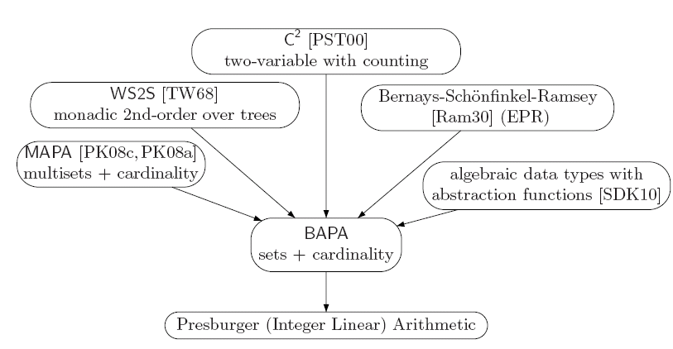
BAPA - Reducibility
relation images
[YPK10]
totally ordered
sets and msets[KPS10]
lists with sublists
and content[WMK11]

Slide 43
Amalgamation of Models:
The Disjoint Case
model for F
model for G
?
model for F Æ G
Cardinalities of the
models coincide
model for F Æ G

Slide 44
Amalgamation of Models:
The Set-Sharing Case
model for F
model for G
Cardinalities of all
Venn regions over shared sets coincide
model for F Æ G

Slide 45
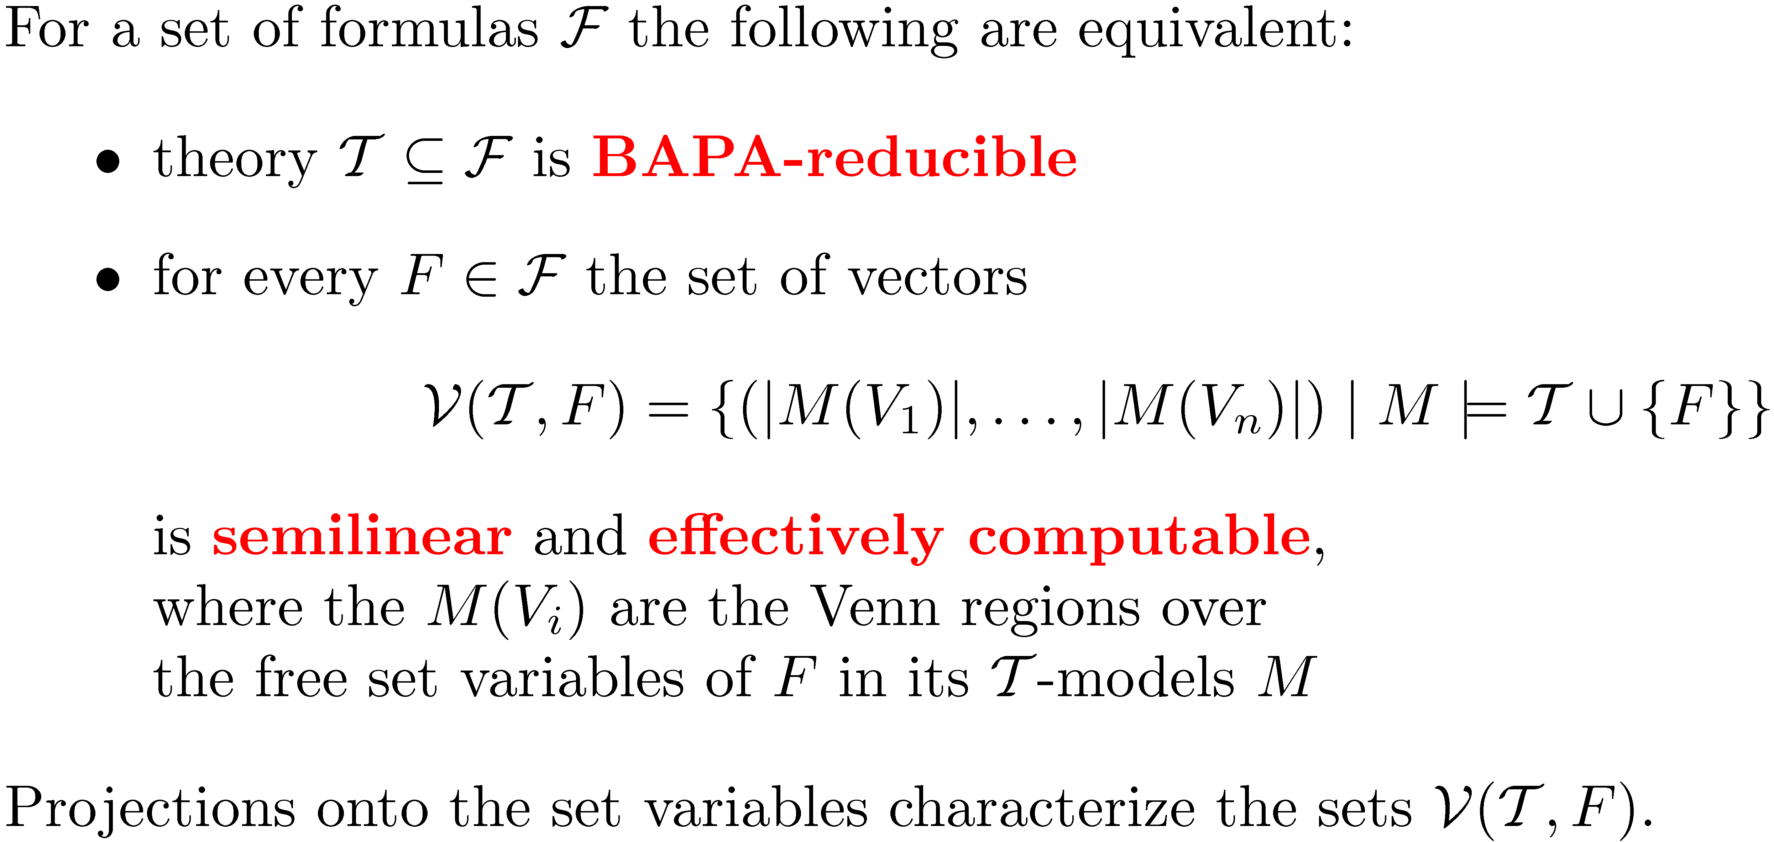
BAPA-reducible Theories

Slide 46
Outline
Software Synthesis
  Basic idea
  Complete functional synthesis
  Synthesis for integers
Combination of non-disjoint logics
  Basic idea
  BAPA-reducible theories
  BAPA reduction for reasoning about lists

Slide 47
BAPA-reduction for WS1S
Decision procedure for sat. of WS1S:
- construct finite word automaton A from F
- check emptiness of L(A)
Parikh 1966:
Parikh image of a regular language is semilinear and effectively computable from the finite automaton
Construct BAPA formula from Parikh image of the reg. lang.

Slide 48
BAPA-reduction for WS1S
WS1S formula for a regular language
F = ((A Æ:B)(B Æ:A))* (:B Æ:A)*
Formulas are interpreted over finite words
Symbols in alphabet correspond to
(:A Æ:B),(A Æ:B),(:A Æ B),(AÆB)
Model of formula F
00
10
01
11
A
B
1
0
0
1
1
0
0
1
1
0
0
1
1
0
0
1
0
0
0
0
0
0
0
0
0
0
0
0
0
0

Slide 49
BAPA-reduction for WS1S
WS1S formula for a regular language
F = ((A Æ:B)(B Æ:A))* (:B Æ:A)*
Model of formula F
A,B denote sets of positions in the word w.
, , , denote Venn regions over A,B
Parikh image gives card.s of Venn regions
Parikh(w) = {  7,  4,  4,  0}
A
B
1
0
0
1
1
0
0
1
1
0
0
1
1
0
0
1
0
0
0
0
0
0
0
0
0
0
0
0
0
0
} w
00
10
01
11
00
10
01
11

Slide 50
BAPA-reduction for WS1S
WS1S formula for a regular language
F = ((A Æ:B)(B Æ:A))* (:B Æ:A)*
Parikh image of the models of F:
Parikh(F) = {(q,p,p,0) | q,p ¸ 0}
BAPA formula for projection of F onto A,B:
|A Å B^{c}| = |A^{c} Å B| Æ |A Å B| = 0
00
10
01
11

Slide 51
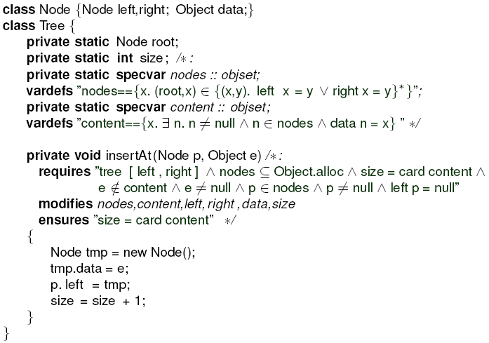
Fragment of Insertion into Tree
size:
4
left
right
p
left
right
data
left
tmp
data
data
data
e

Slide 52
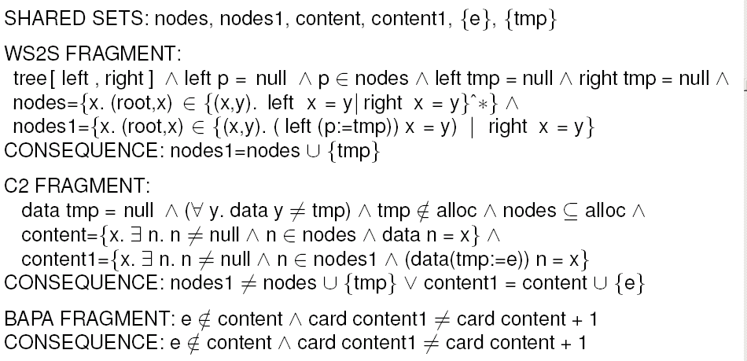
Reduction of VC for insertAt
Conjunction of projections unsatisfiable → so is original formula

Slide 53
Related Work and Conclusions

Slide 54
Related Work on Combination
Nelson-Oppen, 1980 – disjoint theories
reduces to equality logic (finite # of formulas)
Tinelli, Ringeissen, 2003 – general non-disjoint
we consider the particular case of sets
Ghilardi – sharing locally finite theories
cardinality on sets needed, not locally finite
Fontaine – gentle theories (BSR, …)
disjoint case only
Ruess, Klaedtke – WS2S + cardinality (no C²)
Jovanovic, Barrett, 2010 – polite theories
combining non-stably-infinite theories

Slide 55
Related Work on Software Synthesis
Solar-Lezama, L. Tancau, R. Bodík, S. A. Seshia, V. A. Saraswat: “Combinatorial sketching for finite programs”. ASPLOS 2006
S. Jha, S. Gulwani, S. A. Seshia, A. Tiwari: “Oracle-guided component-based program synthesis”. ICSE (1) 2010
S. Srivastava, S. Gulwani, J.S. Foster: From program verification to program synthesis. POPL 2010
S. Gulwani: Dimensions in program synthesis. PPDP 2010
W. Pugh: The Omega test: a fast and practical integer programming algorithm for dependence analysis

Slide 56
Summary
Complete Functional Synthesis: extending
decision procedures into synthesis algorithms
    method to obtain correct software from the given specification
    http://lara.epfl.ch/w/comfusy
  new combination technique for theories sharing sets by reduction to a common shared theory (BAPA)
    allows reasoning about lists, sets, multisets, relations
Notes:
56

