Slide 1

Constraint Based Synthesis
With the Sketch synthesis system
Armando Solar-Lezama
Notes:
Over the last few days, we have seen several different applications of synthesis for what could collectively be called Quality Control

Slide 2
The success of solvers in QC
Solver-based technology has transformed QC
  Automated testing
  Bounded model checking
  Verification
  Vulnerability discovery
  …
The next step is to transform the way we program
  Programming aids
  Automatic debugging
  Synthesis

Slide 3
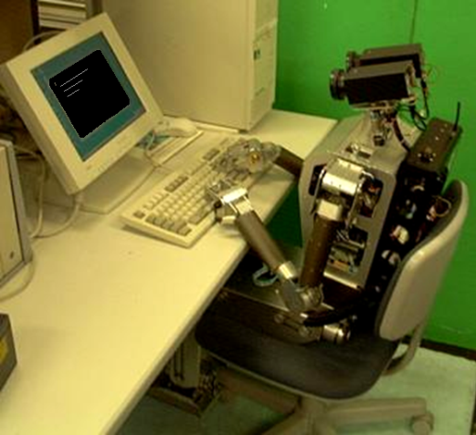
Framing the synthesis problem
Mundane
Science Fiction
VisualBasic
( )
Python
Automate challenging programming steps
Leverage programmer knowledge

Slide 4

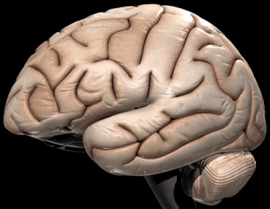
Fundamental question
How to combine human insight and machine power
Programming is the ultimate intellectual challenge
Synergy between human and machine is key

Slide 5
Example
You want to partition N elements over P procs
  How many elements should a processor get?
Obvious answer is N/P
Obvious answer is wrong!
N = 18
P = 5

Slide 6
Synthesizing a partition function
What do we know?
  The interface to the function we want
  Not all processors will get the same # of elements
  The kind of expressions we expect
void partition(int p, int P, int N, ref int ibeg, ref int iend){
if(p< {$ p, P, N, N/P, N%P : *, + $} ){
iend = {$ p, P, N, N/P, N%P : *, + $};
ibeg = {$ p, P, N, N/P, N%P : *, + $};
}else{
iend = {$ p, P, N, N/P, N%P : *, + $};
ibeg = {$ p, P, N, N/P, N%P : *, + $};
}
}
N
P
N%P
*
+
p
N/P

Slide 7
Synthesizing a partition function
How does the system know what a partition is?
harness void testPartition(int p, int N, int P){
if(p>=P || P < 1){ return; }
int ibeg, iend;
partition(p, P, N, ibeg, iend);
assert iend - ibeg < (N/P) + 2;
if(p+1 < P){
int ibeg2, iend2;
partition(p+1, P, N, ibeg2, iend2);
assert iend == ibeg2;
}
if(p==0){ assert ibeg == 0; }
if(p==P-1){ assert iend == N; }
}
Partitions should be balanced
Adjacent partitions should match
First and last partition should go all the way to the ends

Slide 8
DEMO
Notes:
// bound the size of integers and the depth of generated expressions
pragma options "--bnd-inline-amnt 3 --bnd-inbits 3";
void partition(int p, int P, int N, ref int ibeg, ref int iend){
if(p< {$ p, P, N, N/P, N%P : *, +$} ){
iend = {$ p, P, N, N/P, N%P : *, + $};
ibeg = {$ p, P, N, N/P, N%P : *, + $};
}else{
iend = {$ p, P, N, N/P, N%P : *, + $};
ibeg = {$ p, P, N, N/P, N%P : *, + $};
}
}
harness void testPartition(int p, int N, int P){
if(p>=P || P < 1){ return; }
{
int ibeg, iend;
partition(p, P, N, ibeg, iend);
assert iend - ibeg < (N/P) + 2;
if(p+1 < P){
int ibeg2, iend2;
partition(p+1, P, N, ibeg2, iend2);
assert iend == ibeg2;
}
if(p==0){ assert ibeg == 0; }
if(p==P-1){ assert iend == N; }
}
}

Slide 9
Solution
void partition(int p, int P, int N, ref int ibeg, ref int iend){
if(p < (N % P)){
iend = ((N / P) + 1) * (1 + p);
ibeg = p + ((N / P) * p);
}else{
iend = ((N / P) * p) + ((N / P) + (N % P));
ibeg = (N % P) + ((N / P) * p);
}
}

Slide 10
The sketch language

Slide 11
Sketch language basics
Sketches are programs with holes
  write what you know
  use holes for the rest

Slide 12
Specifications
Idea: Use unit tests as specification
  Programmers know how to write those
Two mechanisms
  assertions
  function equivalence
assert x > y;
blockedMatMul(Mat a, Mat b) implements matMul

Slide 13
Holes
Holes are placeholders for the synthesizer
  synthesizer replaces hole with concrete code fragment
  fragment must come from a set defined by the user
Defining sets of code fragments is the key to Sketching effectively

Slide 14
Language Design Strategy
Extend base language with one construct
  Constant hole: ??
Synthesizer replaces ?? with a constant
High-level constructs defined in terms of ??
int bar (int x)
{
int t = x * ??;
assert t == x + x;
return t;
}
int bar (int x)
{
int t = x * 2;
assert t == x + x;
return t;
}

Slide 15
Integer Holes → Sets of Expressions
Expressions with ?? == sets of expressions
  linear expressions x*?? + y*??
  polynomials x*x*?? + x*?? + ??
  sets of variables ?? ? x : y

Slide 16
Integer Holes → Sets of Expressions
Example: Least Significant Zero Bit
  0010 0101 → 0000 0010
Trick:
  Adding 1 to a string of ones turns the next zero to a 1
  i.e. 000111 + 1 = 001000
int W = 32;
bit[W] isolate0 (bit[W] x) { // W: word size
bit[W] ret = 0;
for (int i = 0; i < W; i++)
if (!x[i]) { ret[i] = 1; return ret; }
}
!(x + 1) & (x + 0)
!(x + 1) & (x + 0xFFFF)
!(x + ??) & (x + ??)
→
!(x + 0) & (x + 1)
!(x + 0xFFFF) & (x + 1)

Slide 17
Integer Holes → Sets of Expressions
Example: Least Significant Zero Bit
  0010 0101 → 0000 0010
int W = 32;
bit[W] isolate0 (bit[W] x) { // W: word size
bit[W] ret = 0;
for (int i = 0; i < W; i++)
if (!x[i]) { ret[i] = 1; return ret; }
}
bit[W] isolateSk (bit[W] x) implements isolate0 {
return !(x + ??) & (x + ??) ;
}

Slide 18
Integer Holes → Sets of Expressions
Expressions with ?? == sets of expressions
  linear expressions x*?? + y*??
  polynomials x*x*?? + x*?? + ??
  sets of variables ?? ? x : y
Semantically powerful but syntactically clunky
  Regular Expressions are a more convenient way of defining sets

Slide 19
Regular Expression Generators
{| RegExp |}
RegExp supports choice ‘|’ and optional ‘?’
  can be used arbitrarily within an expression
    to select operands {| (x | y | z) + 1 |}
    to select operators {| x (+ | -) y |}
    to select fields {| n(.prev | .next)? |}
    to select arguments {| foo( x | y, z) |}
Set must respect the type system
  all expressions in the set must type-check
  all must be of the same type

Slide 20
Least Significant One revisited
How did I know the solution would take the form
!(x + ??) & (x + ??) .
What if all you know is that the solution involves x, +, & and !.
bit[W] tmp=0;
{| x | tmp |} = {| (!)?((x | tmp) (& | +) (x | tmp | ??)) |};
{| x | tmp |} = {| (!)?((x | tmp) (& | +) (x | tmp | ??)) |};
return tmp;
This is now a set of statements
(and a really big one too)

Slide 21
Sets of statements
Statements with holes = sets of statements
Higher level constructs for Statements too
  repeat
bit[W] tmp=0;
repeat(3){
{| x | tmp |} = {| (!)?((x | tmp) (& | +) (x | tmp | ??)) |};
}
return tmp;

Slide 22
repeat
Avoid copying and pasting
  repeat(n){ s} ➔ s;s;…s;
  each of the n copies may resolve to a distinct stmt
  n can be a hole too.
n
bit[W] tmp=0;
repeat(??){
{| x | tmp |} = {| (!)?((x | tmp) (& | +) (x | tmp | ??)) |};
}
return tmp;

Slide 23
Example: remove() for a sorted, linked list
The data structure:
  linked list of Nodes
  sorted by Node.key
  with sentries at head and tail
The problem: implement a concurrent remove() method
-∞
a
b
c
+∞
Notes:
|…> we want to implement a [HIGHLY?] concurrent remove() method for a set data type with the following implementation

Slide 24

Thinking about the problem
Sequential remove ():
Insight 1: for efficiency, use fine-grain locking
  of individual Nodes, rather than the whole list
Insight 2: Keep a sliding window with two locks
-∞
a
b
c
+∞

Slide 25
Hand Over Hand Locking
bit add(Set S, int key) {
bit ret = 0;
Node prev = null;
Node cur = S.head;
aas
if(??) lock(LOC);
if(??) lock(LOC);
aas
find (S, key, prev, cur);
if (key < cur.key) {
prev.next = newNode (key, cur);
ret = 1;
} else {
ret = 0;
}
aas
if(??) unlock(LOC);
if(??) unlock(LOC);
return ret;
}
void find (Set S, int key,
ref Node prev, ref Node cur) {
while (cur.key < key) {
reorder{
if(COMP) lock(LOC);
if(COMP) unlock(LOC);
{ prev = cur;
cur = cur.next; }
}
}
}
#define COMP {| ((cur|prev)(.next)? | null) (== | !=) (cur|prev)(.next)? |}
#define LOC {| (cur | prev )(.next)? |}

Slide 26
How does it work

Slide 27
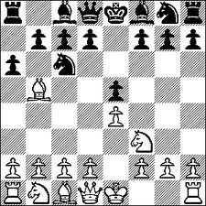
Synthesis problem at the high level
Game theoretic view of synthesis
For every move of the environment
Synthesized program makes a counter move

Slide 28
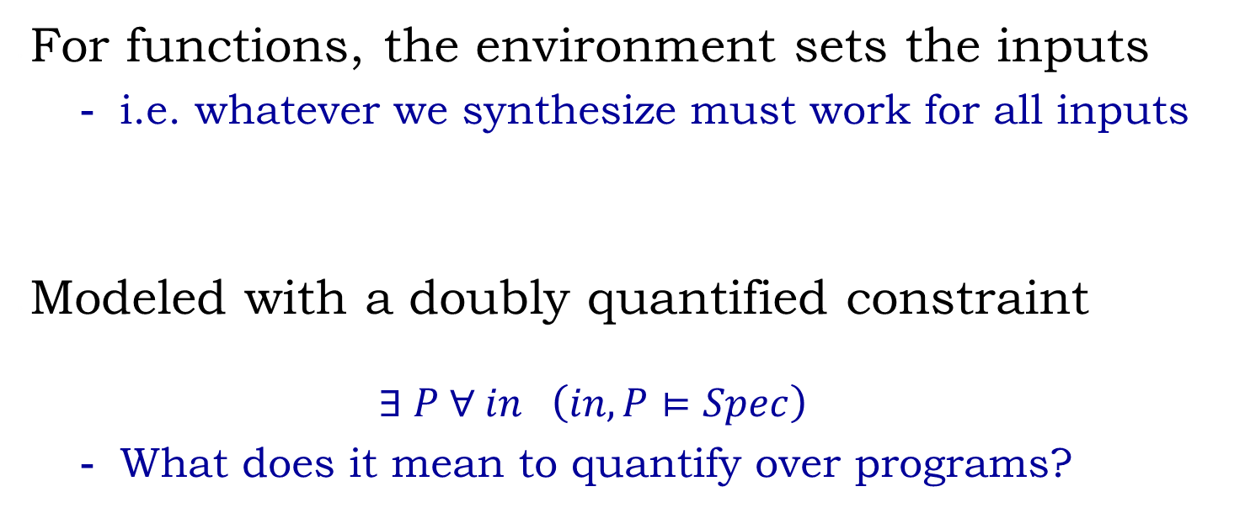
The challenge of synthesis
For functions, the environment sets the inputs
  i.e. whatever we synthesize must work for all inputs
Modeled with a doubly quantified constraint
  $$∃ P ∀ in \left(in, P⊨Spec\right)$$
  What does it mean to quantify over programs?

Slide 29
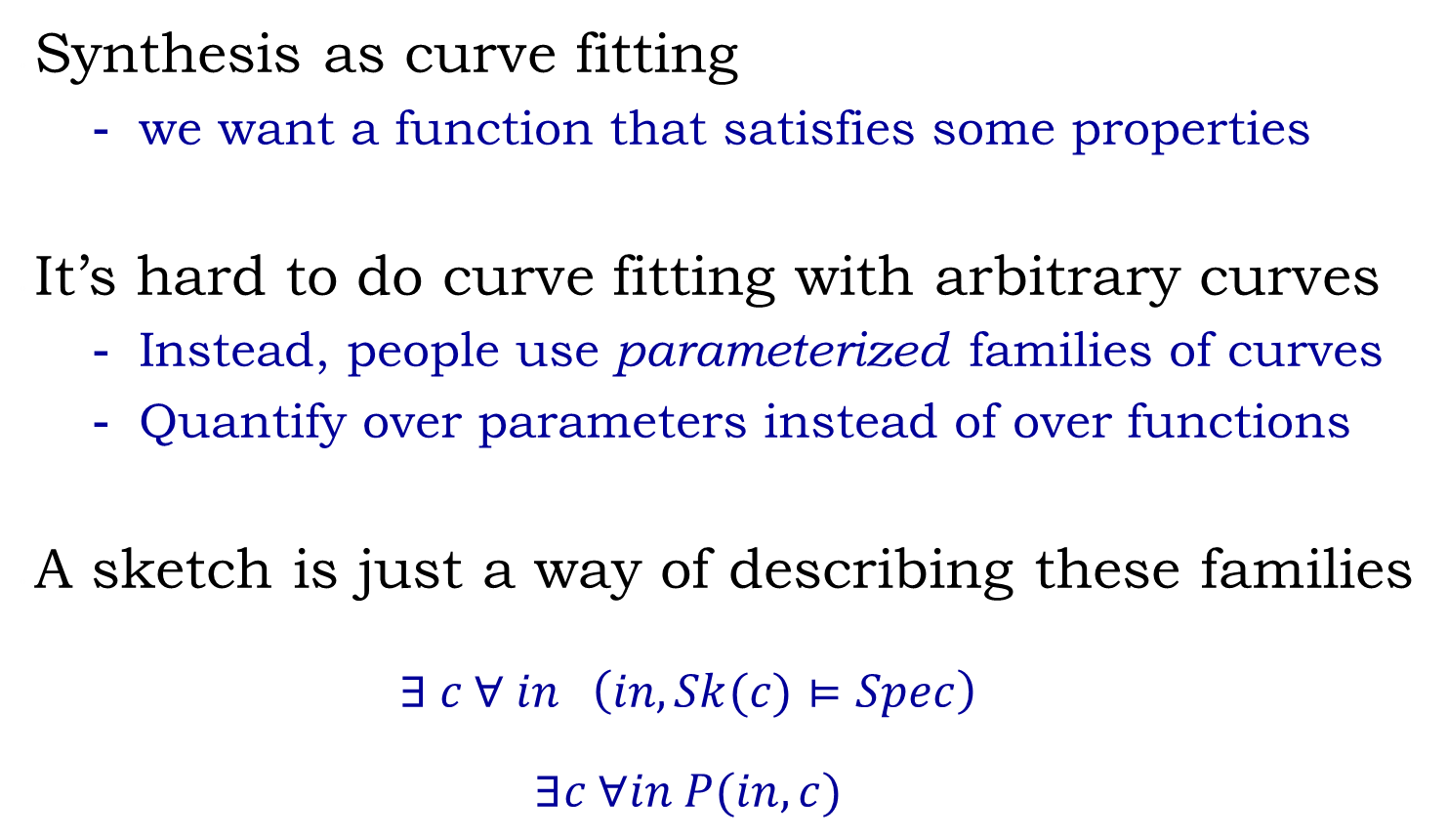
Quantifying over programs
Synthesis as curve fitting
  we want a function that satisfies some properties
It’s hard to do curve fitting with arbitrary curves
  Instead, people use parameterized families of curves
  Quantify over parameters instead of over functions
A sketch is just a way of describing these families
  $$∃ c ∀ in \left(in, Sk(c)⊨Spec\right)$$
  $$∃c ∀in P(in, c)$$

Slide 30
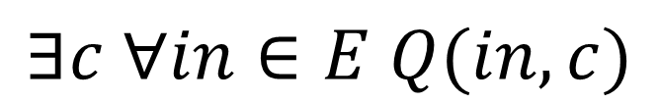
Insight
Sketches are not arbitrary constraint systems
  They express the high level structure of a program
A small number of inputs can be enough
  focus on corner cases
This is an inductive synthesis problem !
$$∃c ∀in∈E Q(in, c)$$
where E = {x₁, x₂, …, x_{k}}

Slide 31

Counterexample –Guided Inductive Synthesis (CEGIS)
Sequential
candidate implementation
succeed
Inductive Synthesizer
Automated Validation
Derive candidate implementation from concrete inputs.
fail
ok
buggy
Your verifier/checker goes here
$$∃c ∀in∈E Q(in, c)$$
fail
counterexample input
observation set E
Notes:
The idea behind inductive synthesis is that rather than looking for a candidate that is correct for all inputs, we want to look for a candidate which works correctly for all inputs in a small set of observations E.
If no such candidate exists, then clearly the sketch must be buggy.
If we find such a candidate, then we want to know if it generalizes to all inputs, so we pass it to an automated validation procedure; a bounded-model checker in our case.
If the validation succeeds, then we are done; but if it doesn’t, the validator produces something really valuable, a new observation which covers a corner-case in the sketch not covered by any of the previous observations.
By adding this counterexample to our observation set, we can very quickly converge on an observation which works for all inputs. In the sequential case, we were able to search spaces of over 30000 bits in about 600 iterations.
In order to extend this algorithm to handle concurrency we must address several problems.

Slide 32
What about concurrency?

Slide 33
Reframing the problem
Sequential constraints are in terms of inputs
  derived from the sequential semantics of the program
Concurrent constraints defined in terms of traces
  traces have sequential semantics
E
A
φ. x.
Q(x, φ)
set of traces of the sketch
E
A
φ. t in tr(P).
Q(t, φ)
We can do inductive synthesis on traces as well!

Slide 34
Counterexample –Guided Inductive Synthesis (CEGIS)
Sequential
Concurrent
candidate implementation
succeed
Inductive Synthesizer
Inductive Synthesizer
Automated Validation
Derive candidate implementation from concrete inputs.
Derive candidate implementation from counterexample traces
fail
ok
buggy
SPIN
Your verifier/checker goes here
E
A
φ. t in E.
Q(t, φ)
fail
counterexample trace
counterexample input
observation set E
traces of the sketch
!=
trace of a candidate
Notes:
First, we need a validation procedure which understands concurrency. In our case we use the bounded model checker SPIN.
But the biggest problem is that the counterexample is no longer an input, but a trace showing a bug with a specific thread interleaving. The problem with these counterexamples is that, unlike inputs, traces are very specific to the particular candidate that produced them.
So the inductive synthesizer is left with the task of producing a candidate implementation that avoids the bugs exposed by traces from several different candidate implementations.

Slide 35
Learning from traces
Problem:
Traces are only relevant to the program they came from
Solution: Trace Projection t_{p} ► S
Desired property
  if P’ shares the bug exposed by t_{p} …
  … t_{p} ► S should expose the bug too
  allows inductive synthesis through constraint solving
Trace on sketch S
Trace on program P

Slide 36
How to do projection
The key is to preserve statement ordering
  statements in the trace ⊆ statements in the
Control flow may be an obstacle
  but we can get rid of it

Slide 37
Projection Algorithm: Key Ideas
Sk[c]
Sk
P = Sk[0]
Want a parameterized set of traces
  preserve order of common statements
Algorithm
If-Conversion of the Sketch
  Easier to build a trace
Schedule the statements
  preserve order from original trace
if(c){
S1;
}else
{ S2;
S3; }
S4;
if(c) S1;
if(!c) S2;
if(!c) S3;
S4;
S2;
S3;
S4;
t_{p} ► Sk
t_{P}
c=0
c=1
if(c) S1;
if(!c) S2;
  if(c) S1;
  if(!c) S2;
if(!c) S3;
  if(!c) S3;
S4;
  S4;
S2;
  S2;
S3;
  S3;
S4;
  S4;

Slide 38
Sample of what sketch can do
Bit-level manipulations
  If you want to do low-level bit-vector manipulations use sketch
  don’t waste time doing it by hand…
  …but don’t expect the SAT solver to break crypto functions
Integer problems
  very good at coming up with tricky arithmetic expressions
  … but only when used with an SMT solver backend
Data-structures
  Very good at local manipulations of lists and trees
  We have sketched some interesting graph algorithms
Concurrent objects
  Various implementations of locked and lock-free manipulations of lists/queues
  Synchronization objects such as 2-phase barrier

Slide 39
Beyond sketches

Slide 40
How to reverse a linked list in place
Graphic description is clear and intuitive
The code is not…
…
c
c
h
c
c
c
h
h
c
h
h
c
h
h
c
c
c
h
h
c
c
h
h
h
h
h
a
c
d
z
z
z
z
a
e
z
a
a
a
b
b
c
c
c
c
d
d
d
d
e
z
e
z
z
z
a
z
a
a
a
a
a
b
b
b
b
b
b
z
a
y
z
c
c
c
c
c
d
a
b
c
d
z
a
b
z
p
p
p
p
p
p
p
p
p
p
list reverseSK(list lst){
node cur=null, prev=null;
while(null!=lst.head){
cur = lst.head;
lst.head = cur.next;
cur.next = prev;
prev = cur;
}
lst.head = cur;
return lst;
}

Slide 41
Synthesis from storyboards
Input to the Synthesizer
Result
Input/Output Relation
Synthesized Algorithm
a
b
y
z
list reverseSK(list lst){
node cur=null, prev=null;
while(null!=lst.head){
cur = lst.head;
lst.head = cur.next;
cur.next = prev;
prev = cur;
}
lst.head = cur;
return lst;
}
a
b
y
z
Inductive Insight about
what “ .” means

Slide 42
What we have so far
Formal notation to describe input/output relations and inductive insights
Synthesis engine to generate code from storyboards
  Based on constraint based synthesis algorithm
  Built on top of Sketch synthesis system

Slide 43
Linked list reversal
head
. . .
a
x₁
x_{n}
b
head
a
x₁
. . .
x_{n}
b

Slide 44
Storyboard
head
a
x₁
. . .
x_{n}
b
head
a
x₁
. . .
x_{n}
b
Notes:
Lets see how we represent such insights in the storyboard framework.

Slide 45
Storyboard
head
head
a
b
a
f
e
b
mid
head
a
b
head
head
head
a
e’
f’
b
mid
a
head
head
a
a
x
{ f=x, e=x }
f
e
mid
x
f’
e’
{ f=x, e=e’ }
mid

Slide 46
Case studies - I
Manipulation | #Clauses | Memory | #Scen | Time
ll-insertion | 1.99M | 0.75G | 4 | 2m9s
ll-deletion | 1.88M | 0.54G | 4 | 1m48s
ll-reverse | 1.30M | 0.35G | 4 | 1m49s
ll-find-last | 1.02M | 0.29G | 4 | 0m56s
ll-swap-first-last | 1.08M | 0.31G | 4 | 4m18s
dll-traversal | 1.72M | 0.88G | 4 | 1m58s
dll-reversal | 2.04M | 0.49G | 4 | 3m47s

Slide 47
Case studies - II
Manipulation | #Clauses | Memory | #Scen | Time
bst-search(contains) | 0.62M | 0.37G | 1 | 1m02s
bst-search | 0.77M | 0.45G | 1 | 6m07s
bst-find-min | 0.63M | 0.45G | 1 | 0m58s
bst-find-max | 0.57M | 0.18G | 1 | 0m23s
bst-left-rotate | 1.41M | 0.50G | 3 | 3m18s
bst-right-rotate | 1.47M | 0.43G | 3 | 3m15s
bst-insertion | 1.04M | 0.46G | 3 | 1m52s
bst-deletion | 0.63M | 0.62G | 6 | 3m13s
Manipulation | #Clauses | Memory | #Scen | Time
aig-insertion | 0.17M | 0.31G | 4 | 1m04s

Slide 48
Key ideas
Solvers are a powerful tool for synthesis
  They enable new more flexible forms of interaction
Power of the solvers is still an issue
  A lot of opportunities for optimization at the high level
Engineering the interaction is a key challenge
Now go break our server!
  http://bit.ly/sketch-language

