Slide 1
Construction of an insulation gene circuit towards studying attenuation of retroactivity in vivo
Kayzad Soli Nilgiriwala

Slide 2
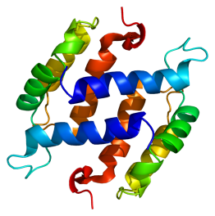
Symbols used and some basics in brief
PROMOTER
RBS
TERMINATOR
GENE CODING DNA
Transcription start
Transcription stop
TRANSCRIPTION
Ribosome
mRNA
AUG
TAA
Translation start
Translation stop
TRANSLATION
PROTEIN

Slide 3


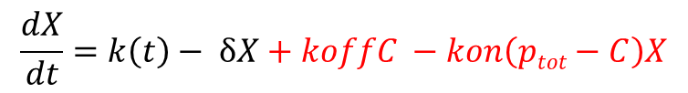
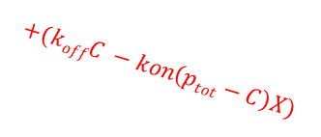


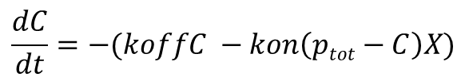

Retroactivity and Insulation in biology
Input (u)
Output (y)
Retroactivity to input (r)
Retroactivity to output (s)
$$+k\left(t\right)$$
$$−(koffC −kon\left(ptot−C\right)X)$$
p₀
X
p
Z
Retroactivity to input (r)
$$+(koffC −kon\left(ptot−C\right)X)$$
Retroactivity to output (s)
$$−δX$$
k_{on}
$$X+p C$$
k_{off}
$$\frac{dX}{dt}=k\left(t\right)− δX+koffC −kon\left(ptot−C\right)X$$
$$\frac{dC}{dt}=−(koffC −kon\left(ptot−C\right)X)$$

Slide 4
Activation of ntr-regulon genes by phosphorylated NRI
Substrate protein
No transcriptional activation
σ⁵⁴
ntr genes
Two tetramers of unphosphorylated NRI (N) binds to the enhancer sites
Phosphorylation
by Kinase (K)
(Input)
De-phosphorylation
by Phosphatase (P)
(Negative feedback)
Downstream system
An octamer of phosphorylated NRI (NP) is required for activation of transcription
P
P
σ⁵⁴
Transcription
P
P
P
P
P
P
ntr genes
Output protein

Slide 5
Biomolecular circuit for testing the insulation device in the ntr regulon of E. coli
Pconst(weak)
tetRLVA
X (aTc)
T
Ptet
Kinase
K
G
PglnA
N
NP
sf-gfpLVA
Pconst(weak)
Legend:
T → TetRLVA
L → LacILVA
N → NRI
NP → NRI~P
K → NRII (Kinase)
P → NRII (Phosphatase)
X → aTc → anhydrotetracycline
Y → IPTG → Isopropyl-β-D-thiogalactopyranoside
G → sf-GFPLVA
PglnA → Promoter glnA
NRI
P
Plac
Phosphatase
Pconst(weak)
L
Repressor System
Reporter System
Test System
Y (IPTG)
lacILVA

Slide 6
Pconst(weak)
Details of the model
tetRLVA
kon
T + X ↔ C1
T + θ1 ↔ C2
θ1 → K → φ
T
Ptet
NP + p ↔ C5
C5 → G → φ
koff
δ1
X (aTc)
δ3
Kinase
K
G
PglnA
α1
k1
N + K ↔ D1 → NP + K
N
β1
NP
Pconst(weak)
α2
sf-gfpLVA
k2
NP + P ↔ D2 → N + P
Legend:
T → TetRLVA
L → LacILVA
N → NRI
NP → NRI~P
K → NRII (Kinase)
P → NRII (Phosphatase)
X → aTc → anhydrotetracycline
Y → IPTG → Isopropyl-β-D-thiogalactopyranoside
G → sf-GFPLVA
p → Promoter PglnA
W → Load
β2
NRI
Plac
P
L
Phosphatase
Pconst(weak)
L + Y ↔ C3
L + θ2 ↔ C4
θ2 → P → φ
Y (IPTG)
Conservation law:
N_{T} = N + NP + D1 + D2 + C5
p_{T} = p + C5
lacILVA
δ2

Slide 7
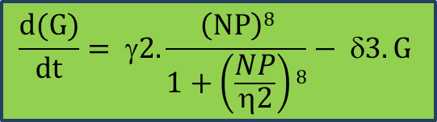


ODEs of the circuit
$\frac{d(K)}{dt}=γ1.\frac{X}{1+\frac{X}{η1}}$- δ1.K - α1(N_{T} – NP – D1 – D2 – C5).K + (β1 + k1).D1
$\frac{d(NP)}{dt}=k1.D1 −\text{α}2.NP.\left(PT −D2\right)+ β2.D2 −kon.NP.(pT −C5)$ + koff.C5
$$\frac{d(D1)}{dt}= α1\left(NT −NP −D1 −D2 −C5\right).K −\left(β1+k1\right).D1$$
$\frac{d(D2)}{dt}= α2.NP(PT −D2)$ – (β2 + k2).D2
$\frac{d(C5)}{dt}=kon.NP(pT −C5)$ - koff.C5
$$\frac{d(G)}{dt}= γ2.\frac{\left(NP\right)8}{1+\left(\frac{NP}{η2}\right)8}− δ3.G$$

Slide 8
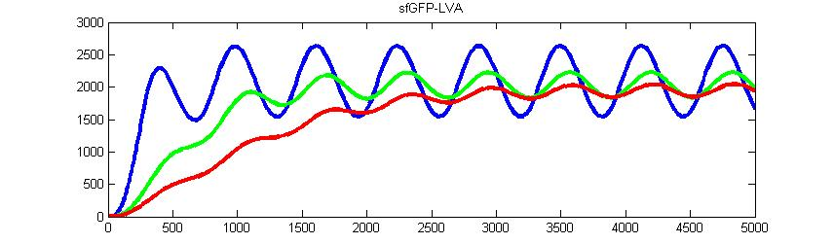
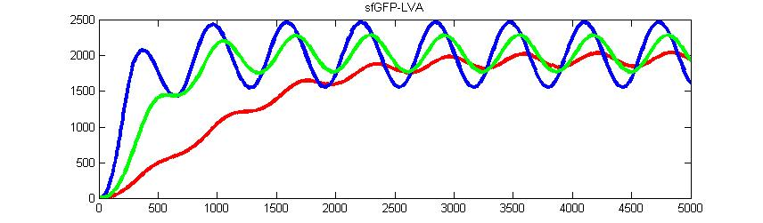
Retroactivity and its attenuation
Increase in Load (pT)
Increase in Substrate (N_{T}) and Negative Feedback (P) with a constant high Load

Slide 9
A brief recap and overview
Past status | Process performed | Current status
Repressor system mutations | Decrease in promoter strength | Successfully cloned
NRI mutations | Decrease in promoter strength | Successfully cloned
Functionality tests | All parts individually tested | All parts are functional
Complete circuit not constructed | Sequential cloning of parts done to complete the circuit | Complete circuit constructed (but unstable in pACYC184)
Microfluidics strategy designed | Obtained microscope, pumps, tubing and perfusion chambers for microfluidics and standardization process started | Microfluidics setup being tested

Slide 10
Cloning locations in pACYC184
pACYC184
Plasmid
BsoBI
XbaI
Reporter system
NRI
HindIII
SphI
Repressor system (tetRLVA + lacILVA)
NRII (Kinase)
BspHI
BamHI
NRII
(Phosphatase)

Slide 11
Cloning of Reporter system in pACYC184
sf-gfpLVA
XbaI
HindIII
PglnA
pACYC184
XbaI
pUC57
HindIII
E
S
P
Digested the pUC57 reporter plasmid with XbaI - HindIII and cloned reporter in pACYC184 at same sites
sf-gfpLVA
PglnA
XbaI
pACYC184
HindIII

Slide 12
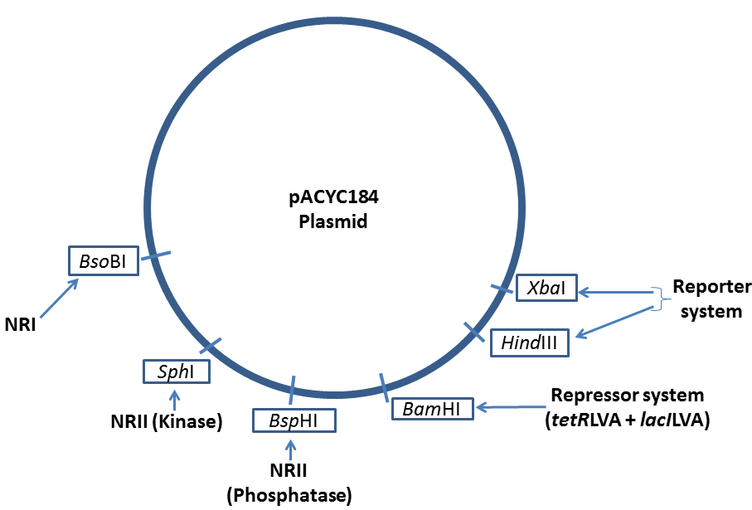
Complete circuit construction status
Result: Reporter cloned in pACYC184

Slide 13
Functionality tests for the reporter system
Fluorescence / OD_{600nm}
Concentration of ammonium (%)
Dynamics with 0.001% ammonium salt
Fluorescence / OD_{600nm}
Time (h)

Slide 14
Cloning of Repressor system in BB plasmid (pUC) & pACYC184
tetRLVA
lacILVA
X
S
X
E
P
tetRLVA and lacILVA in BB plasmids
E
S
BB plasmid
P
BB plasmid
tetRLVA
lacILVA
X
X
E
Cloning of double terminator
E
BB plasmid
S
BB plasmid
S
P
P
tetRLVA
lacILVA
Cloning of RBS
X
X
E
BB plasmid
S
E
BB plasmid
S
P
P
PCR with promoter (low; 256) in primer
E
X
S
P
S
E
P
X

Slide 15
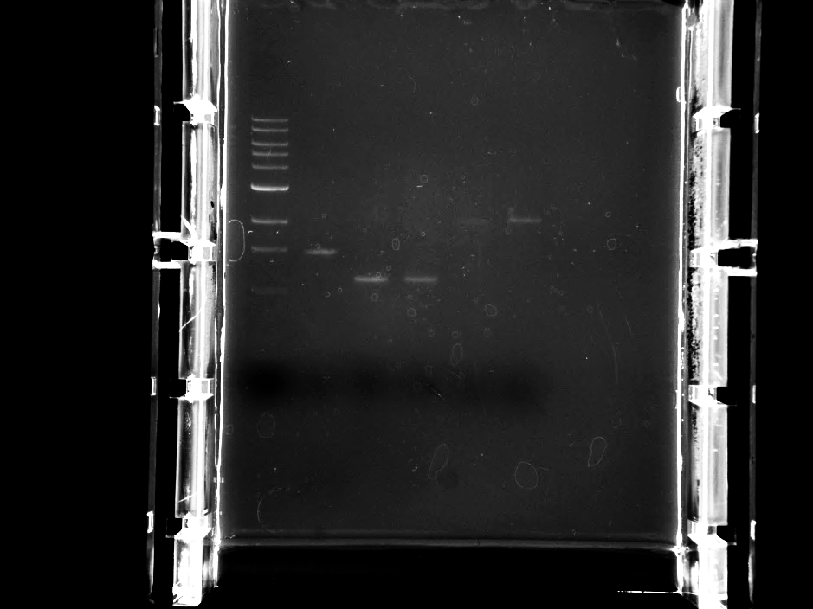
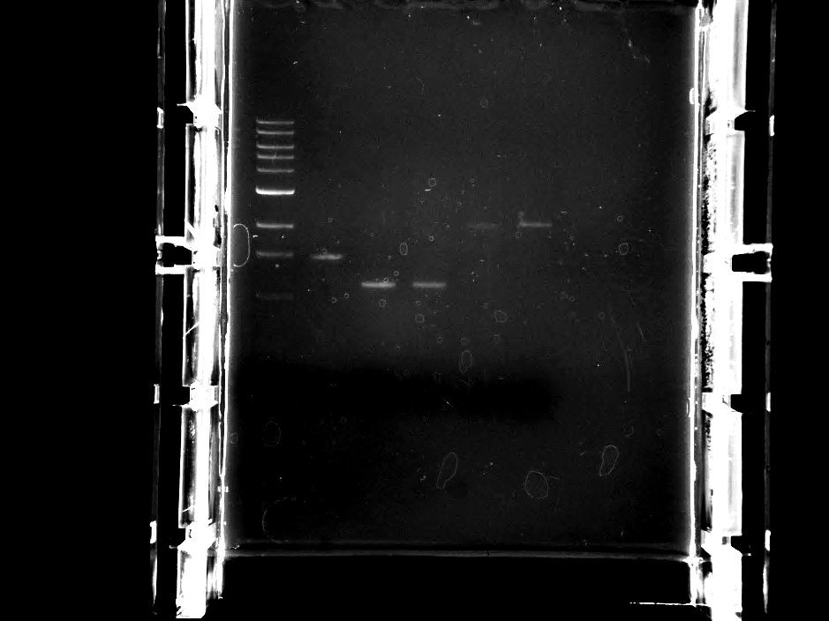
tetRLVA
lacILVA
Pconst
(low; 256)
Pconst
(low; 256)
X
pUC57
S
X
pUC57
S
E
P
E
P
lacILVA
tetRLVA
Pconst
(low; 256)
Adding up both constructs
tetRLVA
lacILVA
Pconst
(low; 256)
Construct is stable
X
pUC57
S
E
P
BamHI
PCR
E
X
S
P
Pconst (low; 256)
BamHI
tetRLVA
lacILVA
Pconst (low; 256)
X
pACYC184
S
Construct is stable
E
P
BamHI
BamHI

Slide 16
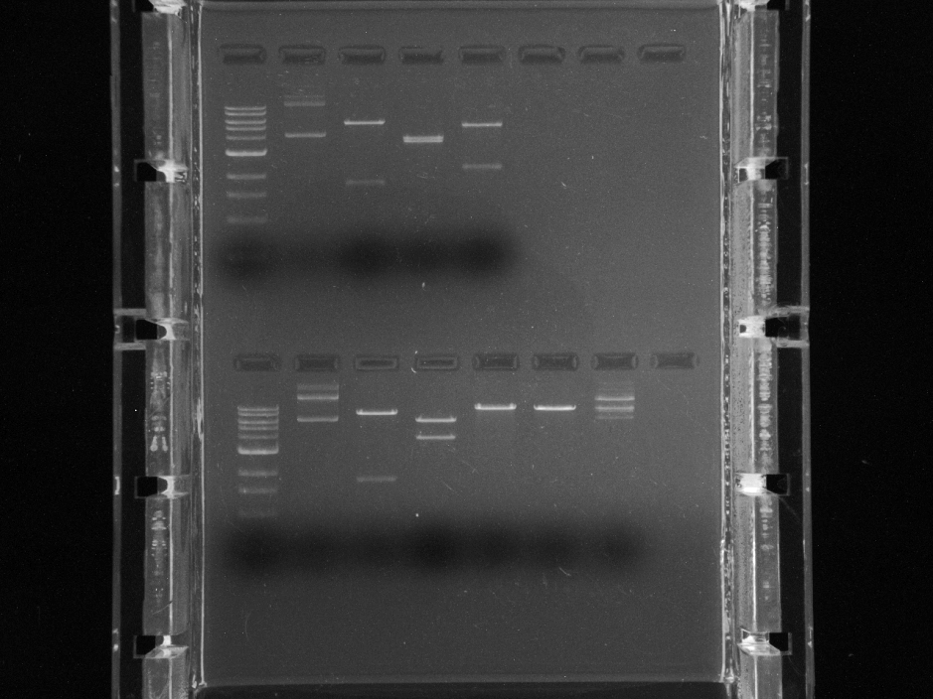
Complete circuit construction status
T+L
R
Result: Reporter and repressor cloned in pACYC184

Slide 17

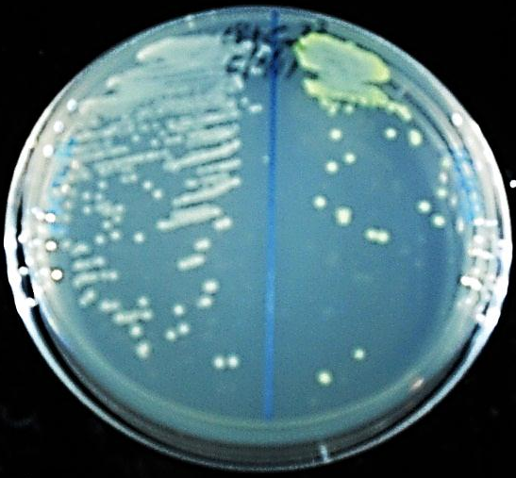
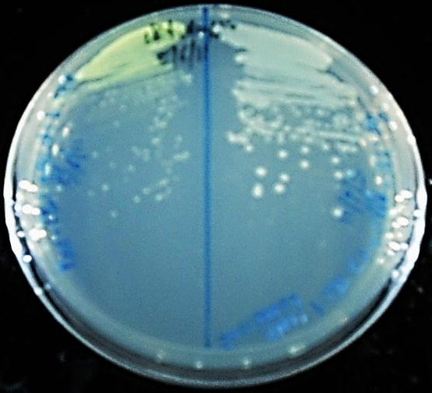
Functionality tests for tetRLVA and lacILVA
 | Visually the co-transformants (COTs) are observed to be green and hence, the tetRLVA is functional.
 | Visually the COTs are observed to have become colorless from green and hence, the lacILVA is functional.
Pconst
(low)
tetRLVA
Plac
lacILVA
gfpLVA
Ptet
pUC57
pWhite
Pconst
(low)
lacILVA
gfpLVA
Plac
pUC57
pGreen
Fluorescence / OD_{600nm}
tetRLVA+pWhite
lacILVA+pGreen
pWhite
pGreen
Time (h)

Slide 18
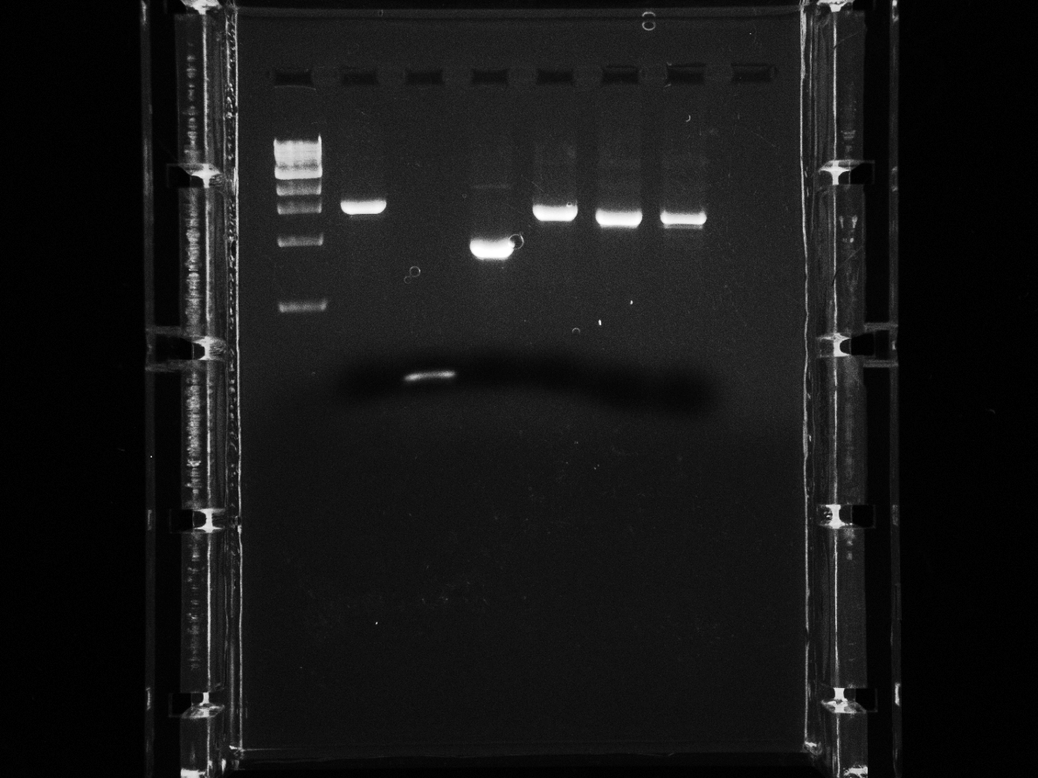
Cloning of NRII (Kinase) with Ptet in pACYC184
NRII (Kinase)
Ptet
X
BB plasmid
S
E
P
PCR
SphI
E
X
S
P
SphI
Cloning in SphI site
NRII (Kinase)
Ptet
X
pACYC184
S
E
P
SphI
SphI

Slide 19
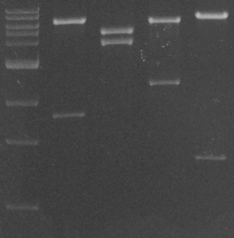
Complete circuit construction status
T+L
R
K
Result: Reporter, repressor and kinase cloned in pACYC184

Slide 20
Cloning of NRII (Phosphatase) with Plac in pACYC184
NRII (Phosphatase)
Plac
X
BB plasmid
S
E
P
PCR
BspHI
E
X
S
P
BspHI
Cloning in BspHI site
NRII (Phosphatase)
Plac
X
pACYC184
S
E
P
BspHI
BspHI

Slide 21
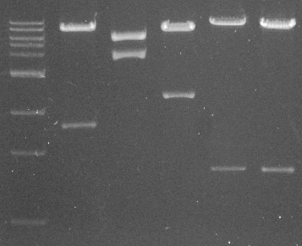
Complete circuit construction status
T+L
R
P
K
Result: Reporter, repressor, kinase and phosphatase cloned in pACYC184

Slide 22
Functionality tests for NRII (Kinase) and NRII (Phosphatase)
Reporter
sf-gfpLVA
NRII
(Kinase)
 | Enhances the reporter fluorescence due to kinase activity (Please see graph below).
 | Represses the reporter fluorescence due to phosphatase activity (Please see Graph below).
PglnA
Ptet
pACYC184
BB plasmid
Reporter
sf-gfpLVA
NRII
(Phosphatase)
PglnA
Plac
pACYC184
BB plasmid
Fluorescence / OD_{600nm}
Time (h)

Slide 23
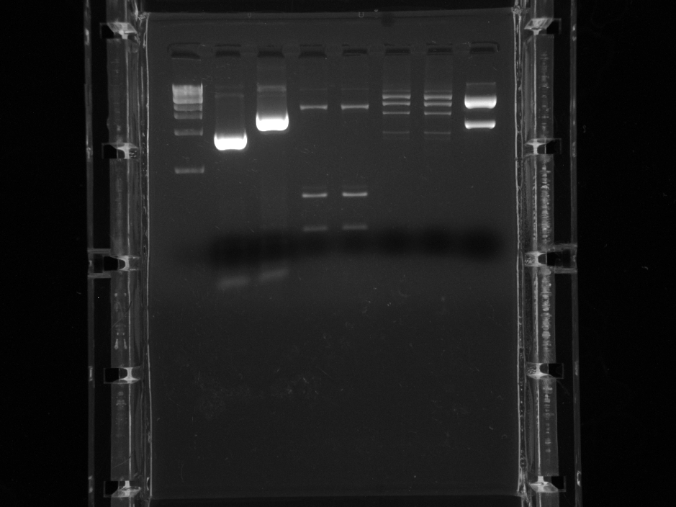
Cloning of NRI with Pconst (low; 256) in pACYC184
Pconst
(low; 256)
NRI
X
S
E
P
X
BB plasmid
S
BB plasmid
E
P
E
X
S
P
E
X
S
P
BsoBI
PCR
E
X
S
P
PCR
BsoBI
Pconst
(low; 256)
NRI
Construct is stable
X
pACYC184
S
E
P
BsoBI
BsoBI

Slide 24
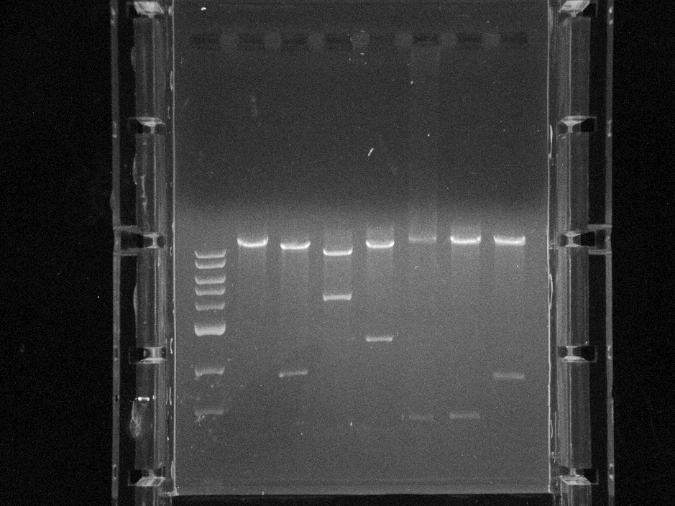
Complete circuit construction status
T+L
R
N
P
K
Result: Reporter, repressor, kinase, phosphatase and NRI cloned in pACYC184 which completes the circuit

Slide 25
Functionality of complete circuit in 3.300LG strain with controls
Fluorescence/OD_{600nm}
Fluorescence/OD_{600nm}
Time (h)
Time (h)

Slide 26
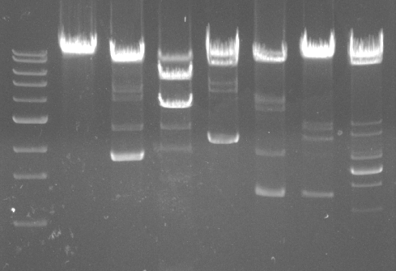
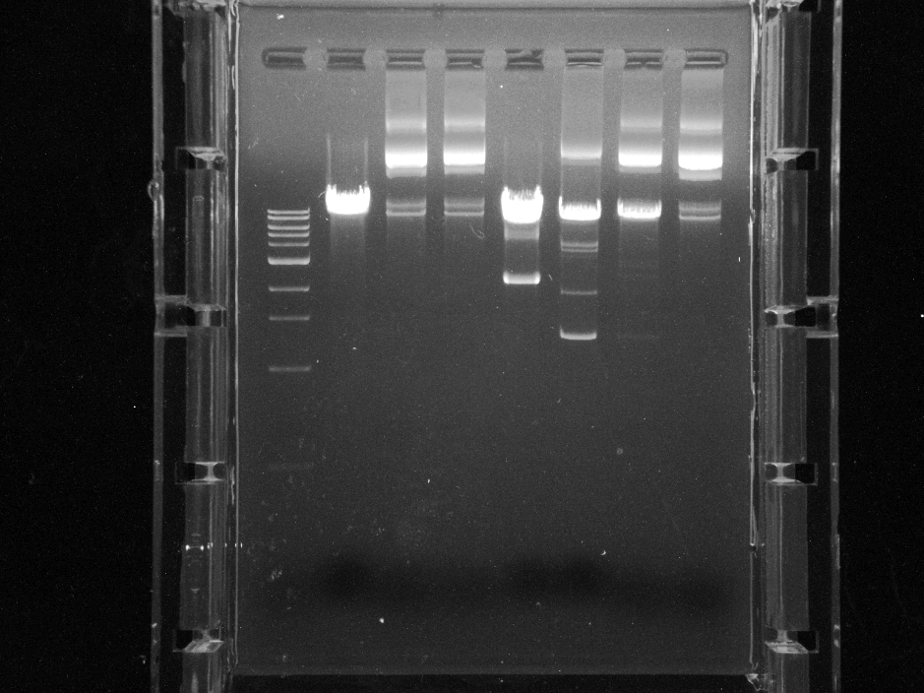
Stability of complete circuit
First sub-culture
T+L
R
N
Second sub-culture
P
K
R
T+L
N
Third sub-culture
P
K
T+L
P
K

Slide 27
Distributive cloning strategy-1
NRI
X
S
E
P
pSC101
NRII (Phosphatase)
X
S
E
pUC
P
pACYC184
XbaI
Reporter system
HindIII
SphI
Repressor system (tetRLVA + lacILVA)
NRII (Kinase)
BamHI

Slide 28
Functionality of complete circuit in DH5alpha strain
(20-25)% reduction
Fluorescence/OD_{600nm}
Time (h)

Slide 29
Distributive cloning strategy-2
Repressor system
NRI
S
X
P
E
pSC101
NRII (Phosphatase)
X
S
E
pUC
P
pACYC184
XbaI
Reporter system
HindIII
SphI
NRII (Kinase)

Slide 30
Functionality of complete circuit in DH5alpha strain
(40-45)% reduction
Fluorescence/OD_{600nm}
Time (h)

Slide 31
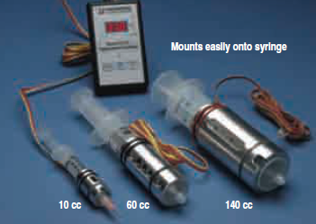
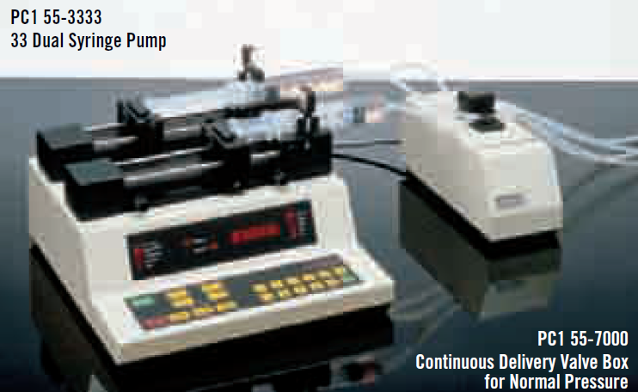
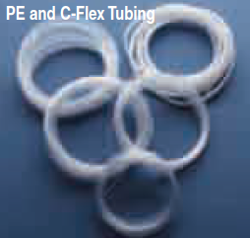

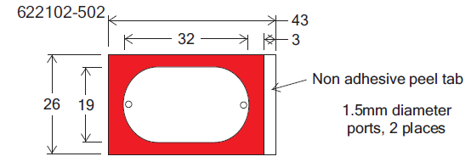
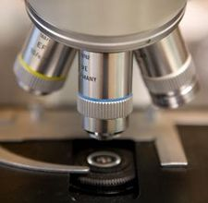
Construction of microfluidic device
Pumps/valve box/ramps/syringe warmers/tubings (Harvard apparatus)
INLET
OUTLET
Perfusion chamber (Grace Biolabs)
Bacteria
Side View
Concanavalin-A (Sigma-Aldrich)
Coverslip (VWR)
Top View
OUTLET
Fluorescence microscope (Leica)
INLET

Slide 32
Conclusions
Complete insulation circuit was cloned in pACYC184 plasmid
The complete circuit in pACYC184 functional except for phosphatase which showed only mild activity
Circuit DNA is unstable in pACYC184 and leads to arbitrary deletions of genes after two subsequent sub-cultures
Alternative strategy of distributive cloning in different vectors was applied to surpass the toxicity of the genes in the circuit
Functionality of all genes in the distributive cloning strategy-2 in DH5alpha showed positive response

Slide 33
Future directions
To test the complete circuit (in the distributive strategy-2) in 3.300LG strain
Addition of variable DNA loads in the circuit to test for increase in retroactivity and to test the insulation device by increasing the amount of substrate and phosphatase
To test for stability of the circuit in the distributive cloning strategies
Deleting the recA gene in the 3.300LG strain if the circuit is still unstable
Integrating the circuit in the genome if required

