Slide 1

Experimental Results for a Vehicle-to-Vehicle Intersection Collision Avoidance (ICA) System
Mike Hafner
Group Meeting
9/29/2011

Slide 2
Outline
Motivation
Safety Control Problem
Modeling Approach
Test-bed Overview
Experimental Results
Videos
Conclusion

Slide 3
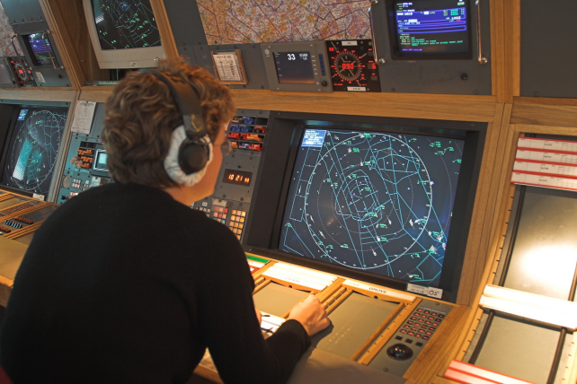
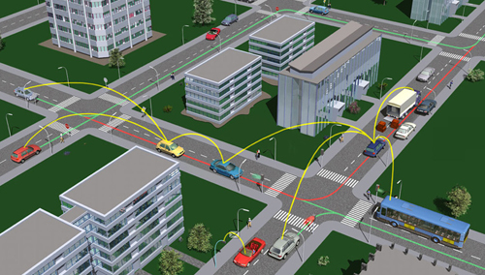
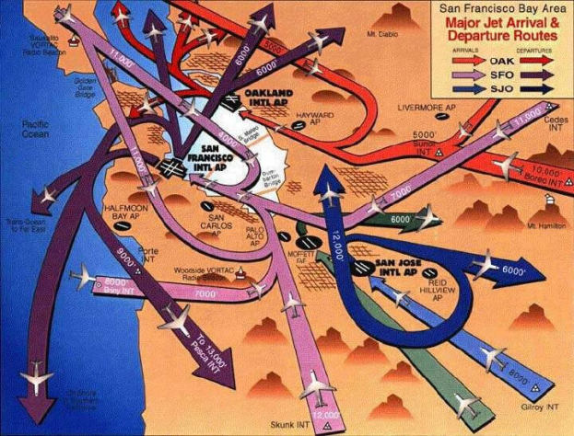
Safety Control
of Multi-Agent Systems
Critical Assumptions
-Imperfect State Information
-Limited Computational Resources
Want Distributed Solution!
Have Centralized Solution

Slide 4
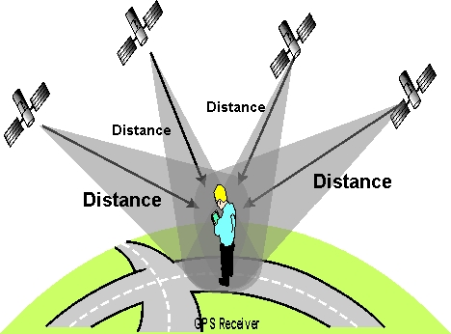
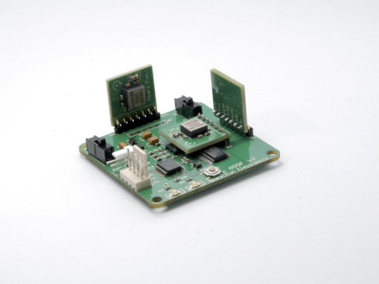
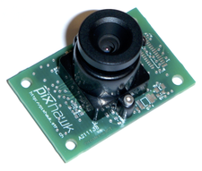
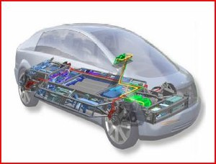
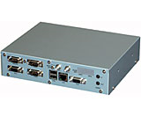
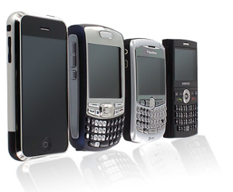
Enabling Technologies
Intelligent Transportation Systems (ITS)
-Sensors
GPS, IMU, Camera, Internet
-Communication (DSRC)
V2V, V2I, V2X
-Control
DbW(!)
-Computation (WSU)

Slide 5
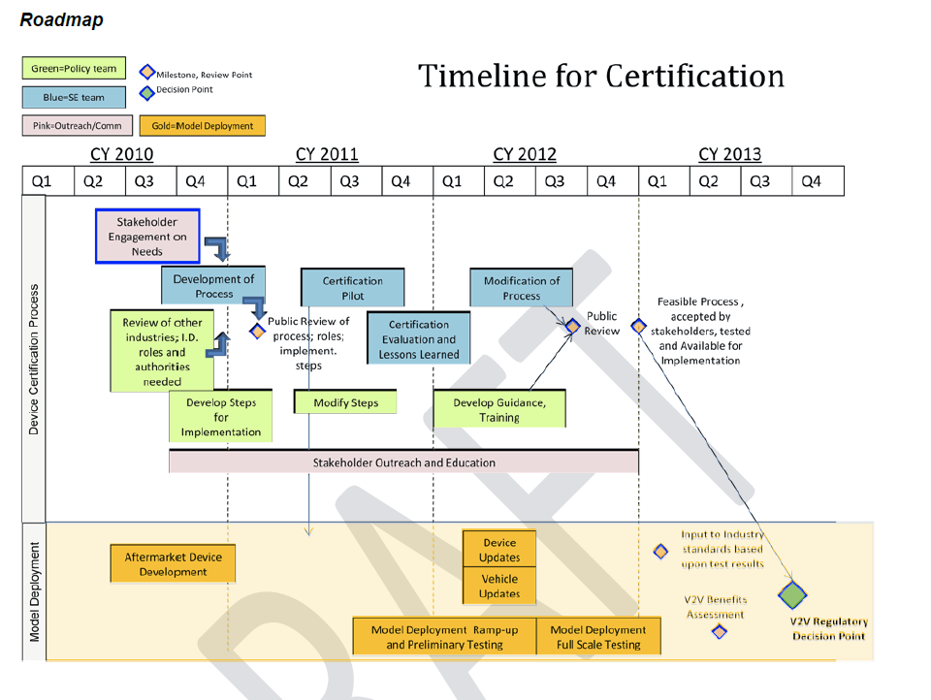
IntelliDriveSM
Safety Program Policy Roadmap http://www.its.dot.gov/press/pdf/DRAFT_Safety_ProgramPolicyRoadmap_5_19_10.pdf
Device and Equipment Certification
B. Certificate Authority, Privacy, and Security
C. Risk Allocation and Liability / Data Ownership
D. Cost-Benefit Analyses in Support of NHTSA Regulatory Decision
E. Rules of Operation and Application of Standards
F. Spectrum Analysis and FCC Role
G. Infrastructure
H. Governance Structure and Authority (cross-jurisdictional, cross-vehicle model)

Slide 6
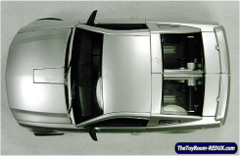
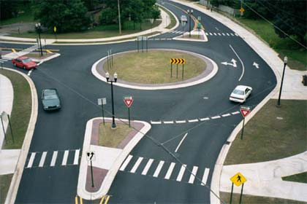

Problem Considered
Intersection Related Crashes
- 41.1% crashes at intersections (NHTSA)
- 44.1% : inadequate driver surveillance vs. 7.1% in other cases
Assumptions
-Liveliness Condition
-Trajectory constrained to path
-Only actuate brake/throttle

Slide 7
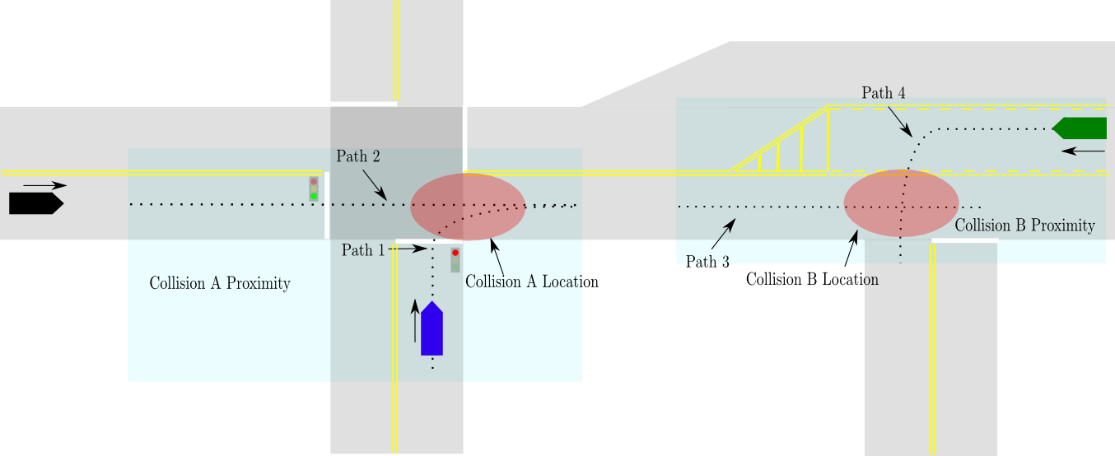
Application Context
Conditions necessary for system to activate

Slide 8
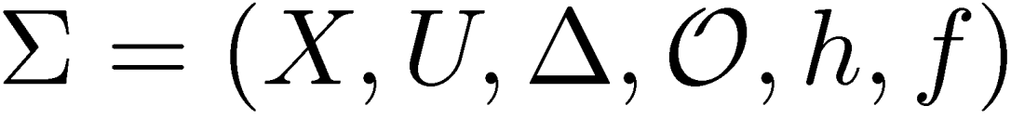

















Modeling Formalism

Slide 9

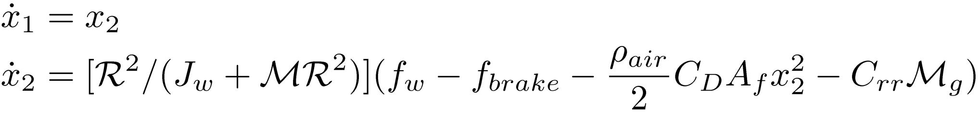


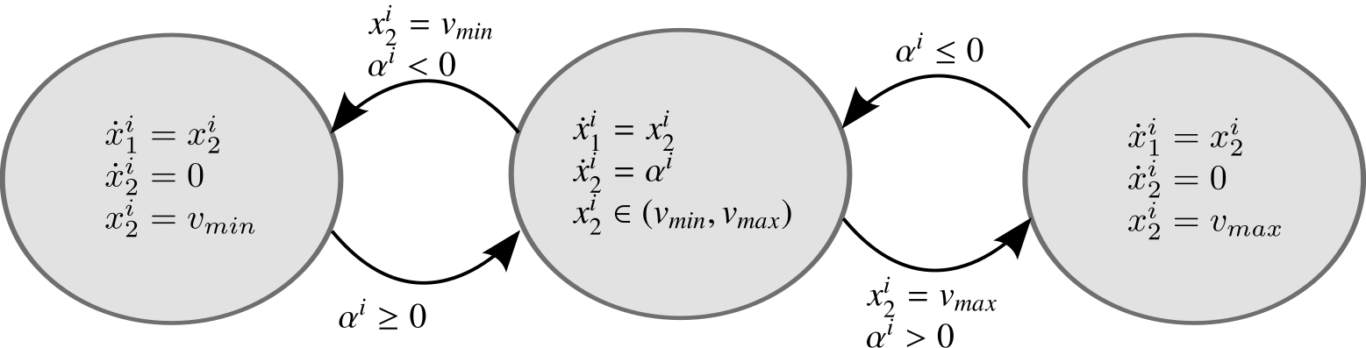
Piecewise Continuous Dynamics
Dynamic model of a full scale vehicle
Adherence to speed limits

Slide 10
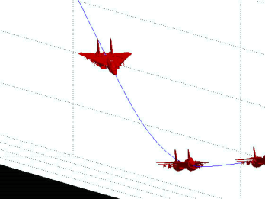







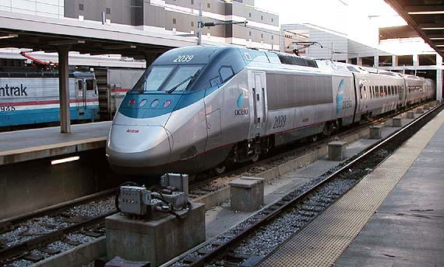









Order Preserving Systems
Mechanical Systems Evolving on a Path

Slide 11
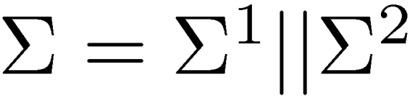

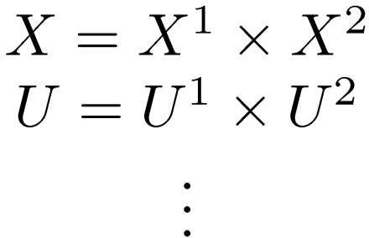





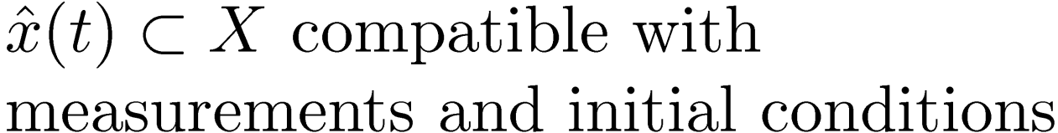


Two Agent Safety Control Problem
Total system - parallel composition
State Estimate

Slide 12












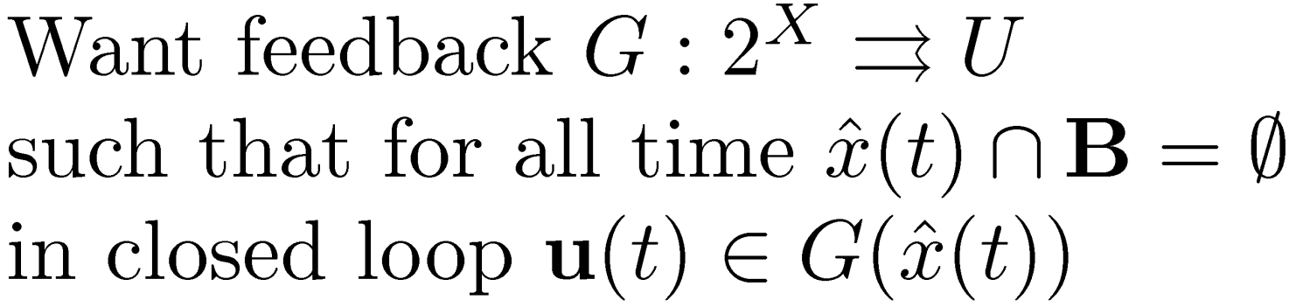


Safety Control Problem
Cont.

Slide 13
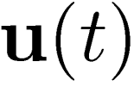
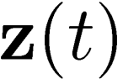
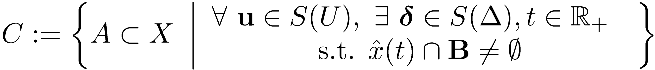

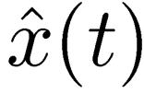
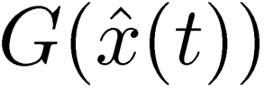




Safety Control Solution
Identify Capture Set and Control Map
13

Slide 14
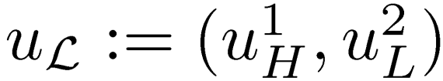
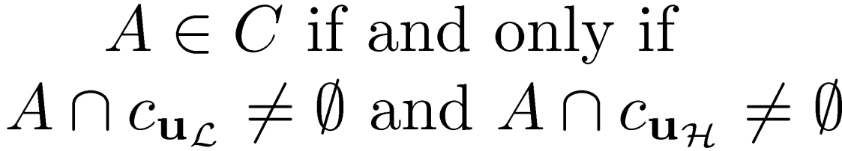
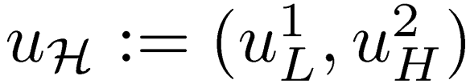







Computation of C
Restricted Capture set
Theorem
Example

Slide 15















Online Computation
Restricted Capture Set Computation

Slide 16
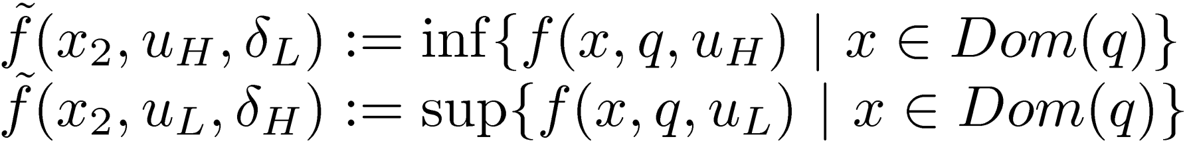
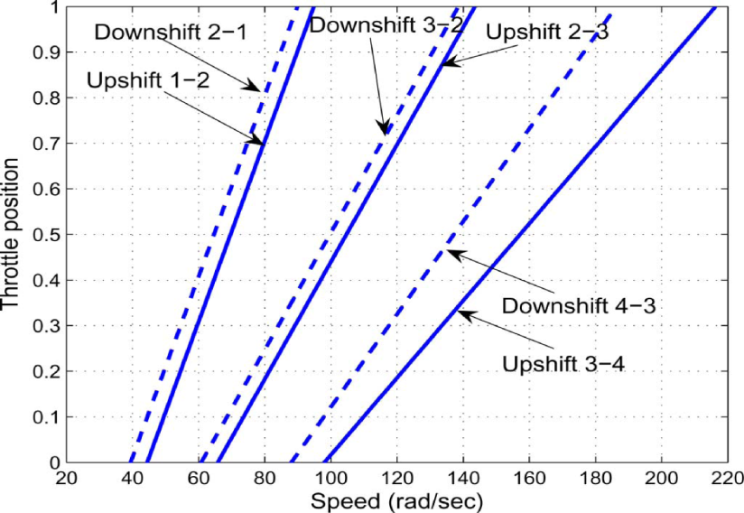

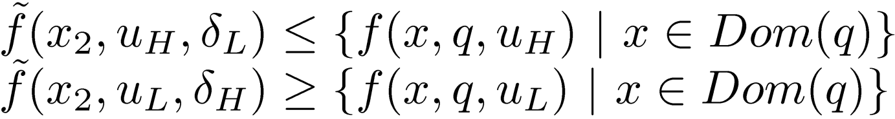
System ID for Control
I/O system too complex (model reduction)

Slide 17

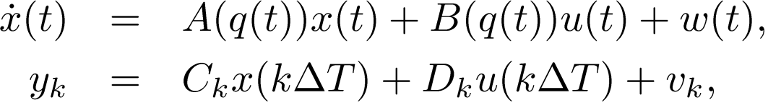

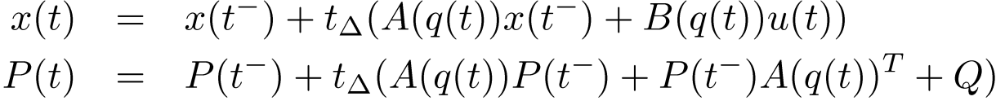

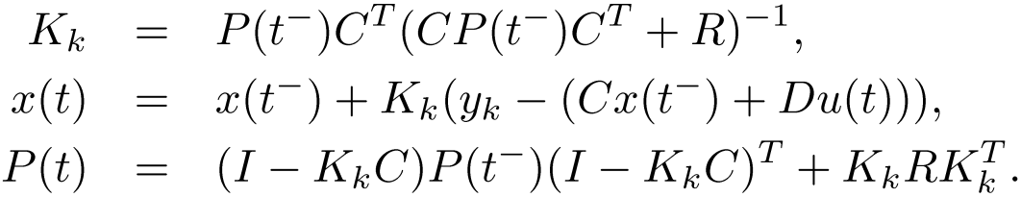
Local State Estimation
Use Kalman filter to produce on-board state estimate

Slide 18
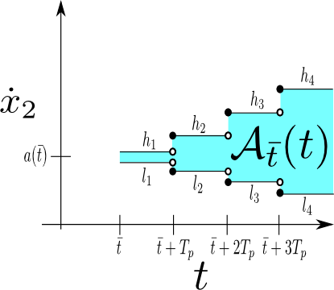
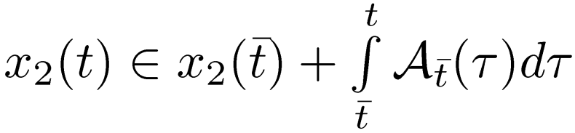

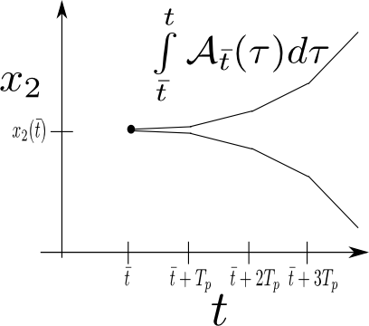
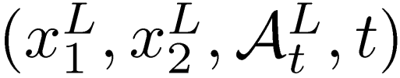
State Prediction
Acceleration Profile (non-causal) with KF
Send Local State

Slide 19
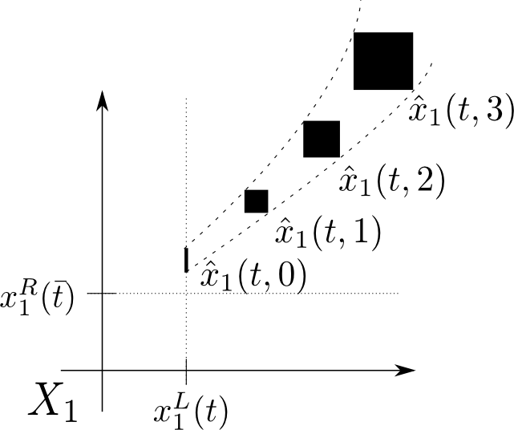
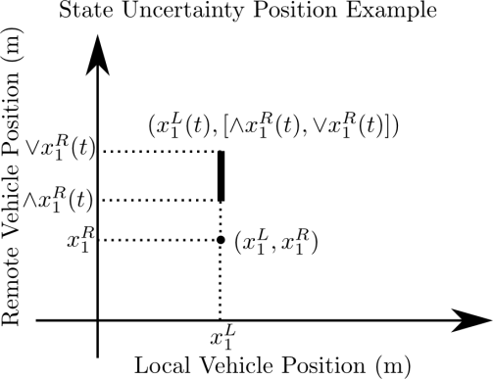
Complete State Estimation
Received state synchronized
Note that state information not identical on-board both vehicles

Slide 20
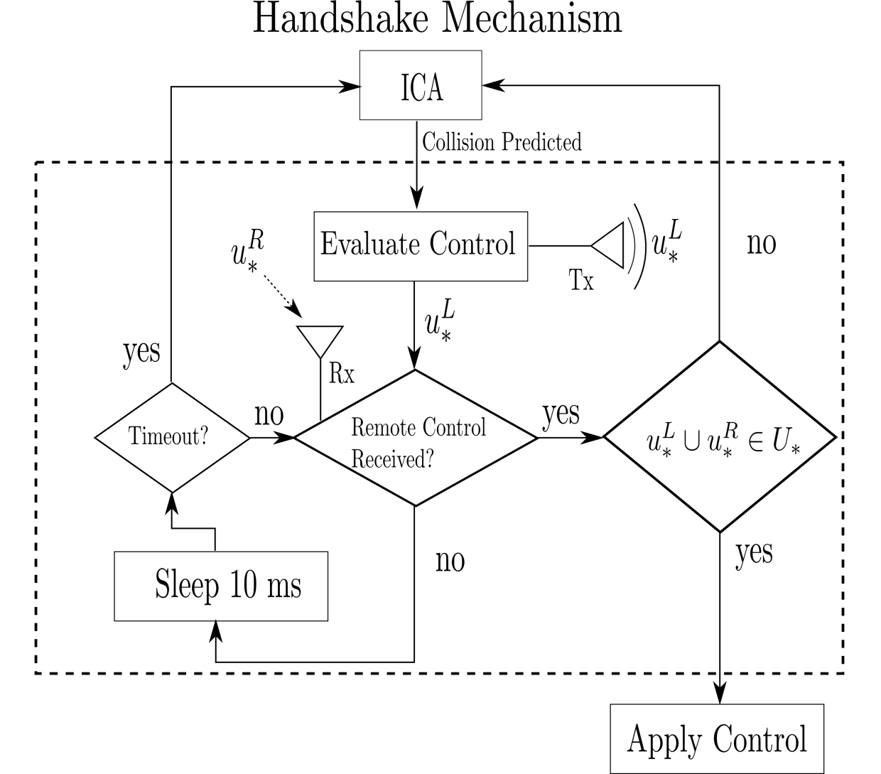
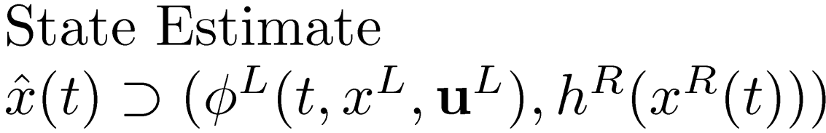
Distributed Evaluation of Feedback
Both vehicles apply the same control simultaneously
Implement handshake mechanism

Slide 21
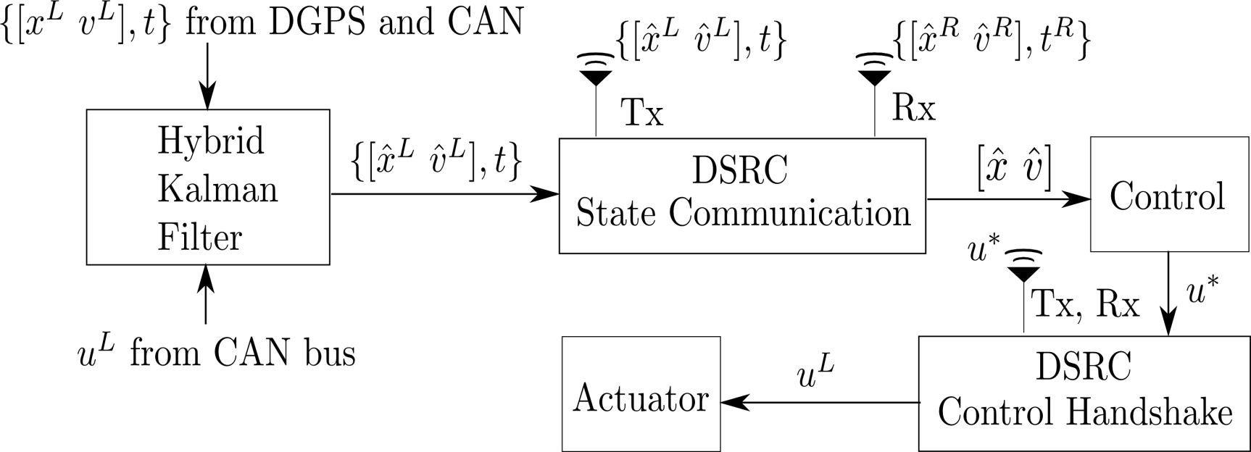


Software System
Algorithm Implementation (asynchronous)

Slide 22
ICA Main Application
200 ms periodic run time
Control = EscapeController(local, Remote)
22

Slide 23
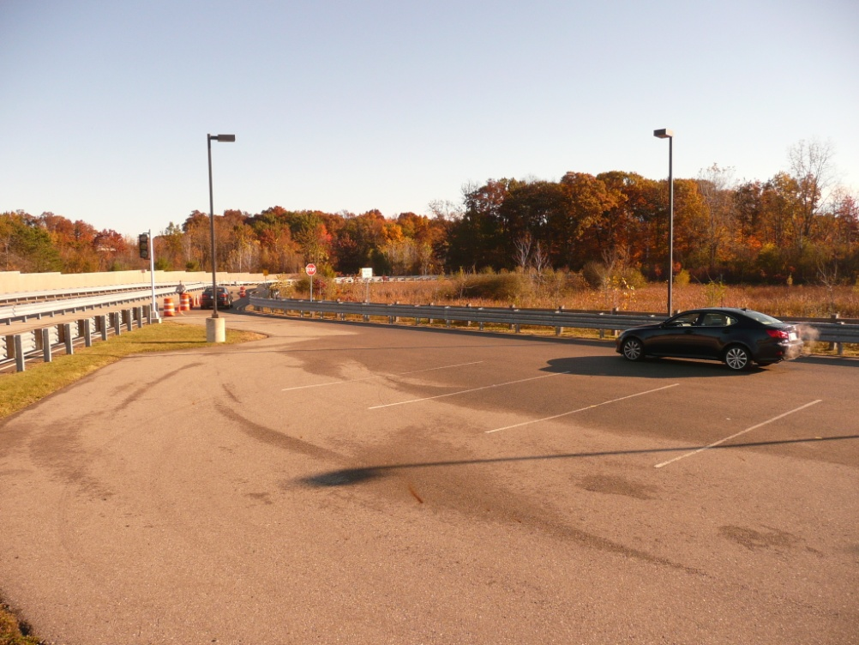
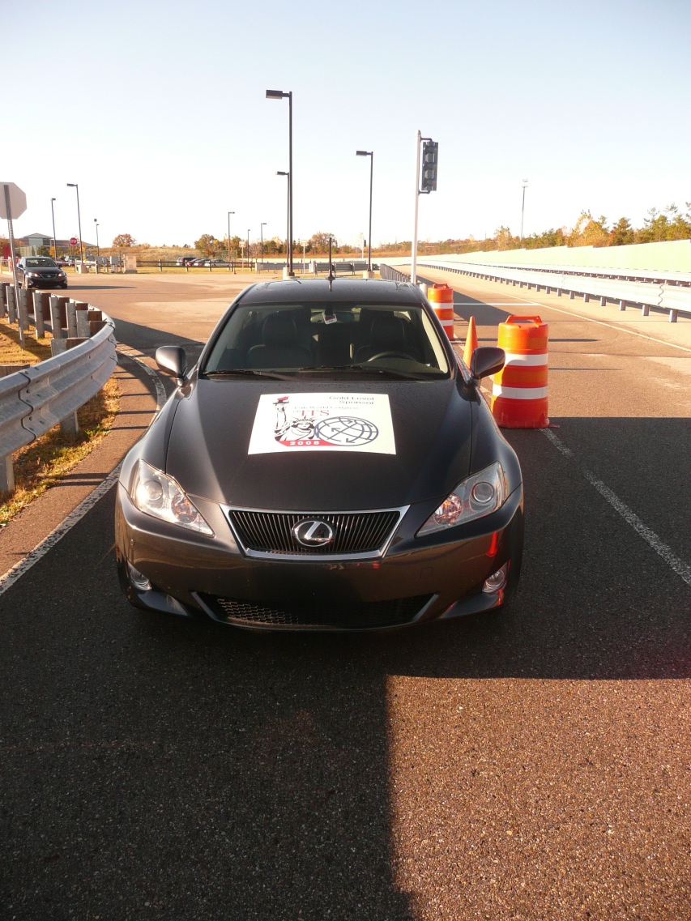
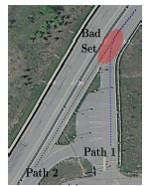
Experiments

Slide 24
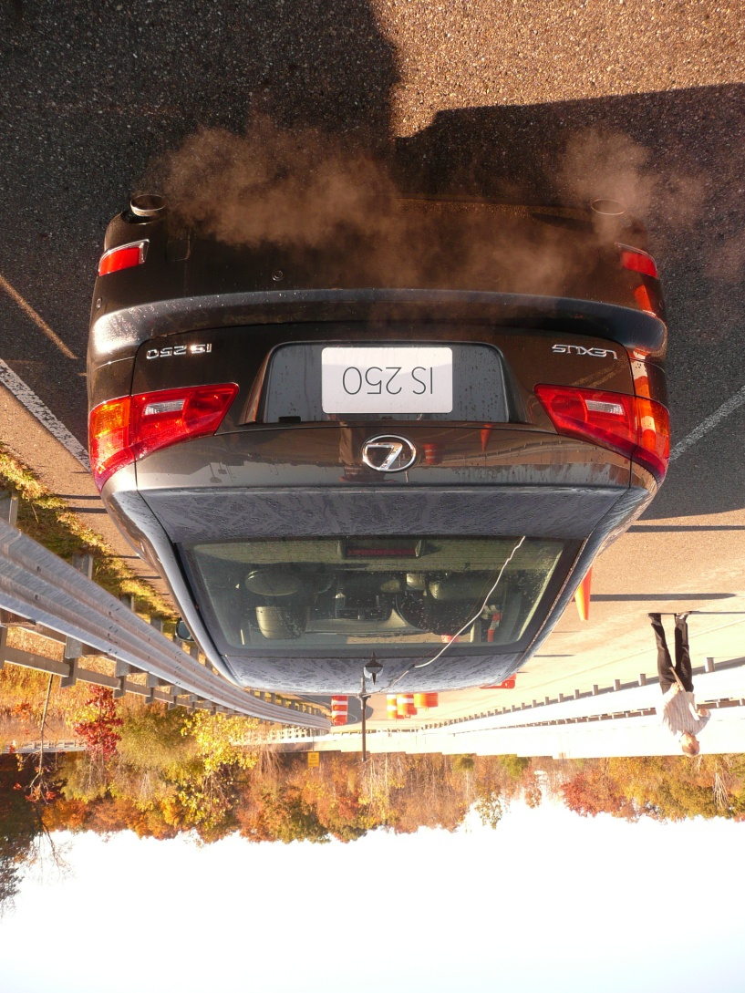
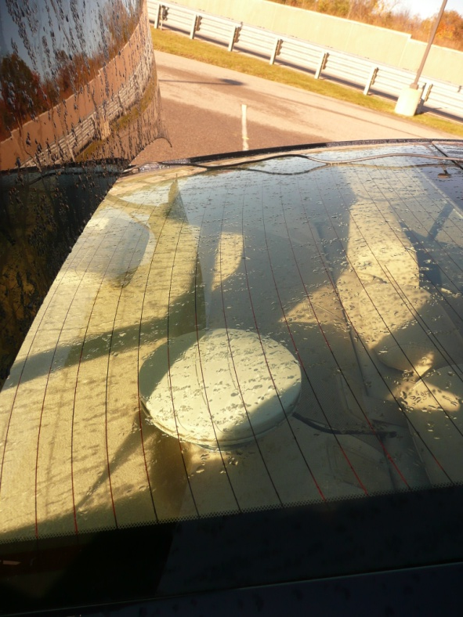




Test Vehicles

Slide 25





Test Vehicles Cont.

Slide 26




Test Overview

Slide 27


Experimental Trial
Use Case A

Slide 28

Video

Slide 29


Signals – Test 3

Slide 30
Signals -Test 4

Slide 31
Vehicle Starts in
Bad Interval

Slide 32
Experimental Trial
Use Case B

Slide 33

Video

Slide 34
Signals – Test 11

Slide 35
Signals – Test 3

Slide 36
Collision Avoided!

Slide 37

Inside the Vehicle

Slide 38

Inside the Vehicle (2)

Slide 39
Conclusion
Motivated problem
Introduced two-vehicle safety control problem
Introduced experimental test-bed
Described software modules
Experimental trials/videos shown

Slide 40
Future Work
Verifying distributed control solution
Model hybrid powertrain dynamics in context of order preserving system

Slide 41

Questions and
Acknowledgements
Thanks to Prof. Del Vecchio, Lorenzo Caminiti (TTC), Drew Cunningham (TTC), Rajeev Verma (Eaton) and everyone else in the IVS group.
Questions

