Slide 1
GOLC
UTC
Jim Henry
University of Tennessee at Chattanooga

Slide 2
GOLC
UTC
--Features, Philosophy, …
--Examples
--All this on the web at
http://chem.engr.utc.edu/GOLC

Slide 3
UTC Remote Labs
UTC’s Focus
Applications in engineering
Operation of equipment
Less so about fundamentals,
per se

Slide 4
UTC Remote Labs
Controls Systems
Pressure
Voltage
Speed
Level
Flow
Temperature
Chemical Eng’g
Distillation
Pressure Swing
adsorption
PEM Fuel Cell
Drying
Packed bed
absorption

Slide 5
UTC Remote Labs
Mechanical Eng’g
Heat exchanger
Vibrations
Slider-crank
HVAC
Journal Bearing
Electrical Eng’g
Variable-speed
3-phase
motor
DC, self-
excited
generator

Slide 6
UTC Remote Labs
Features
Users first-come, first served
Simultaneous real-time shared
viewing
History of experiments saved

Slide 7
UTC Remote Labs
Features (2)
“Password” needed
GOLC-EMCS

Slide 8
UTC Remote Labs
Usage history includes
USA, Canada, Mexico, Australia, Germany, Romania, Armenia, Diponegoro, ISS, ...

Slide 9
UTC Remote Labs
Philosophy
Provide a menu of experiments for engineering schools worldwide
Particularly developing schools and regions

Slide 10
UTC Remote Labs
2 Modes
-- LabVIEW Remote Panels
-- DB-driven

Slide 11
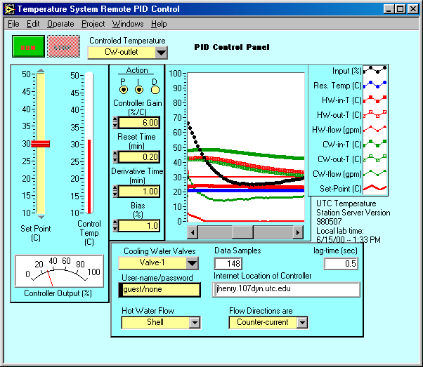
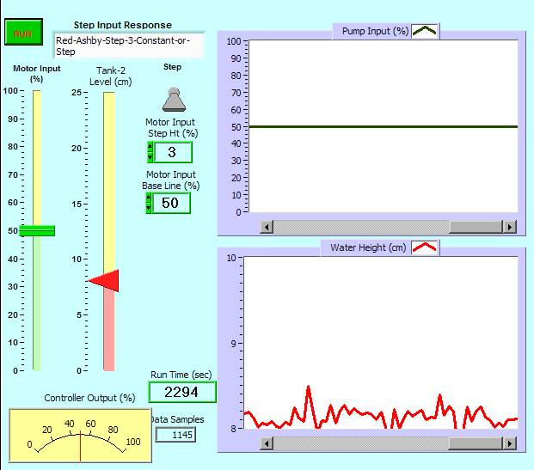
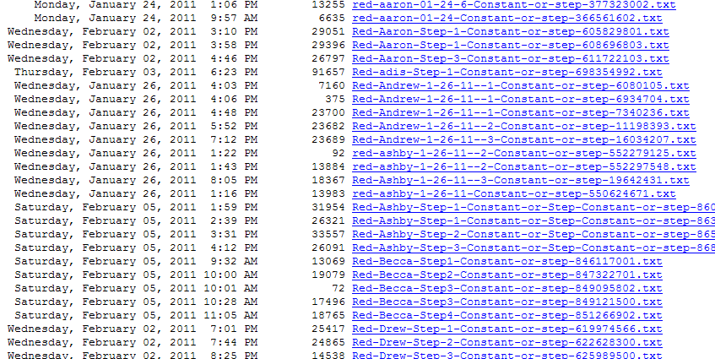
UTC Remote Labs
2 Modes
-- LabVIEW Remote Panels
http://flow.engr.utc.edu:443/LRC-Step.htm
Side note: Colton-2003
“It’s the richness of transient behavior that can be seen in these experiments.”

Slide 12
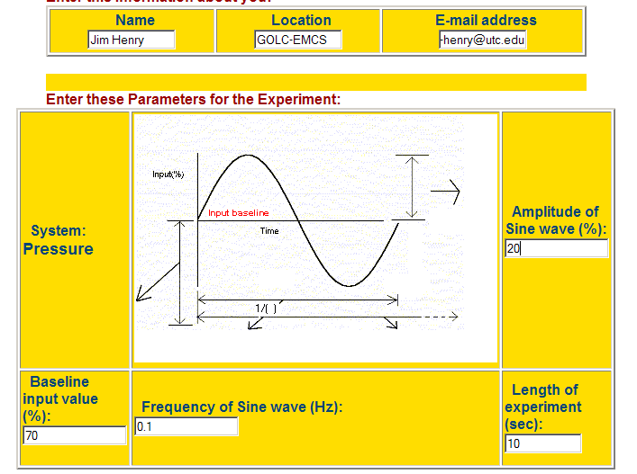
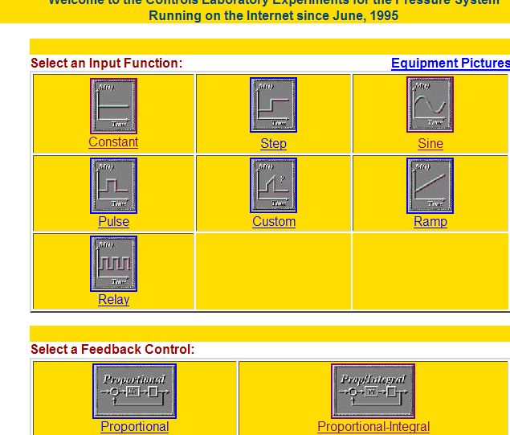
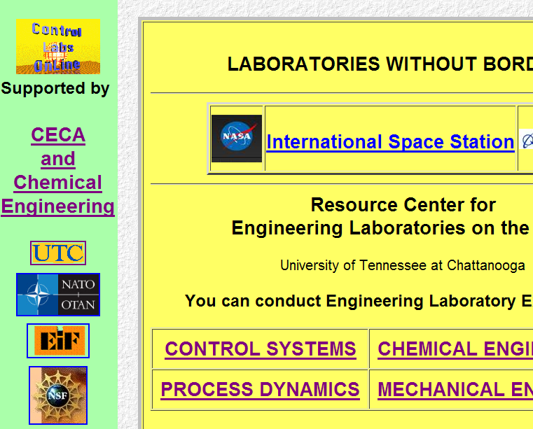
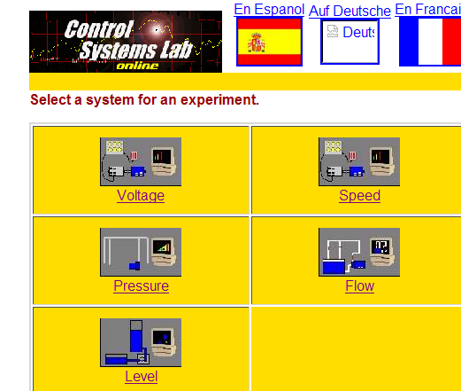
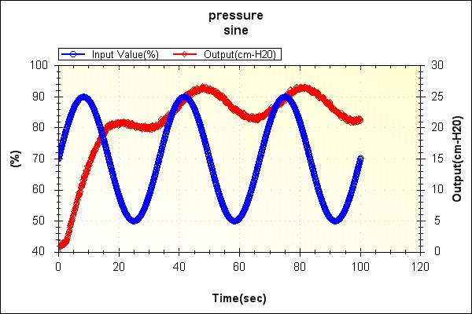
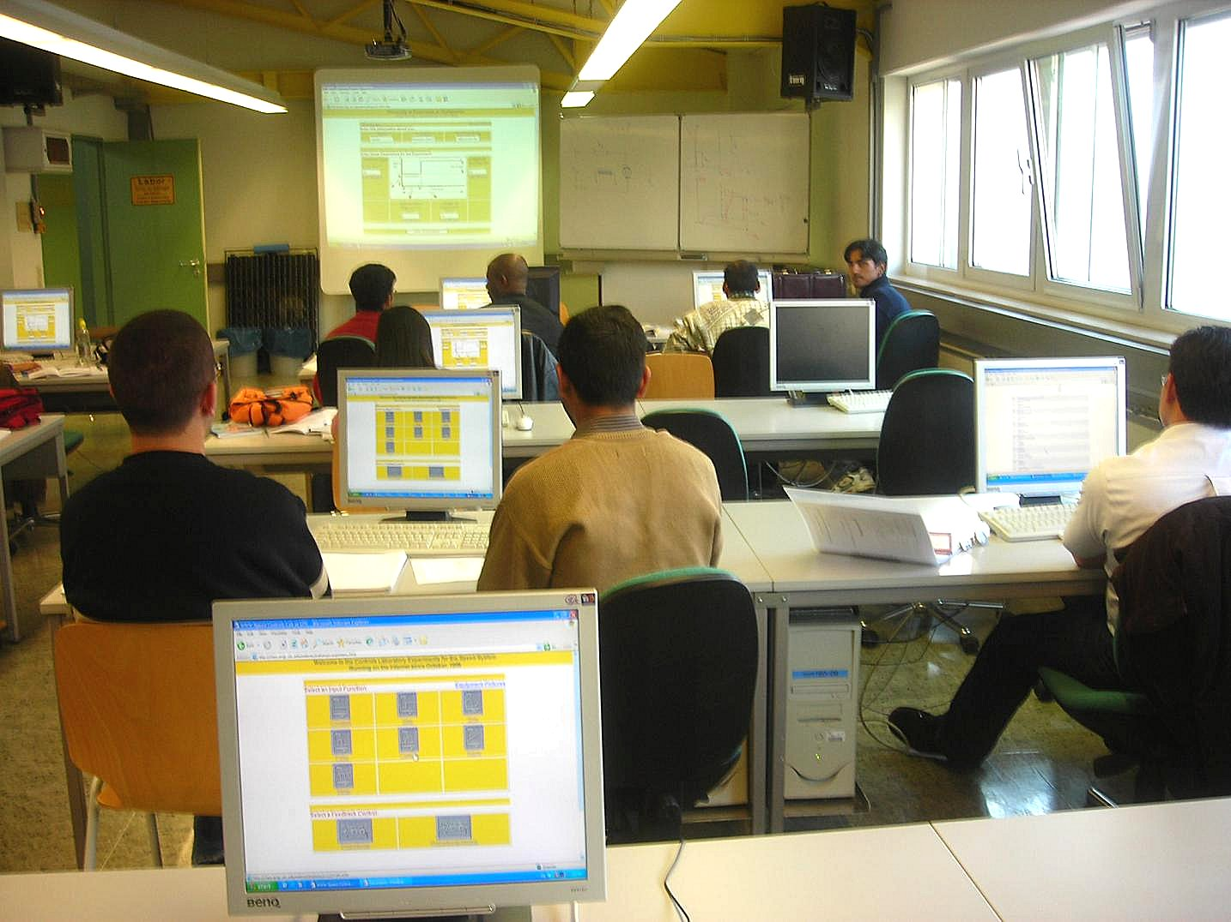

UTC Remote Labs
2 Modes
-- Data-Base Driven
Side note: Colton-2003
“It’s the richness of transient behavior that can be seen in these experiments.”

Slide 13
UTC Remote Labs
Thanks to
-- Tennessee Taxpayers
-- UTC Students
-- National Instruments
-- NSF
-- EIF
-- NATO
-- Boeing

Slide 14
GOLC
UTC
--Features, Philosophy, …
--Examples
--All this on the web at
http://chem.engr.utc.edu/GOLC

