Slide 1
4th GOLC Meeting
Cambridge MA, USA, 07/08 February 2011
Global Online Laboratory Consortium - GOLC

Slide 2
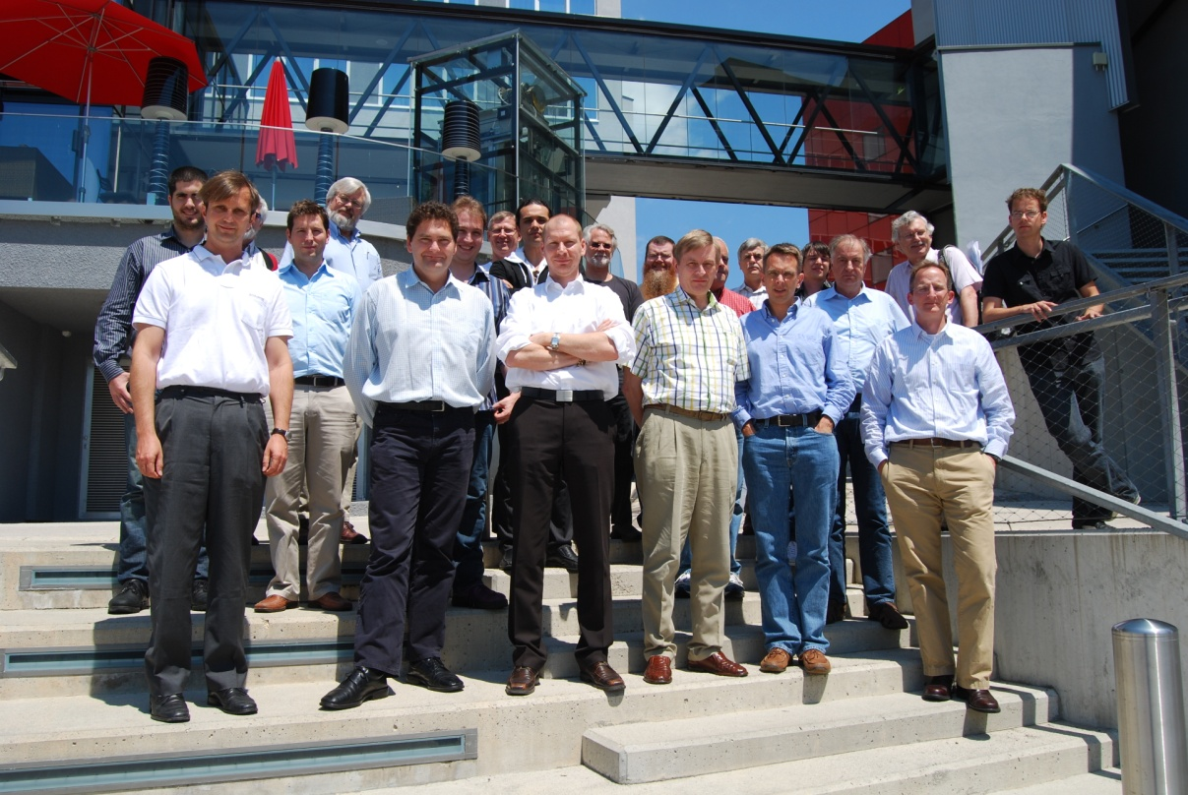
Third Meeting
25/25 June 2010
Villach, Austria
Establishment of GOLC as a non-profit association by Austrian law.
Main topics of the agenda:
Mission Statement
Meta data model
Cornerstones of bylaws

Slide 3
4th GOLC Meeting
To be done during this meeting:
Declaration of participants regarding membership
Meetings of the standing committees, nomination of chairs
Decision of the members about the final GOLC bylaws
Election of the Executive Committee
http://auer.cx/dl/bylaws_golc_en_final.pdf

Slide 4
Types of Membership
Ordinary members (voting members)
Educational partners (universities, colleges, schools, and museums)
Corporate affiliates (for-profit companies)
Community members
Government and non-profit associates (professional associations, foundations, government agencies)
Individuals

Slide 5
Structure
Annual General Meeting (AGM)
Executive Committee (EC)
(6)
Auditors
Standing Sub-Committees
(2)
Technical Sub-Committee (TecSC)
Educational Sub-Committee (EduSC)
Economic Sub-Committee (EcoSC)

Slide 6
Executive Committee
President
Vice-President
Secretary General
Chairs of the Sub-committees (3)
EC shall be elected by Members at an AGM every 3 years.
Each Officer shall serve no more than two consecutive terms.
Only Ordinary Members have the right to vote in the Annual General Meeting and can nominate candidates for Executive Committee positions.
The only condition for candidates/members of the EC is, that they are members. Once elected they act as individuals and not as representative of a member organization.

Slide 7
Standing Committees
Standing Committees
  Educational Committee; Chair: Mark Schulz (UQ)
  Technical Committee; Chairs: Jud Harvard (MIT), Steve Murray (UTS)
  Economic Committee; Chair: Phil Long (UQ)
Each ordinary member can nominate one person as member of each Sub-Committee.
The EC can ratify additional appointments – which could be suggested by the previous year’s committee chairs.
Sub-Committee membership should run for a year at a time.
One year means here the term from AGM to AGM!

Slide 8
Decision Making Processes
  A quorum for the transaction of business at any meeting of the Members shall be all Members who show up.
AGM:
Voting at duly held meetings shall be by voice vote.
Election of Officers, however, shall be by written ballot.
EC and Sub-Committees:
Meetings may be called or held by telephone, electronic mail or by using any other technology.
Voting may be via electronic communications means.

Slide 9
Next Steps
During this meeting's first day participants have to declare, if they (respective their institutions) are interested to become a member of GOLC.
On the second day we will have a meeting (1st AGM of GOLC) with these persons to approve the bylaws and to elect the EC members.
Agenda of the AGM
  Approval of the bylaws
  Election of the Executive Committee members
  Discussion about further activities and next steps of GOLC

Slide 10
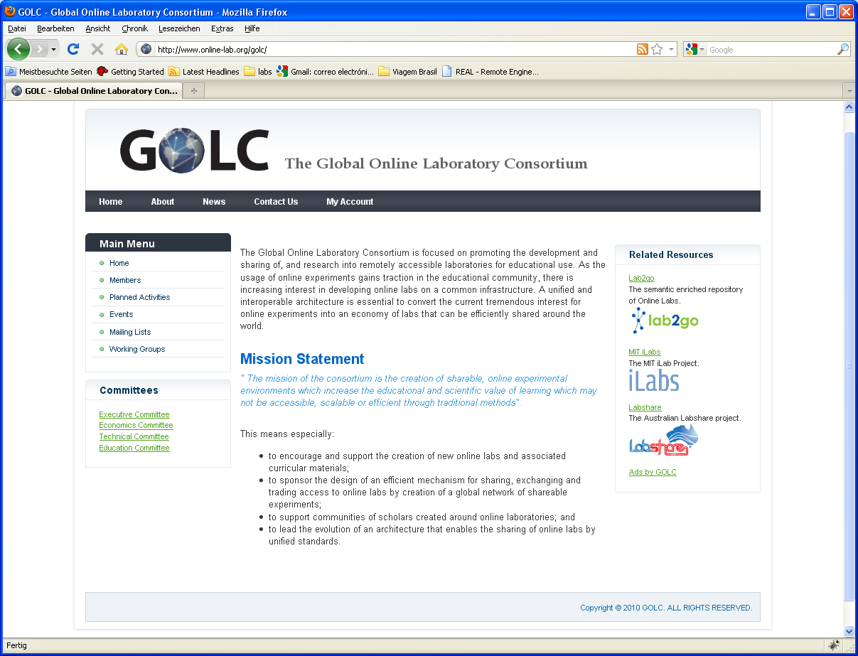
GOLC Web
www.online-lab.org
Based on Joomla!
Members area
Admin tool (coming soon)

Slide 11

Lab2go
Repository of Online Laboratories

Slide 12
What is Lab2go?
Motivation
Repository of Online Laboratories
Developed within the scope of a EU founded project (OntoWiki)
Offer search mechanisms to help users to find Online Labs of interest
Based on a Wiki principle

Slide 13


Some data about Lab2go
Around 180 different Online Laboratories
Around 220 different Online Experiments
From more than 60 different Institutions

Slide 14
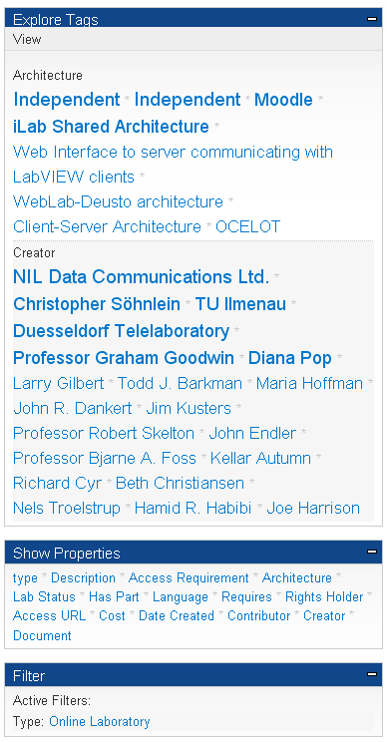
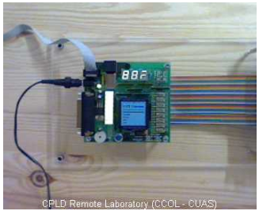
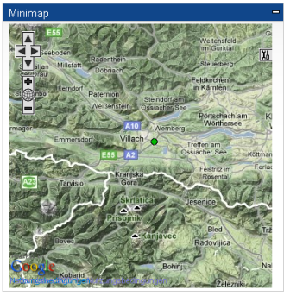
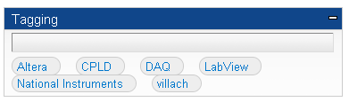
Some features of Lab2go (1)
Faceted Navigation
Plug-ins for displaying specific data like: pictures, videos, maps (google maps).
Resources tagging

Slide 15
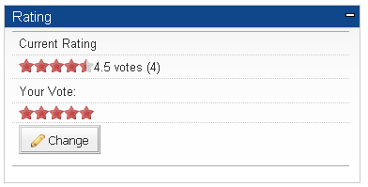

Some features of Lab2go (1)
User roles:
Anonymous: can only browse through the repository
Editors: can create and edit Metadata
User Feedback
  Comments
  Rating

Slide 16
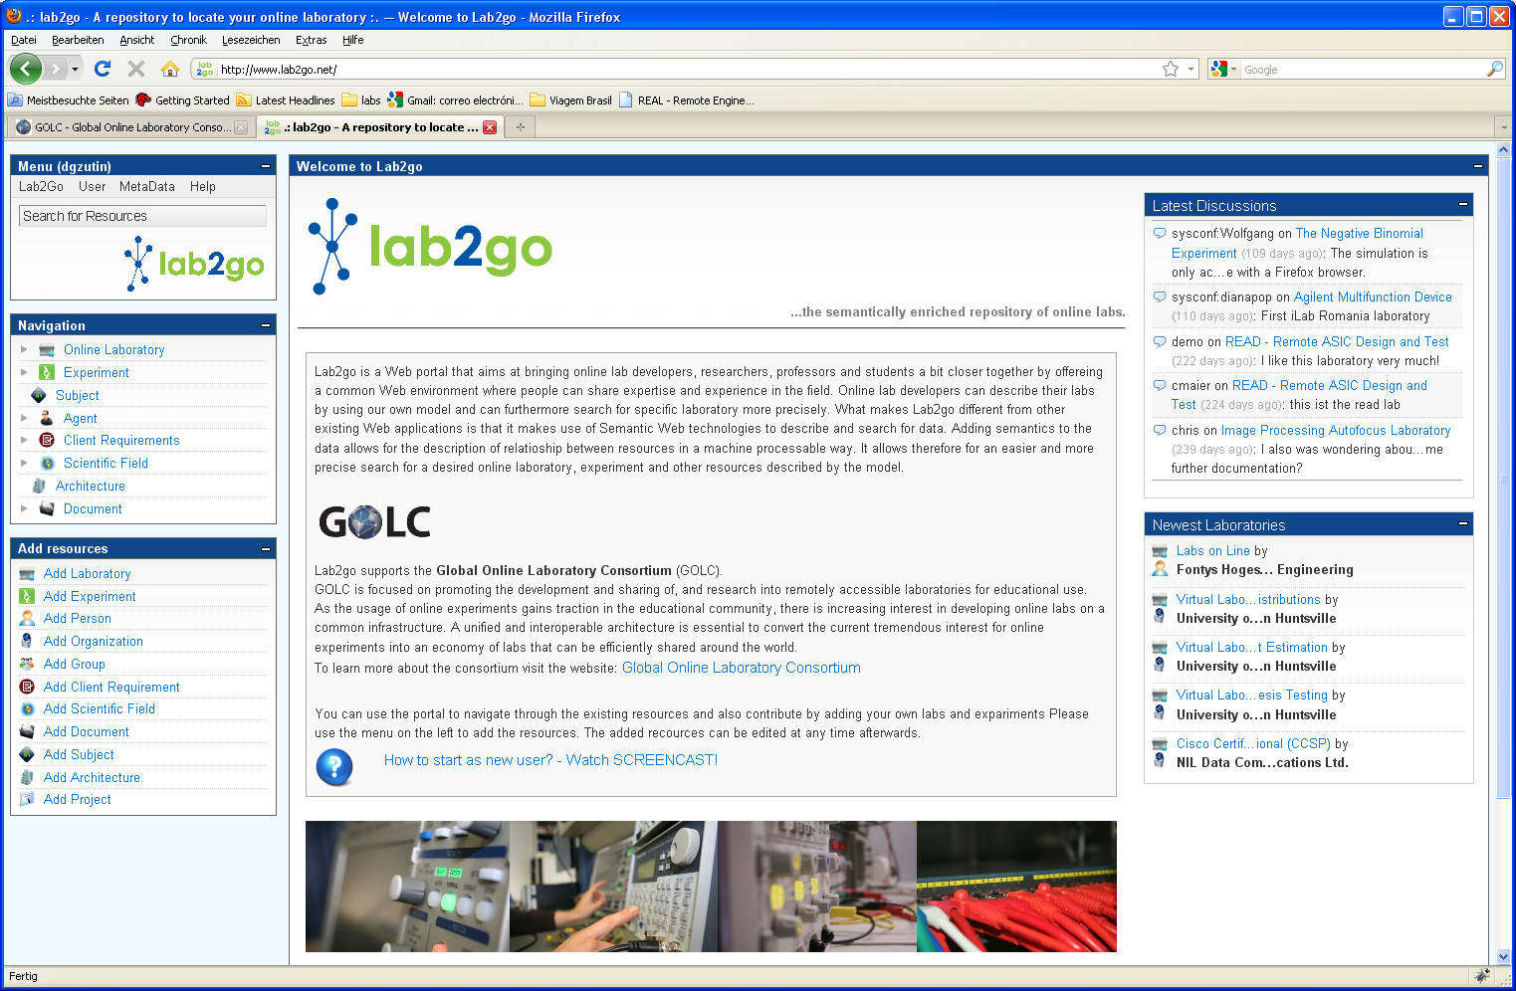
  Lab2go has been running for almost 2 years now
  We have reached a stable version

Slide 17
Use of Lab2go Framework
New Lab2go instance in Portugal in the scope of a national founded project Experiment@Portugal
- University of Porto
KTH Royal Institute of Technology with the project Explore Energy Virtual University
- Repository of Educational Programs
IIDEA - International Institute for Developing Engineering Academics
  - Global Clearing House for Engineering Education Programs

