Slide 1
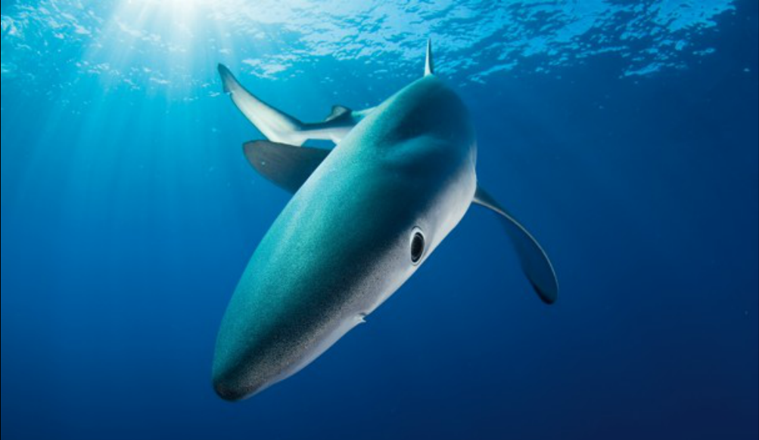
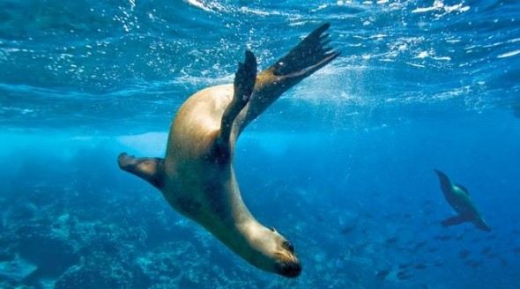
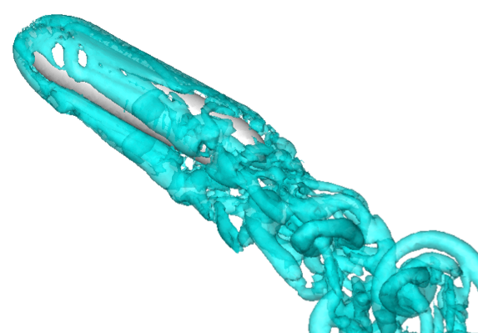
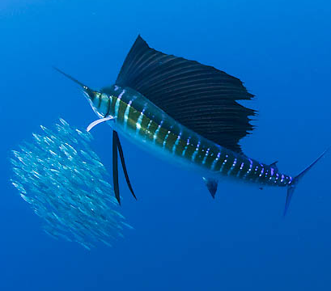
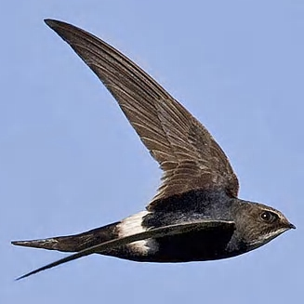
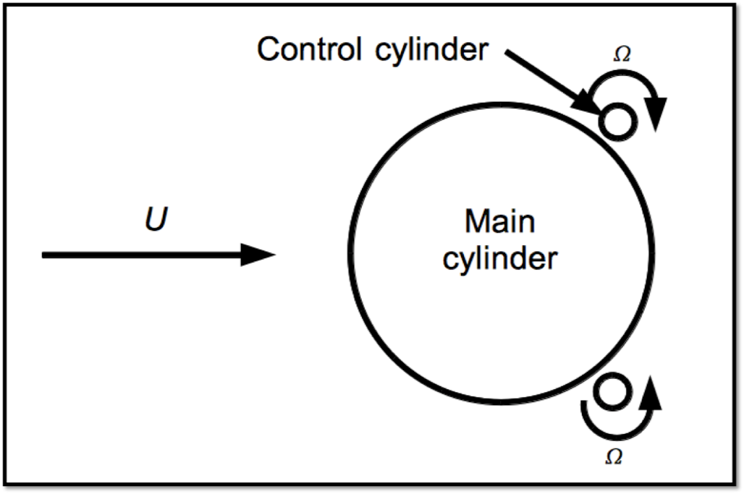
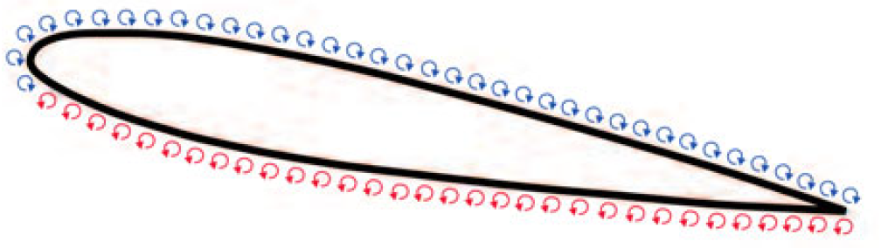
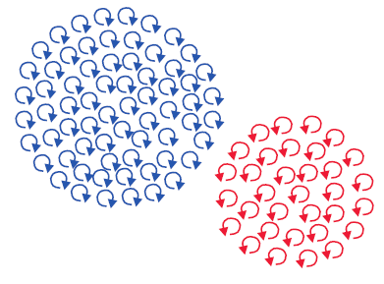
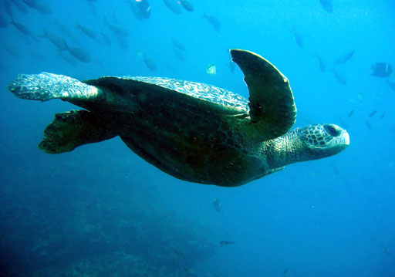
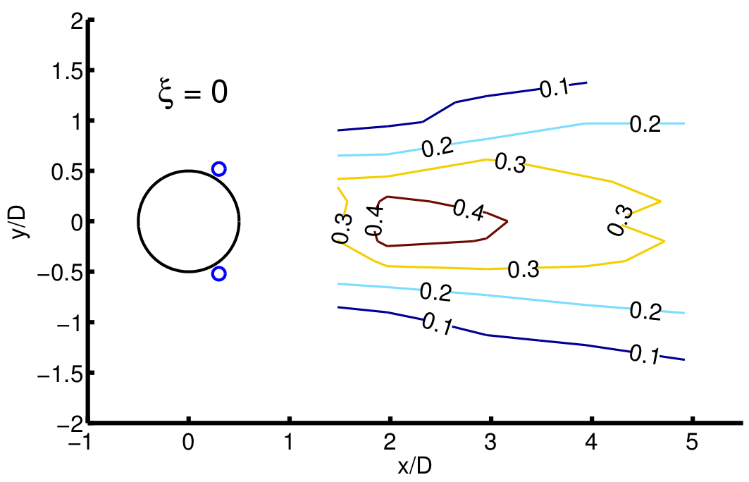
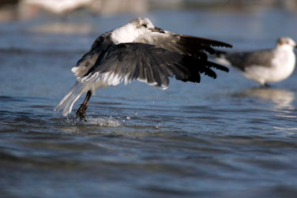
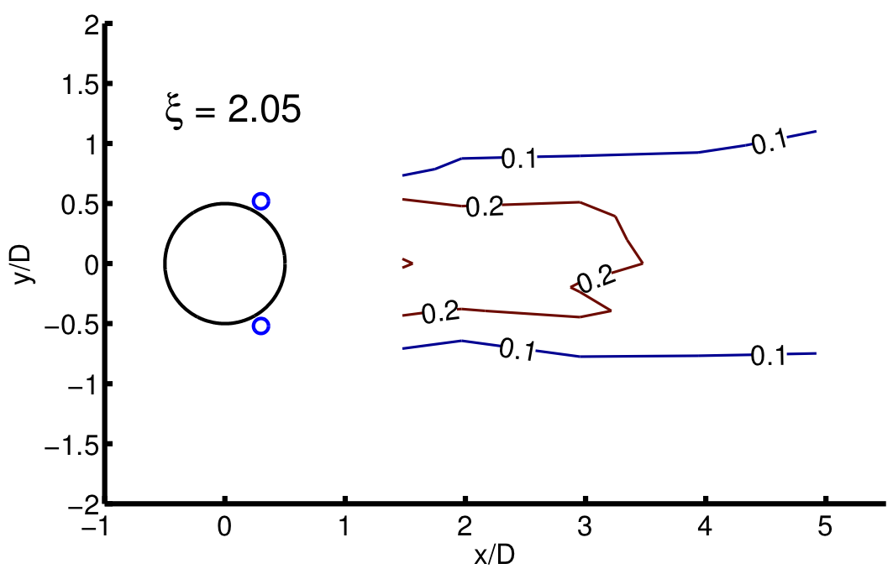
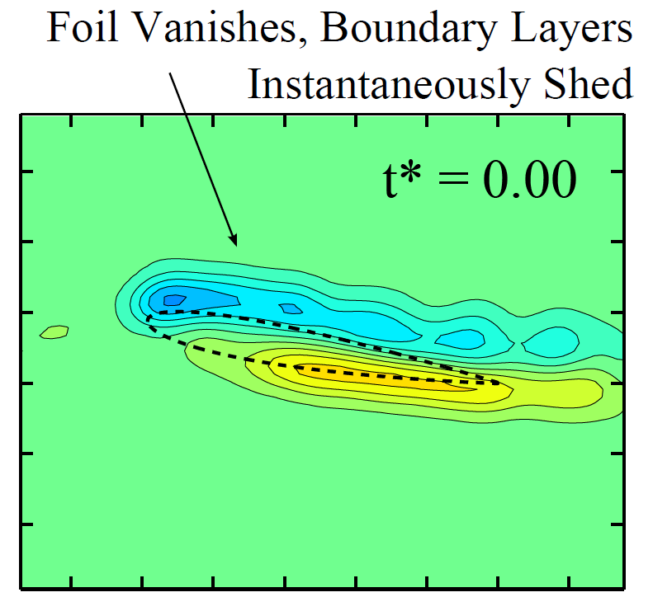
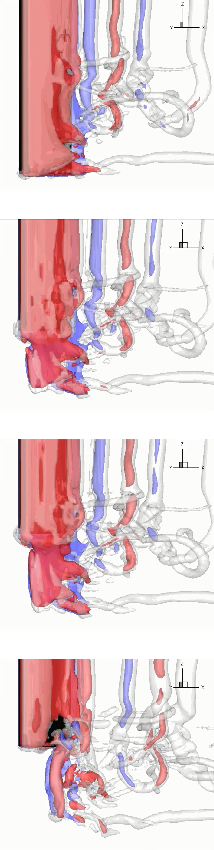
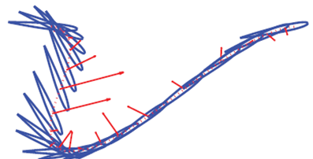
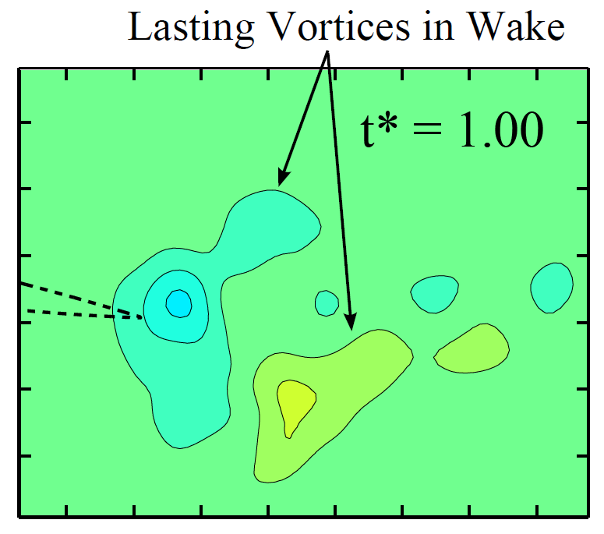
Super-Maneuverability of Ocean Vehicles
Jacob Izraelevitz, James Schulmeister, Stephanie Steele,
Dr. Jason Dahl, Dr. Gabe Weymouth, Prof. Michael Triantafyllou
Ocean Vehicle Maneuverability
Maneuvering rapidly in the ocean requires generating large forces and overcoming strong resistance due to massive flow separation. Marine animals are experts in efficient and graceful underwater acrobatics. They maneuver effectively by both actively and passively controlling the flow around their bodies. Taking cues from the experts in the field, we seek to develop technologies for super-maneuverability of ocean vehicles through:
  Generating large transient forces
  Controlling and minimizing flow separation
Left: A blue shark gracefully maneuvers with superior vorticity and flow control.
Right: A sea lion nimbly changes course just beneath the sea surface.
http://www.washingtonpost.com/national/health-science
http://www.creative-journeys.com
Force Vectoring with Flapping Foils
Flow Separation Control
Global Vorticity Shedding for Maneuverability
Global vorticity shedding is a phenomenon where the boundary layer vorticity on an object is released into the fluid as a free vortex when the object is vanished. Retracting a wing can be a good approximation to ‘vanishing’ if the retraction is fast enough. Various animals that are acrobatic tumblers through the air or water retract their wings, such as the sailfish, which can retract its massive sail-like dorsal fin, and the swift, which can rapidly change wing sweep for tight turns.
A towed foil can be ‘vanished’ by rapidly retracting the foil in the span-wise direction. As illustrated above, the boundary layer vorticity on a towed foil reforms into two vortices in the fluid that produce strong forces to be used for maneuverability .
We see global vorticity shedding in action below. The left column shows experimental Particle Imaging Velocimetry vorticity data. The right column shows a 3D simulation; curtains of vorticity shed and collapse into two vortex tubes in the wake. (G. Weymouth)
Flapping hydrofoils, similar to the oscillating fins of fish, can dwarf the efficiency of the propeller, making them a promising alternative in ship and AUV design. Furthermore, the “waste” component of a flapping foil wake can create high forces perpendicular to the direction of travel, making them a promising method for improving maneuverability.
Unfortunately, those same forces that improve maneuverability also oscillate, meaning that a flapping foil actuator makes the vehicle a recoil back and forth as it moves. Controlling this perpendicular force component is key to the adoption of flapping foil actuation.
At right is simulated
vortex separation from a
maneuvering submersible.
Massive flow separation like
this increases drag by as much as
ten times and severely limits
maneuverability. Fish and other swimming
animals control flow separation to improve maneuverability and swimming efficiency.
Simulation by Dr. Gabe Weymouth (CENSAM)
www.oceanwideimages.com
www.mostfacts.com
Rotating Cylinder Control
Rotating cylinders can be used to control flow separation and reduce drag on maneuvering vehicles.
Inline Foil Flapping
Turtles solve this issue by flapping their flippers diagonally backwards (right top), essentially rotating all the foil lift towards the ideal forward direction. A turtle flipper can therefore control the amount and direction of resultant fluid force.
Birds (right bottom) instead use inline foil motion in the opposite direction to augment the lift perpendicular to the airflow.
Rotating cylinders are positioned at 120 degrees to the upstream stagnation point in the immediate vicinity of a larger main cylinder. The control cylinders are rotated to inject momentum into the slow-moving boundary layer flow of the main cylinder. This delays flow separation and reduces drag. Implementing this type of control on a vehicle would improve maneuverability and efficiency.
Flap
Force
Flow
http://www.skardu.net/Journal_20.html
Flap
Force
Flow
http://www.firstlighttours.com/fl_birds.html
Left - Backwards inline motion of a foil moving through a fluid, with respect to a static observer. The red arrows indicate the recorded
Above, contours of velocity fluctuations are plotted for an experiment with rotating cylinder control. The rotation parameter, ξ, is the normalized control cylinder rotation rate. Rotating control cylinders in the bottom image delays separation and reduces drag by 20%, which is apparent in the reduction of both the area and intensity of fluctuating flow in the wake.
instantaneous force on the foil. Note how almost all the force is in the direction of travel. Figure taken from [1]
References:
Acknowledgments:
[1] Backwards in-line motion of a foil moving through a fluid, with respect to a static observer. The red arrows indicate the recorded instantaneous force on the foil. Figure taken from - Licht, S. C., Wibawa, M. S., Hover, F. S., & Triantafyllou, M. S. (2010). In-line motion causes high thrust and efficiency in flapping foils that use power downstroke. The Journal of experimental biology, 213(1), 63-71.
Lab members would like to thank the Center for Environmental Sensing and Modeling (CENSAM), the Singapore-MIT Alliance for Research and Technology (SMART), and the National Defense Science and Engineering Graduate (NDSEG) fellowship programs for generous support of the presented research projects. We are also indebted to Drs. Dahl, Weymouth, and Prof. Triantafyllou for guidance and support.

